Slide 1

Getting to know your iPad:
Showbie

Slide 2
A Quick Reminder…
If you do not yet have your iPad – we know!
Ms Lamont and Miss Edwards will call you to get your iPad issued when we have time.
No one else should ever have your iPad. If you do not have a bag, ask pastoral care to look after it. It is your responsibility to keep it safe.
S1-4 are not allowed to change the lock code. Spot checks will be carried out to ensure this.

Slide 3
Common Questions/FAQ’s
Internet issues? Turn your iPad off then on again. Go to Safari. Wait for the ‘Proxy’ pop up and enter your computer username and password.
If you forget your password ask a member of staff to reset it. You must log onto a computer and change it from the default ‘welcome’ to something else.
‘Verify Apple Id’ pop up? For S 1- 4 your passcode is 020508. S5 & 6 set their own, if you have forgotten this, email Ms Lamont
Self Service issues - known issue still slowly being fixed
Battery not charging all the way? Let your iPad drain completely of battery, leave it over night not on charge, charge it in the morning. Best to do this at a weekend!
iOS update? Do this in the evening, plugged into your charger and on WiFi.
Locked out of your iPad? S1 – 4 all have the same code. S5 – 6 can see Ms Lamont for a reset.

Slide 4
Digital Ambassadors
You can also ask for help from our Digital Ambassadors!
You can contact them via twitter at @RosshallDigiAmb
You can go to the Genius Bar for in person help Tuesday Break in SF23!

Slide 5
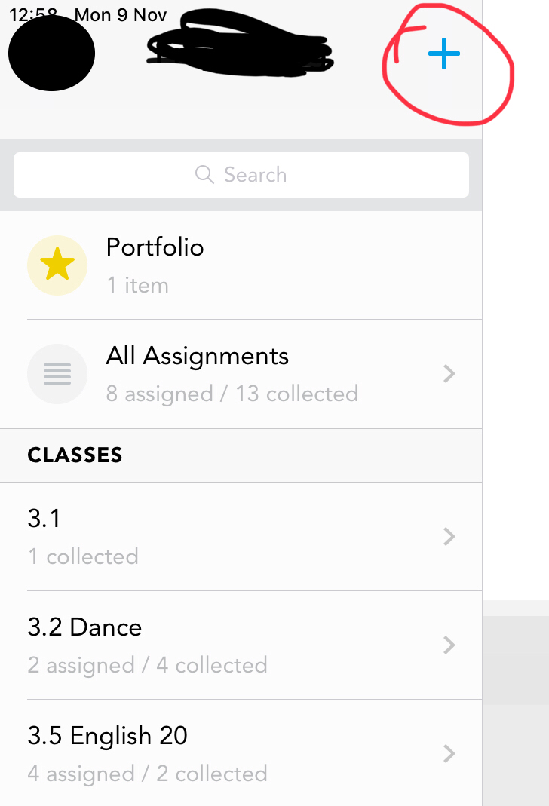
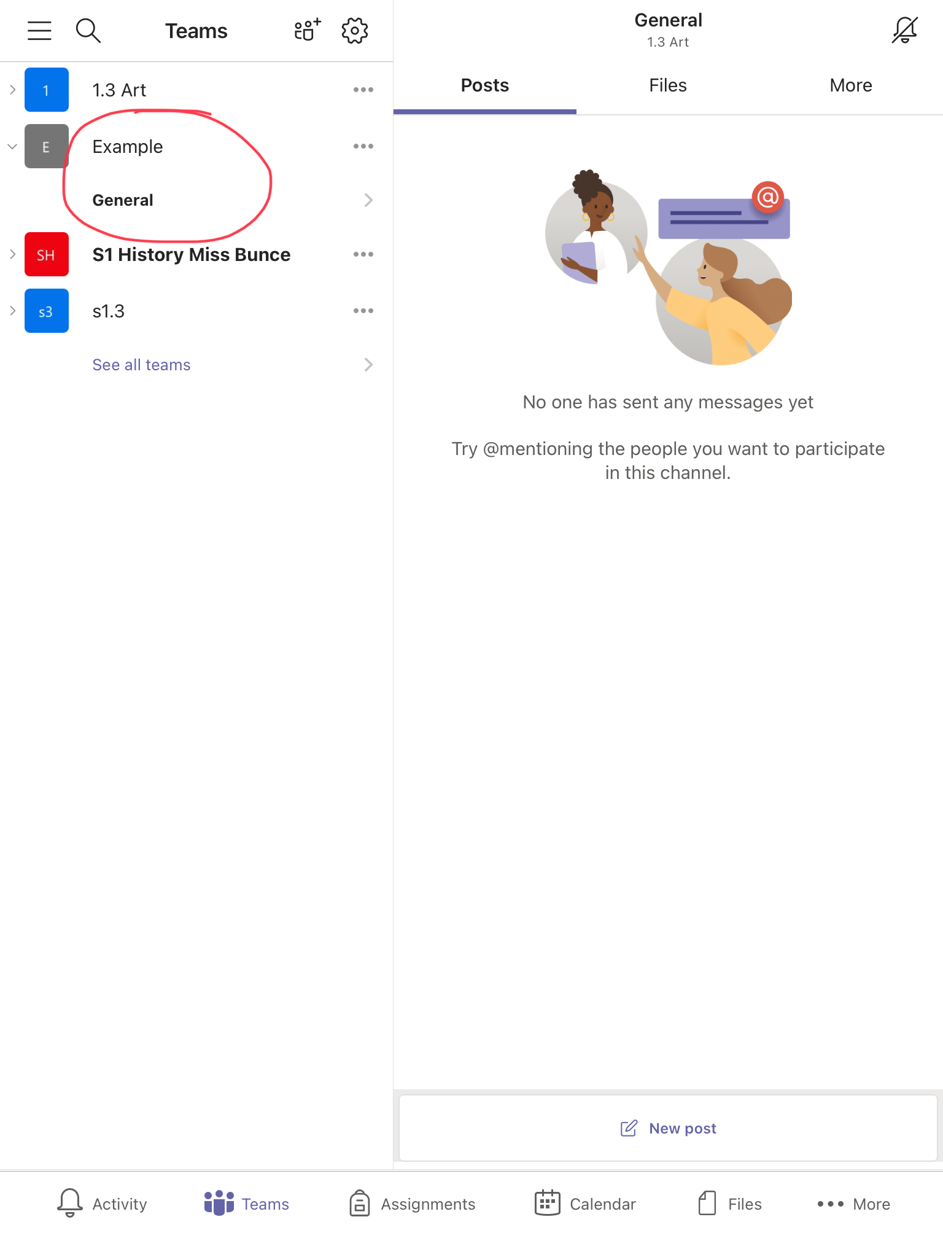
Using the code your teacher gives you, click on this icon and add yourself to your class Showbie.

Slide 6
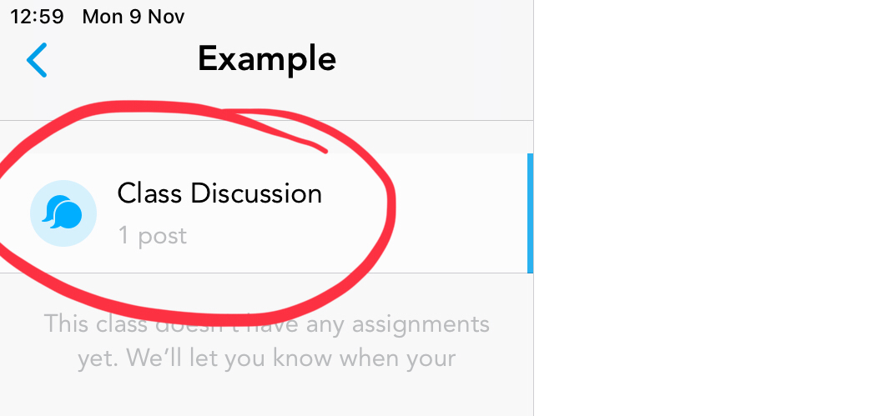
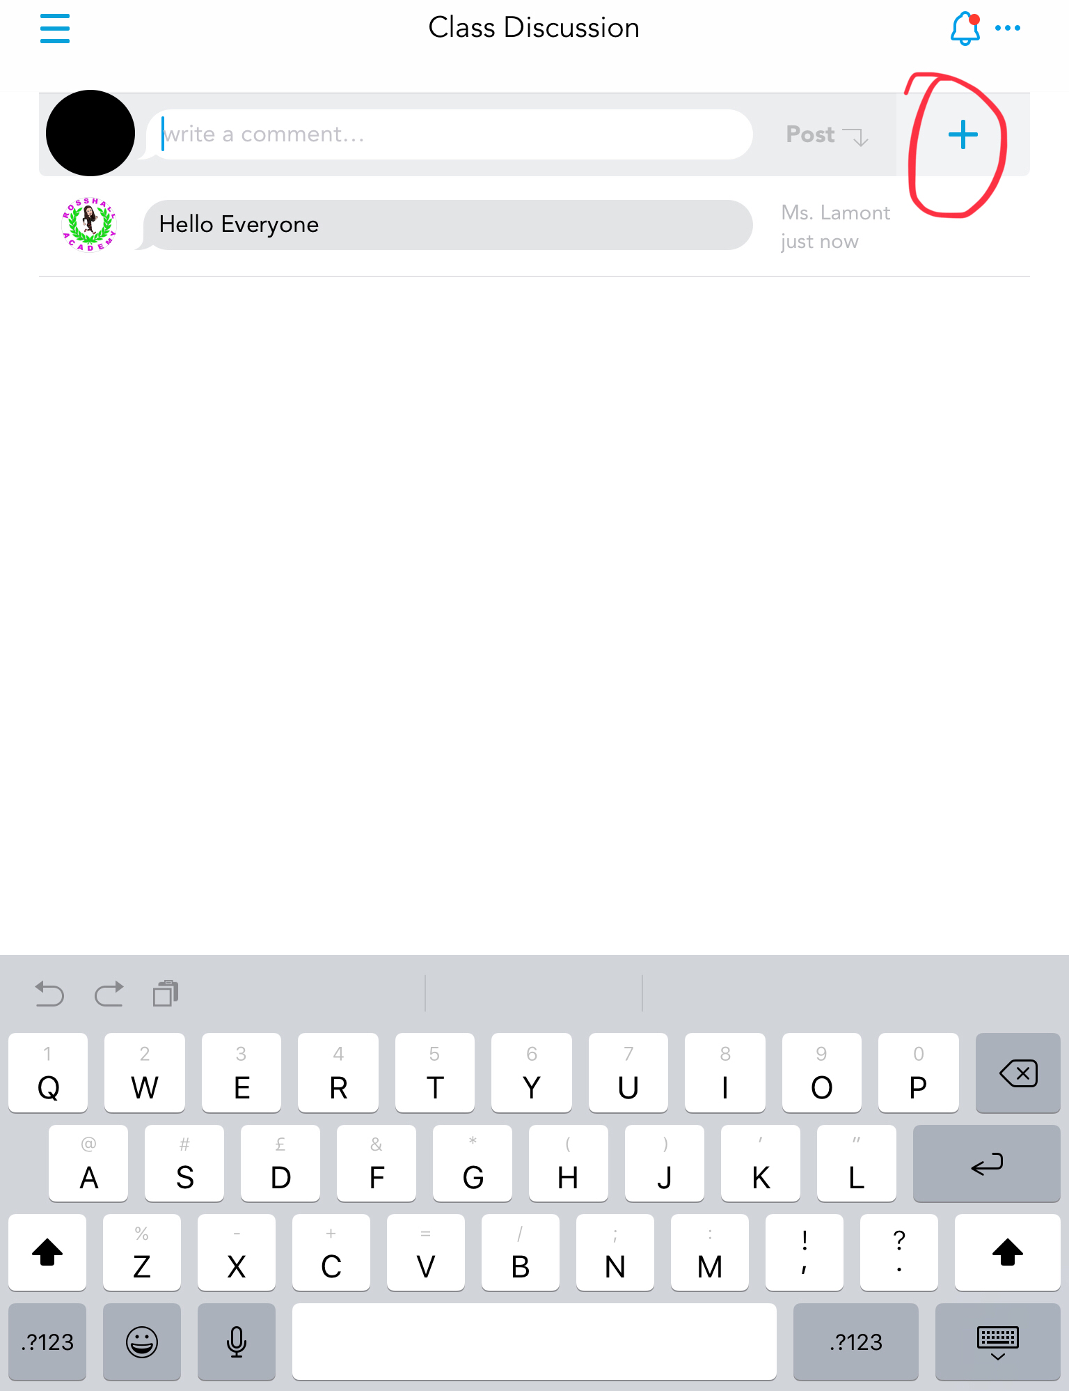
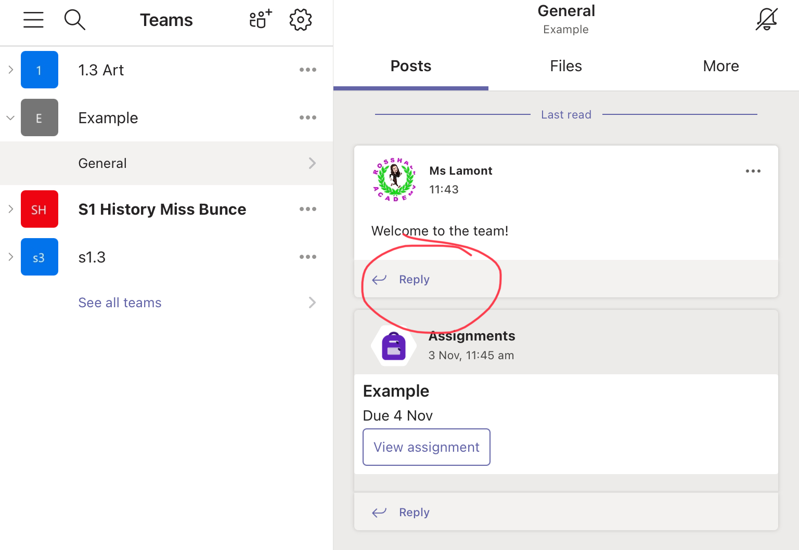
If your teacher has allowed a class discussion, you can communicate here with them to ask general questions about your lessons.

Slide 7
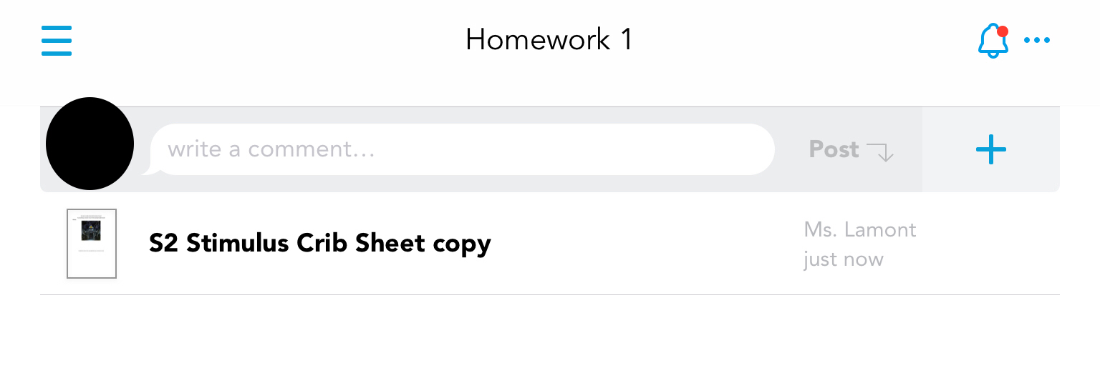
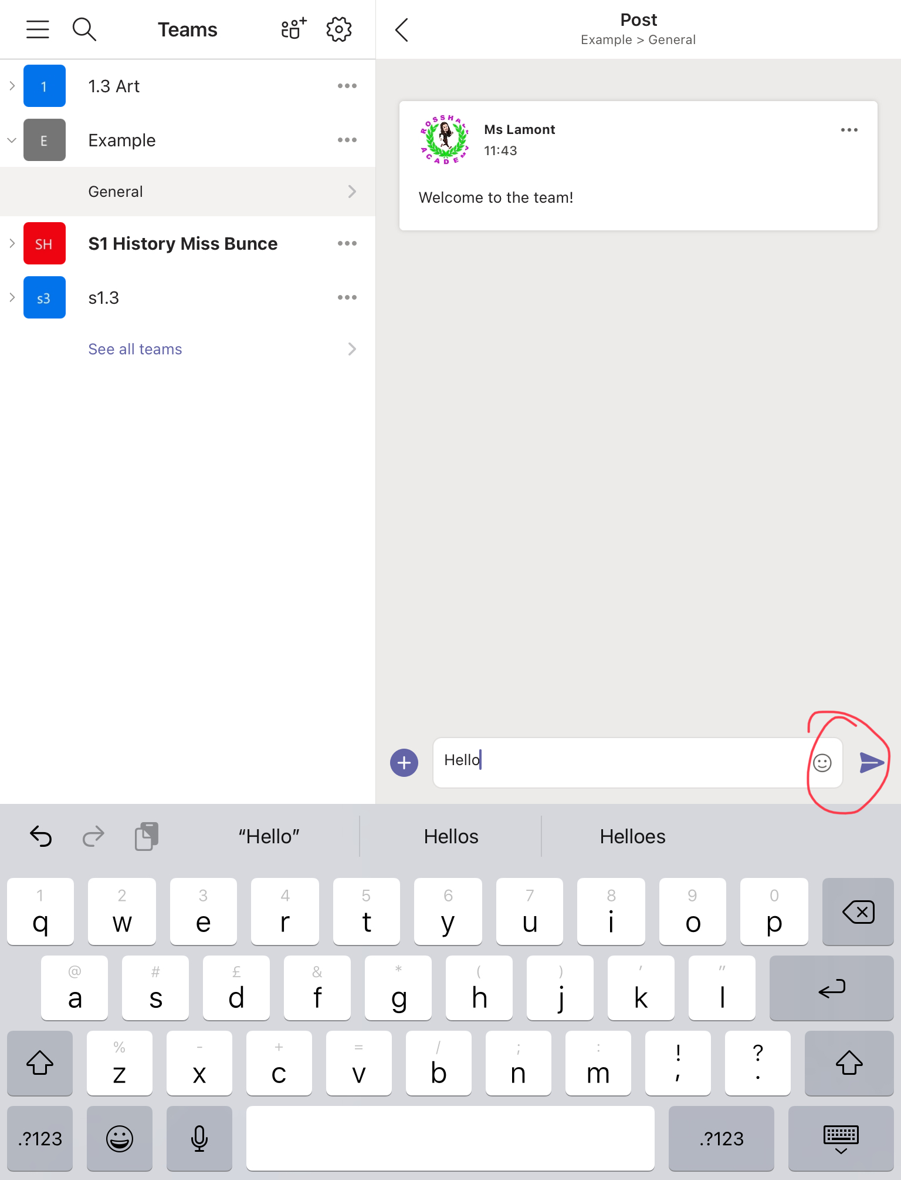
Your teacher will upload homework to the relevant folder.
To view it, click on the document they upload.

Slide 8
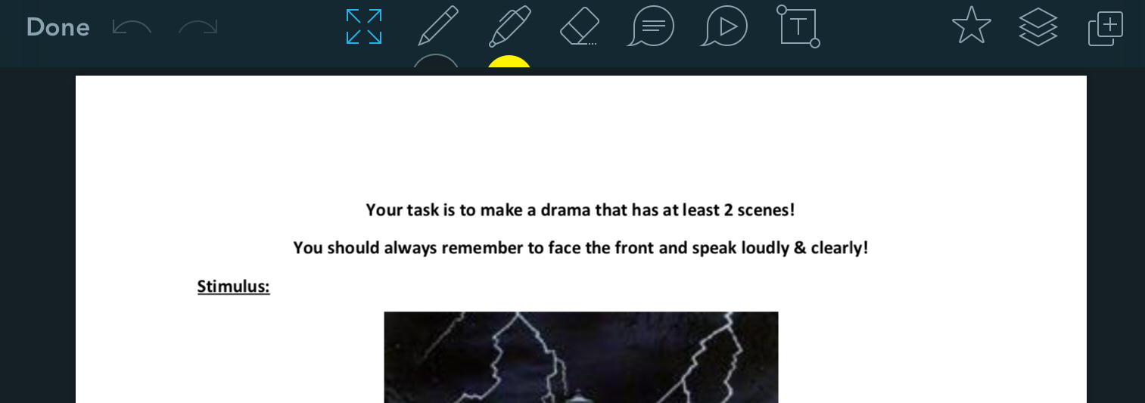
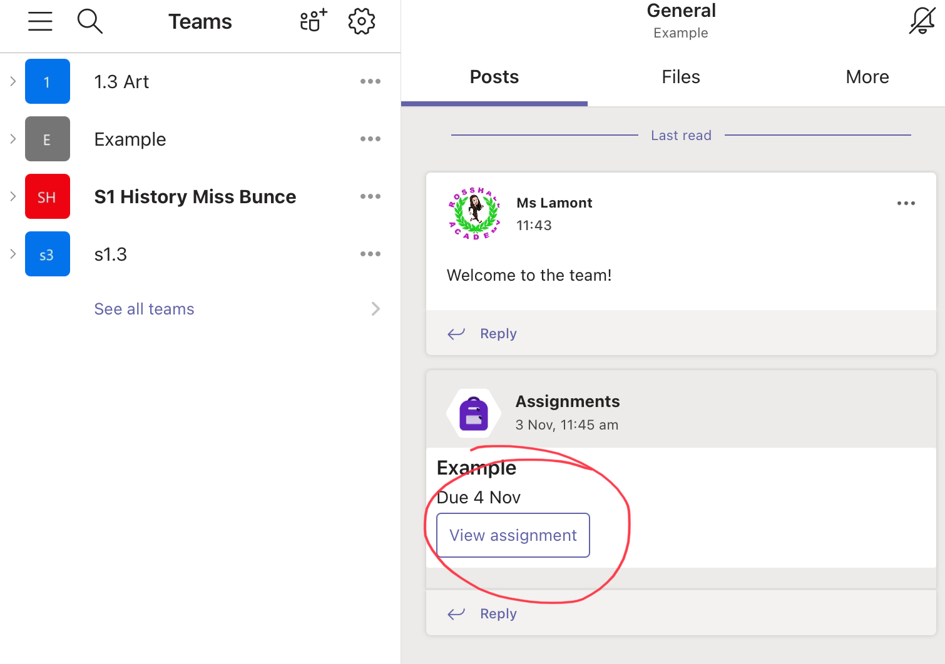
You can edit your document using the tools in Showbie, such as the pen, the eraser and the text box

Slide 9
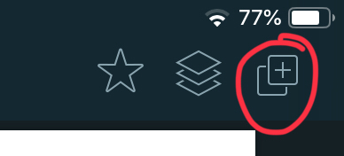
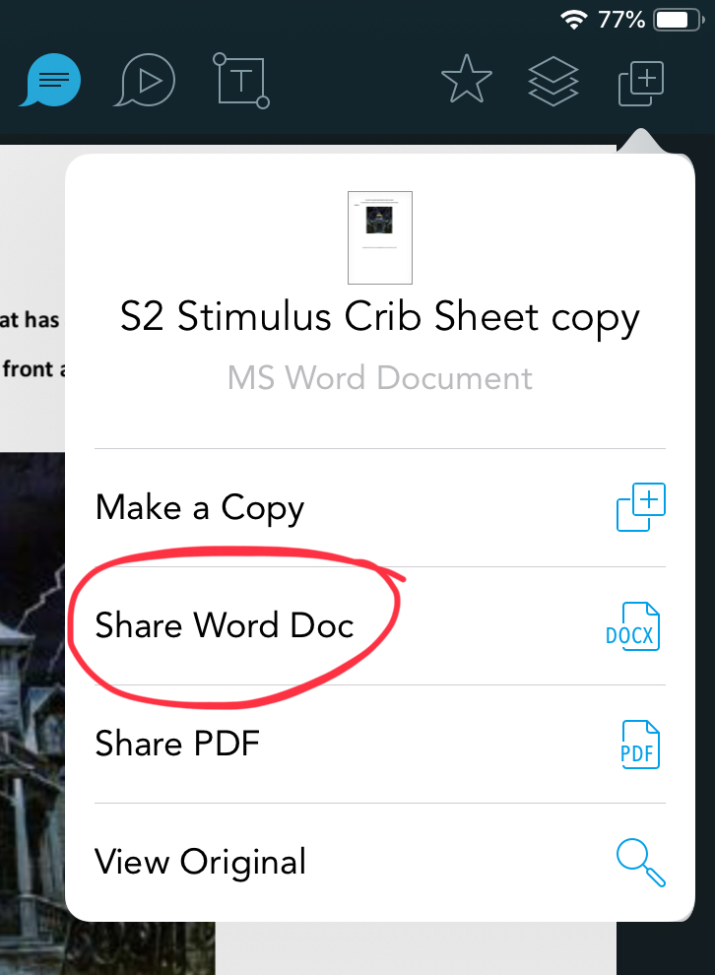
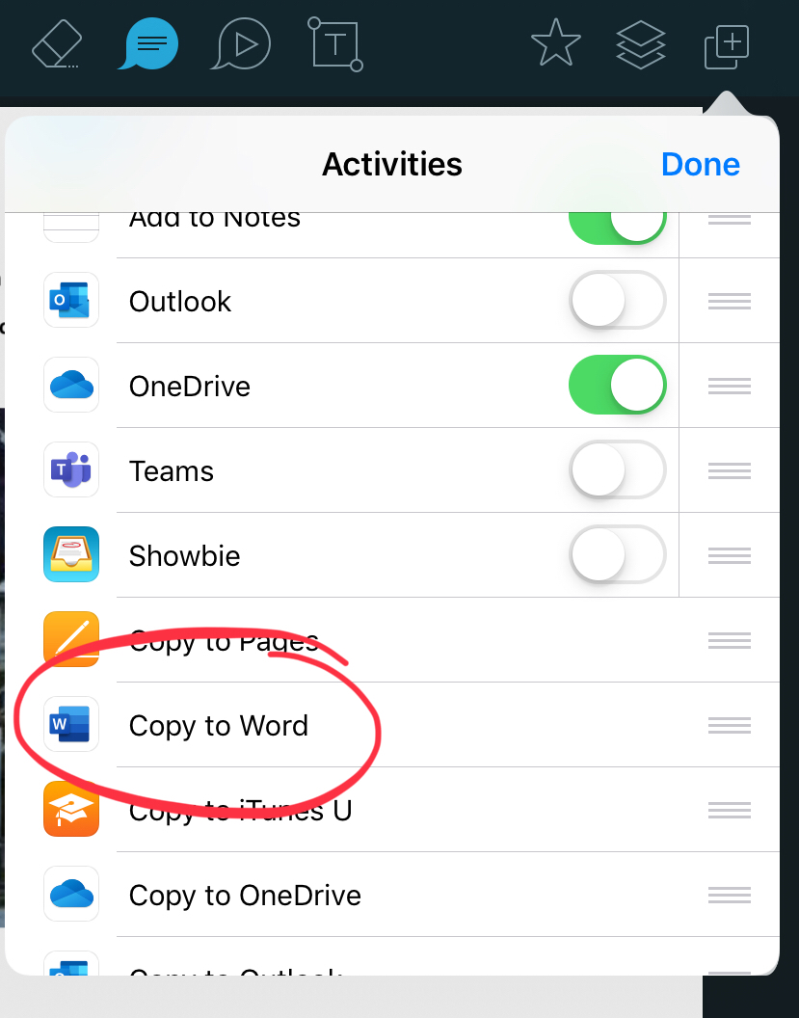
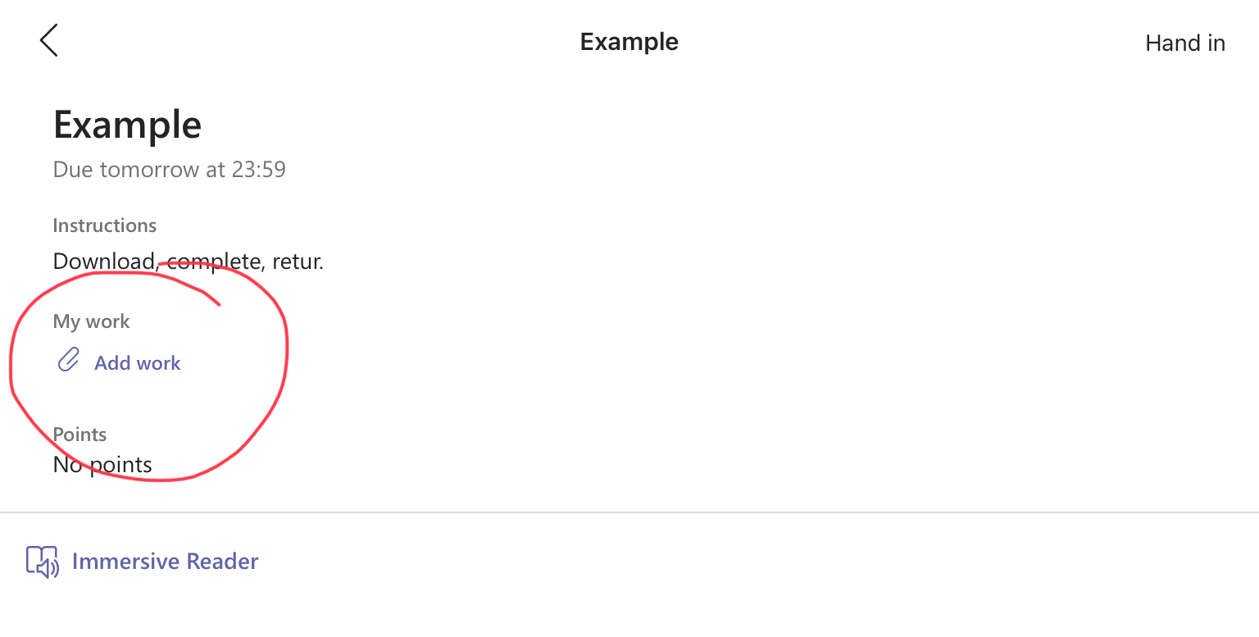
Or you can open and use it like a normal word document for example by pressing this icon and selecting word (or PowerPoint or Keynote…)

Slide 10
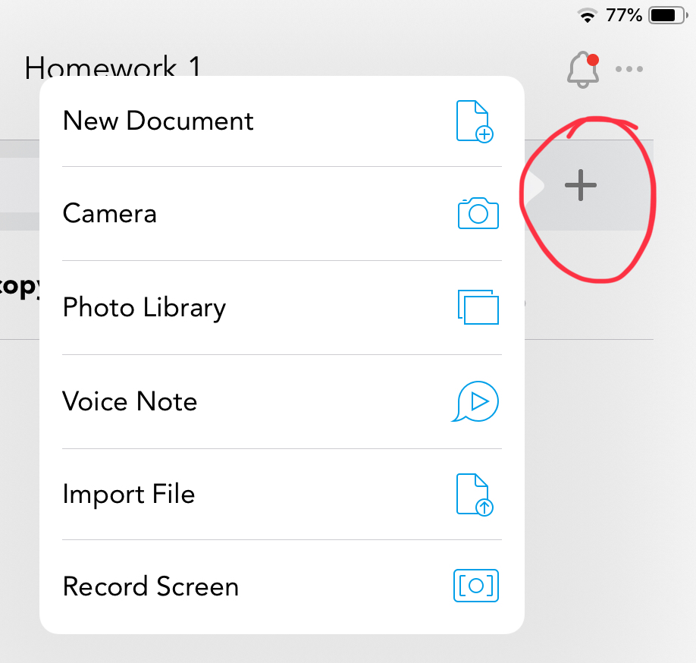
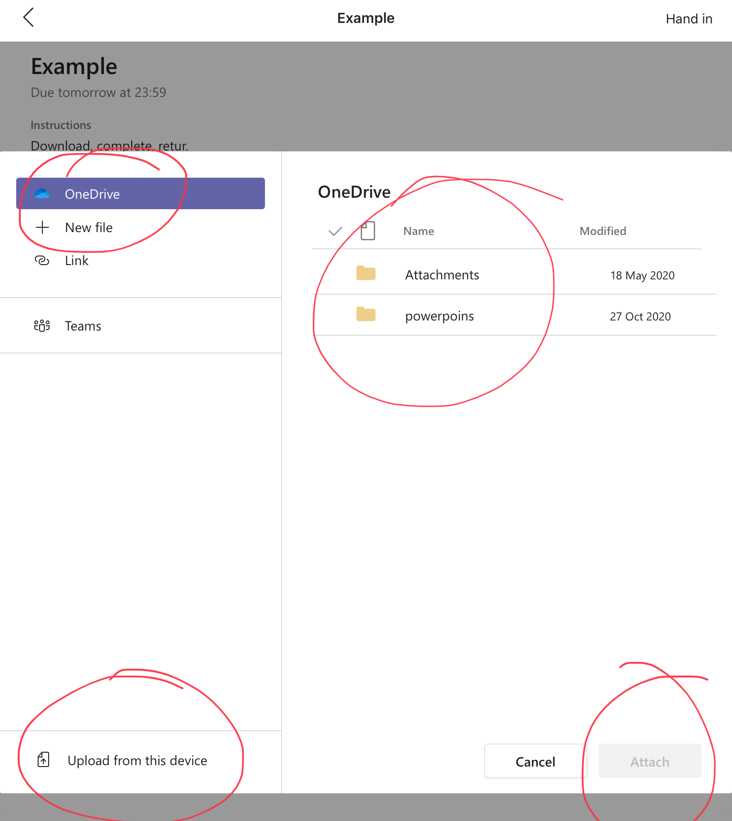
To send your teacher your work, you go back to the homework and press the + icon. You can upload a file like our example or even take a picture of your work if you write it by hand!

Slide 11
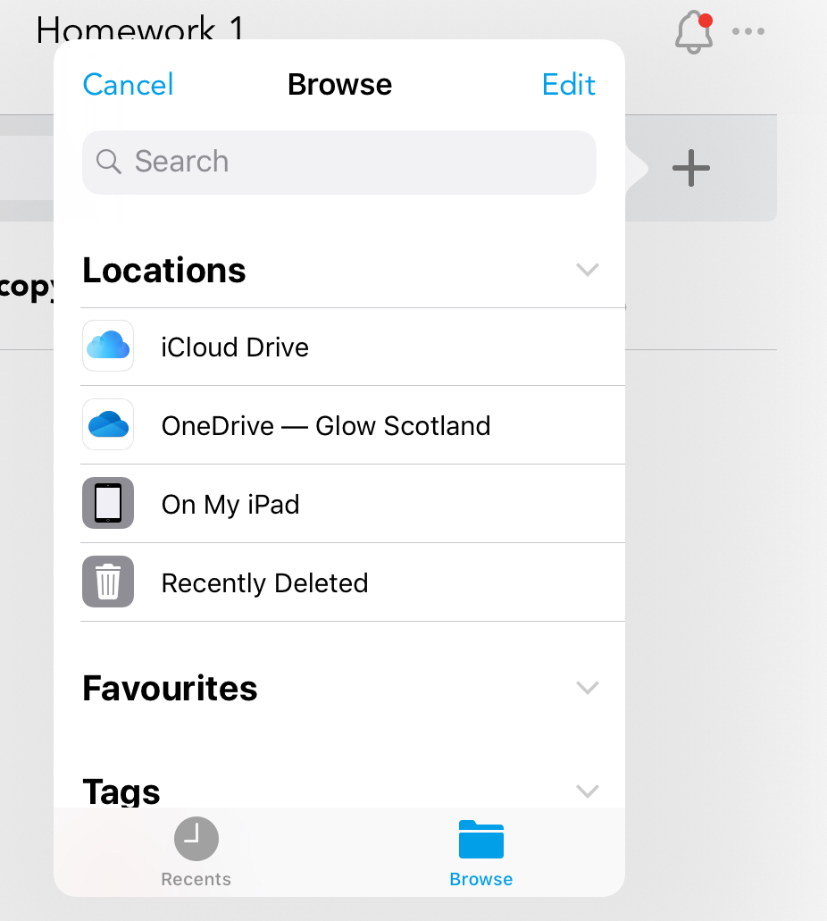
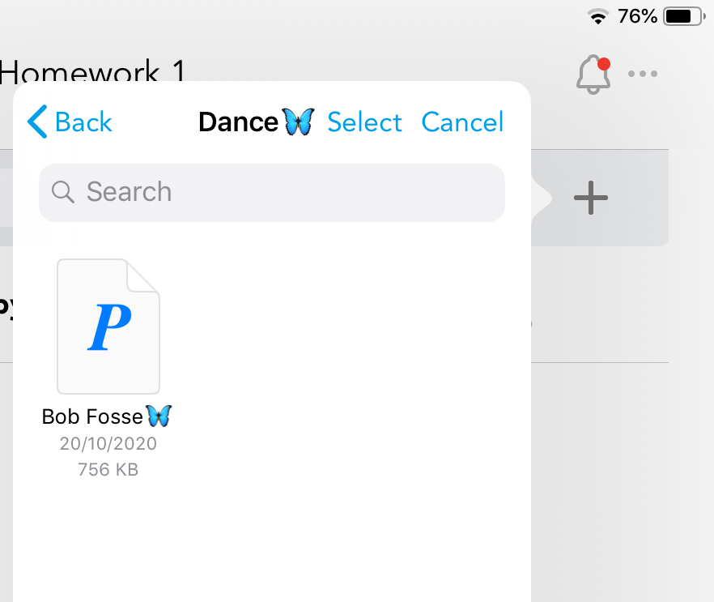
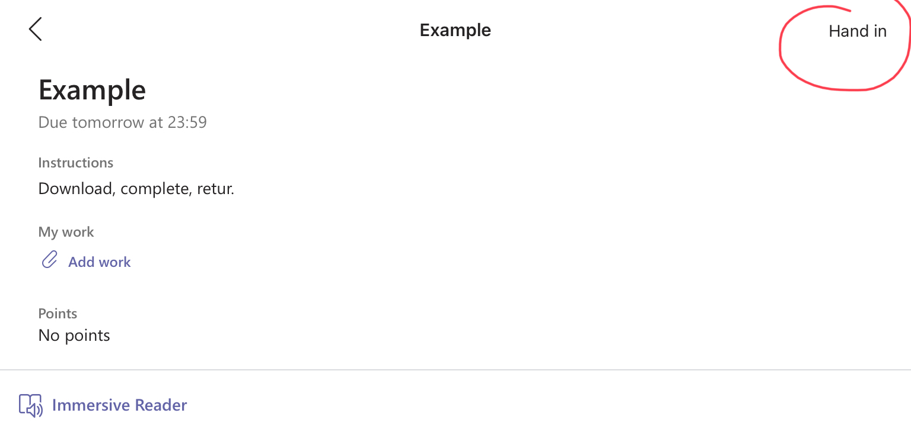
To upload a word document, click on import file then find the document in your folders! See lesson ½ for tips on turning on OneDrive

Slide 12
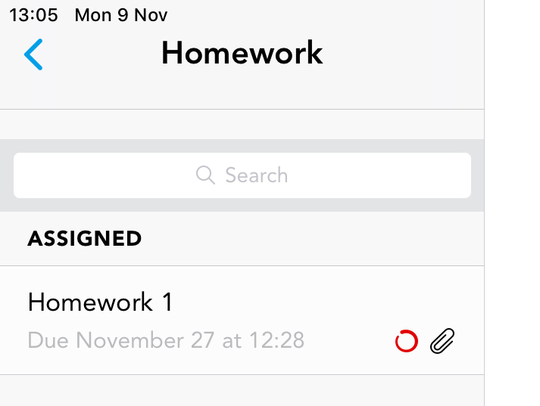
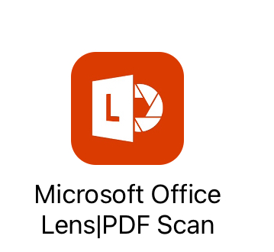
When you have successfully uploaded your homework you will see a paper clip icon. The red circle means your teacher has responded to you or given you feedback.

Slide 13
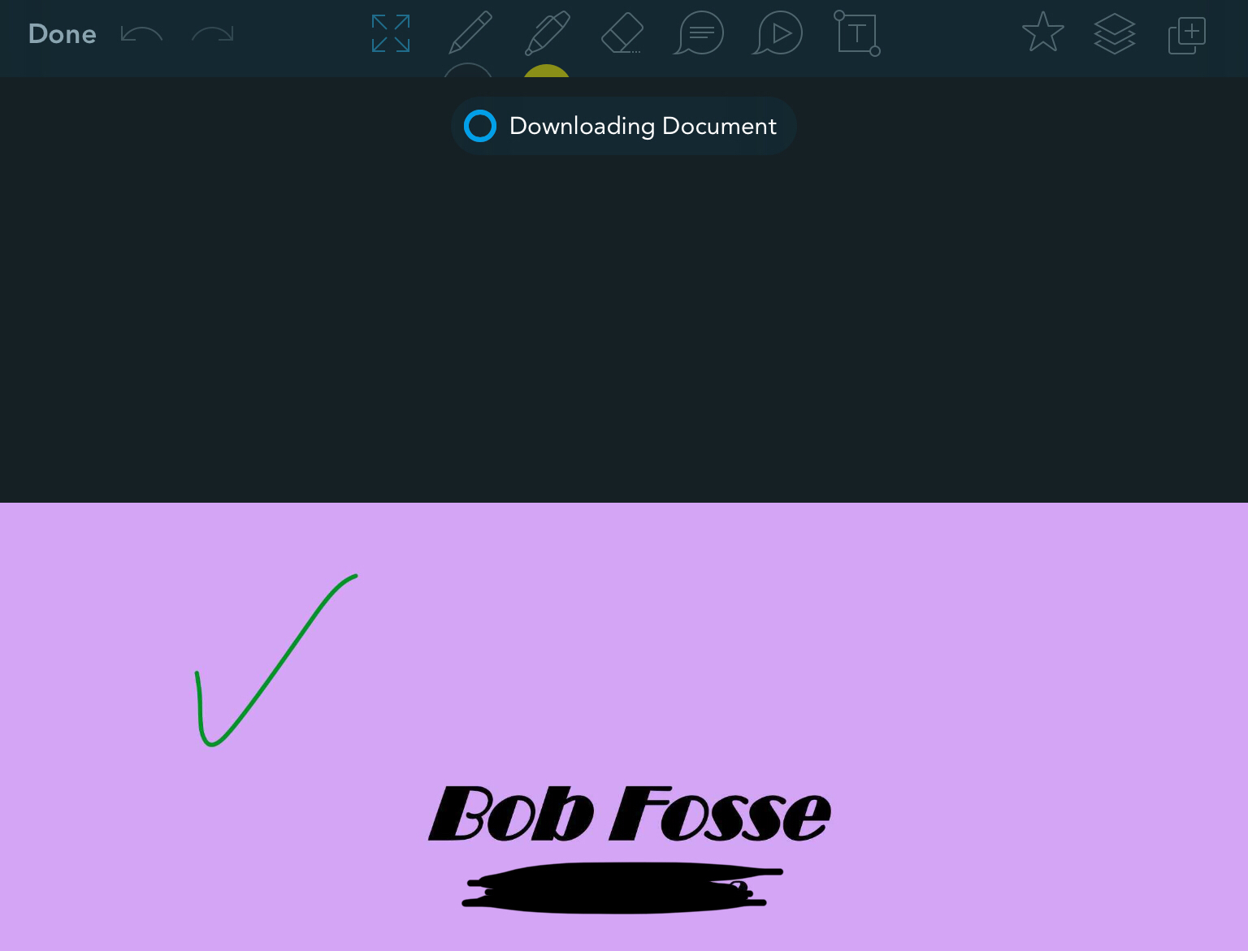
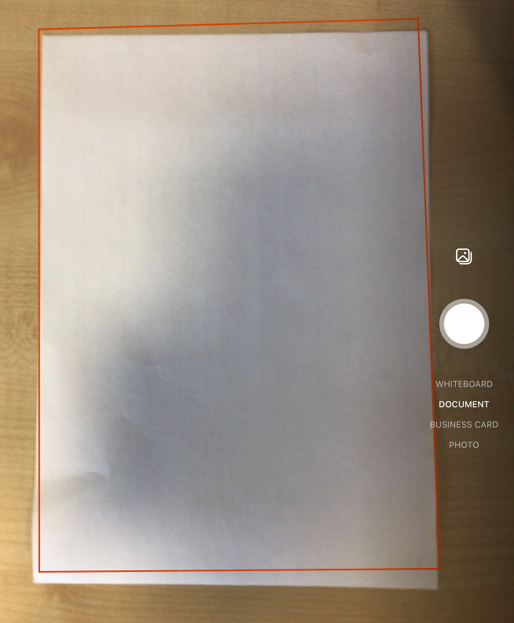
Open up your homework to see your teacher feedback!

Slide 14

If you have any other requests for iPad tips and tricks please either email or speak to Ms Lamont.

