Slide 1
Getting to know your iPad

Slide 2
A Quick Reminder…
If you do not yet have your iPad – we know!
Ms Lamont and Miss Edwards will call you to get your iPad issued when we have time.
Do not come round to see us, especially during class time, ‘to get your iPad’ if we have not specifically arranged this with you. We cannot simply hand you an iPad, it takes time to set up.
No one can get your iPad on your behalf.
If you still do not have Self Service, or still have issues downloading apps, you should email your Computer Username and Asset Tag (the PT number on the back of the iPad) to Ms Lamont.

Slide 3
S1/2 iPads
We have had extensive problems with S1/2 iPads this week, as many of you will know.
We will not be able to hand out any more S1/2 iPads until this is solved.
We are sorry about this but it is not something we can help at the moment, we are working very hard behind the scenes to get it fixed!
You just need to be patient!

Slide 4
FAQ’s
Internet issues? Turn your iPad off then on again. Go to Safari. Wait for the ‘Proxy’ pop up and enter your computer username and password.
If you forget your password ask a member of staff to reset it. You must log onto a computer and change it from the default ‘welcome’ to something else.
‘Verify Apple Id’ pop up? For S 1- 4 your passcode is 020508. S5 & 6 set their own, if you have forgotten this, email Ms Lamont
Battery not charging all the way? Let your iPad drain completely of battery, leave it over night not on charge, charge it in the morning. Best to do this at a weekend!
iOS update? Do this in the evening, plugged into your charger and on WiFi.
Locked out of your iPad? S1 – 4 all have the same code. S5 – 6 can see Ms Lamont for a reset.

Slide 5
Setting up your Emails
It is a good idea to set up your Outlook app for emails to save you having to log onto Glow via safari all of the time!
Follow these steps to do so.

Slide 7
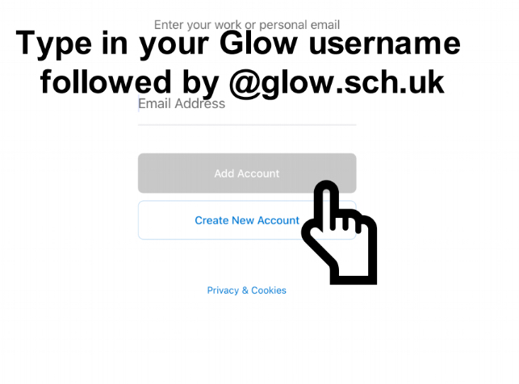

Slide 8
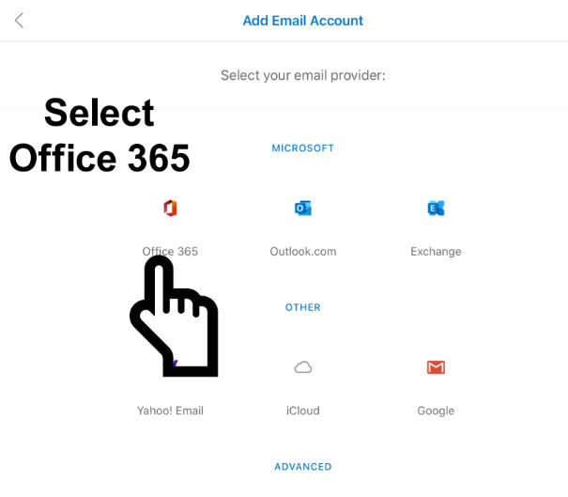

Slide 9
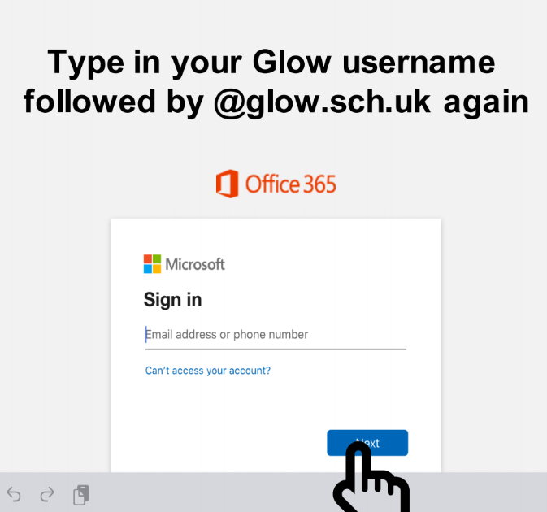

Slide 10
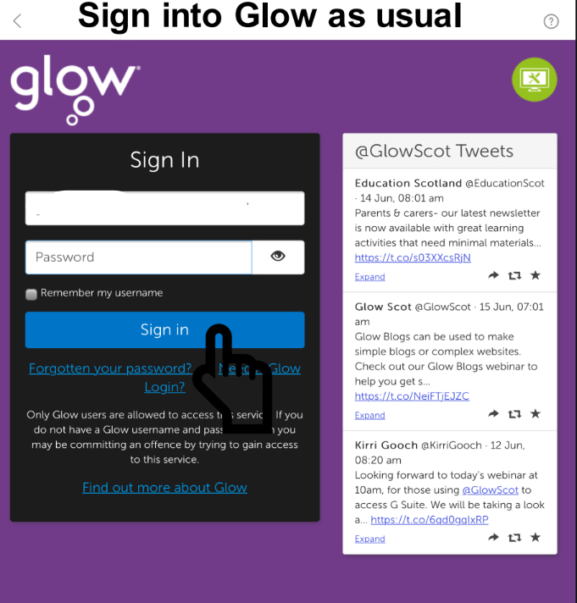

Slide 11
Glow Issues
If your have forgotten your glow password, a staff member can reset this
For staff: this can be found by logging into glow via safari/internet browser, selecting Management Console in the top tool bar then searching for the pupil!

Slide 12
Microsoft Word
There are many features for saving your work.
We will now go over some of your options!
To have OneDrive as an option in your other apps, you should have the app downloaded and log into it with your glow email.

Slide 13
Open up a blank document in Word.

Slide 14
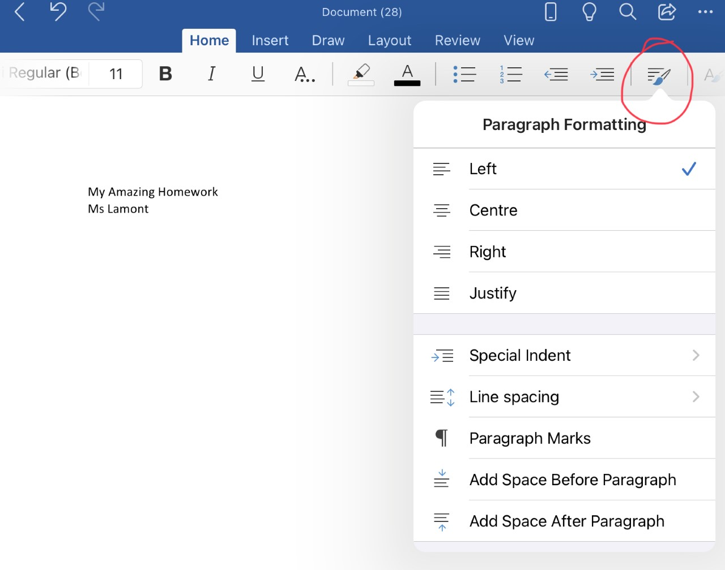
To align your work, press the icon with 3 lines and a paintbrush.

Slide 15
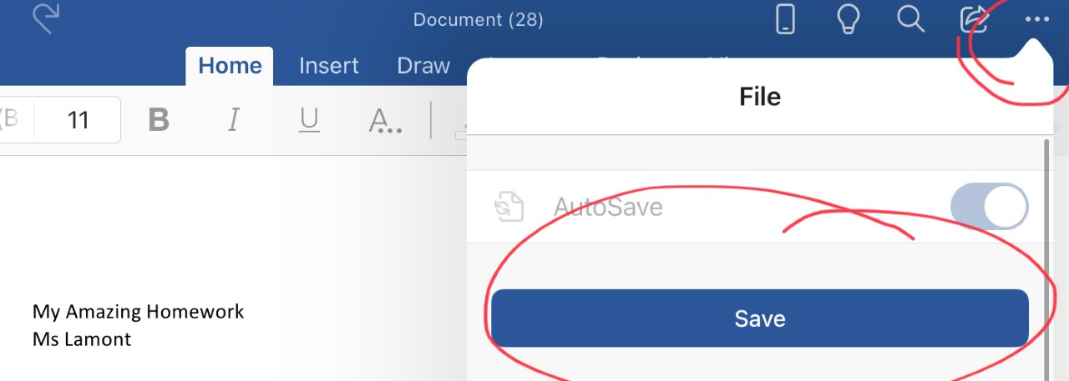
When you have finished typing, press the 3 dots in the top right hand corner and press save.

Slide 16
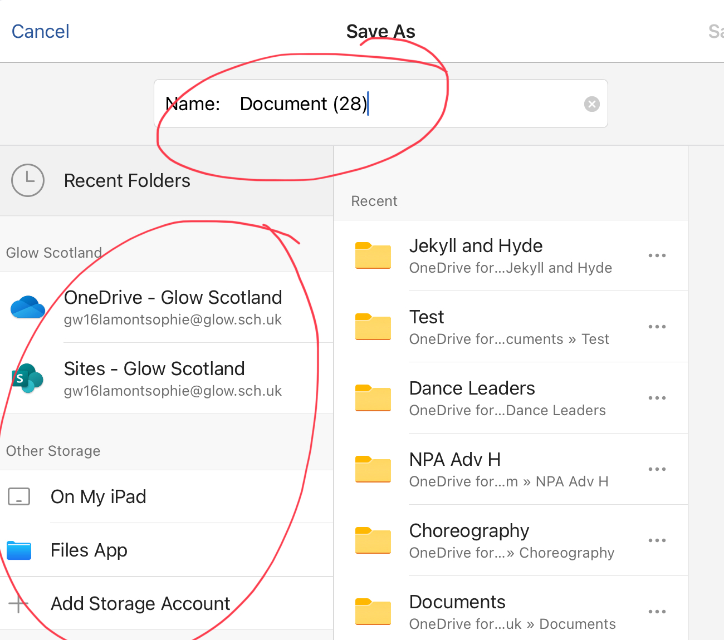
Rename your document by clicking on the top bar, then select where you want to save your file!

Slide 17
Sending a Document via Email
Open Outlook (assuming you have set up your emails already!)

Slide 18
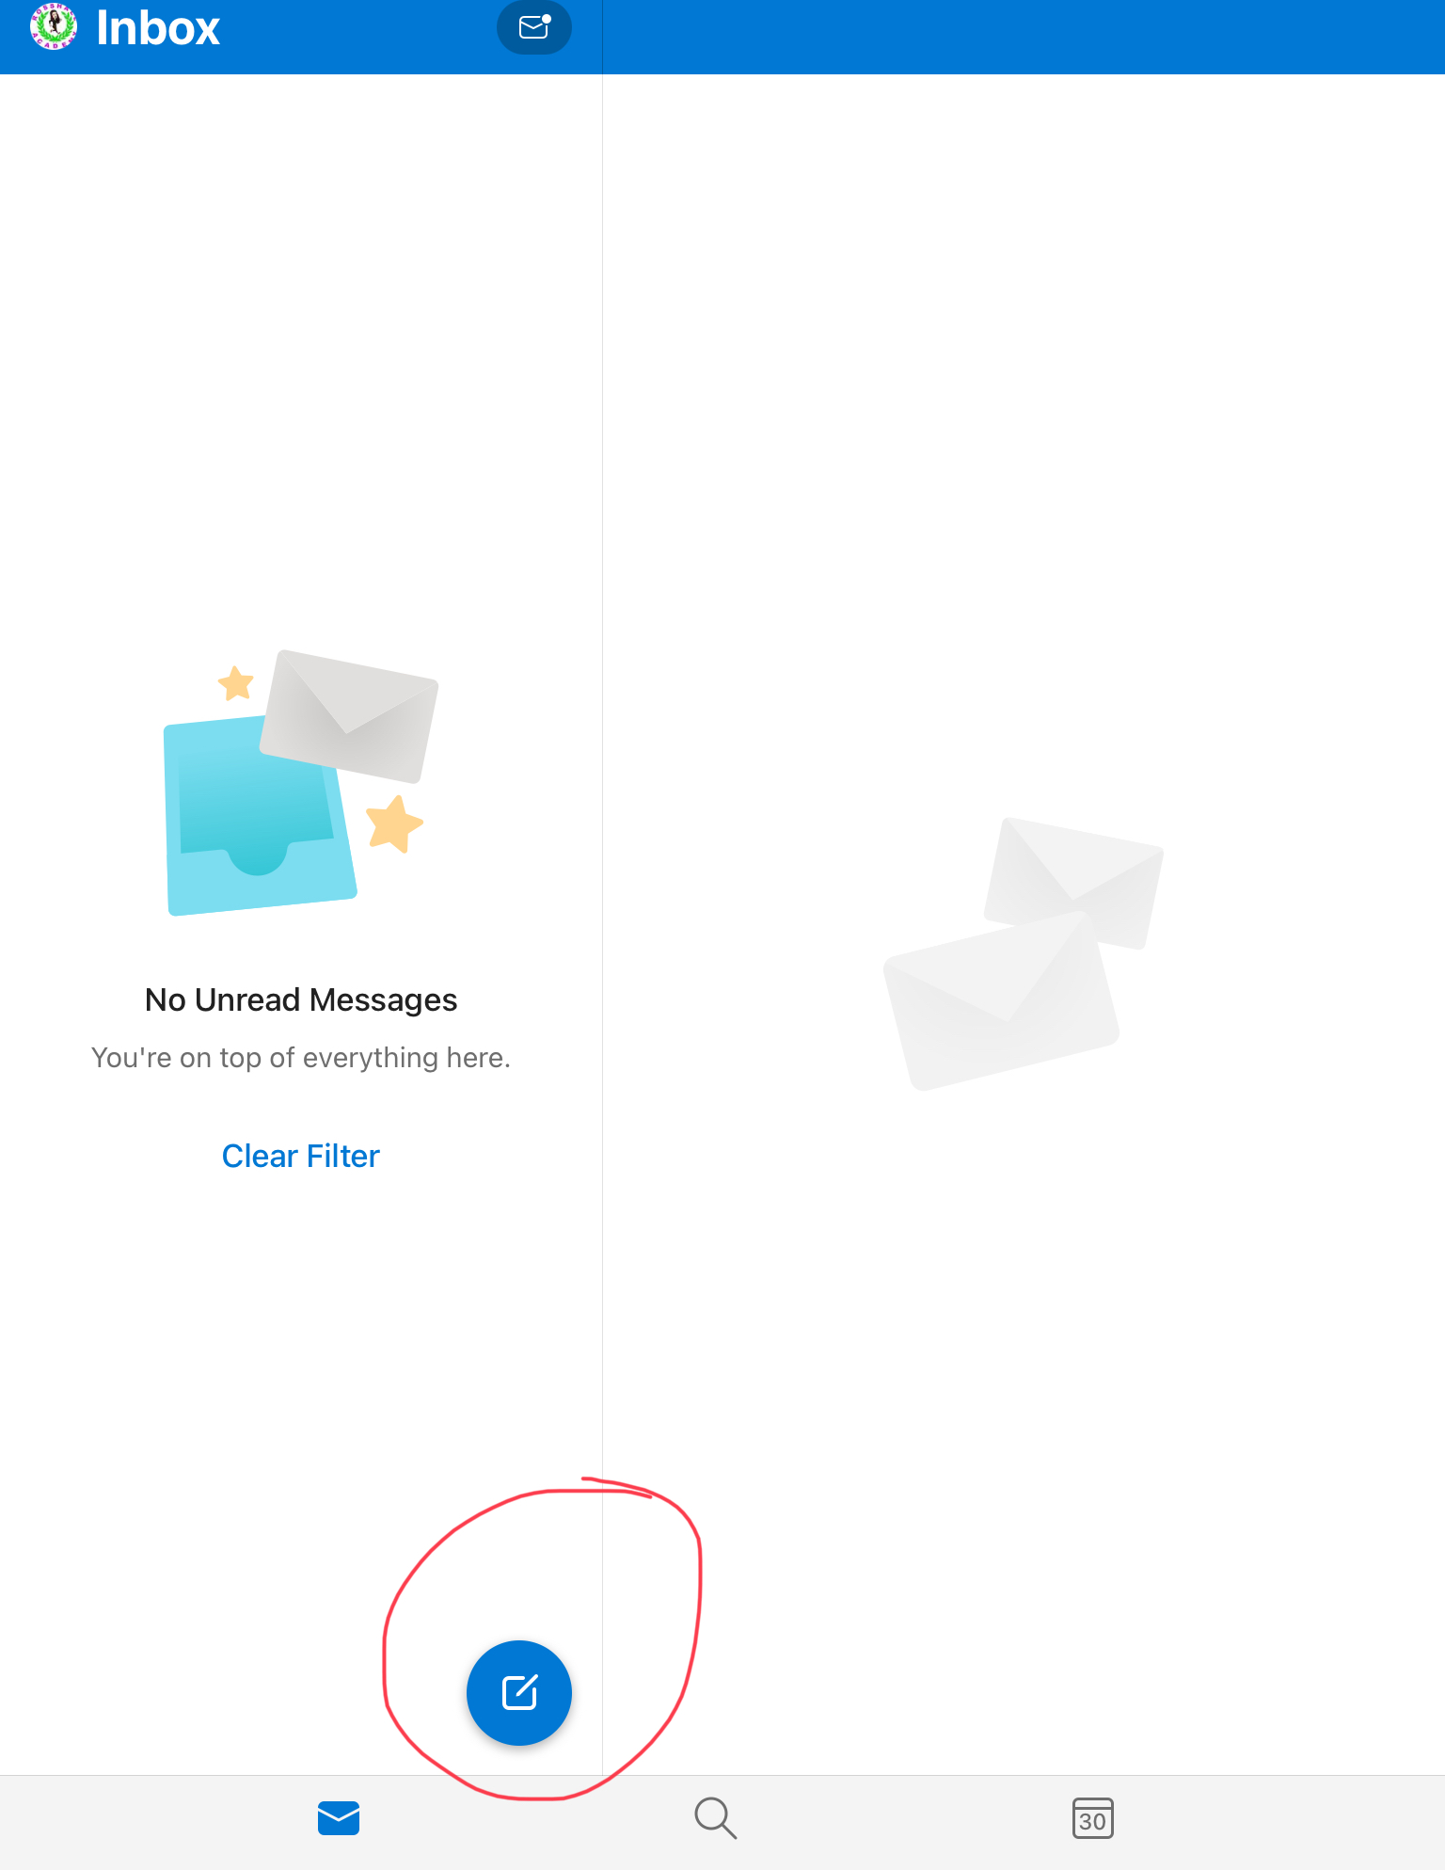
Sending a Document via Email
Click on the blue circle with a square and pencil icon.

Slide 19
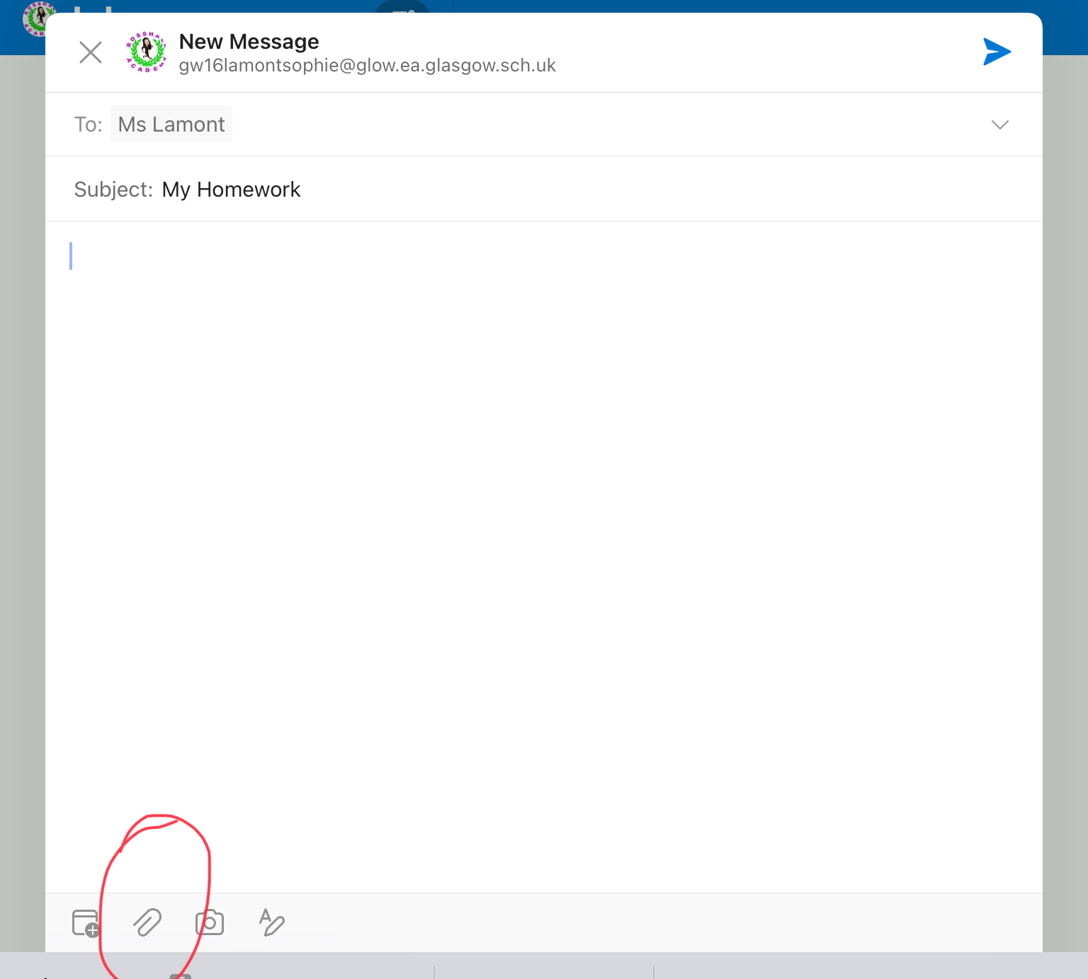
Type in the email address/teacher the work is being sent to.
Remember to put in a subject!
Then click the paperclip icon.

Slide 20
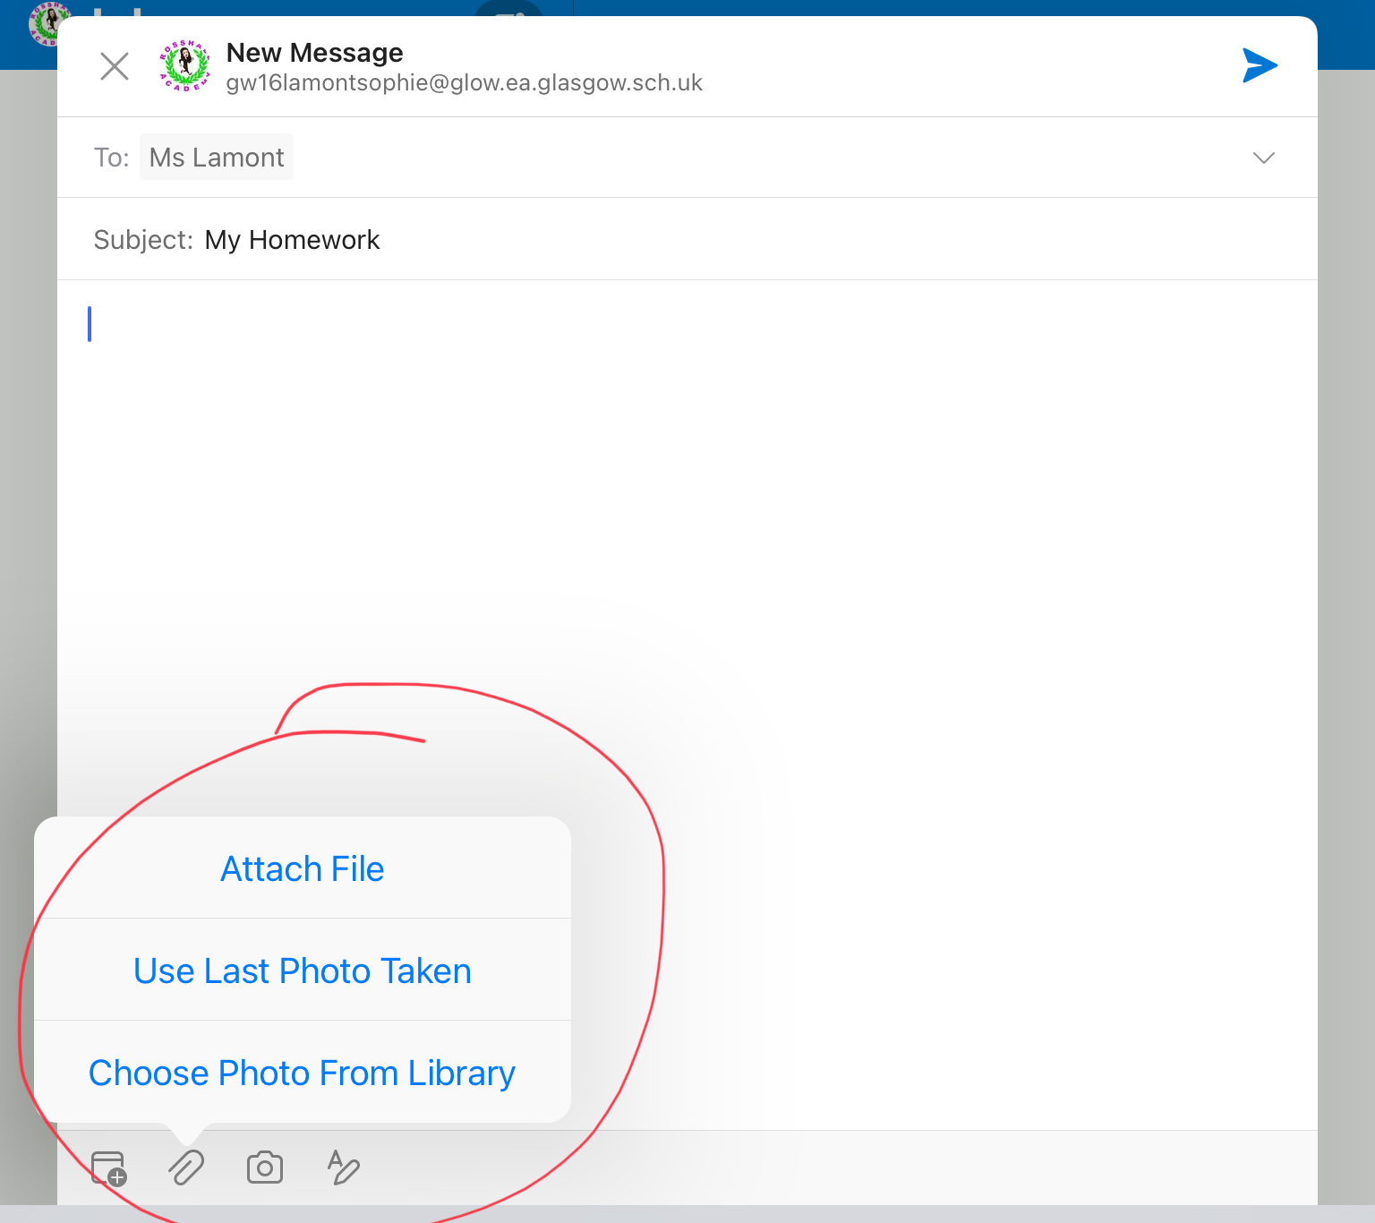
Choose either Attach File if you are sending a word/power point document, or Photo Library if it is a video.

Slide 21
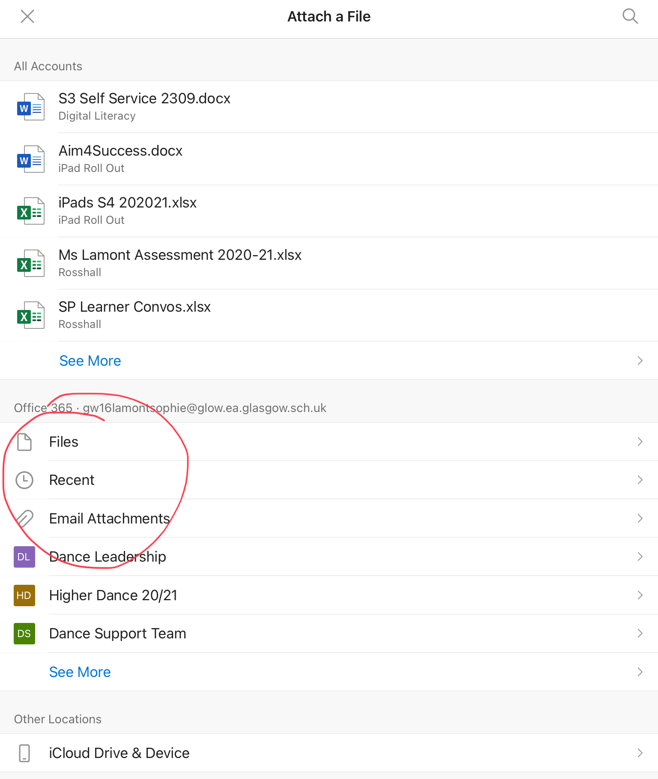
You can find your documents either in files, or if it was a recently opened document it should be at the top!

Slide 22
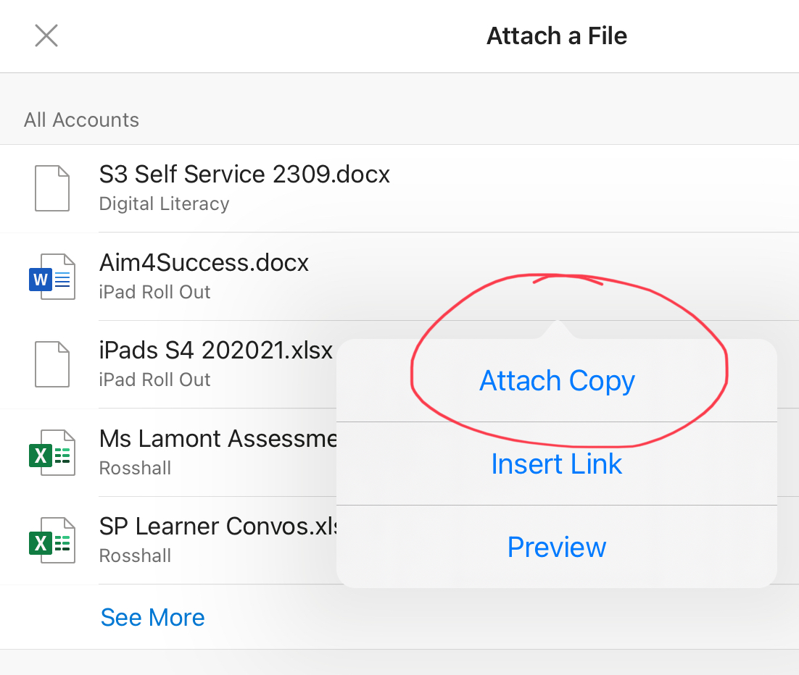
Attach as a copy!

Slide 23
Send by clicking on the blue arrow!

Slide 24
More How To’s
There will be more How To’s every Thursday Personal Support, and if you have any specific requests please feel free to write your suggestions to Ms Lamont via email, or pop in during a suitable time (I.e. break of lunch) and let her know!
Next week we will look at Teams and Showbie!

