Slide 1
Getting to know your iPad

Slide 2
A Quick Reminder…
If you do not yet have your iPad – we know!
Ms Lamont and Miss Edwards will call you to get your iPad issued when we have time.
Do not come round to see us, especially during class time, ‘to get your iPad’ if we have not specifically arranged this with you. We cannot simply hand you an iPad, it takes time to set up.
No one can get your iPad on your behalf.
If you still do not have Self Service, or still have issues downloading apps, you should email your Computer Username and Asset Tag (the PT number on the back of the iPad) to Ms Lamont.
Please remember both Ms Lamont and Miss Edwards will be rolling out the S1 & 2 iPads over the next few weeks and are still teaching regular classes – replies to your emails for help etc may take longer.

Slide 3
Common Questions/FAQ’s
Internet issues? Turn your iPad off then on again. Go to Safari. Wait for the ‘Proxy’ pop up and enter your computer username and password.
If you forget your password ask a member of staff to reset it. You must log onto a computer and change it from the default ‘welcome’ to something else.
‘Verify Apple Id’ pop up? For S 1- 4 your passcode is 020508. S5 & 6 set their own, if you have forgotten this, email Ms Lamont
Self Service issues - known issue still slowly being fixed
Battery not charging all the way? Let your iPad drain completely of battery, leave it over night not on charge, charge it in the morning. Best to do this at a weekend!
iOS update? Do this in the evening, plugged into your charger and on WiFi.
Locked out of your iPad? S1 – 4 all have the same code. S5 – 6 can see Ms Lamont for a reset.

Slide 4
Adjusting Your Screen
You may want to increase your font size or add some accessibility features such as a colour overlay.
You can do this by…

Slide 5
Go to settings and choose Accessibility

Slide 6
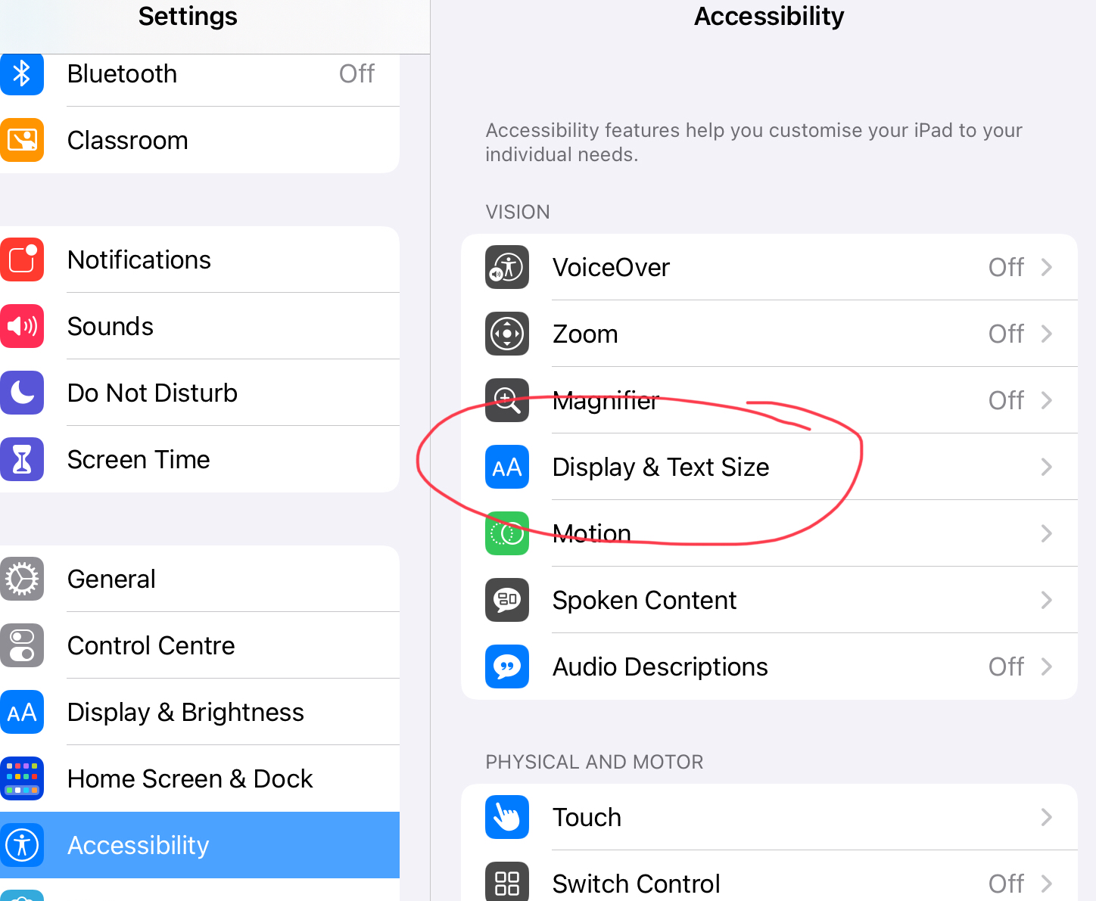
Here you will find lots of options including Display and Text size

Slide 7
To add a filter select Colour Filters

Slide 8
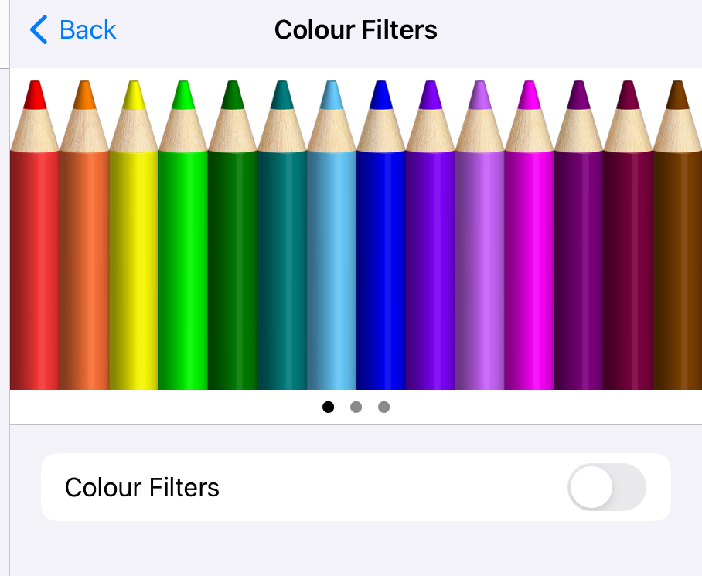
Here you have plenty of options to suit your needs!

Slide 9
Setting up your Emails
It is a good idea to set up your Outlook app for emails to save you having to log onto Glow via safari all of the time!
Follow these steps to do so.

Slide 11
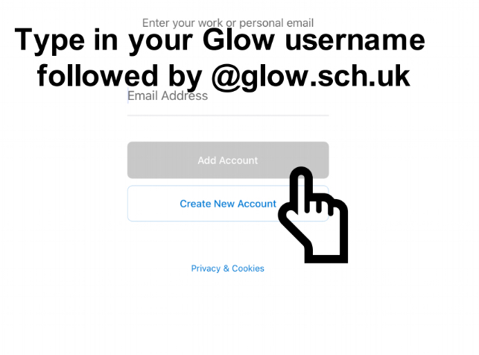

Slide 12
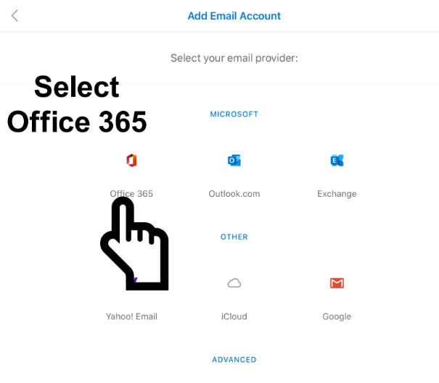

Slide 13
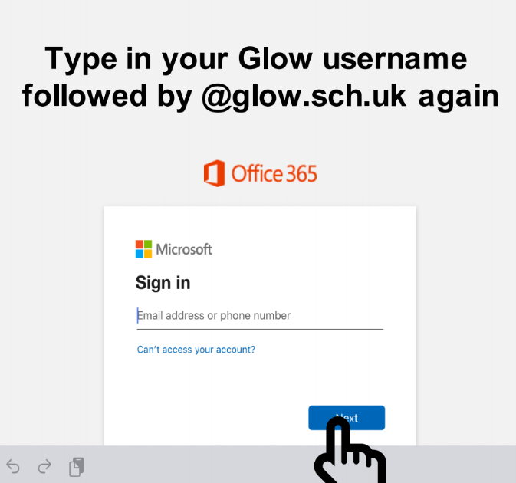

Slide 14
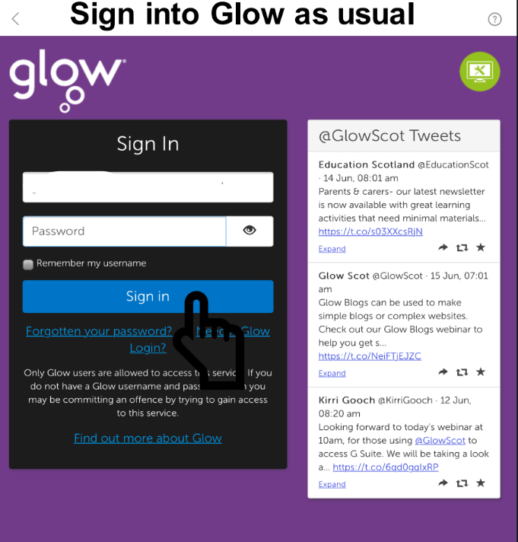

Slide 15
Glow Issues
If your have forgotten your glow password, a staff member can reset this
For staff: this can be found by logging into glow via safari/internet browser, selecting Management Console in the top tool bar then searching for the pupil!

Slide 16
Saving Your Work
There are many features for saving your work.
We will now go over some of your options!
To have OneDrive as an option in your other apps, you should have the app downloaded and log into it with your glow email.

Slide 17
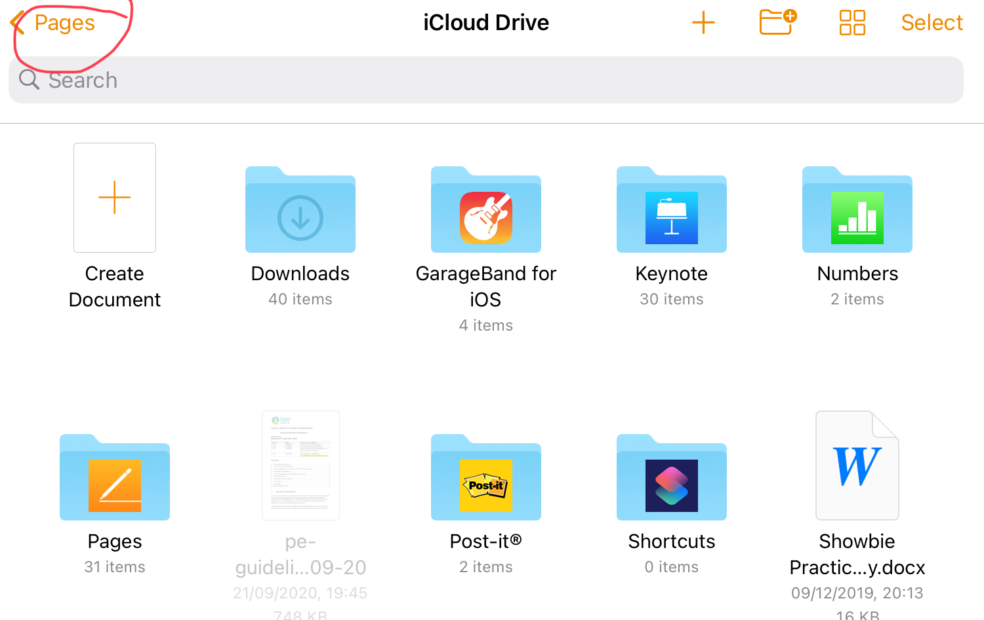
Open an app such as Pages

Slide 18
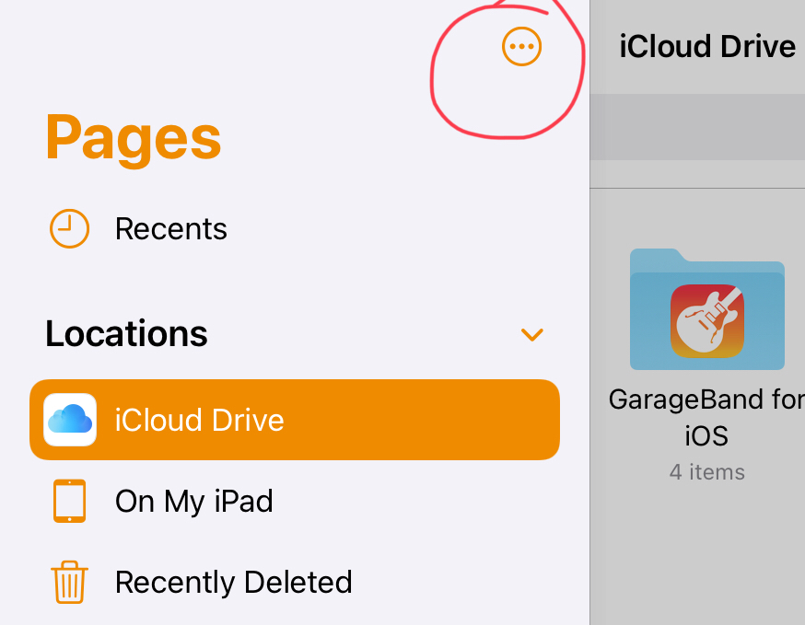
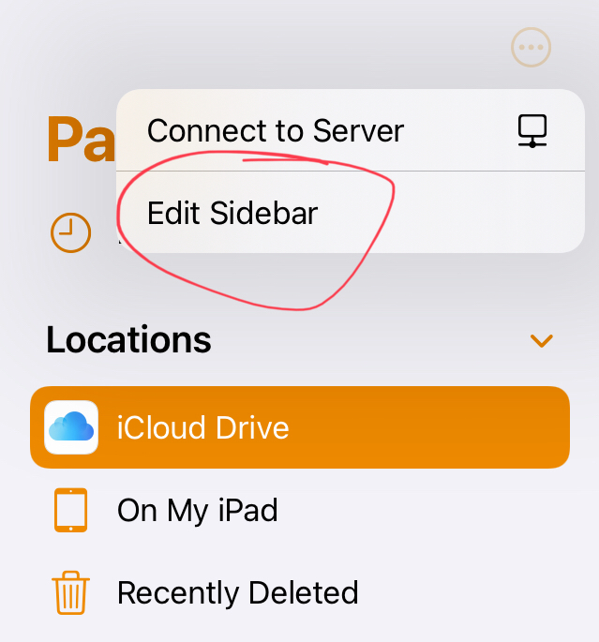
Select the Three Wee Dots, then edit sidebar.

Slide 19
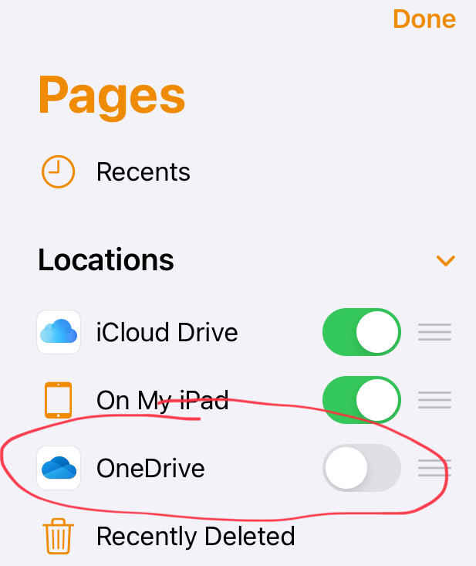
Toggle OneDrive on!

Slide 20
Saving Your Work
You can also save to the iCloud/to your iPad, but OneDrive is useful because you can log onto a desktop computer and print your work if it has been saved to your OneDrive!

Slide 21
More How To’s
There will be more How To’s every Thursday Personal Support, and if you have any specific requests please feel free to write your suggestions to Ms Lamont via email, or pop in during a suitable time (I.e. break of lunch) and let her know!

