Slide 1
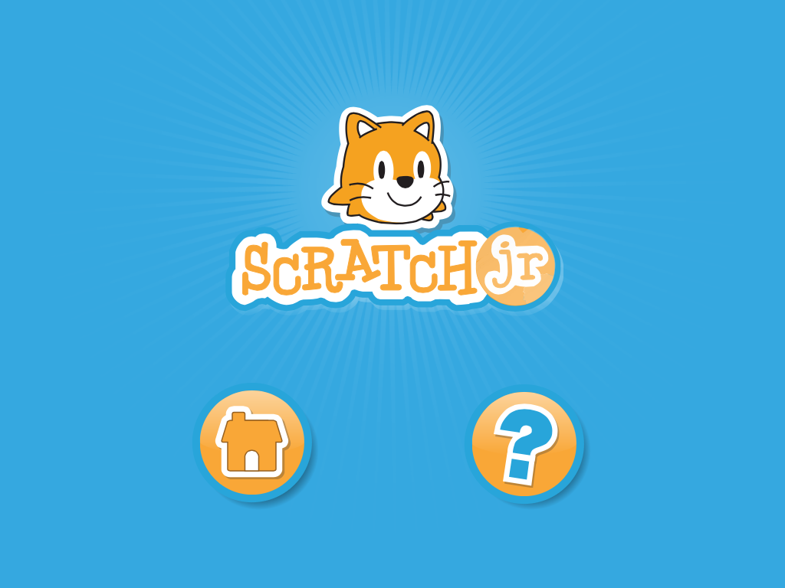
Steps on how to work scratch junior
For teachers
A step-by-step guide
Lesson = the hungry caterpillar
By Christopher Ewing

Slide 2
Step 1 – Finding THE APP
First of all, unlock the iPad. Look for the Scratch Jr. symbol in all of the tiles on the home screens of the iPad.

Slide 3
Step 2 – accessing THE APP
Once you have tapped on the app, hit the home button on the opening screen that will appear first.

Slide 4
Step 3 – CREATING A NEW PROJECT
You can then create a new Scratch program by tapping on the (+) button or use a previous created program from the ones loaded. Today we will just use the new (+) button as we are beginners.

Slide 5
Step 4 – ADDING A BACKGROUND
You will then come across this screen. To add a new background go to the top of the screen which looks like a landscape and tap on this.

Slide 6
Step 5 – picking THE BACKGROUND
A whole range of backgrounds will appear but to make it relevant to the hungry caterpillar we will pick the Jungle background. Double tap to apply. See the Right hand side.

Slide 7
STEP 6 – deleting UNWANTED CHARACTERS
You can then delete any characters. In this case the cat, as we do not need a cat for this story. Press down on the animal until it dances and a red cross appears. Once the red cross appears tap on it and it should disappear.

Slide 8
Step 7 – ADDING NEW CHARACTERS
To add new characters hit the left hand side plus (+) button. And a menu of all different characters should appear on the screen.

Slide 9
Step 8 – PICKING THE CHARCTERS WE NEED
There will be several characters that we can use but for this story we are going to pick the Snake. (As there is no caterpillar and it looks like the closest thing to it)

Slide 10
Step 9 – ADDING MORE CHARCTERS
We then need to add another character 'the butterfly' as the hungry caterpillar turns into a beautiful butterfly.

Slide 11
Step 10 – adding new characters
We also need such characters as an apple; peach; tree; mushroom and a flower for the caterpillar to eat. Tap on the ones we need.

Slide 12
Step 11 - Saving the program
I would advise saving the Scratch Jr. we have made, in the top right hand corner as the app has a tendency to force close.

Slide 13
Step 12 – saving the program
Once you have hit the small symbol in the right hand corner from the previous screen this screen will appear. Type into the save tap and call it what you would like. To confirm the saved scratch Jr hit the tick on the top right-hand corner.

Slide 14
STEP 13 – CODING THE snake
Use the bottom tab to code the snake (caterpillar). All of the below codes can be found in the different coloured tabs. There is 6 in total. Find the same codes as shown below. Make sure the envelopes stay the same colour as provided in the pictures.

Slide 15
Step 14 – coding the Mushroom
Use the bottom tab to code the mushroom. All of the below codes can be found in the different coloured tabs. There is 6 in total. Find the same codes as shown below. Make sure the envelopes stay the same colour as provided in the pictures.

Slide 16
Step 15 – coding the Peach
Use the bottom tab to code the peach. All of the below codes can be found in the different coloured tabs. There is 6 in total. Find the same codes as shown below. Make sure the envelopes stay the same colour as provided in the pictures.

Slide 17
Step 16 – coding the apple
Use the bottom tab to code the apple. All of the below codes can be found in the different coloured tabs. There is 6 in total. Find the same codes as shown below. Make sure the envelopes stay the same colour as provided in the pictures.

Slide 18
Step 17 – coding the Tree
Use the bottom tab to code the tree. All of the below codes can be found in the different coloured tabs. There is 6 in total. Find the same codes as shown below. Make sure the envelopes stay the same colour as provided in the pictures.

Slide 19
Step 17 – coding the Daisy
Use the bottom tab to code the daisy. All of the below codes can be found in the different coloured tabs. There is 6 in total. Find the same codes as shown below. Make sure the envelopes stay the same colour as provided in the pictures.

Slide 20
Step 18 – coding the butterfly
Use the bottom tab to code the butterfly. All of the below codes can be found in the different coloured tabs. There is 6 in total. Find the same codes as shown below. Make sure the envelopes stay the same colour as provided in the pictures.

Slide 21
STEP 20 – HOW TO WORK THE FINISHING PROJECT
You now have all the codes for this to work.
Hit the green flag at the top right and corner
Now drag the snake onto the different things for it to eat and it should begin to grow.
IMPORTANT POINT! THE DAISY MUST BE THE LAST THING EATEN BY THE CATERPILLAR FOR IT TO TURN INTO A BEAUTIFUL BUTTERFLY!

Slide 22
Finished project in video format
Here is a video of how the finished project works. To watch the video, make sure you are off of full screen Slide View and double tap on the picture and the video will open.

Slide 23
Lesson approach...
The teacher could read the story from the hungry caterpillar from the book.
The teacher could then when finished reading see what children remembered and use the scratch Jr made in the previous slides so the children can see if eat all the different things. This would further clarify to the Early level any bits that may have not made sense to them when listening to the story.
OR the teacher could move the scratch game along as they read the book. This promoting active engagement as they would be both seeing and hearing from the teacher what was going on in the story.
The teacher could then if possible and accessible to certain resources get the class to have a go themselves. However, as some steps can be a bit intense and difficult: guided support would need to be on offer. This would help the children to further emphasis their understanding as they would get a go themselves, which would help them remember what happened in the story .

Slide 24
Relating to Curriculum for excellence...
This creation can apply to many of the CfE outcomes which can be made as a teacher and as a learner:
Literacy – as this is quite a young story the outcomes will be best suited to early level
I enjoy exploring and choosing stories and other texts to watch, read or listen to, and can share my likes and dislikes. LIT 0-01b / LIT 0-11b
To help me understand stories and other texts, I ask questions and link what I am learning with what I already know. LIT 0-07a / LIT 0-16a / ENG 0-17a
I enjoy exploring events and characters in stories and other texts, sharing my thoughts in different ways.
Technologies – although some steps may be difficult with guided support, this will work with Early
Level and they should be able to create the same thing:
I am developing problem-solving strategies, navigation and co-ordination skills, as I play and learn with electronic games, remote control or programmable toys. TCH 0-09a / TCH 1-09a

Slide 25
Why Scratch Jr. should be used in class...
Scratch Jr. In general should be used in class as it can make children have a more interactive; engaging and fun experience when it comes to such things as story telling. Rather than just being told the story they can see movement and even have a go of making the story. Also, it can encourage the children to be creative and make their own stories in a different and unique way.
Scratch Jr. Can make a normal lesson such as creative writing more fun but still very informative and learning to the children as they are still having to use the skills they have gained. For example, if the teacher asked them to use Scratch Jr. to create a story on what they did over the weekend they still have to write things but in speech bubbles as Scratch allows this. They would still be communicating as they could communicate to the teacher or class verbally as to what is happening in their weekend.
This not only improves their literacy skills but improving their confidence levels as they present in front of others their personal story. It will also improve such thing in their communication skills such as their verbal and non-verbal communication.

Slide 26
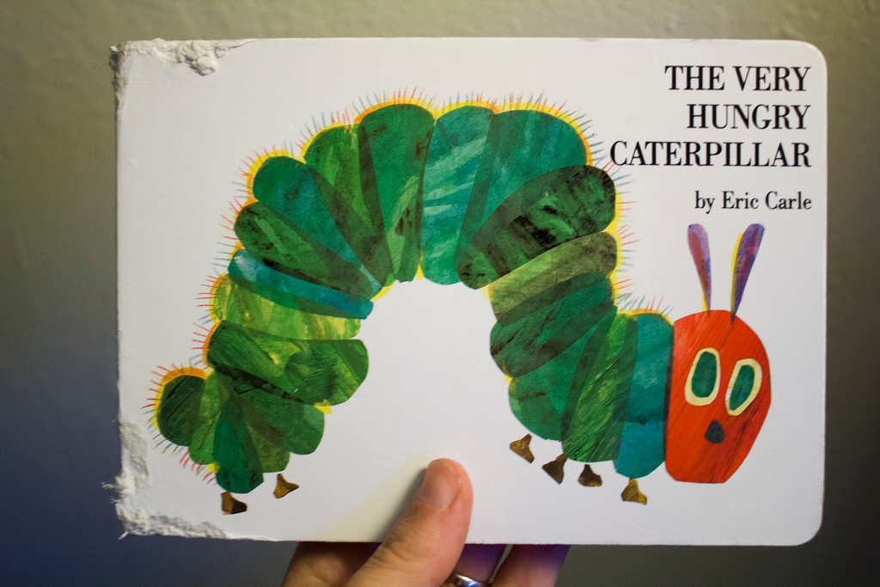
Why the scratch Jr. should be used in class. (the hungry caterpillar story)...
This activity will be interactive and make sure the children in early years fully understand what is happening in the story. This Scratch Jr will cater to different learners who learn more through: practical involvement; listening and visually seeing it.
It also helps the children to become more engaged as they can see the story by the teacher and then get a chance to have a go and make it themselves. This will help it to stay in their end which extends their general knowledge and vocabulary learned within the story.
This creative invention for the story of the Hungary Caterpillar us Scratch Jr. Is an excellent programm for also meeting several outcomes of CfE. This saving time for the teacher as they can progress through more in less time. For the learner it means they are getting a multicultural of knowledge in different areas rather than just taking one at a time. They are learning two things at once rather than just one which is more interesting and fun for the children.

