Slide 1

#SCELTLP
Rachnna Bhalla
My Leadership Journey
Teacher Leadership Programme
Notes:
You will have 10 minutes to tell your leadership journey. One minute to introduce yourself and three minutes for each of the following image slides.
Please note: You are not expected to tell the story of your enquiring approach in this presentation, this is the purpose of your poster. You may need to mention your enquiring approach, but you are encouraged to focus on your leadership learning through this programme.

Slide 2







Past
Notes:
Add an image which fills this slide to represent the past in your leadership journey. You will have three minutes to share this. This image can be taken from your context (with appropriate permissions) or from the web. If sourcing your image from the web please ensure you are permitted to use it. You can do this be searching for Creative Commons images: https://search.creativecommons.org/ Or images with no copyright at all: https://pixabay.com/

Slide 3

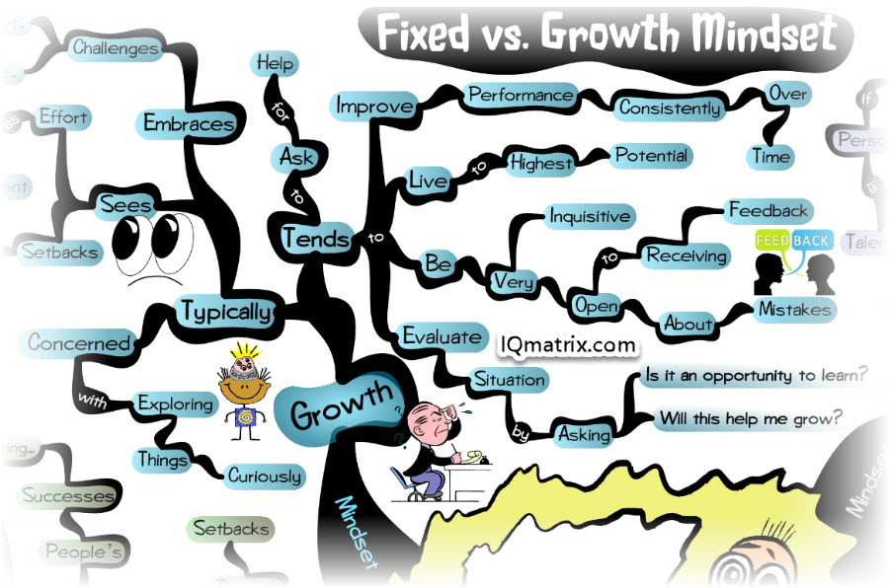


Present
Notes:
Add an image which fills this slide to represent the present in your leadership journey. You will have three minutes to share this. This image can be taken from your context (with appropriate permissions) or from the web. If sourcing your image from the web please ensure you are permitted to use it. You can do this be searching for Creative Commons images: https://search.creativecommons.org/ Or images with no copyright at all: https://pixabay.com/

Slide 4



Future
Notes:
Add an image which fills this slide to represent the future in your leadership journey. You will have three minutes to share this. This image can be taken from your context (with appropriate permissions) or from the web. If sourcing your image from the web please ensure you are permitted to use it. You can do this be searching for Creative Commons images: https://search.creativecommons.org/ Or images with no copyright at all: https://pixabay.com/

