Slide 1
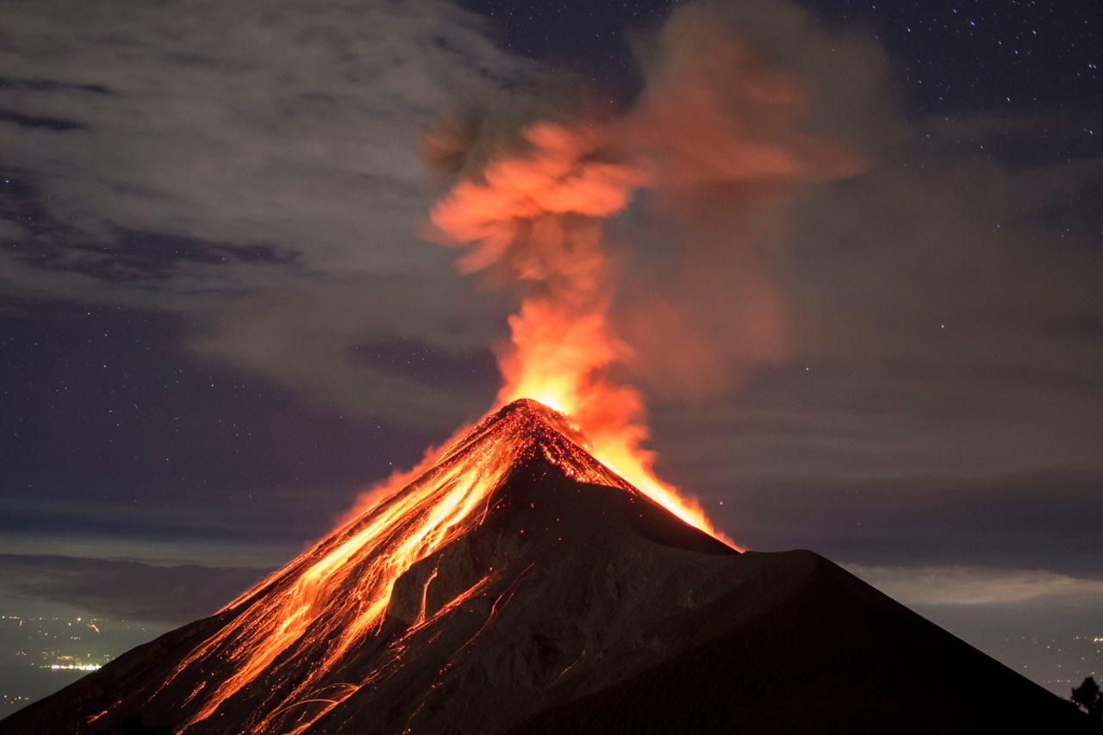
Volcanoes
ALISHA, HANNAH, KIERAN, RACHEL, SOPHIE AND SHANNON

Slide 2
Learning intentions
At the end of today's lesson you will be able to describe what a volcano is.
At the end of today’s lesson you will be able to give a cause and effect of a volcano.

Slide 3
What is a Volcano?
A Volcano is an opening on the surface of a planet or moon that allows material warmer than it’s surroundings to escape from its interior. When this material escapes, it causes an eruption.
On earth the erupted material can be liquid rock (‘lava’) when it’s on the surface. It is called ‘magma’ when it is underground, ash, cinders and gas.
Magma can rise when pieces of earth’s crust can be forced deep into it’s interior. This high heat and pressure causes the crust to melt and rise as magma.

Slide 4
Did you know?
The word ‘Volcano’ comes from the Roman name ‘ Vulcan’- The roman god of fire.
350 million, or one in 20 people in the world live within ‘danger range’ of an active volcano.

Slide 5
What causes volcanoes to erupt?
The earth’s crust is made up of massive slabs called ‘Plates’, which fit together like a jigsaw puzzle. The plates can move.
When two plates collide, one section glides on top of the other, the one beneath is pushed down. Magma is squeezed up between these two plates.

Slide 6
What Causes A Volcano?
There is a red-hot liquid rock in the earth’s core called magma.
Volcanoes occur when the magma rises to the surface of the earth, causing bubbles of gas to appear in it.
This gas can cause pressure to build up in the mountain, and it eventually explodes. When the magma bursts out of the earth, it is called lava.

Slide 7
Can We Predict When A Volcano Is Going To Erupt?
Scientists who specialize in volcanoes are called volcanologists.
They are getting better at predicting volcanoes. The most reliable method is listening to the ‘rumbles’ inside a grumbling mountain.
They also look at the changing in the gases which come out of volcanic mountains, the angle of the slopes and the behavior of the animals in the area.
Animals are able to ‘detect’ when an eruption is coming – become agitated and worried.

Slide 8
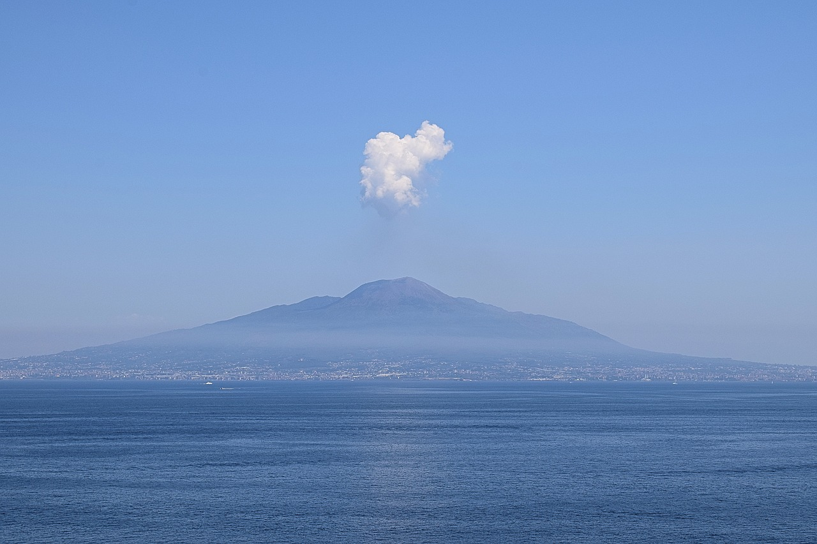
Pompeii
Mount Vesuvius most famous eruption took place in the year 79 A.D., when the volcano buried the ancient Roman city of Pompeii under a thick carpet of volcanic ash.
Around 2000 people died due to the volcano and the city remained abandoned for as many years.
The city was discovered in 1748 – city was remarkably intact.
Approximately 2.5 million visit Pompeii per annum.

Slide 9
https://www.youtube.com/watch?v=K7Oq9_DU1Mc&authuser=0

Slide 10
Curricular links
I can describe the physical processes of a natural disaster and discuss its impact on people and the landscape SOC 2-07b
By exploring a natural environment different from my own, I can discover how the physical features influence the variety of living things SOC 1-12b
I can explain how the physical environment influences the ways in which people use land by comparing my local area with a contrasting are. SOC 2-13a

Slide 11
THANKS FOR LISTENING!
CAN EVERYONE HOLD UP A FIST OF FIVE TO SAY IF THEY ENJOYED LEARNING ABOUT VOLCANOES.

