Slide 1
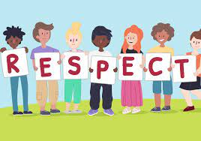
What is?

Slide 2
What does the word Respect Mean to you?

Slide 3
Dictionary Definition
respect noun (HONOUR) politeness, honour, and care shown towards someone or something that is considered important:

Slide 5
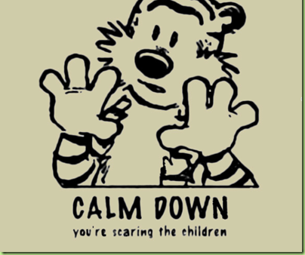

Slide 6
Respect
Respect can be summed up this way:
It's about treating others as you would like to be treated.
Its about building a respectful and honourable character.

Slide 8
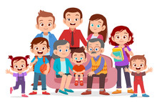
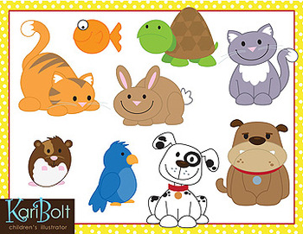
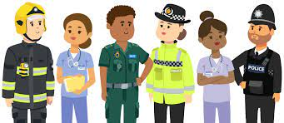
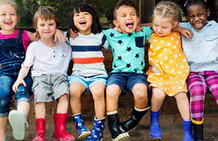
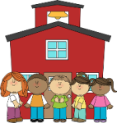
Who
Who should we respect?

Slide 9
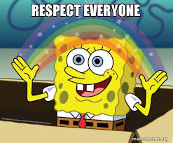

Slide 10
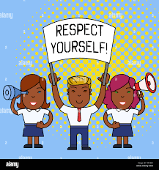

Slide 11
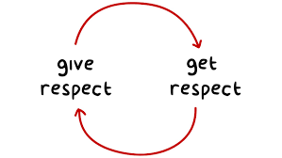

Slide 12
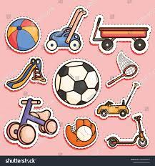
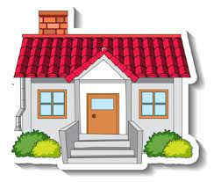
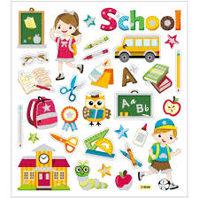
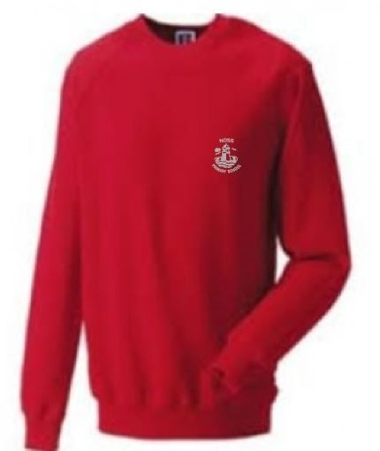
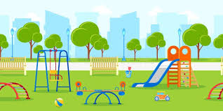
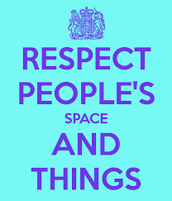
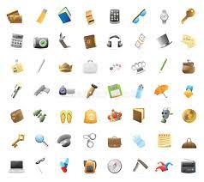
What

Slide 13
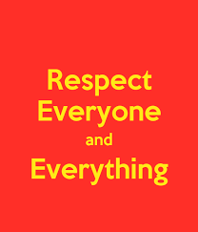
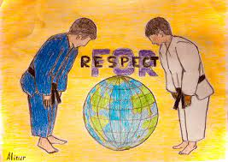

Slide 14
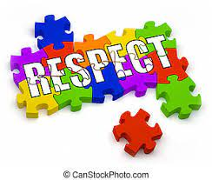
When

Slide 15
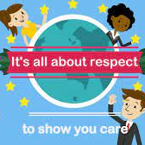
All the time.

Slide 16
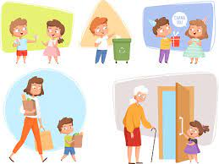
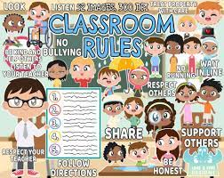
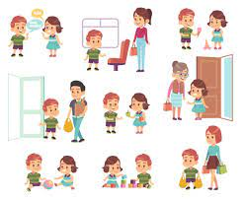
How

Slide 17
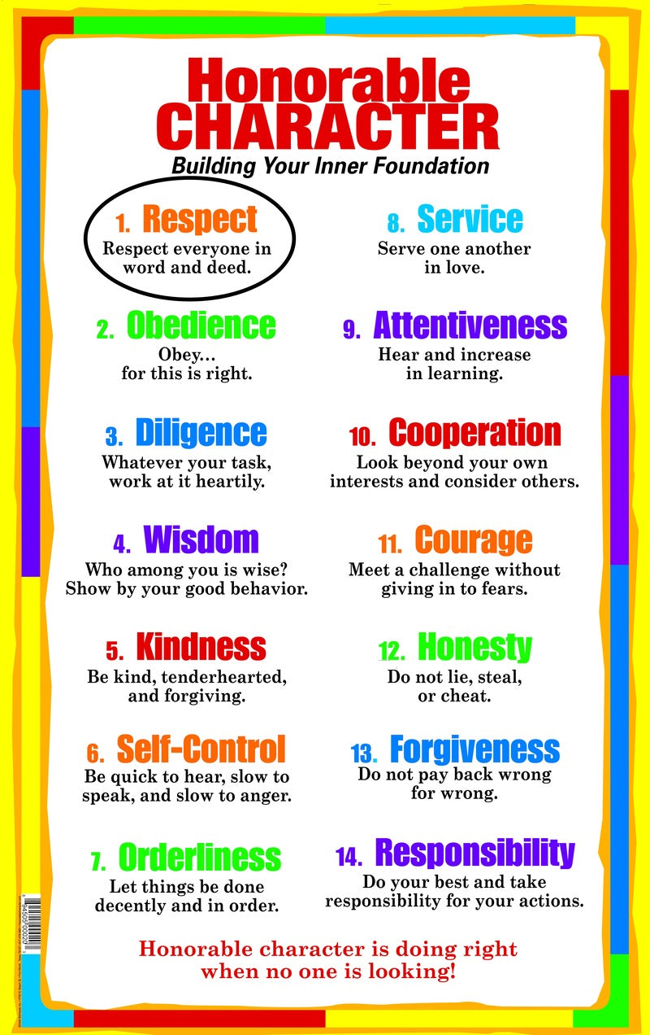

Slide 20
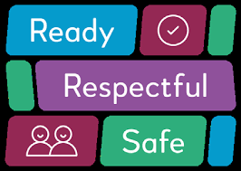
Our School Values

Slide 21
 | Respectful: Listen carefully when an adult or another pupil is talking Speak respectfully to your peers and adults in the school Use good manners and be kind to others at all times Keep the school tidy and litter free Respect the school, it’s property and the uniform. Respect your own and other peoples belongings/property.

Slide 22
Ready:
 | Wear correct and smart uniform. Be ready to learn Show a determination to do your best Push yourself to be the best you can be.

Slide 23
Safe: | Do not run inside the school Act as a positive role model Keep your hands and feet to yourself Think before you speak.

