Slide 1
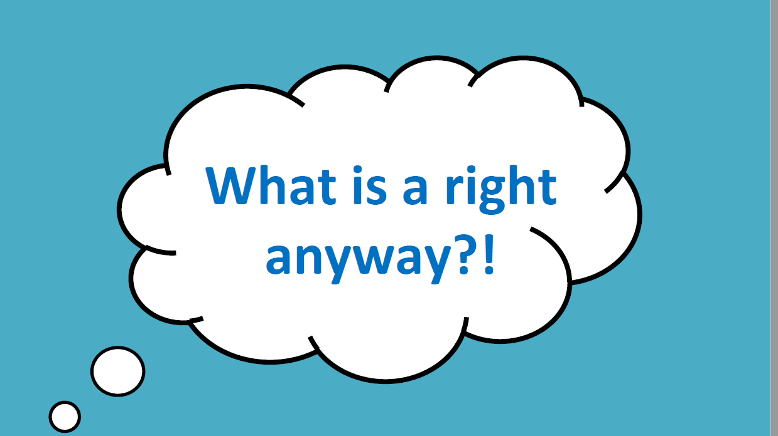

Slide 2
Activity
Notes:
Evacuation Bag Activity.
Tell the class that they have to evacuate their home, due to a wild fire, flood or war and that they are to be evacuated to safety. They will be given a backpack, they have 2 minutes to put 10 items into their bag, items that are important to them and that they can’t live with out. They can write down their 10 items or you could do tis as a whole class exercise. After the 2 minutes is up go round the class to see what they came up with.
The next part of the activity is you then tell them that once they have reached the evacuation centre there is not enough room for everyone to have 10 items and they can now only choose 5 of their 10 items to take with them, give them 2 minutes to make their choices. Again discuss what they would take. This exercise leads nicely into needs and wants activity.

Slide 3
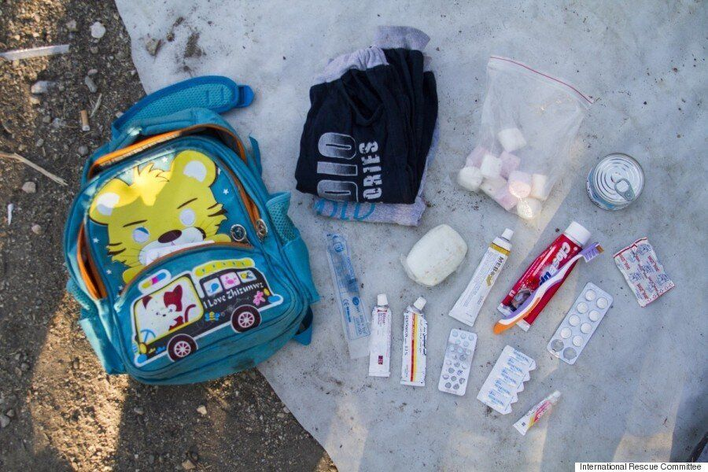
Real Life bag contents.
A child. Name: Omran. Age: 6. From: Damascus, Syria
1 pair of pants, 1 shirt
A syringe for emergencies
Marshmallows and sweet cream (Omran’s favorite snacks)
Soap, toothbrush and toothpaste
Bandages

Slide 4
Activity
Needs and Wants

Slide 6
Child Friendly definition
Rights are freedoms we have that are protected by our laws, while responsibilities are duties or things that we should do. In order to be good citizens, or members of a community, we must understand our rights and responsibilities

Slide 8
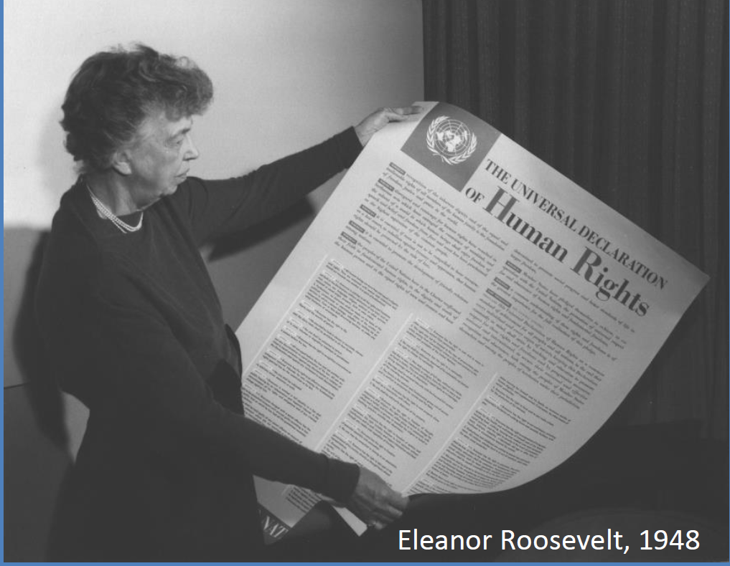

Slide 9
All about UNICEF
United Nations Children’s Fund, works to build a better world for every child, every day, everywhere. UNICEF provides more children with clean water, life-saving food and vaccines, education and protection from violence than any other humanitarian organisation.

Slide 11
What is the UN Convention?
The UN Convention on the Rights of the Child (UNCRC) is the basis of all of UNICEF’s work. It is the most complete statement of children’s rights ever produced and is the most widely-ratified international human rights treaty in history.

Slide 12
What makes the UN Convention so special?
The Convention has 54 articles that cover all aspects of a child’s life and set out the civil, political, economic, social and cultural rights that all children everywhere are entitled to. It also explains how adults and governments must work together to make sure all children can enjoy all their rights.

Slide 13
Getting to know your Rights

Slide 14
https://www.youtube.com/watch?v=fS-fdwNfg0o

Slide 15
https://www.youtube.com/watch?v=ZMz5Esm9tRk

Slide 16
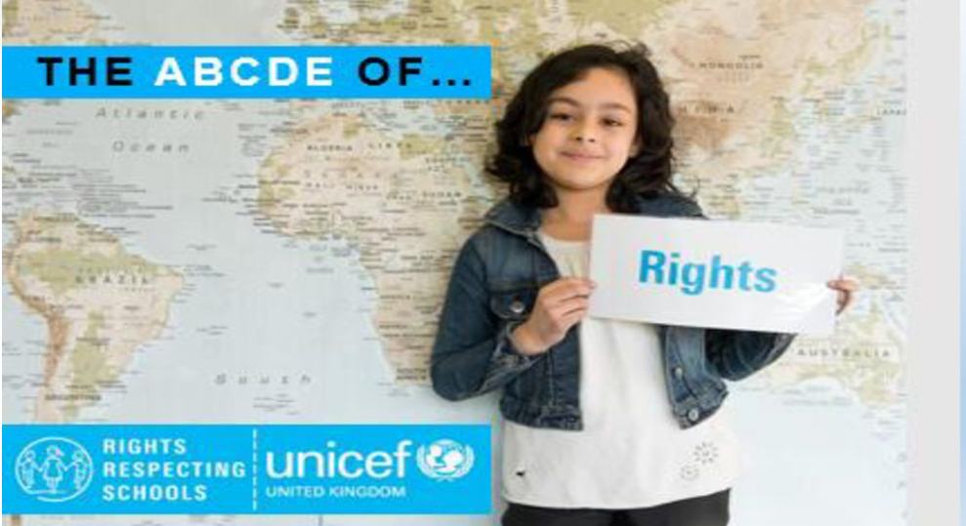

Slide 22
Rights Holders and Duty Bearers
Rights Holders:
The United Nations Convention on the Rights of the Child (UNCRC) applies to all children and they are Rights Holders. They have the rights!
Rights/Duty Bearers:
Adults such as parents, teachers and local government are Duty Bearers who help children and young people to enjoy their rights.

Slide 23
Time to learn about your Rights with a song.

Slide 24
https://www.youtube.com/watch?v=LN_70HXxd5Y

