Slide 1
Sustainability Challenge #CSscot23
Notes:
Goals Archive - The Global Goals
Getting Started with Scratch - Scratch - Ideas (mit.edu)
Scratch support for educators - Scratch - Educators (mit.edu)
Setting up a Class Account in Scratch - Guide: Teacher Accounts (mit.edu)
Scratch Studio to share your final class projects (You will need to create the projects online and share them via an online account) - #DigiLearnScot #CSscot23 Sustainability - Scratch Studio (mit.edu)
If you can't use Scratch online then please share on social media channels using #CSscot23

Slide 2
Notes:
Goals Archive - The Global Goals
Getting Started with Scratch - Scratch - Ideas (mit.edu)
Scratch support for educators - Scratch - Educators (mit.edu)
Setting up a Class Account in Scratch - Guide: Teacher Accounts (mit.edu)
Scratch Studio to share your final class projects (You will need to create the projects online and share them via an online account) - #DigiLearnScot #CSscot23 Sustainability - Scratch Studio (mit.edu)
If you can't use Scratch online then please share on social media channels using #CSscot23

Slide 3
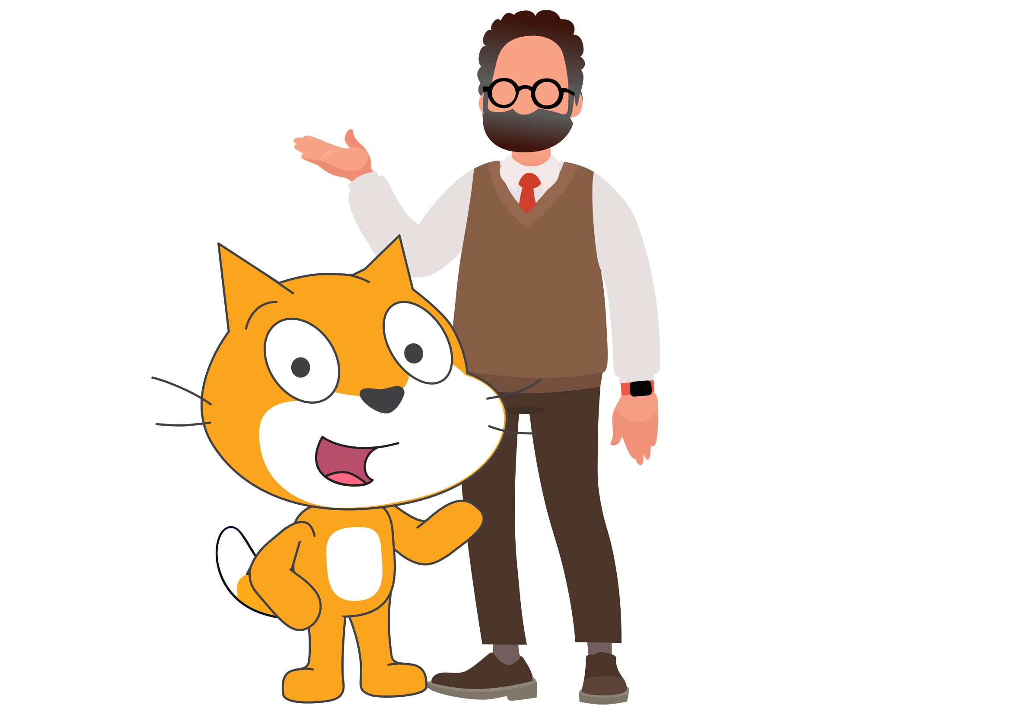
Notes:
Goals Archive - The Global Goals
Getting Started with Scratch - Scratch - Ideas (mit.edu)
Scratch support for educators - Scratch - Educators (mit.edu)
Setting up a Class Account in Scratch - Guide: Teacher Accounts (mit.edu)
Scratch Studio to share your final class projects (You will need to create the projects online and share them via an online account) - #DigiLearnScot #CSscot23 Sustainability - Scratch Studio (mit.edu)
If you can't use Scratch online then please share on social media channels using #CSscot23

Slide 4
Create an animation in Scratch demonstrating the life cycle of a mobile phone.
Where does it come from, where does it go - is it recycled?
Reduce, Reuse, Recycle!
Notes:
Goals Archive - The Global Goals
Getting Started with Scratch - Scratch - Ideas (mit.edu)
Scratch support for educators - Scratch - Educators (mit.edu)
Setting up a Class Account in Scratch - Guide: Teacher Accounts (mit.edu)
Scratch Studio to share your final class projects (You will need to create the projects online and share them via an online account) - #DigiLearnScot #CSscot23 Sustainability - Scratch Studio (mit.edu)
If you can't use Scratch online then please share on social media channels using #CSscot23

Slide 5
Using Scratch, create a campaign – Climate Action!
YOUNG PEOPLE'S VOICES DEMAND TO BE HEARD!
Improve awareness about climate change in your local community.
Notes:
Goals Archive - The Global Goals
Getting Started with Scratch - Scratch - Ideas (mit.edu)
Scratch support for educators - Scratch - Educators (mit.edu)
Setting up a Class Account in Scratch - Guide: Teacher Accounts (mit.edu)
Scratch Studio to share your final class projects (You will need to create the projects online and share them via an online account) - #DigiLearnScot #CSscot23 Sustainability - Scratch Studio (mit.edu)
If you can't use Scratch online then please share on social media channels using #CSscot23

Slide 6
Using Scratch create a game to raise awareness and Save our Sealife!
You might want to use the theme of plastic pollution, different types micro plastics and the impact on marine life.
Notes:
Goals Archive - The Global Goals
Getting Started with Scratch - Scratch - Ideas (mit.edu)
Scratch support for educators - Scratch - Educators (mit.edu)
Setting up a Class Account in Scratch - Guide: Teacher Accounts (mit.edu)
Scratch Studio to share your final class projects (You will need to create the projects online and share them via an online account) - #DigiLearnScot #CSscot23 Sustainability - Scratch Studio (mit.edu)
If you can't use Scratch online then please share on social media channels using #CSscot23

Slide 7
Create a story about how we can save our woodlands.
You might want to focus on the local natural habitats of animals and the threat to our woodlands from invasive species
Notes:
Goals Archive - The Global Goals
Getting Started with Scratch - Scratch - Ideas (mit.edu)
Scratch support for educators - Scratch - Educators (mit.edu)
Setting up a Class Account in Scratch - Guide: Teacher Accounts (mit.edu)
Scratch Studio to share your final class projects (You will need to create the projects online and share them via an online account) - #DigiLearnScot #CSscot23 Sustainability - Scratch Studio (mit.edu)
If you can't use Scratch online then please share on social media channels using #CSscot23

Slide 8
WHAT MATTERS
TO YOU?
Notes:
Goals Archive - The Global Goals
Getting Started with Scratch - Scratch - Ideas (mit.edu)
Scratch support for educators - Scratch - Educators (mit.edu)
Setting up a Class Account in Scratch - Guide: Teacher Accounts (mit.edu)
Scratch Studio to share your final class projects (You will need to create the projects online and share them via an online account) - #DigiLearnScot #CSscot23 Sustainability - Scratch Studio (mit.edu)
If you can't use Scratch online then please share on social media channels using #CSscot23

Slide 9
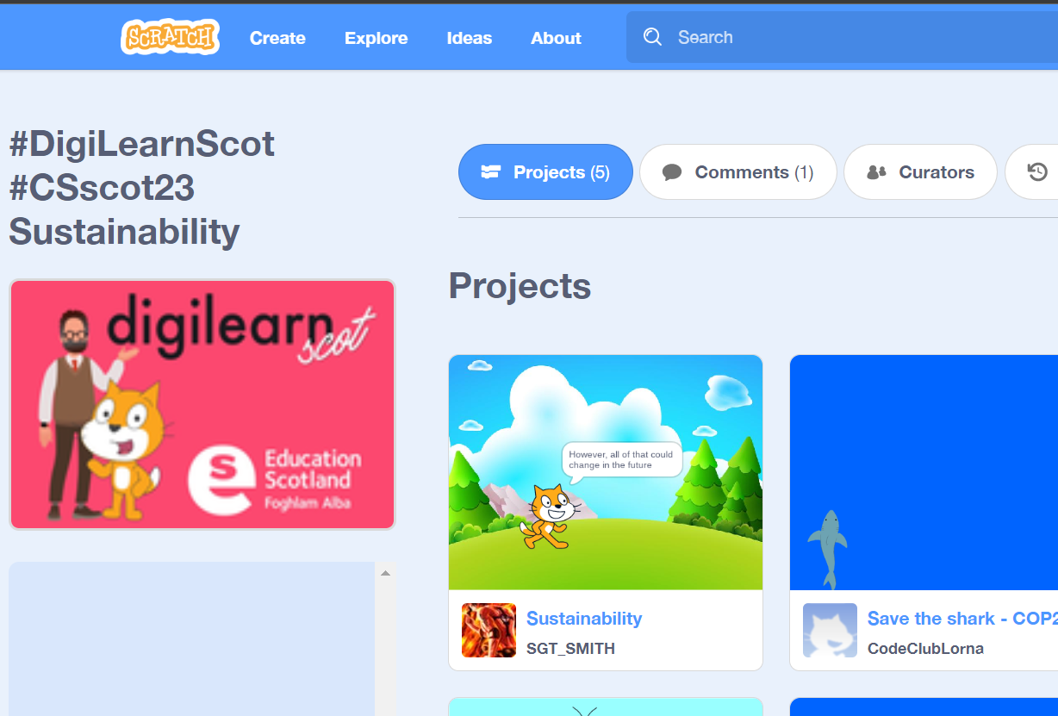
SHARE YOUR PROJECTS!
Notes:
Goals Archive - The Global Goals
Getting Started with Scratch - Scratch - Ideas (mit.edu)
Scratch support for educators - Scratch - Educators (mit.edu)
Setting up a Class Account in Scratch - Guide: Teacher Accounts (mit.edu)
Scratch Studio to share your final class projects (You will need to create the projects online and share them via an online account) - #DigiLearnScot #CSscot23 Sustainability - Scratch Studio (mit.edu)
If you can't use Scratch online then please share on social media channels using #CSscot23

Slide 10
SHARE YOUR PROJECTS!
#CSscot23
Notes:
Goals Archive - The Global Goals
Getting Started with Scratch - Scratch - Ideas (mit.edu)
Scratch support for educators - Scratch - Educators (mit.edu)
Setting up a Class Account in Scratch - Guide: Teacher Accounts (mit.edu)
Scratch Studio to share your final class projects (You will need to create the projects online and share them via an online account) - #DigiLearnScot #CSscot23 Sustainability - Scratch Studio (mit.edu)
If you can't use Scratch online then please share on social media channels using #CSscot23

Slide 11
Sustainability Challenge #CSscot23
Notes:
Goals Archive - The Global Goals
Getting Started with Scratch - Scratch - Ideas (mit.edu)
Scratch support for educators - Scratch - Educators (mit.edu)
Setting up a Class Account in Scratch - Guide: Teacher Accounts (mit.edu)
Scratch Studio to share your final class projects (You will need to create the projects online and share them via an online account) - #DigiLearnScot #CSscot23 Sustainability - Scratch Studio (mit.edu)
If you can't use Scratch online then please share on social media channels using #CSscot23

