Slide 1
Quality Assurance
A digital option for National Qualifications

Slide 2
Use Case 1
Department
Trios/Groups Across LAs/RICs
Form trios of subject departments from different schools in a local authority or regional improvement collaborative.
One person from each department uploads learner evidence to OneNote.
All members of the departments join the team to access the OneNote

Slide 3
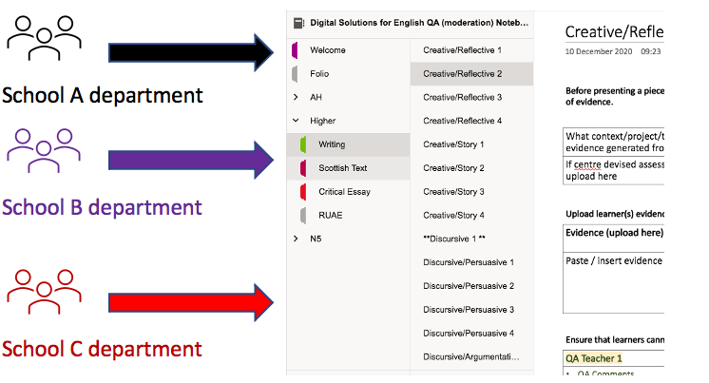

Slide 4
Use Case 2: Single Person departments across LAs/RICs
In smaller local authorities or single person departments in local authorities / regional improvement collaboratives, each person would be responsible for joining the team and uploading evidence
Each person uploads learner evidence to OneNote.

Slide 5
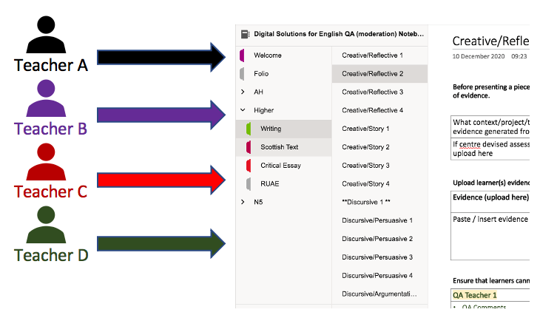

Slide 6
Use Case 3: Whole School
Create Section Groups for each subject. (must be done via OneNote desktop app)
Within each Section Group, create appropriate sections for courses
Each staff member/department uploads learner evidence to an appropriate page within the subject section

Slide 7
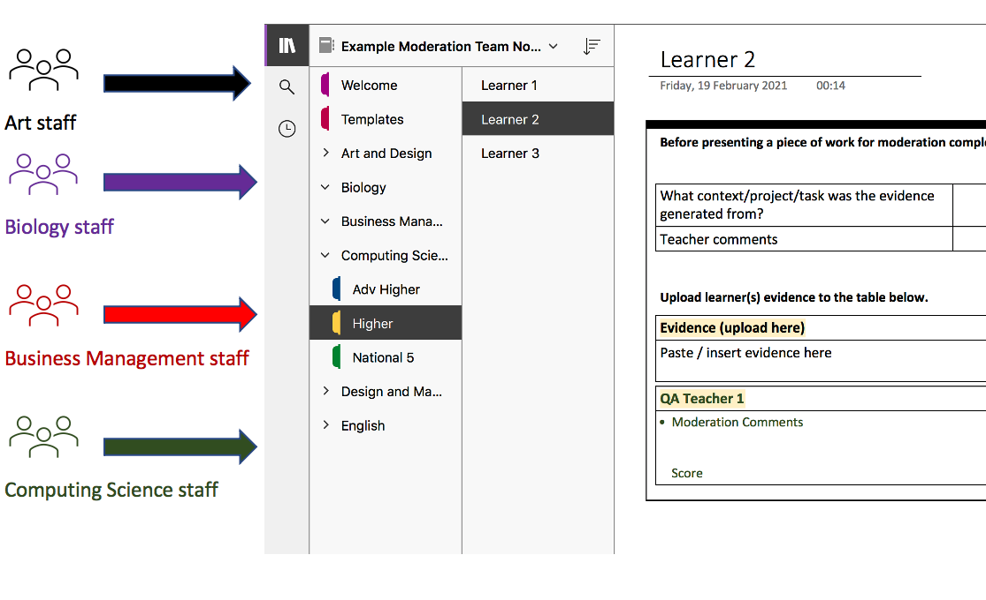

Slide 10
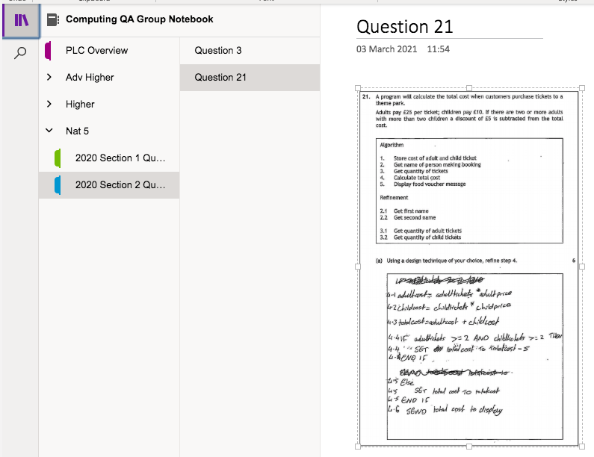
Use Case 4:
Specific Questions / Assignment

