Slide 1




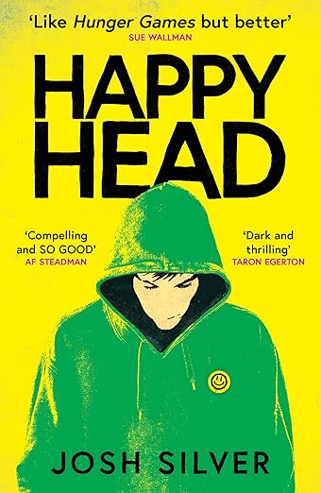
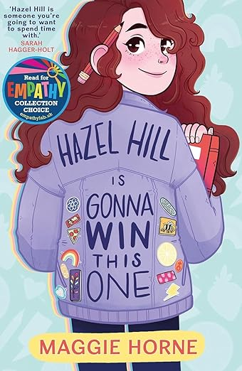
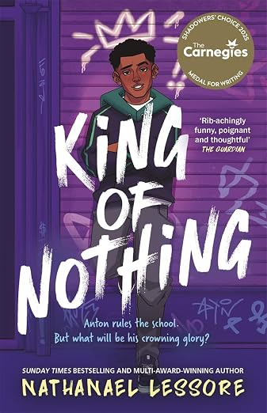
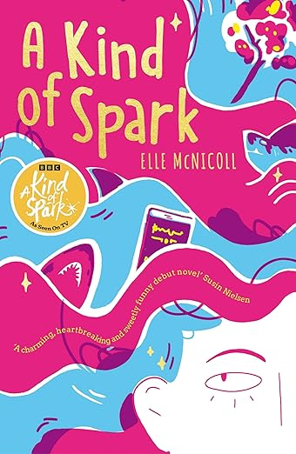
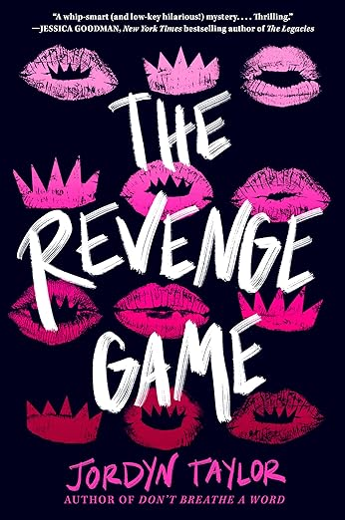
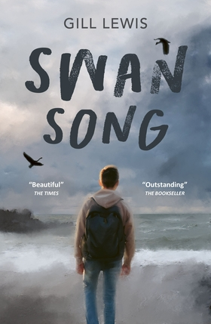
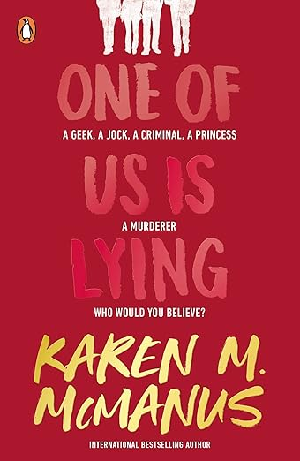
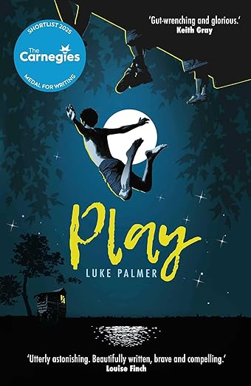
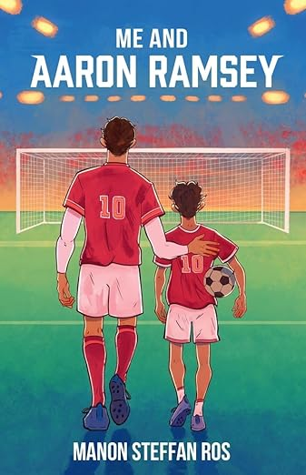

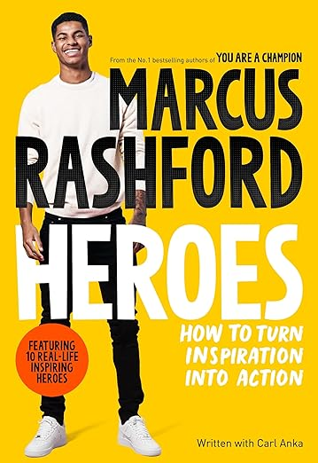
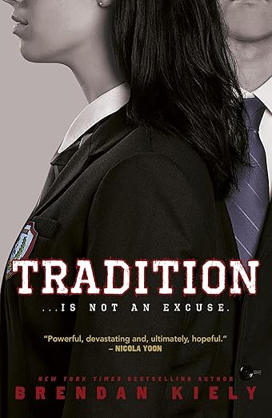
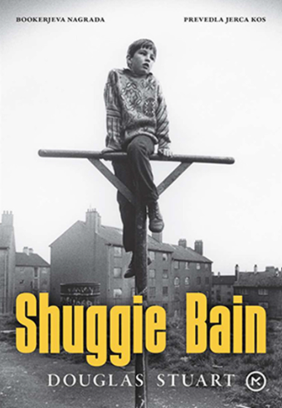

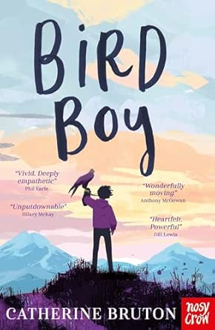

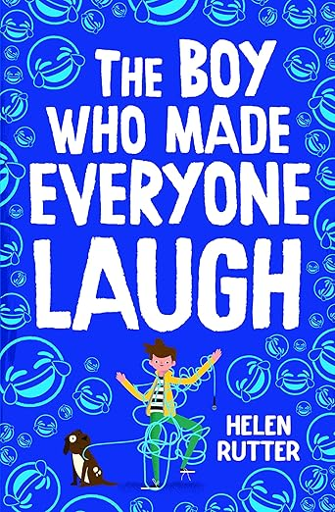
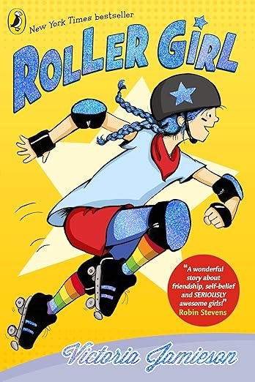
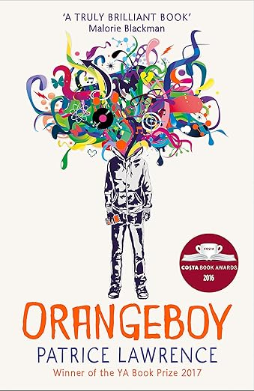
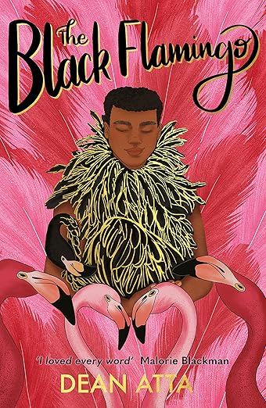
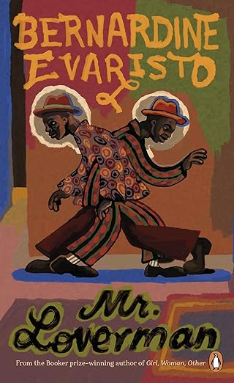
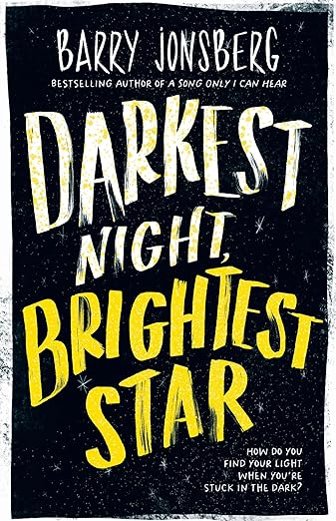
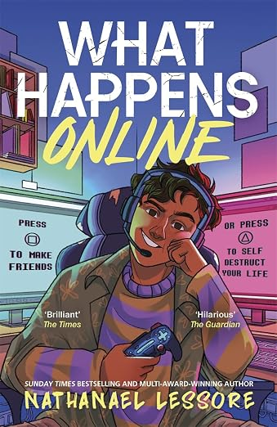
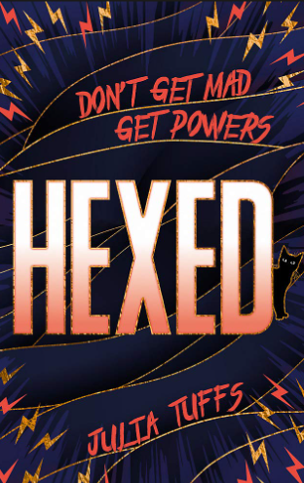
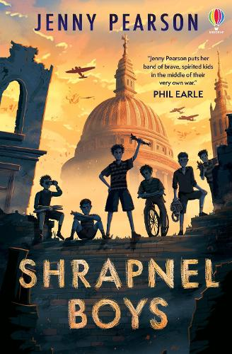
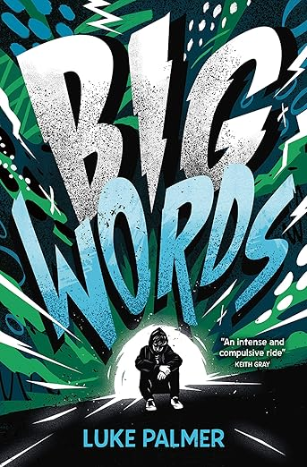
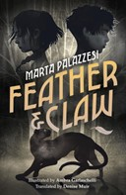
Browse
Search
Trending Now
Top Picks For You
New Releases

Slide 2
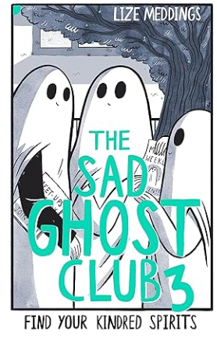
You Don’t Know Me
Fourteen-year-old John lives with his single mother and her boyfriend, a man who is violent towards him whenever John's mother is not around.
John believes that if he tells his mother about the abuse, she will side with "the man who is not my father". There's a lot of pain, but also humour too, and horror in this book before John resolves his relationship with his mother and lets her begin to know him.
Suitable for ages 13+.
Source: amazon.co.uk
Back

Slide 3
The Black Flamingo
A boy comes to terms with his identity as a mixed-race gay teen - then at university he finds his wings as a drag artist, The Black Flamingo.
A bold story about the power of embracing your uniqueness. Sometimes, we need to take charge, to stand up wearing pink feathers - to show ourselves to the world in bold colour.
Suitable for ages 14+.
Source: amazon.co.uk
Back

Slide 4
Shuggie Bain
It is 1981. Glasgow is dying and good families must grift to survive. Agnes Bain has always expected more from life, dreaming of greater things. But Agnes is abandoned by her philandering husband, and as she descends deeper into drink, the children try their best to save her, yet one by one they must abandon her to save themselves.
It is her son Shuggie who holds out hope the longest. Shuggie is different, he is clearly no’ right. But Shuggie believes that if he tries his hardest, he can be normal like the other boys and help his mother escape this hopeless place.
Suitable for ages 16+.
Source: amazon.co.uk
Back

Slide 5
Girl, Woman, Other
This is Britain as you've never read it.
This is Britain as it has never been told.
From Newcastle to Cornwall, from the birth of the twentieth century to the teens of the twenty-first, Girl, Woman, Other follows a cast of twelve characters on their personal journeys through this country and the last hundred years. They're each looking for something - a shared past, an unexpected future, a place to call home, somewhere to fit in, a lover, a missed mother, a lost father, even just a touch of hope.
Suitable for ages 12+.
Source: amazon.co.uk
Back

Slide 6
Mr. Loverman
Barrington Jedidiah Walker is seventy-four and leads a double life. Born and bred in Antigua, he's lived in Hackney since the sixties. A flamboyant, wise-cracking local character with a dapper taste in retro suits and a fondness for quoting Shakespeare, Barrington is a husband, father and grandfather - but he is also secretly homosexual, lovers with his great childhood friend, Morris.
His deeply religious and disappointed wife, Carmel, thinks he sleeps with other women. When their marriage goes into meltdown, Barrington wants to divorce Carmel and live with Morris, but after a lifetime of fear and deception, will he manage to break away?
Suitable for ages 16+
Source: amazon.co.uk
Back

Slide 7
A Kind of Spark
Meet Addie, she's eleven and officially on a mission to make her voice heard! When she discovers that her small Scottish town once put "witches" on trial, she knows she has to act. After all, if anyone understands what it’s like to be misunderstood for being different, it’s Addie.
It’s time to start a spark that will change everything . . .
Suitable for ages 9+.
Source: amazon.co.uk
Back

Slide 8
I Am Malala
In the face of Taliban oppression, one girl's unwavering defiance sparked a worldwide movement. Shot in the head for daring to seek an education, Malala Yousafzai defied all odds, emerging stronger than ever. From a valley in Pakistan to the global stage, she became a beacon of peaceful resistance and the youngest Nobel laureate. I Am Malala is an extraordinary story of resilience, a family shattered by terrorism and the power of one voice to inspire change in the world.
Suitable for ages 13+.
Source: amazon.co.uk
Back

Slide 9
Roller Girl
Astrid has always done everything with her best friend Nicole. So when Astrid falls in love with roller derby and signs up for a summer camp, she's sure Nicole will be right by her side - until Nicole signs up for ballet camp instead, with Astrid's biggest rival.
And so begins the hardest summer of Astrid's life, as she struggles to stay on her skates, to learn who she is without Nicole . . . and to find out what it takes to be a strong, tough, awesome roller girl.
Suitable for ages 10+.
Source: amazon.co.uk
Back

Slide 10
Hazel Hill is Gonna Win this One
Girls in Hazel's school are being harassed by an anonymous person online, someone who seems to know all about their insecurities and dreams. With no one willing to stand up and face the bully, how will Hazel be able to prove her suspicions? Hazel Hill is Going to Win This One confronts bullying, both online and in person, to give children the power to stand up for themselves and speak out against harassment.
Suitable for ages 8-12+.
Source: amazon.co.uk
Back

Slide 11
Orangeboy
Sixteen-year-old Marlon has made his mum a promise - he'll never follow his big brother, Andre, down the wrong path. So far, it's been easy, but when a date ends in tragedy, Marlon finds himself hunted. They're after the mysterious Mr Orange, and they're going to use Marlon to get to him. Marlon's out of choices - can he become the person he never wanted to be, to protect everyone he loves?
Suitable for ages 13+.
Source: amazon.co.uk
Back

Slide 12
Happyhead
We are in an epidemic. An epidemic of unhappiness.
Friends, here is the good news: HappyHead has the answer.
When Seb is offered a place on a radical retreat designed to solve the national crisis of teenage unhappiness, he is determined to change how people see him and make his parents proud. But as he finds himself drawn to the enigmatic Finn, Seb starts to question the true nature of the challenges they must undergo. The deeper into the programme the boys get, the more disturbing the assessments become, until it’s clear there may be no escape...
Suitable for ages 14+.
Source: amazon.co.uk
Back

Slide 13
Heroes: How to Turn Inspiration Into Action
Marcus Rashford is not only an International footballer – he's also a campaigner who has been on a mission to end child food poverty. Starting on this journey was never something that he could have done alone, and in Heroes Marcus wants to shine a light on ten brilliant people who have inspired him to make a difference.
Each person has changed Marcus's life in their own way, and now he wants to show YOU how his heroes can inspire you to be your best self, and make a difference to the world around you. Written with Carl Anka, this book features profiles of 10 inspirational people from around the world who have inspired Marcus, and is full of brilliant advice and top tips.
Suitable for ages 10-14+.
Source: amazon.co.uk
Back

Slide 14
Bird Boy
After the tragic death of his mother, eleven year old Will is sent to temporarily stay with his uncle in the mountains. After years trapped in a high-rise flat, with only birds for company, Will doesn't know how he'll survive a place like this, but he soon finds solace in the woods, when he's surrounded by birdsong.
With his new friend Omar - a refugee from Afghanistan - Will discovers an osprey nest, with two small chicks inside. He forms an unbreakable bond with the birds, especially the smallest chick, who they name Whitetip. But when tragedy almost strikes again one stormy night, and Whitetip is knocked out of the nest - breaking a wing, Will is determined to save her. Smuggling her down from the mountain, he finds a way to keep her alive.
Suitable for ages 10+.
Source: amazon.co.uk
Back

Slide 15
Me and Aaron Ramsey
Sam and his dad both love football, which is always there for them however tough real life becomes. That is, until Dad's dreams of football stardom go horribly wrong. Sam's love for the footballing legend becomes tangled with his relationship for his father as things go south in their family life.
Suitable for ages 9-12 and above.
Source: amazon.co.uk
Back

Slide 16
Swan Song
Dylan is struggling. Since he started high school, everything has become too much to handle. Now he's been expelled and is forced to move to the tiny village in Wales where his grandad lives. But when Grandad invites Dylan out on his boat to watch the Whooper swans return to their winter feeding ground, things begin to change.
Grandad doesn't judge or question; he just lets Dylan be. Out on the water, with no distractions or pressure, Dylan begins to feel like himself again. But when the swans and their home are threatened, and tragedy strikes at home, can Dylan keep going when it feels like everything is slipping out of control again? A profoundly moving novel on the redemptive, healing power of nature from bestseller Gill Lewis.
Suitable for ages 9-11+.
Source: amazon.co.uk
Back

Slide 17
Play
Four boys grow up together at school, itching to get out of their small town. They play games, scoring points from each other, anything to pass the time until they're free.
Matthew slips into his imagination, Luc pushes his body to the limit, and Johnny... well who knows what Johnny's up to. But when Mark starts running errands for his older brother's mysterious associate, he thinks he's found the best game of all. There's money in his pocket and his friends have started looking at him differently.
Then Mark breaks a rule, and quickly realises that the penalties in this game far outweigh the prizes. Can they all make it to the finish line before someone loses more than just face?
Suitable for ages 14+.
Source: amazon.co.uk
Back

Slide 18
King of Nothing
They're used to ruling the school and Anton wears the crown. The other kids run away when he's about but that's the way he wants it - he's got a reputation to live up to after all.
So when he gets into serious trouble at school, he doesn't really care, but his mum most definitely does. She decides it's time for Anton to make some new friends and join the Happy Campers, a local activity group. Anton would quite literally rather do anything else, especially when he finds out Matthew, the biggest loser in school, is also a member.
But after Matthew unexpectedly saves Anton's life, Anton figures maybe this kid is worth a shot. Teaching him some game is the least Anton can do to repay the debt.
As the boys strike up an unlikely friendship, Anton finds himself questioning everything he thought was important. Does he want ruling the school to be his crowning glory or should he set his sights on better things?
Suitable for ages 11+.
Source: amazon.co.uk
Back

Slide 19
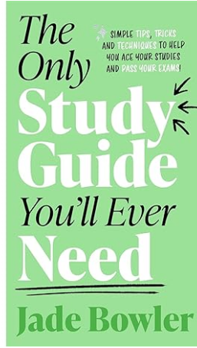
The Boy Who Made Everyone Laugh
He wants to be a stand-up comedian when he grows up: delivering pinpoint punch-lines and having audiences hang on his every hilarious word.
A tough career for anyone, but surely impossible for Billy, who has a stammer. How will he find his voice, if his voice won't let him speak?
Suitable for ages 9-13+.
Source: amazon.co.uk
Back

Slide 20
The Nowhere Girls
The Nowhere Girls by Amy Reed presents a powerful narrative about three high school misfits. Grace Salter, Rosina Suarez, and Erin Delillo come together to fight back against sexual assault. Their story centers on another girl, Lucy Moynihan, who faced devastating consequences after bravely accusing three popular boys of gang rape. The trio forms an anonymous group, the Nowhere Girls, to instigate change in their school’s oppressive culture.
Suitable for ages 13+
Source: amazon.co.uk
Back

Slide 21
Tradition
Prestigious. Powerful. Privileged. This is Fullbrook Academy.
Jules Devereux just wants to keep her head down, avoid distractions, and get into the right college, so she can leave Fullbrook and its old-boy social codes behind.
Jamie Baxter feels like an imposter at Fullbrook, but the hockey scholarship that got him in has given him a chance to escape his past and fulfill the dreams of his parents and coaches, whose mantra rings in his ears: Don’t disappoint us.
As Jules and Jamie’s lives intertwine, and the pressures to play by the rules and to keep the school’s toxic secrets, they are faced with a powerful choice: remain silent while others get hurt, or stand together against the ugly, sexist traditions of an institution that believes it can do no wrong.
Suitable for ages 15+.
Source: amazon.co.uk
Back

Slide 22
The Revenge Game
Alyson is a romantic, and sometimes it gets her into trouble. Like last summer, she thought her co-worker was into her, when in reality he found her flirting pathetic.
Then she meets Brenton Riggs Jr., and right away she knows that their connection isn’t just in her head. When he swoops in to save her one night from a less than savory party encounter, she falls head-over-heels. Finally, someone Alyson likes who likes her back!
But when she finds out about the King’s Cup—a competition the guys at their boarding school started to see who has the most sexual prowess—she’s put on edge. Does Brenton really want to be with her, or is he just trying to win? Then Alyson and the other girls at the school start a competition of their own: The Queen’s Cup. It’s all about reclaiming their power. But as the competition heats up, Alyson’s relationship begins to fall apart—and it isn’t long before the cracks in her perfect love story start to show through.
Suitable for ages 14+.
Source: amazon.co.uk
Back

Slide 23
One of Us Is Lying
Five students walk into detention. Only four come out alive.
Yale hopeful Bronwyn has never publicly broken a rule.
Sports star Cooper only knows what he's doing in the baseball diamond.
Bad boy Nate is one misstep away from a life of crime.
Prom queen Addy is holding together the cracks in her perfect life.
And outsider Simon, creator of the notorious gossip app at Bayview High, won't ever talk about any of them again.
He dies 24 hours before he could post their deepest secrets online. Investigators conclude it's no accident. All of them are suspects.
Everyone has secrets, right?
What really matters is how far you'll go to protect them.
Suitable for ages 14+.
Source: amazon.co.uk
Back

Slide 24
Darkest Night, Brightest Star
Thirteen-year-old Morgan lives with his dad and his older brother, Mitch. He hasn't heard from his mum since she left when he was two. He works hard on his football skills, striving to meet his father's high expectations and 'be a man'.
But what that means isn't always clear-cut. When Morgan makes a friend at school, gets injured in a game, and his long-lost mum turns up, everything changes. Then, when he meets an old woman in need of help, Morgan must decide what kind of man he wants to be.
Suitable for ages 12-18+.
Source: amazon.co.uk
Back

Slide 25
What Happens Online
Online, Fred goes by Existor@stmarks. His alter ego is the best gamer around - constantly on a winning streak, with tonnes of followers, and the confidence to go with it.
But offline, Fred's life is miserable. His dad's always working, his mum's struggling, and at school, everyone looks straight through him. Until Existor's notoriety spreads to his school, and Fred sees an opportunity: everyone listens to what Existor has to say, so why not use that?
Soon, Fred is coming up with outlandish rumours about his classmates, and everyone's lapping it up. His bullies are shunned, and people are finally taking notice of him. But it's a slippery slope and Fred struggles to keep track of all the stuff he's posted as his lies start to wreak unexpected havoc.
Fred will have to answer for his crimes against reality, but will he ever find someone to like him for who he really is?
Suitable for ages 10+.
Source: amazon.co.uk
Back

Slide 26
Hexed
New girl, new school, new life on stupid island - thanks Mum. All Jessie Jones wants is to keep her head down, avoid school douchebag Callum Henderson, and coast - middle-of-the-road-like. But when strange powers start to manifest during crippling period pains, flying under the radar seems highly unlikely.
Can Jessie embrace her new-found witchiness, control her erratic powers and work out a way to bring down Callum and his cult of toxic masculinity?
Suitable for ages 13-18+.
Source: amazon.co.uk
Back

Slide 27
Shrapnel Boys
When war comes to London in 1939, Ronnie Smith is scared and excited: scared of the bombs that fall at night, but excited to race his friends to collect the best bits of shrapnel every morning.
But for Ronnie, the battles aren't just in the sky and on the streets. They're at school and at home too. His little brother is up to no good with a secret job and dangerous new friends, and Ronnie's worried he's getting himself into big trouble.
Ronnie's desperate to help his little brother. But he isn't expecting to uncover secrets that could change the fate of the whole war...
Suitable for ages 9+.
Source: amazon.co.uk
Back

Slide 28

Big Words
Biggest goes first – always. That’s one of the unspoken rules of Kiln, the forbidden wasteland where Sam and his mates hang out. So when Sam comes up with a plan to go sledging on the rust-ridden bonnet of a rotting car, he goes first. To show the others how it’s done.
His mates aren’t so keen. But there’s no complaining. No backing down. Those are the other rules of Kiln. Even when they lead to disaster.
Will their friendship survive the wreckage that follows, or is it time for the rules to be changed?
Suitable for ages 11+.
Source: amazon.co.uk
Back

