Slide 1
MVP Co-ordinators Network Meeting
December 2024
For Scotland's learners, with Scotland's educators
Do luchd-ionnsachaidh na h-Alba, le luchd-foghlaim Alba
Notes:
This is a front cover page and can only be used once. Use the corresponding blue internal and back pages if you are using this page. You may add a title and a subtitle if needed only. Do not add anything else or move elements around.

Slide 2
Agenda
Welcome
Highlights/challenges: feedback from co-ordinators
Local Authority Training needs
Staffing-new DO links
Primary pilot-results to date and next steps
Working with Equally safe-update
Quality Assurance
AOCB

Slide 3
Highlights/challenges: feedback from co-ordinators

Slide 4
Local Authority Training Needs

Slide 5
Sarah Scott – MVP Development Officer
Aberdeenshire
Angus
Dumfries & Galloway
Dundee City
East Lothian
Edinburgh
Fife
Midlothian
Moray
North Lanarkshire
Perth & Kinross
Renfrewshire
Scottish Borders
West Dumbartonshire
West Lothian
Western Isles

Slide 6
Lauren Nelson – MVP Development Officer
Aberdeen City
Argyll & Bute
Clackmannanshire
East Ayrshire
East Dumbartonshire
East Renfrewshire
Falkirk
Glasgow City
Highlands
Inverclyde
North Ayrshire
Orkney
Shetland
South Ayrshire
South Lanarkshire
Stirling

Slide 7
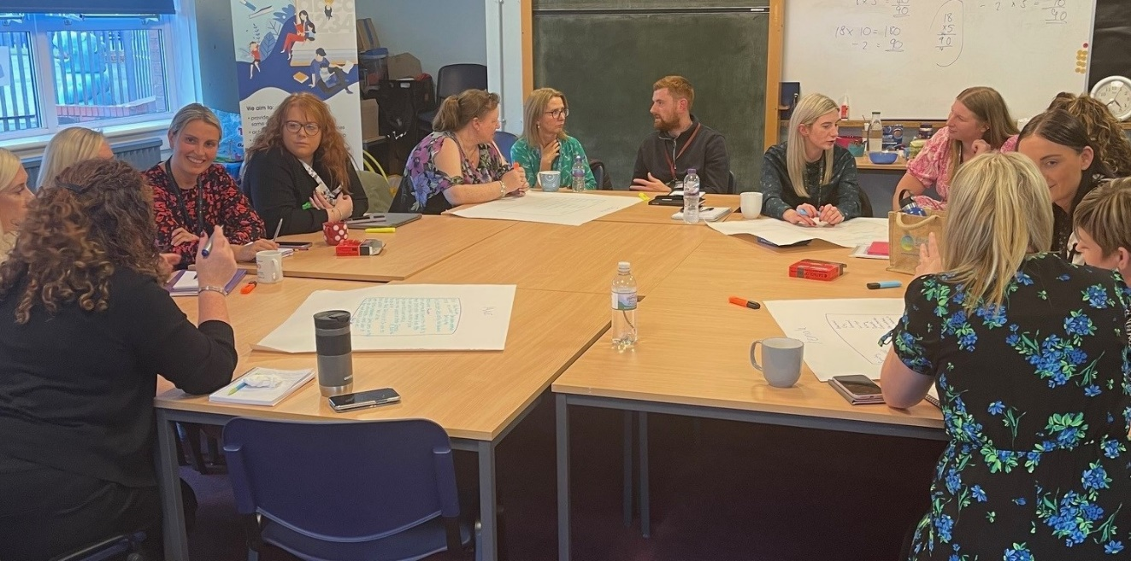
Primary Pilot
Renfrewshire: one day
staff from 13 primaries and one ELC setting, Local Authority lead
East Lothian: one day
staff from two primary schools and Local Authority lead
two primaries withdrew due to cover issues
Dumfries and Galloway: planned for one day
Cancelled due to schools withdrawing
East and North Ayrshire: 3 twilights
East Ayrshire: staff from 4 primaries
North Ayrshire: staff from 2 primaries

Slide 8
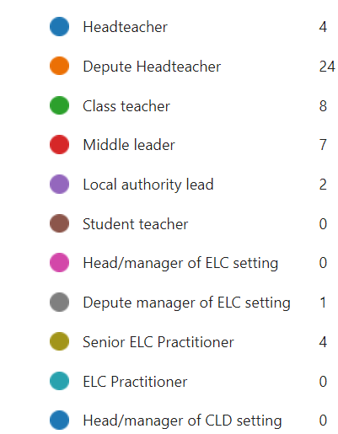
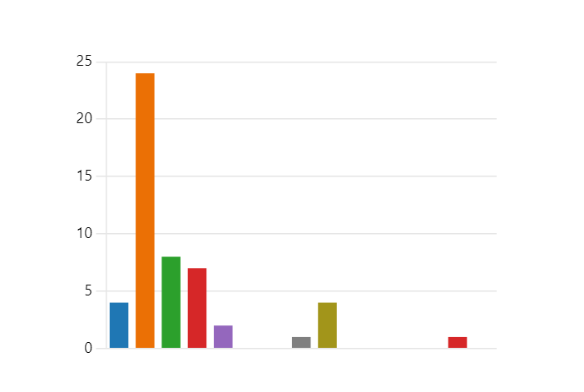
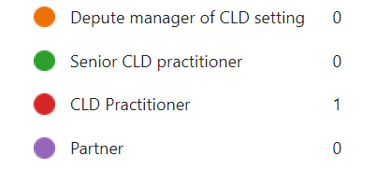
What roles did participants hold?

Slide 9
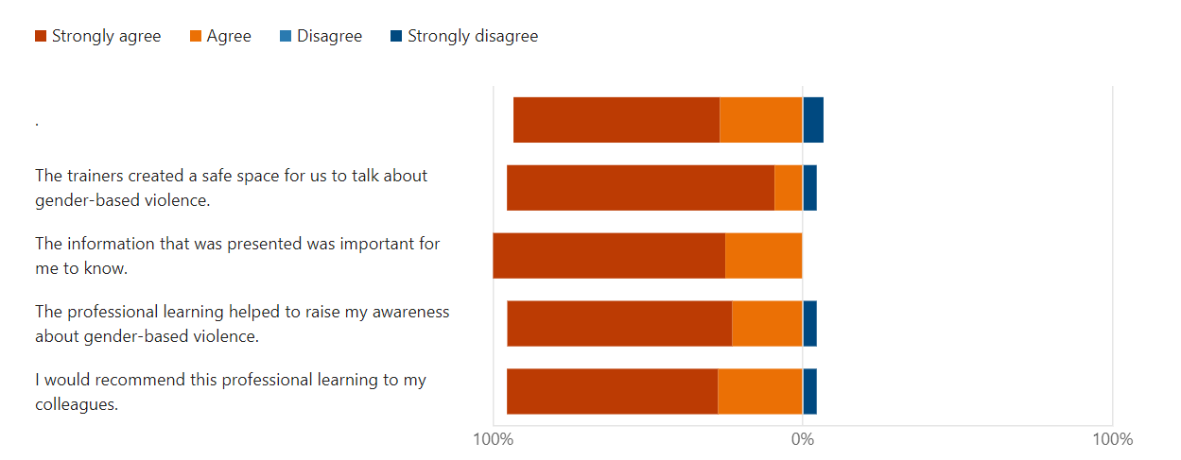
Primary Pilot-Feedback
Participants reported increased knowledge in relation to GBV and had planned next steps for improvement

Slide 10
Primary Pilot-Comments about what was helpful?
Sharing experience and expertise with colleagues
Learning about statistics and stereotypes
Resources and thinking about an implementation plan
Defining , discussing, planning
Signposting lots of resources I wasn’t aware of
Activities were helpful in raising understanding and making connections

Slide 11
Primary Pilot-Next Steps
Dates for the diary
4th February-all day
18th March-all day (provisional)

Slide 12
Working with Equally Safe-Update

Slide 13
Quality Assurance - Action
Quality Assurance Workshop for MVP school leads – September 25th 2024.
Joined by H Hamilton (PT English & Drama – Perth & Kinross)
Existing Quality Assurance documents.
Shared ideas on Quality Assurance & Evaluation.
Considered gaps & how we best support school leads / LA Coordinators.
Consider how we access quality impact data at school, local authority and national level.

Slide 14
Quality Assurance – Plan
Have Quality Assurance/ Evaluation documents in 1 place on MVP blog – accessibility.
Engage critical friends – feedback on documents / plans etc.
Streamline resources - Pre / post surveys for both mentor and staff training - accessed by schools & then shared.
MVP Quality Assurance & Self Evaluation document – shared vision / consistency / linked QA documents.
Question prompts – MVP focus group discussion – quality impact data.

