Slide 1



MVP Co-ordinators Network Meeting
October 2024
For Scotland's learners, with Scotland's educators
Do luchd-ionnsachaidh na h-Alba, le luchd-foghlaim Alba
Notes:
This is a front cover page and can only be used once. Use the corresponding blue internal and back pages if you are using this page. You may add a title and a subtitle if needed only. Do not add anything else or move elements around.

Slide 2

Agenda
Welcome
National Update
  Staffing
  Annual report now published
  Primary pilot-next steps
  Working with Equally safe-update
  Train the Trainer
Quality Assurance
Highlights/challenges: feedback from co-ordinators
AOCB

Slide 3

Update
Staffing
Annual Report
For Scotland's learners, with Scotland's educators
Notes:
This is an internal page in blue and can be duplicated to create additional pages. Always keep the heading and footer as shown. Use the corresponding blue internal and back pages if you are using this page.

Slide 4
Primary Pilot-next steps

Slide 5

Working with Equally Safe-Update

Slide 6
Train the Trainer
Dates 5th and 6th November-Glasgow

Slide 7

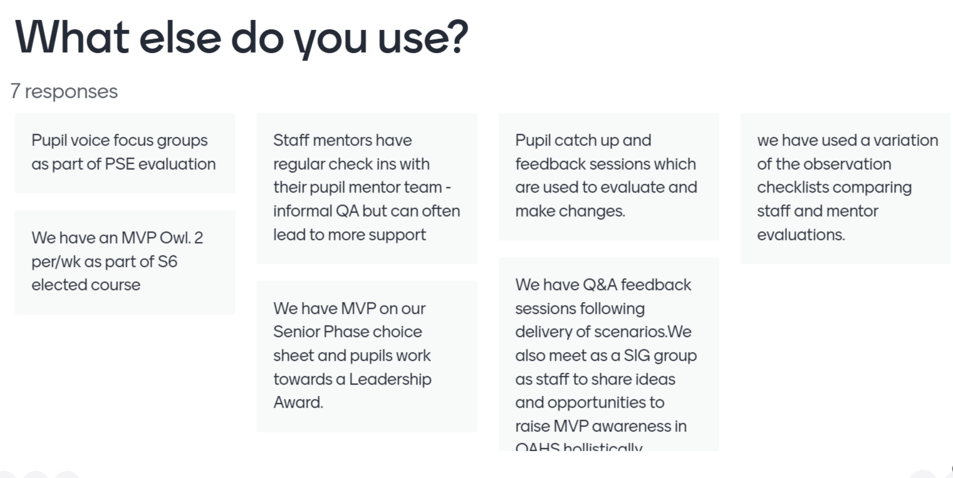
Quality Assurance Workshop

Slide 8
Quality Assurance Workshop Summary
Staff are using a range of QA documents.
Mentor Evaluation survey is the most used document.
Not everyone is using the Implementation Guide.
Observation Checklist is too complex - How can we make this more simplistic & user friendly?
Baseline survey & post survey would be beneficial - Gives staff own data but they then send on to LA co-ordinator (local authority report) and Education Scotland (MVP Annual report).
Discussed recommended remit of MVP school lead - could this be included in staff training?
Display different models that schools use to deliver MVP - share on MVP Glow Blog.
Fearless documents & NKBL resources shared on MVP Glow Blog.

Slide 9
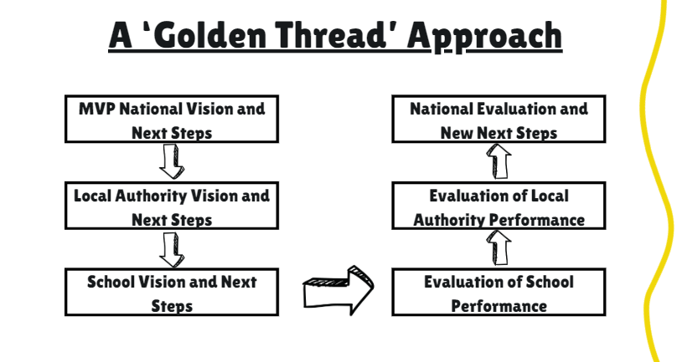
Holly Hamilton – Quality Assurance

Slide 10
How do you think we could strengthen quality assurance?
?

Slide 11

Highlights/challenges: feedback from co-ordinators

