Slide 1



MVP Co-ordinators Network Meeting
June 2024
For Scotland's learners, with Scotland's educators
Do luchd-ionnsachaidh na h-Alba, le luchd-foghlaim Alba

Slide 2

Agenda
Welcome
National Update
  Staffing
  End of year report
  National plans for next session
  Primary pilot
  Feedback on practitioner/ mentor/ mentee impact surveys
  Potential new scenarios
  Challenges
Highlights/challenges: feedback from co-ordinators
AOCB/dates for next session

Slide 3

Update
Staffing
End of Year Report
For Scotland's learners, with Scotland's educators
Notes:
One staff member due to start in August
Annual report will be published at the end of August 2024

Slide 4
Business Plan 2024 to 2025
Working with Local Authorities to maintain and potentially increase the number of schools and settings delivering MVP.
Quality assure the programme and build its sustainability.
Pilot Early Learning and Childcare (ELC) and Primary practitioner professional learning
Develop the programme to keep it relevant and practical.
Notes:
Pilot- a small number of authorities are piloting the materials and TTT will then be offered.

Slide 5
What GBV issues do you feel need to be explored in MVP?
?

Slide 6
Potential scenarios for development
Sextortion
Stalking

Slide 7

Challenges in the Year ahead
Capacities in schools
Staffing
Communication with co-ordinators/Local Authorities
Quality Assurance

Slide 8
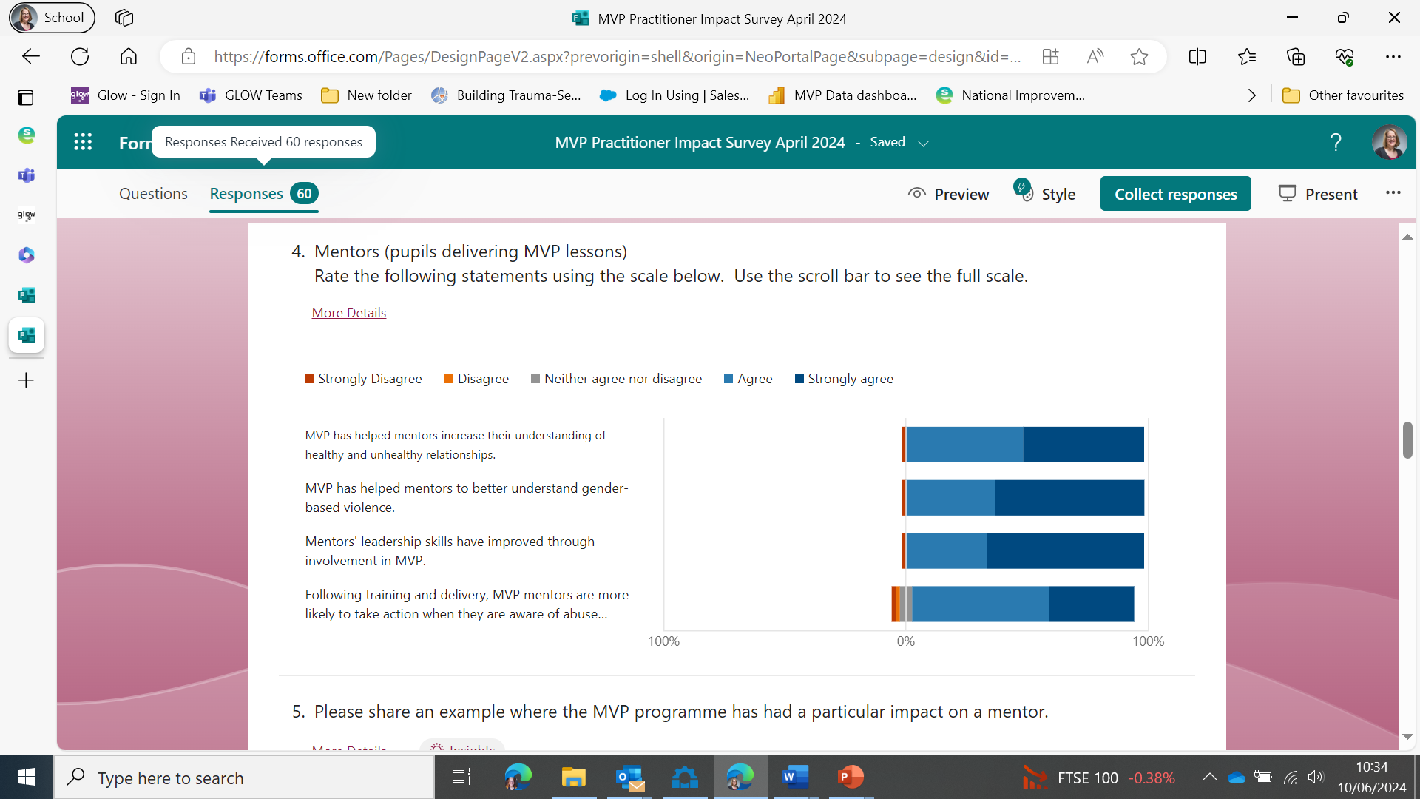
60 responses
Feedback on Practitioner Impact survey
May 2024 Impact on Mentors
21 L.A.’s
For Scotland's learners, with Scotland's educators

Slide 9
A mentor noticed behaviours in their own partner which had been highlighted through the programme and felt able to end the relationship and deal with the fallout with support from others.
Impact on Mentors
I have seen mentors come into their own and independently improve their leadership skills and safely disclose information that has prevented incidents from occurring.
It has been really encouraging to see some of our male students engage with younger pupils and challenge assumptions about gender. A S5 girl shared how she felt confident addressing the use of sexually aggressive language used by an S2 pupil in a workshop she helped deliver.

Slide 10
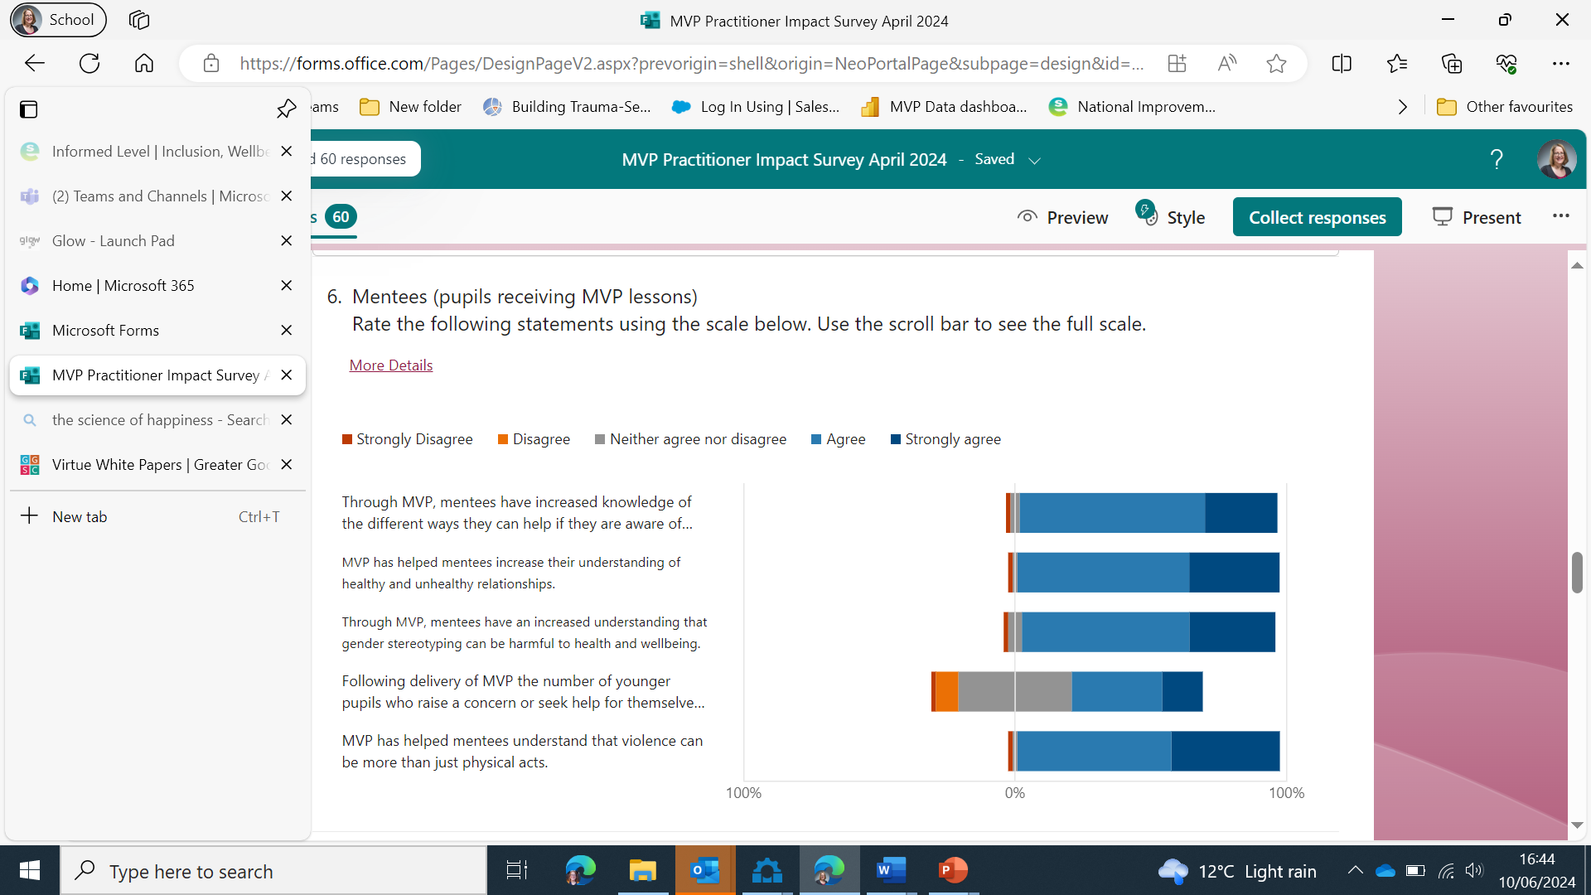
Feedback on Impact survey May 2024
Impact on Mentees (younger pupils)

Slide 11
One young person came forward after receiving nudes and said they did so because of the lesson.
Impact on Mentees
Through their increased understanding
of unacceptable behaviours and healthy/unhealthy relationships we now have more junior pupils reporting negative behaviours that they witness around the school to classroom teachers
Many pupils in S1 and S2 pupils have advocated for friends or peers when they feel they are not/ cannot speak up for themselves. This can be posts online, or isolated at lunchtimes etc

Slide 12
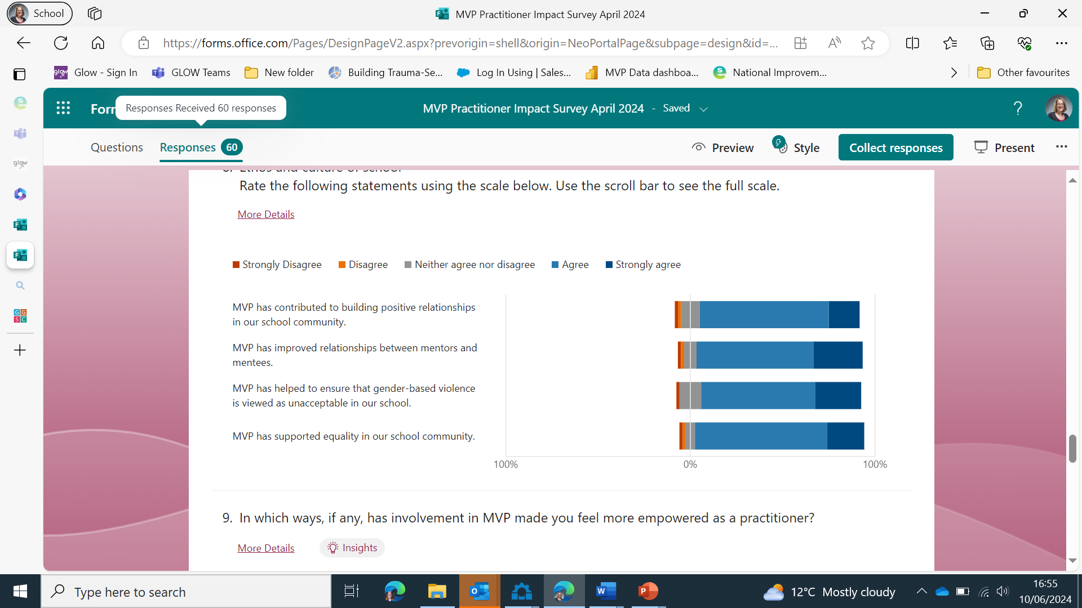
Feedback on Impact survey May 2024
Impact on Ethos and Culture of School

Slide 13
Feedback from Mentor Survey
(Nov. 23 to May 24)
What do you think were the most useful aspects of the MVP programme?
80 responses
9 secondaries
The scenarios that helped put students in the shoes of those that have faced violent situations and visualise how they would behave.
Educating the younger years on gender-based violence was helpful in encouraging debate and understanding other views.
The discussion of unconscious bias and prejudice was very useful.
It brought awareness to kids, and a lot of them showed genuine interest. It is great for teaching kids to be an active bystander, and I even learned from it too.
Being able to gain experience through teaching a class, learning more about violence prevention.
Getting the resources and training with enough time to spare, getting the same class throughout the lessons, sharing the workload with multiple people.

Slide 14
Skills: impact on mentors
No improvement
Slight Improvement
Significant Improvement

Slide 15
Skills: impact on mentors
No improvement
Slight Improvement
Significant Improvement

Slide 16
Feedback from Mentor Survey

Slide 17
Feedback on Impact survey May 2024
Being a mentor shaped me to become the best possible version of myself. It has allowed me to pay more attention to situations at parties and challenge poor behaviour. I have gained so much respect from the S2 pupils and high 5 the boys who think I am cool. I hope it will let them grow up to treat girls properly.
S6 male mentor

Slide 18
Feedback from Mentee Survey
(Nov. 23 to May 24)
What did you find the most helpful about the MVP lessons?
480 responses
11 schools
We were in the head of a bystander for the train of thought and the discussion
Being able to understand what a good relationship looks like
Realising how much goes on under people’s noses
they included our opinions in the subjects
The train of thoughts and the situations were relatable to me and others and brought a personal aspect to the lessons
The fact that they had realistic situations and they gave us options to choose and it was interactive.
That sometimes people get forced to do things (e.g) females being forced to do sexual things
They made people realise the harm they can cause.
How to help people when they are struggling
They have given me more confidence to speak up and talk when things are wrong

Slide 20
Feedback from mentees
Don’t know/not sure
No
Yes
Notes:
Mentors were prepared: Agree 251, Disagree 43, Neither agree or disagree
305 responses re improvement
14% commented on making it more interactive
6% on being prepared
8% on the fit of the topics

Slide 21
Impact on mentees
Yes
No
I haven’t witnessed any bullying or abuse
Notes:
Yes 84 No 79 I haven't witnessed any bullying or abuse 317

Slide 22
How do you think we could strengthen quality assurance?
?

Slide 23
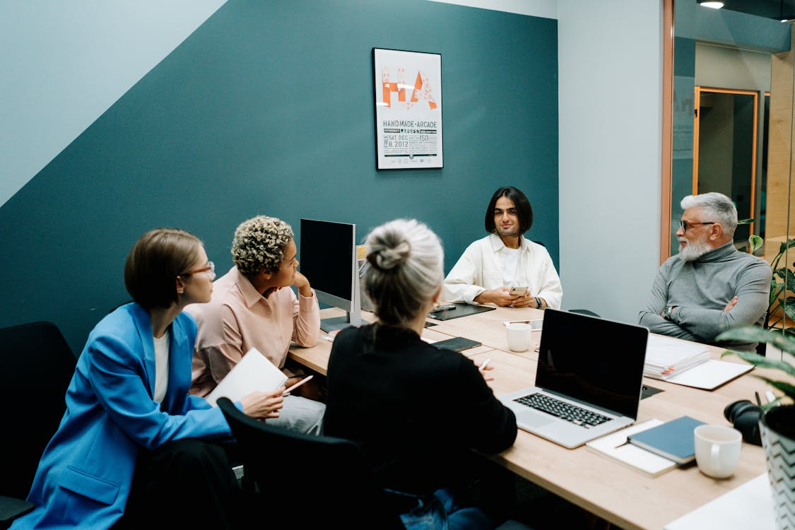
Highlights/challenges: feedback from co-ordinators

Slide 24
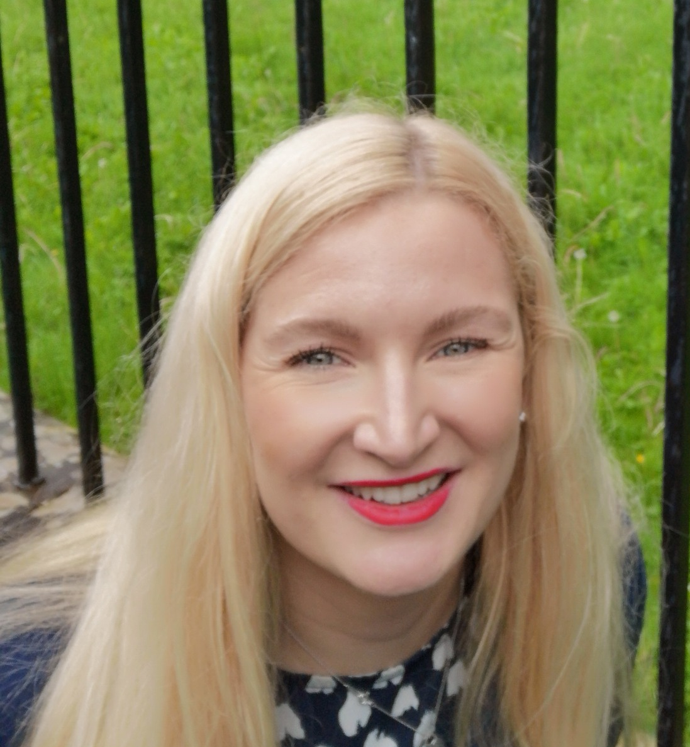
Thank-you Laura!
Notes:
Laura is returning to her post in Stirling. Thanks for all your hard work!

Slide 25

Enjoy your well-deserved break!!

Slide 26

MVP and Equally safe in schools working together

