Slide 1
MENTORS IN VIOLENCE PREVENTION

Slide 2
RESPECT
HEALTHY RELATIONSHIPS
LOOKING AFTER YOUR FRIENDS
KEEPING SAFE

Slide 3
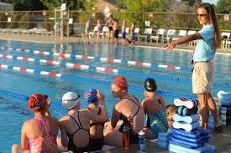
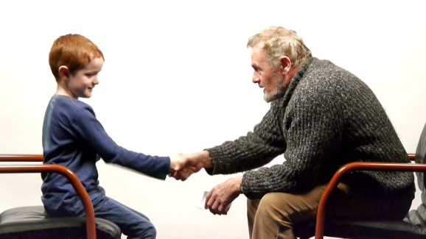
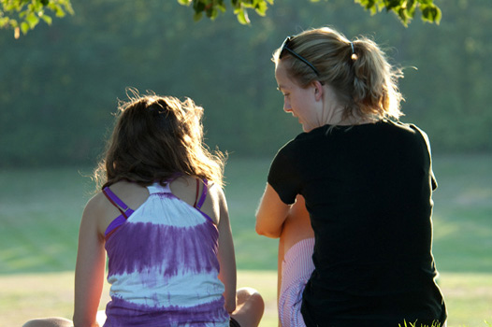
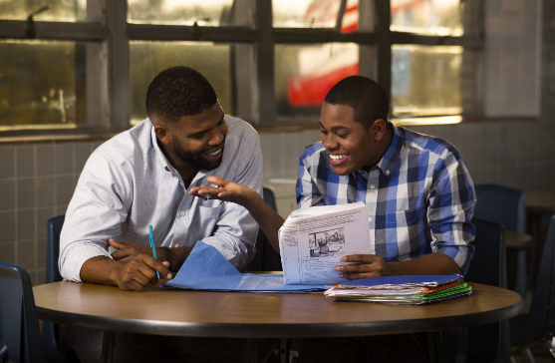
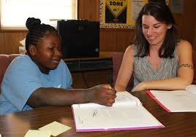
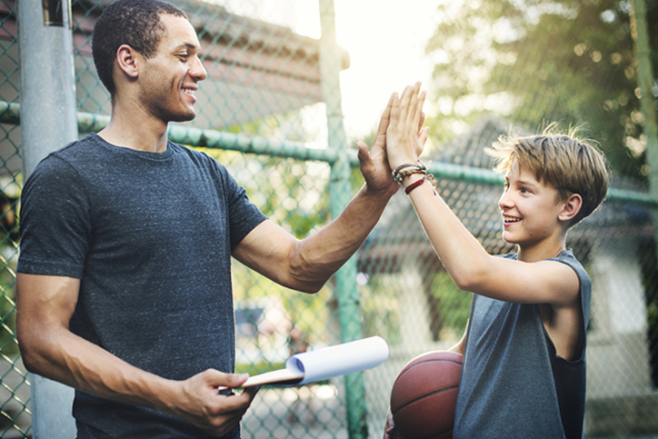
What is a mentor?

Slide 4
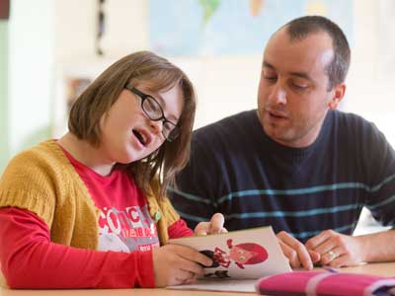
A mentor gives you support. A mentor shows you kindness.
.

Slide 5
A mentor helps you. A mentor cares about you.

Slide 6
A mentor is easy to talk to. A mentor listens to you.

Slide 7
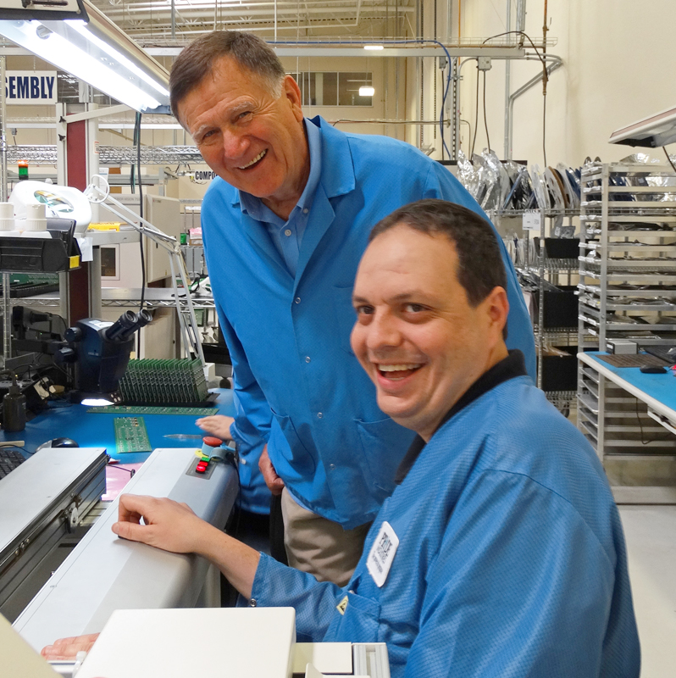
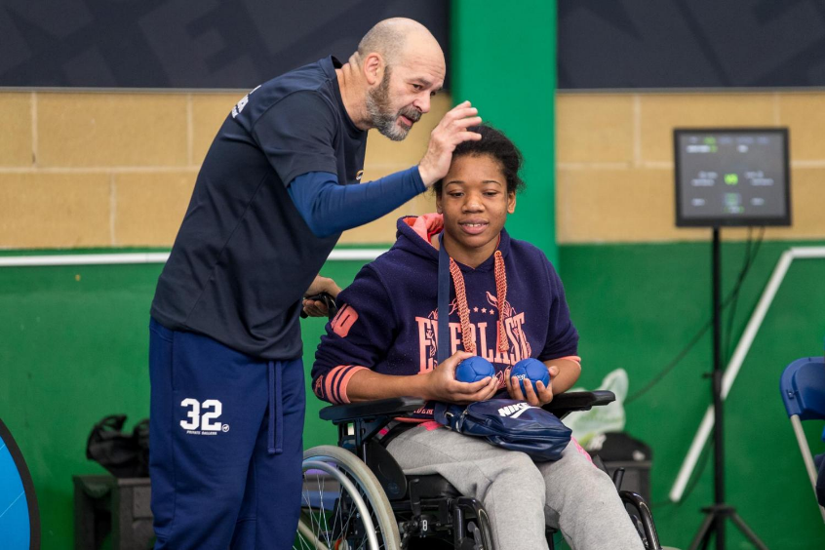
A mentor can teach things to you.

Slide 8
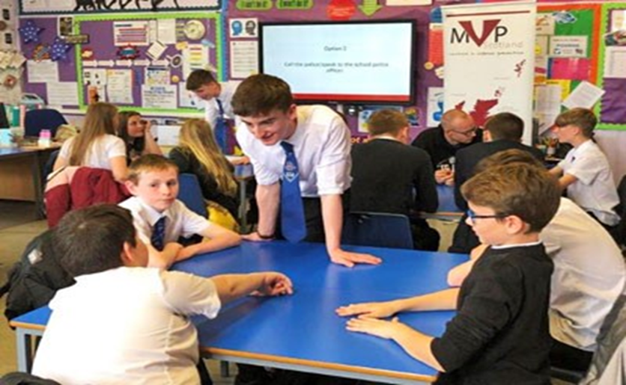
A mentor in school could be a teacher. Mentors in school could be older students helping younger ones.

Slide 9
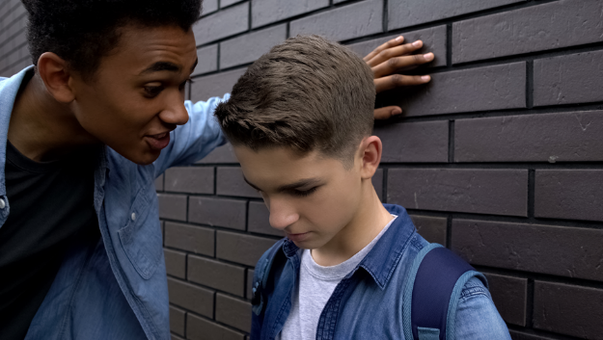
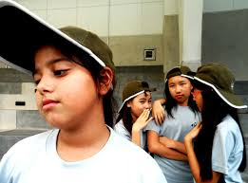
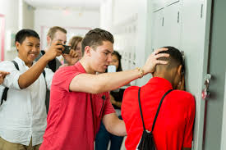
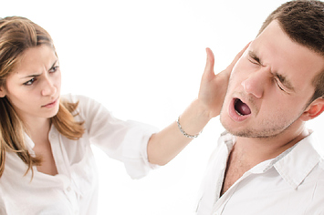
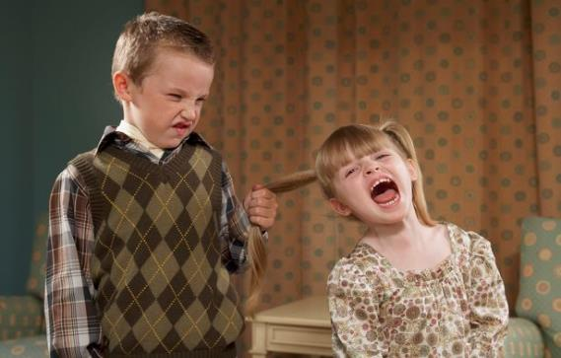
What is Violence?

Slide 10
What is Violence?
Pulling hair
Screaming at someone
Hitting
Threatening
Bullying
Stabbing
Calling names

Slide 11
What is prevention?

Slide 12
Prevention is stopping something from happening. We want to prevent violence in schools. What kind of violence happens in school?

Slide 13
Why do we want to prevent violence?
How do we do this?

Slide 14
Mentors in Violence Prevention
Older pupils supporting and teaching others.
Respecting and listening to one another.

Slide 15
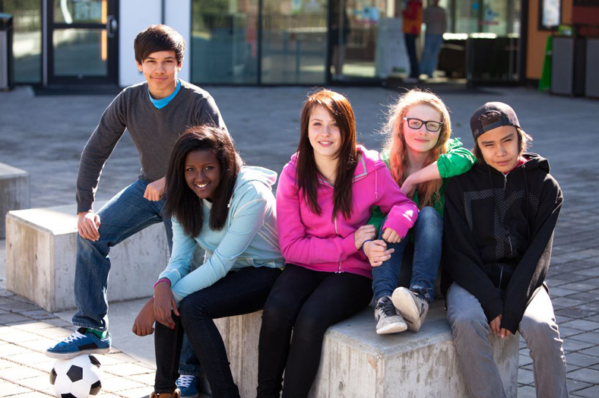
Mentors in Violence Prevention
Helping to stop all kinds of violence and bullying.
Feeling safe and happy in healthy relationships.

