Slide 1





For Scotland's learners, with Scotland's educators
Notes:
This is an internal page in blue and can be duplicated to create additional pages. Always keep the heading and footer as shown. Use the corresponding blue internal and back pages if you are using this page.

Slide 2
What is MVP?
A peer education and leadership programme where senior pupils deliver workshops to younger peers on topics such as groups chats, sexting, domestic abuse, knife crime and homophobic bullying.
A violence prevention and anti bullying programme.
Looks at gender stereotypes and how they impact on our behaviour and relationships.
Encourages us to be active bystanders.
Promotes healthy relationships, and safer schools and communities.
For Scotland's learners, with Scotland's educators
Notes:
This is an internal page in blue and can be duplicated to create additional pages. Always keep the heading and footer as shown. Use the corresponding blue internal and back pages if you are using this page.

Slide 3
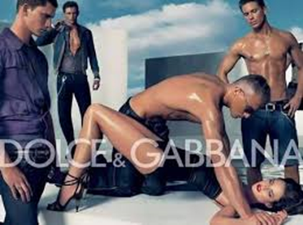



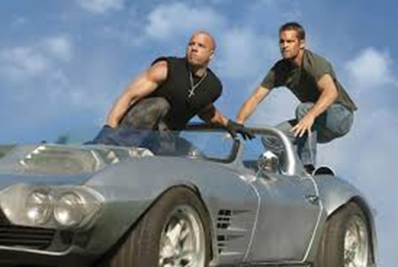
Gender stereotypes
Despite huge improvements in society, stereotypes still exist telling us what it is to be a man and what it is to be a woman.
Through the media we get lots of messages about being male and being female.
MVP discusses the impact this has on us, how
it might affect our behaviour towards one another
and how to challenge it.
TAASA ‘breaking the box’ https://youtu.be/u2GIu5ZpnTM
For Scotland's learners, with Scotland's educators
Notes:
This is an internal page in blue and can be duplicated to create additional pages. Always keep the heading and footer as shown. Use the corresponding blue internal and back pages if you are using this page.

Slide 4
MVP uses a bystander approach to challenge harmful behaviour.
What is a bystander? What do they do?
MVP uses a bystander approach to challenge harmful behaviour.
What is a bystander? What do they do?
Anyone can be a bystander.
Someone who see or hears or knows about something is a bystander.
They can be passive or they can be active.
Bystander have power!
How can bystanders help?
BURGER KING VIDEO https://youtu.be/mnKPEsbTo9s
For Scotland's learners, with Scotland's educators
Notes:
This is an internal page in blue and can be duplicated to create additional pages. Always keep the heading and footer as shown. Use the corresponding blue internal and back pages if you are using this page.

Slide 5
What does being a mentor involve?
Attend a two day training.
Work in groups preparing and practicing your lessons.
Deliver 4-6 lessons in the year to younger pupils.
Work with your staff mentor support team deciding on scenarios to deliver and offering support to younger pupils if needed.
An opportunity to work with others in your year group.
For Scotland's learners, with Scotland's educators
Notes:
This is an internal page in blue and can be duplicated to create additional pages. Always keep the heading and footer as shown. Use the corresponding blue internal and back pages if you are using this page.

Slide 6


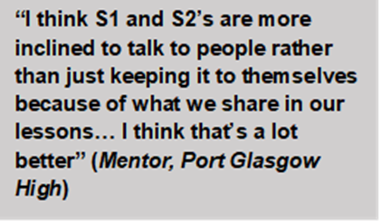
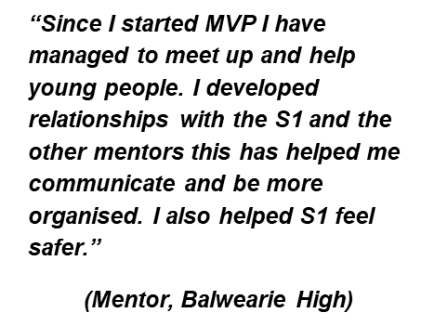
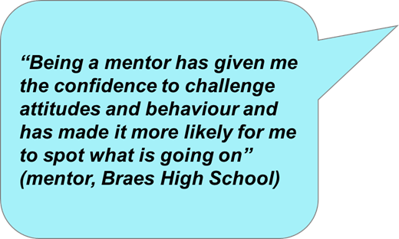

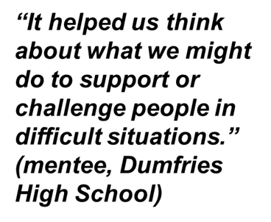
What's in it for you?
Skills development:
Leadership
Team working
Communication skills
Confidence building
Organisational skills
Presentation skills
Building supportive relationships with younger pupils
Experience for your CV, job applications and interviews
For Scotland's learners, with Scotland's educators
Notes:
This is an internal page in blue and can be duplicated to create additional pages. Always keep the heading and footer as shown. Use the corresponding blue internal and back pages if you are using this page.

Slide 7
Next steps…
We are looking for a mentor team that reflects the diverse pupil population of our school
If you are interested in becoming involved or finding out more then:
For Scotland's learners, with Scotland's educators
Notes:
This is an internal page in blue and can be duplicated to create additional pages. Always keep the heading and footer as shown. Use the corresponding blue internal and back pages if you are using this page.

