Slide 1


Accreditation and Youth Awards
Susan Epsworth: Education Officer, Community Learning and Development
MVP Practitioner Development Day
Tuesday 10th March 2020
For Scotland's learners, with Scotland's educators
Notes:
This is a front cover page and can only be used once. Use the corresponding blue internal and back pages if you are using this page. You may add a title and a subtitle if needed only. Do not add anything else or move elements around.

Slide 2
What are Youth Awards?
Wide range of awards that recognise young peoples personal achievements.
Can be achieved through spare time activities or through activity engaged in through a school or college
For Scotland's learners, with Scotland's educators
Notes:
Hello and good afternoon. I’m along to give an input on youth awards which will hopefully give you an insight in to how you might make use of them with the young people you work with. I’m aware that there will be a spectrum of knowledge and experience in the room so apologies if there is lots you’ve heard before, hopefully you’ll find it useful! So in a nutshell what are youth awards? They are wide ranging and recognise young people’s achievements. They can be achieved in a formal education setting but are also often achieve outside of this, for example as part of a youth group or other activities taken part in their spare time.

Slide 3

What is the Awards Network?
A forum of providers of non-formal learning awards in Scotland
Awards that use youth work approaches and are available to young people aged between 10 to 25 across Scotland
Members work together to raise awareness, and promote recognition, of achievements of young people gained through youth awards
For Scotland's learners, with Scotland's educators
Notes:
The Awards Network is a forum of providers of non-formal learning awards in Scotland. The wards all use youth work approaches and are available to young people aged 10 – 25. Members of the network work together to raise awareness and promote recognition of achievement gained through these awards The Award Networks purpose is to promote the participation and achievements of young people gained through youth work awards and it’s Vision is that: Awards are widely valued and recognised as critical evidence of every young person’s learning and achievement

Slide 4

































Awards Network members?
For Scotland's learners, with Scotland's educators
Notes:
Membership of the Awards Network includes major national youth work organisations; a range of niche organisations and award bodies harnessing youth work approaches to support attainment through non-formal learning

Slide 5
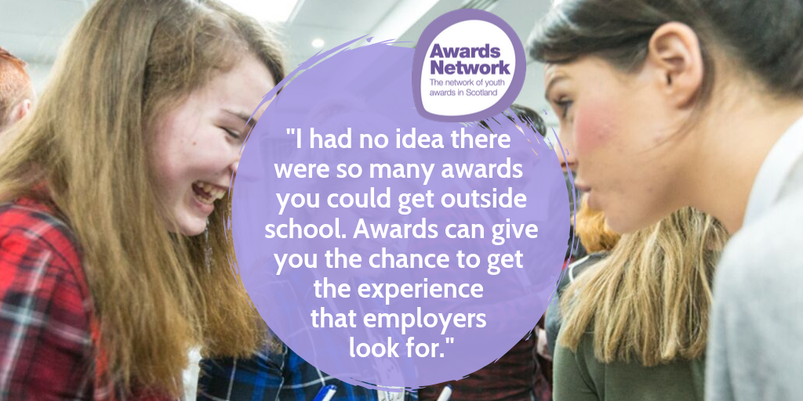

Slide 6
Harnessing Youth Awards to Recognise and Accredit Wider Achievement
Opportunities for multiple recognition / accreditation
Youth Awards providing evidence for SQA Achievement Awards
John Muir Award – evidence for Personal Development Awards (SCQF 4); Wellbeing awards (SCQF 5)
Girlguiding Young Leader Award and SQA Leadership Award (SCQF 5)
DofE and SQA Volunteering Awards (SCQF 3-5)
STEM Learning
Youth Scotland Hi5 Award (SCQF 2)
Scouts – activity badges meeting requirements for CREST awards
Young STEM Leader Award (in pilot stage for SCQF 6 and CfE Level 2)
For Scotland's learners, with Scotland's educators
Notes:
A few examples here of awards networks members including the level of accreditation

Slide 7

Amazing Things
A guide to Youth Awards in Scotland
First edition in 2008
4th edition in 2017 features:
  26 Awards Network members
  48 awards programmes
  18 SCQF credit rated awards
>73,000 awards completed in 2014/15
>114,000 awards completed in 2018/19
For Scotland's learners, with Scotland's educators
Notes:
Introduce Amazing Things – A guide to youth awards in Scotland
Highlight the information contained within it, including the table towards the back that highlights where external accreditation is available.
As this publication was released at SLF 2017, more up to date information, including additional awards, can be found on the Awards Network website

Slide 8
Recognition and Accreditation:
What young people say:
Extra-curricular activities should be better recognised by employers, universities, and other opportunity providers, as equally important to academic qualifications.
Young people should be able to present a well-rounded portrait of themselves as an individual to potential employers and universities, reflecting their interests, hobbies, aspirations, and volunteering activity.
More value needs to be attached to the skills developed through practical volunteering experience and other activities.
Schools could partner with youth groups to co-deliver a skills education programme.
#SQA Futures, Young Scot/SQA, October 2018
For Scotland's learners, with Scotland's educators
Notes:
Here is a snapshot of what young people say about recognition and accreditation of their wider achievement

Slide 9
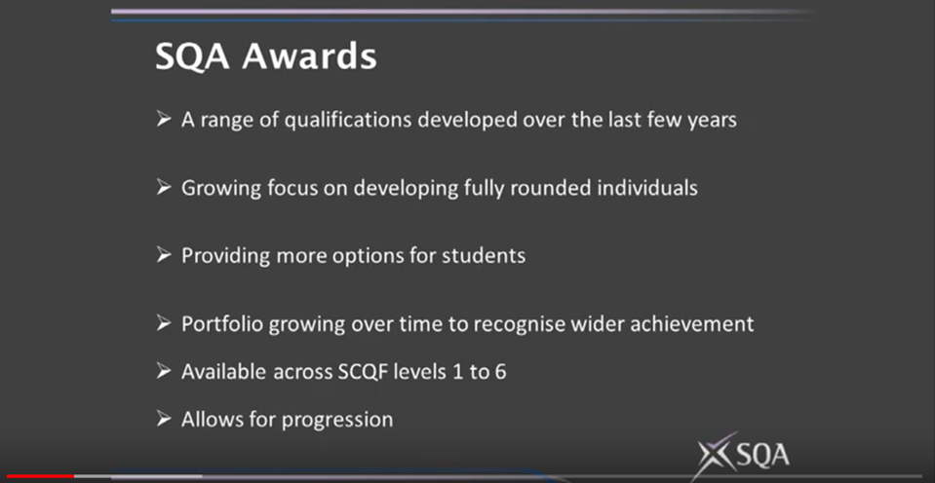
Notes:
I’ve been asked to include a short SQA input as the SQA can’t be here today – I’m not an expert so apologies if I’m mossing something you wanted to know! These are some slides from a group we’ve been facilitating that the SQA is part of

Slide 10
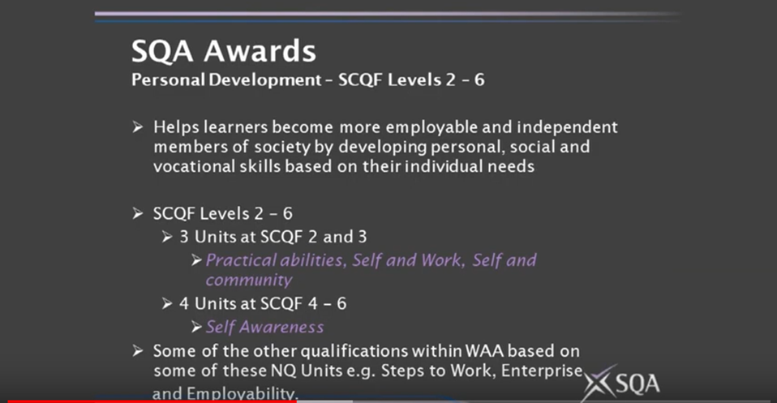
Notes:
A couple of examples

Slide 11
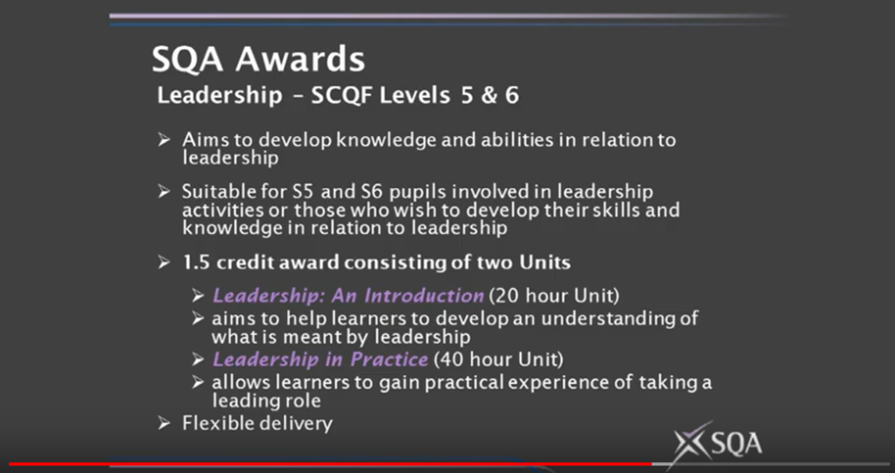

Slide 12
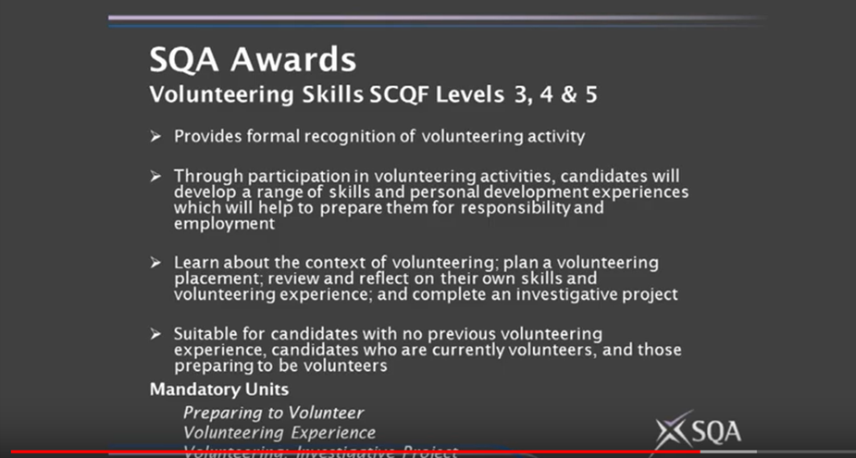

Slide 13
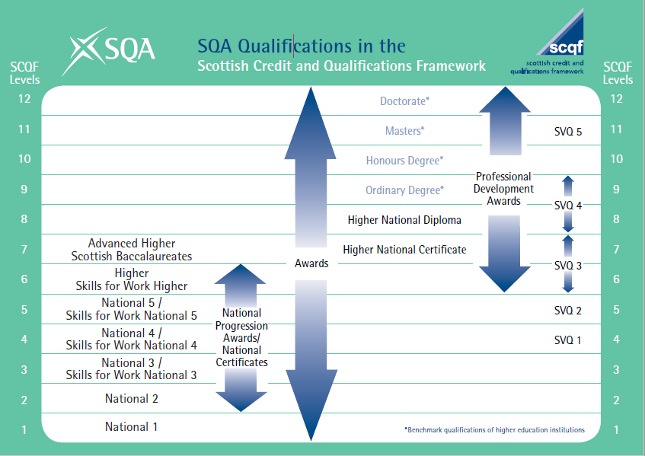
For Scotland's learners, with Scotland's educators
Notes:
And lastly on the SQA this gives you an idea of where SQA Qualifications sit on the SCQF

Slide 14



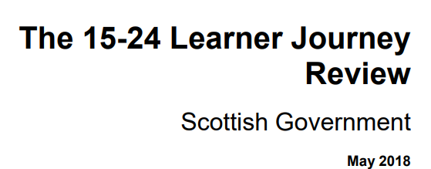
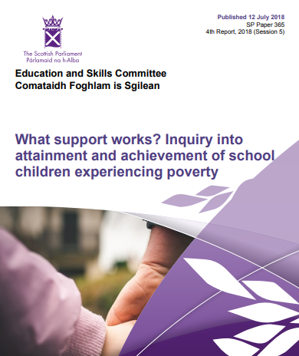
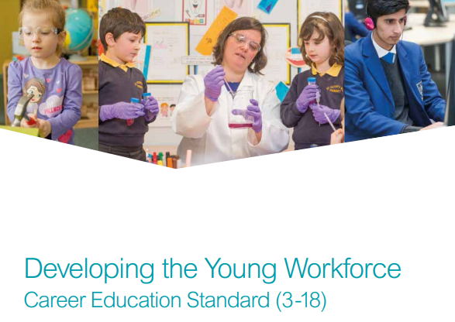

Background and context:
For Scotland's learners, with Scotland's educators
Notes:
Youth awards contribute across a range of policy areas: recognizing achievement; improving attainment and supporting skills development of learning , life and work
Entitlement All children and young people are entitled to have the full range of their achievements recognised’ (Building the Curriculum 5)
The Learner Journey Review: Recommendation 1:
‘We will ensure every learner in Scotland has an online learner account to link their skills and attributes to better course choices.
The approach is expected to ‘recognise wider achievements and informal learning, so that all young people have the opportunity to develop a personal statement and clearly articulate the skills gained and achievements made whilst in school.’
Careers Education Standards:Children and young people will be entitled to:
…..develop skills for learning, life and work as an integral part of their education and be clear about how all their achievements relate to these;
Legacy aim from YoYP2018 given to Education Scotland by Ministers:
To increase parity of esteem between formal qualifications and the skills and experiences that all young people gain through wider learning.

Slide 15
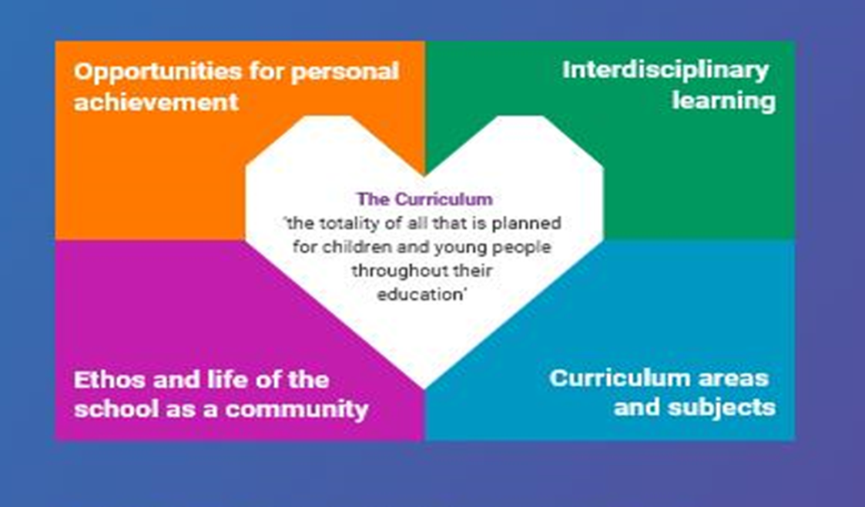
Scotland’s Curriculum for Excellence:
Refreshed Narrative, 2019
For Scotland's learners, with Scotland's educators
Notes:
A refreshed narrative on Scotland's curriculum has been prepared in response to a recommendation made to the Scottish Government by the Organisation for Economic Cooperation and Development (OECD).
It has been created with and for teachers, revisiting the initial Curriculum for Excellence (CfE) and setting it within the current context. The refreshed narrative aims to:
celebrate the successes of CfE and build confidence for future development;
maximise and develop opportunities to meet the aspirations of our learners;
stimulate fresh thinking about Scotland's curriculum;
engage in professional dialogue in curriculum design and inspire, share and nurture innovation.
This image states the four contexts that we will be familiar with – ‘opportunities for personal achievement’ is of particular relevance when we’re discussing youth awards.

Slide 16
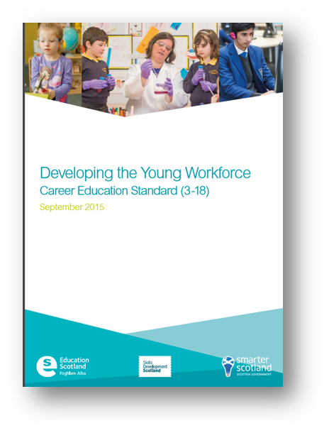
Career Education Standard 3-18
Children and young people will be entitled to:
…..develop skills for learning, life and work as an integral part of their education and be clear about how all their achievements relate to these
For Scotland's learners, with Scotland's educators

Slide 17
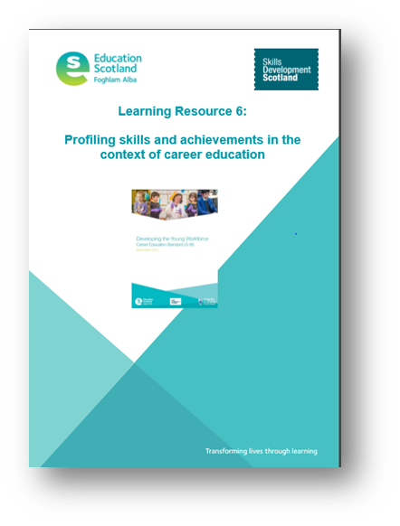
Profiling Skills and Achievements Guidance
(Education Scotland)
‘… to provide children and young people with the understanding and tools to develop, capture and articulate their skills and achievements…’;
‘….to consider the development, monitoring, tracking and recording of achievements both within and out with school…’;
‘Teachers and practitioners should work closely with parents to support learners in the profiling process by discussing …. their learning, achievements and aspirations.’
‘A learner’s profile … may contain:
relevant achievements or experiences out with a formal education such as community engagement, voluntary work , youth awards etc.’
For Scotland's learners, with Scotland's educators
Notes:
We’ll discuss this a bit further in the workshops

Slide 18
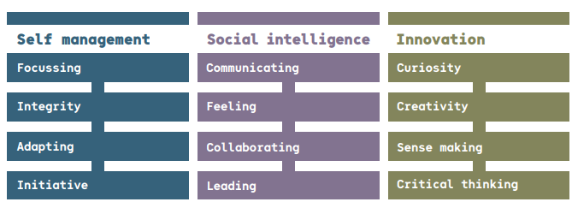
Developing employability skills
Skills for the future: meta-skills (Skills 4.0 - SDS)
Manage the Now | Connect with the World | Create our own change
For Scotland's learners, with Scotland's educators

Slide 19
National Working Group on Recognising All Personal Learning and Achievement
Bringing together schools, youth work, SDS, SQA and other stakeholders to:
Identify and share good practice around capturing and recognising personal learning and achievement
Consider what national advice and support will help to realise Recommendation 1 in the Learner Journey Review.
Notes:
At Education Scotland we’ve been facilitating a national group on recognising personal learning and achievement. A range of partners sit on the group including Schools, Youth Work, SDS, SQA, YouthLInk Scotland and the Awards Network.
The aims of this group are very clear – to identify and share good practice and to consider what national advice and support will help to realise recommendation 1 in the Learner Journey Review that I mentioned later.

Slide 20
National Group: Key messages so far…
Many schools & CLD/youth work providers are collaborating to maximise non-formal opportunities for young people to learn & achieve - in school & in their communities.
Many young people value personal learning & achievement but there is more to be done to make sure that all young people, families, teachers and practitioners, employers and HE/FE are aware of that value.
Personal learning & achievement provides great opportunities for young people to develop the ‘meta’ skills they need.
It’s not always about formal qualifications. The increasing profile of Youth Awards is an important part of the picture.
It’s important to build in opportunities for young people to discuss and reflect on their personal learning and achievements.
Young people should be encouraged to ‘own’ their learning - profiling tools & conversations should emphasise this.
Notes:
Key messages from the group so far:
There is fantastic collaboration happening across the country to maximize opportunities for young people
Young people value their wider achievement but there is more to be done to raise the awareness with others
Young peoples ‘wider’ achievement provides opportunities and a range of contexts for young people to develop meta skills
Both formal and informal qualifications are equally as important
It is important to build in time for young people to reflect on their own learning and achievement
And young people should be encouraged to own their learning – profiling tools and conversations can help this.

Slide 21
National Group: Next Steps
Developing a Learning Resource for Practitioners to:
Increase the understanding of personal learning and achievement as part of Scotland's Curriculum
Be able to reflect on your current practice by considering a wider learning and achievement in a variety of contexts and forms
Be able to consider the development, monitoring, tracking and recording of achievements, both attainment of qualifications and achievements within and out with school
Gain an understanding of the partners and resources that are available to support personal achievement in your context
Notes:
Our next step in this group is too develop a national resource for all practitioners working with young people – that can be picked up and worked with in any setting and cross sector.
Hopefully this resource will give practitioners the tools to support young people in recognizing, reflecting on and capturing all their achievements, in and out of the school setting. Much of the resource will be case studies and links to resources – if you think you have something that should be in there please let us know!

Slide 22

Susan Epsworth: Education Officer, Community Learning and Development
Susan.Epsworth@educationscotland.gov.scot
@edscotcld
For Scotland's learners, with Scotland's educators
Notes:
Here are my contact details – feel free to get in touch. Also the CLD teams twitter – we’ll be giving updates on the personal learning and achievement resource including the launch date and sharing practice examples. Please follow!

