Slide 1

CORRIDOR
Notes:
Welcome, explanation and ice-breaker

Slide 2
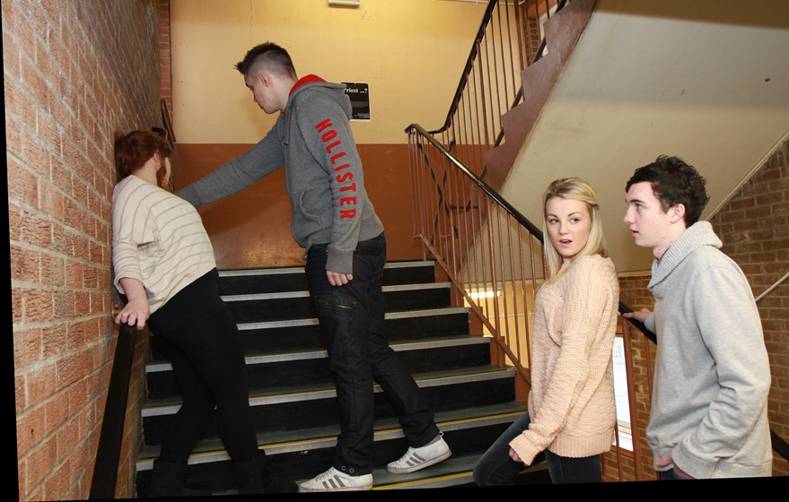
Corridor
In the corridor at school you see a boy and his girlfriend arguing. You know them.
Notes:
Scenario

Slide 3
The boy pushes his girlfriend against the wall. Nobody is doing anything to help.
Notes:
Scenario

Slide 4
Put your hand up if you think there is something wrong with what is happening.

Slide 5

When we think or feel something might be wrong, we call these Red Flags.
What are the red flags?

Slide 6
As a bystander
what might you be thinking?

Slide 7
Train of Thought
What’s going on?
Why is he pushing her?
Should I say something?
If nobody else is doing anything, why should I?
Notes:
Train of Thought

Slide 8
If I get involved he might turn on me. Am I ready for that?
If he treats her like that and she stays with him, is it any of my busi­ness?
But if I don’t do something am I saying it’s okay for him to treat her like this?
What should I do?
Notes:
Train of Thought

Slide 9
What reasons
might someone give for not getting involved?

Slide 10
There is a serious problem of some boys being abusive to their girlfriends.
AGREE ----- UNSURE ----- DISAGREE
Notes:
ADU

Slide 11
Just as many girls as boys are physically abusive to their partners.
AGREE ----- UNSURE ----- DISAGREE
Notes:
ADU

Slide 12
Discussion
In the corridor at school you see a boy and his girlfriend arguing. You know them.
Notes:
Scenario

Slide 13
The boy pushes his girlfriend against the wall. Nobody is doing anything to help.
Notes:
Scenario

Slide 14
What could you do?
What are your options?
Notes:
Scenario

Slide 15
Options
1. Do nothing. It’s none of your business.
2. Distract the couple somehow to defuse the situation.
3. Shout at him to leave her alone and wait to make sure things have calmed down.
Notes:
OPTIONS

Slide 16
Options
4. Talk to the girl at some point to offer her support.
5. Talk to the boy at some point about his behaviour.
Notes:
OPTIONS

Slide 17
Options
6. Talk about this with a parent/carer, a teacher/adult you trust or an MVP mentor, and ask their advice on what to do.
7. Personal Option.
Notes:
OPTIONS

Slide 18

Getting Help
ChildLine
www.childline.org.uk
If you are under 19 you can confidentially call, email or chat online about any problem big or small.
Notes:
OPTIONS

