Slide 1
GROUP CHAT
Notes:
Welcome, explanation and ice-breaker

Slide 2
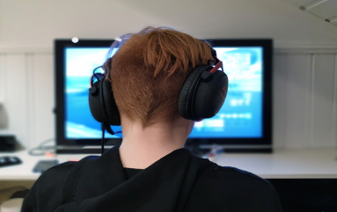
Group Chat
You are part of a group chat with people from school.
Notes:
Scenario

Slide 3
Someone in the group makes fun of your friend. Their comments are nasty.

Slide 4
Your friend doesn’t reply although you can see that they have read the comments.

Slide 5
Put your hand up if you think there is something wrong with what is happening.

Slide 6
When we think or feel something might be wrong, we call these Red Flags.
What are the red flags?

Slide 7
As a bystander what might you be thinking?

Slide 8
Train of Thought
Why are they doing this?
I feel bad about what is happening.
Why is nobody challenging it?
We are all meant to be friends.
Notes:
Train of Thought

Slide 9
Why didn’t my friend reply?
Is it my place to get involved?
If I say something, will I be next?
I feel really uncomfortable when someone is treated like that.
Notes:
Train of Thought

Slide 10
Should I tell someone?
Is it any of my business?
What should I do?
Notes:
Train of Thought

Slide 11
What reasons might
someone give
for not getting involved?

Slide 12
Insulting a person online is not as bad as doing it to their face.
AGREE ----- UNSURE ----- DISAGREE
Notes:
ADU

Slide 13
Discussion
You are part of a group chat with people from school.
Notes:
Scenario

Slide 14
Someone in the group makes fun of your friend. Their comments are nasty.

Slide 15
Your friend doesn’t reply although you can see that they have read the comments.

Slide 16
What could you do?
What are your options?

Slide 17
Options
1. Do nothing. It’s none of your business.
2. Try to change the subject in the group chat.
3. Remove yourself from the group and contact your friend to let them know you don’t agree with what was being said.
Notes:
OPTIONS

Slide 18
Options
4. Post on the chat that you think what they’re saying and doing is wrong.
5. Outwith the group chat, speak to some of your friends who didn’t comment. Do they think it is fair? Discuss together what you should do.
Notes:
OPTIONS

Slide 19
Options
6. Talk about your concerns with a parent/ carer, a teacher/adult you trust or an MVP mentor, and ask their advice on what to do.
7. Personal Option.
Notes:
OPTIONS

Slide 20
Getting Help
ChildLine
www.childline.org.uk
If you are under 19 you can confidentially call, email or chat online about any problem big or small.
Notes:
OPTIONS

