Slide 1
INSULTS
Notes:
Welcome, explanation and ice-breaker

Slide 2
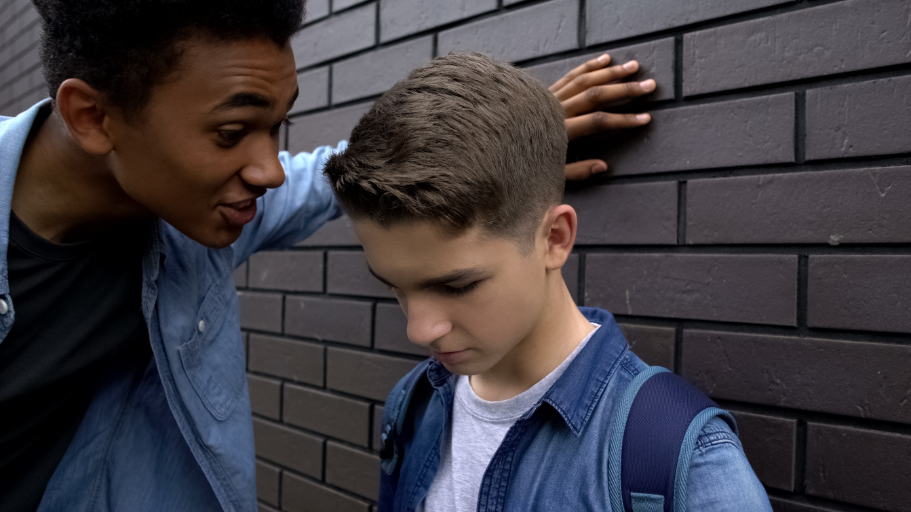
Insults
A friend of yours often insults and makes fun of another boy you know.
Notes:
Scenario

Slide 3
You have never seen your friend hit
the other boy, but you would not be surprised if he did.
Notes:
Scenario

Slide 4
Put your hand up if you feel there is something wrong with what is happening.

Slide 5
When we think or feel something might be wrong, we call these Red Flags.
What are the red flags?

Slide 6
As a bystander what might you be thinking?

Slide 7
Train of Thought
Why is he doing this?
I feel bad about what is happening.
But at least he’s not doing it to me.
Notes:
Train of Thought

Slide 8
Why doesn’t the other boy stand up for himself?
Should I get involved?
Is it any of my business?
If I do, will I be next?
Notes:
Train of Thought

Slide 9
But I feel uncomfortable when I see someone being treated like this.
What should I do?
Notes:
Train of Thought

Slide 10
What reasons might
someone give
for not getting involved?

Slide 11
Sticks and stones may break
my bones but names will
never hurt me.
AGREE ----- UNSURE ----- DISAGREE
Notes:
ADU

Slide 12
Discussion
A friend of yours frequently insults and makes fun of another boy you know.
Notes:
Scenario

Slide 13
You have never seen your friend hit the other boy, but you would not be surprised if he did.
Notes:
Scenario

Slide 14
What could you do?
What are your options?
Notes:
OPTIONS

Slide 15
Options
1. Do nothing. It’s none of your business.
2. Next time it happens distract your friend to stop the behaviour.
3. Talk to the boy who is being insulted to offer support.
Notes:
OPTIONS

Slide 16
Options
4. Tell your friend you think he’s out of order.
5. Share with your friends what you’ve seen and discuss what to do together.
Notes:
OPTIONS

Slide 17
Options
6. Talk about what happened with a parent/
carer, a teacher/adult you trust or an MVP mentor, and ask their advice on what to do.
7. Personal Option.
Notes:
OPTIONS

Slide 18
Getting Help
ChildLine
www.childline.org.uk
If you are under 19 you can confidentially call, email or chat online about any problem big or small.
Notes:
OPTIONS

