Slide 1
BYSTANDERS

Slide 2
What is a bystander?

Slide 3
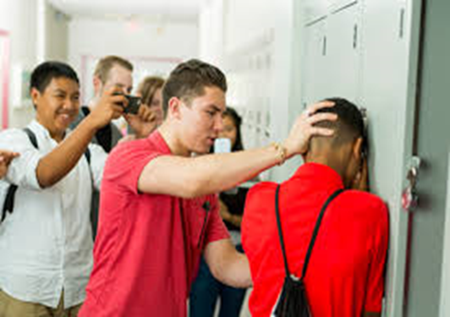
A bystander is someone who sees, hears or knows about an incident but is not directly involved.

Slide 4
Who are the bystanders?
What are they doing?

Slide 5
Corridor Video
We are going to watch a video called corridor.
(Click on the camera to watch)

Slide 6
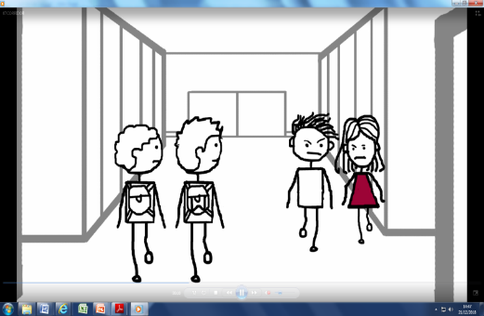
What was happening in the video?
What were the bystanders doing?

Slide 7
A boy gets attacked outside college.

Slide 8
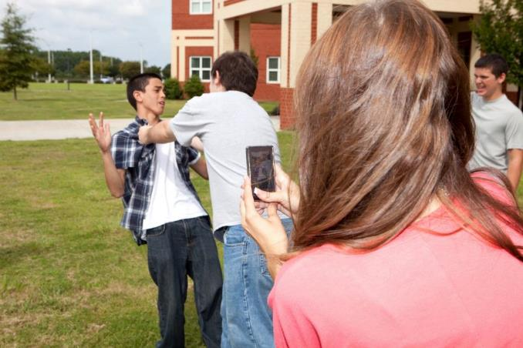
What are the bystanders doing?

Slide 9
Why are bystanders doing nothing to help?

Slide 10
How do you think the boy feels during the attack?
How do you think he feels after?

Slide 11
What do you think the bystanders could have done to help?

Slide 12
If you were the bystander, what could you do to help?

Slide 13
ABUSE

Slide 14
Verbal Abuse

Slide 15
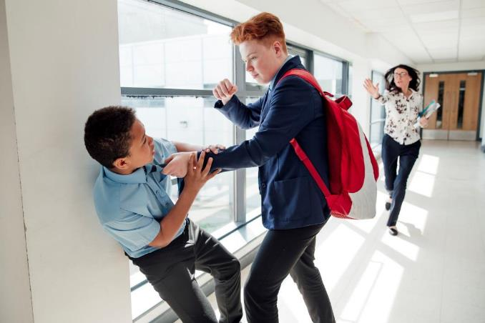
Physical Abuse

Slide 16
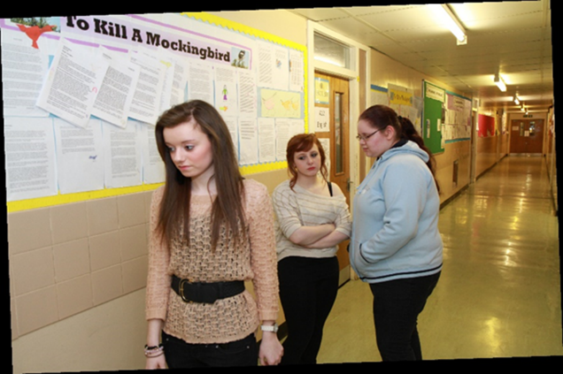
Emotional Abuse

Slide 17
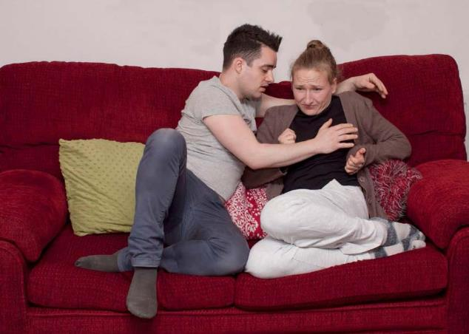
Sexual Abuse

Slide 18
Verbal Abuse
Shouting
Name calling
Swearing at someone
Threatening
Criticising
Nasty ‘jokes’
Physical abuse
Hitting
Pushing
Grabbing
Biting
Stabbing
Pulling hair
Burning

Slide 19
Sexual Abuse
Unwanted
touching of
private body parts
Rape
Forcing someone to watch porn
Forcing to someone to remove their clothes
Emotional abuse
Making someone feel bad about themselves
Making someone scared
Taking someone's money

Slide 20
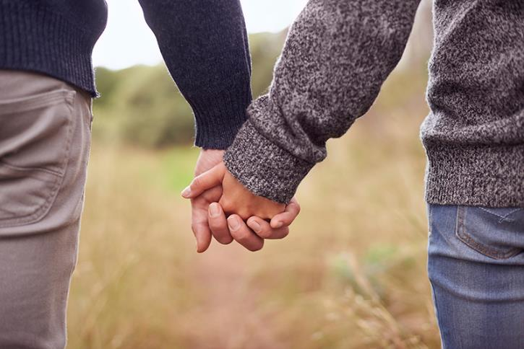
Healthy Relationship

Slide 21
Verbal
Asking how are you?
Friendly tone of voice
Giving compliments
Physical
Shaking hands
Relaxed body posture
Eye contact
Cuddles (if wanted)

Slide 22
Sexual
Asking before touching
Checking your partner is happy with how you are touching them
Consent before sex
Emotional
Considering others feelings
Helping others feel safe and happy
Respecting others money/belongings
Respecting others right to have friends and go out without you

Slide 23
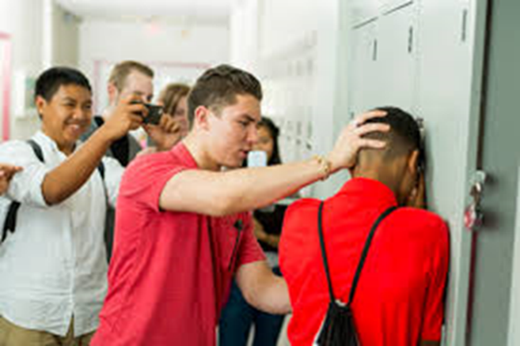
What could you do if you knew someone was being abused?

Slide 24
Who could you tell?

