Slide 1
GENDER BOX

Slide 2
Where do we get our ‘messages’ about
what boys and girls should look like?

Slide 3
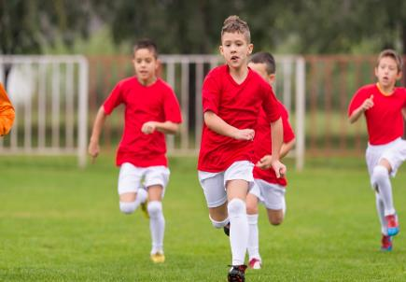
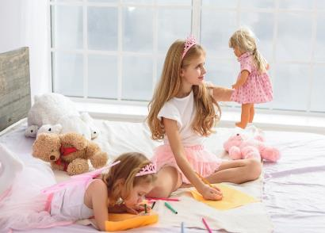
What are the ‘messages’ we get about
how boys and girls should behave?

Slide 4
Miss Representation
Watch the film.
Think about the ‘messages’ that are about how girls look or behave.

Slide 5
Tough Guise
Watch the film.
Think about the ‘messages’ that are about how boys look or behave.

Slide 8
What do we expect boys or girls to look like?

Slide 9
Expected looks
Long eyelashes | Short skirts
Make up | Big muscles
Long hair | Short hair
Pretty | Suntan
Pink baby clothes | Blue baby clothes
Slim | No body hair
Fashionable clothes | Perfect eyebrows
6 pack | Large breasts

Slide 10
What interests or hobbies do we expect boys or girls to have?

Slide 11
Expected interests
Shopping | Football
Ballet | Cars
Motorbikes | Babies
Reading | Science
Cleaning the house | Drinking alcohol
Flowers | Make up
Technology | Cooking
Sewing | Computer games

Slide 12
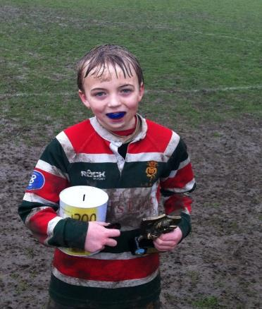
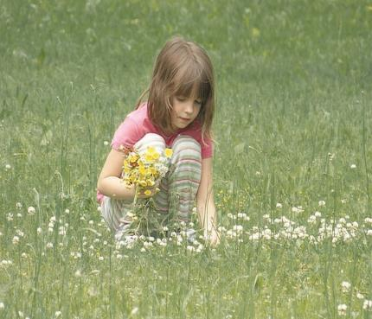
How do we expect boys or girls to behave?

Slide 13
Expected behaviour
Tough | Sweet
Loving | Sporty
Kind | Naughty
Sexy | Caring
Weak | Strong
Fighter | Cheeky
Shy | Confident
In charge | Obedient
Brave | Cries alot

Slide 14
What jobs do we expect men or women to choose?

Slide 15
Jobs
Motor mechanic | Nursery nurse
Chef | Housewife
Nurse | Doctor
Pilot | Air cabin assistant
Scientist | Cleaner
Teacher | Train driver
Secretary | Bank manager
Shop assistant | Consultant

Slide 16
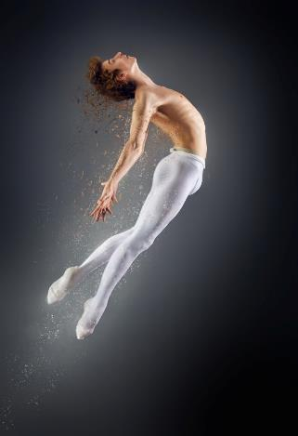
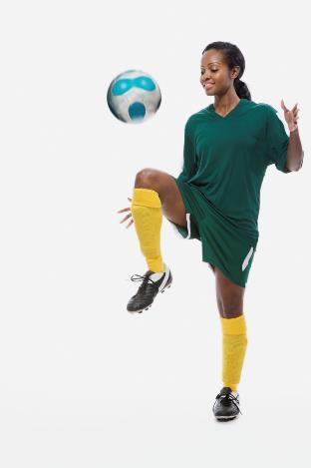
Do all boys and girls fit in with their ‘Stereotype’ ?

Slide 17
What might people say about them?

Slide 18
If someone doesn’t ‘fit’ the stereotype, what impact could this have?

