Slide 1
Creative Writing
Generating Ideas

Slide 2
End Task
You will be asked to pitch your idea for your short story/opening chapter of a novel to a panel of experts (Think Dragon’s Den).
Expect honest feedback on your idea prior to writing.
Once accepted, you will be given a week to complete your piece of creative writing. You will be expected to spend time both in class and at home drafting and redrafting this piece.

Slide 3
Group Discussion
What are the ingredients of a good story?

Slide 4
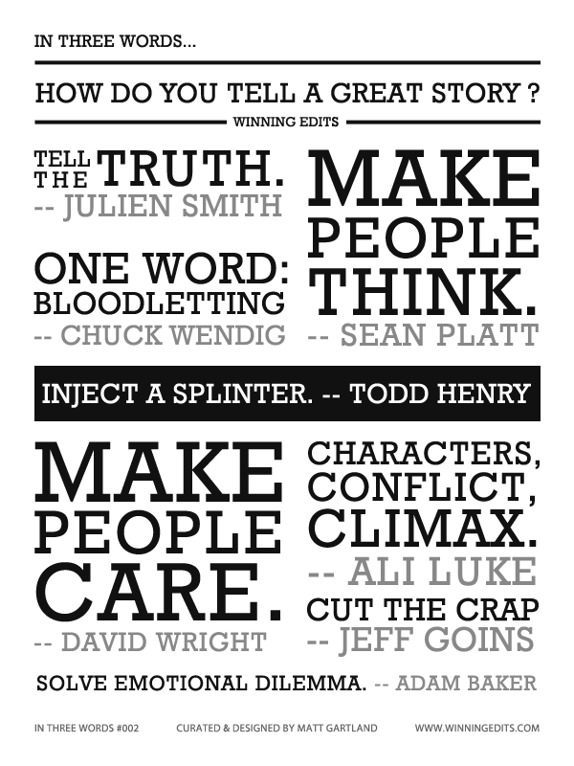
Other pupils’ responses
Characters we care about/emotional connection.
A plot that makes sense but is not boring or predictable.
Conversations and dialogue that show us who the characters Are rather than bland descriptions of what the character is wearing – show don’t tell.
Surprises and discoveries.
Questions, choices and decisions.
Conflicts and resolutions.

Slide 6
Generating Ideas
Facing a blank page can be intimidating. Here are some techniques that professional writers use to generate ideas:
I always begin with character, or characters, and then try to think up as much action for them as possible. – John Irving
A story usually begins with a single idea or memory or mental picture. The writing of the story is simply a matter of building up to that moment. – William Faulkner
I just have a very general idea and then the thing develops as I write. – Aldous Huxley
If I didn’t know the end of my story, I wouldn’t begin. – Katherine Anne Porter

Slide 7
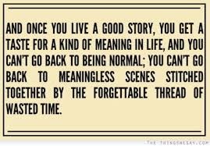
So…
There is no one single way of getting started on a story.
Even professional writers can find generating ideas difficult.

Slide 8
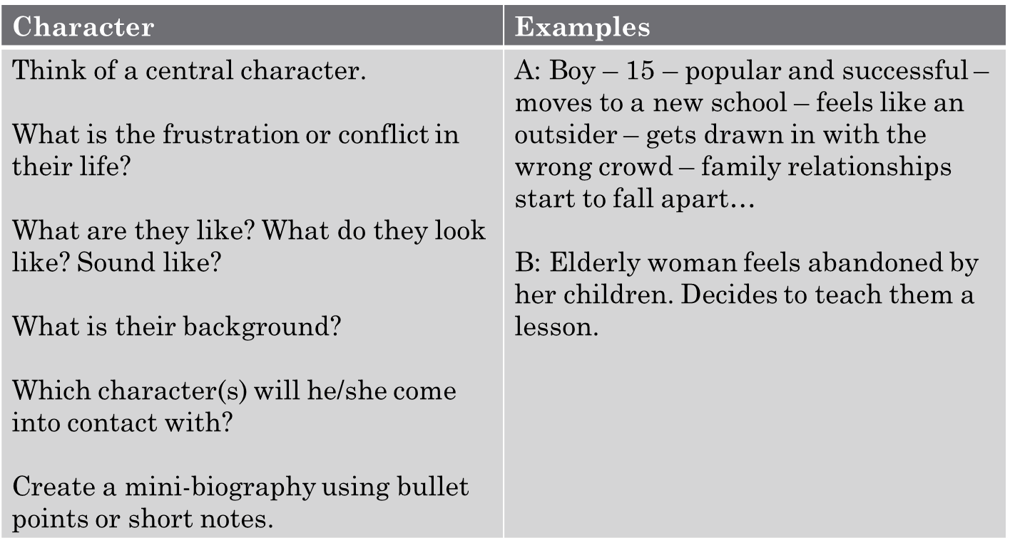
Getting Started

Slide 9
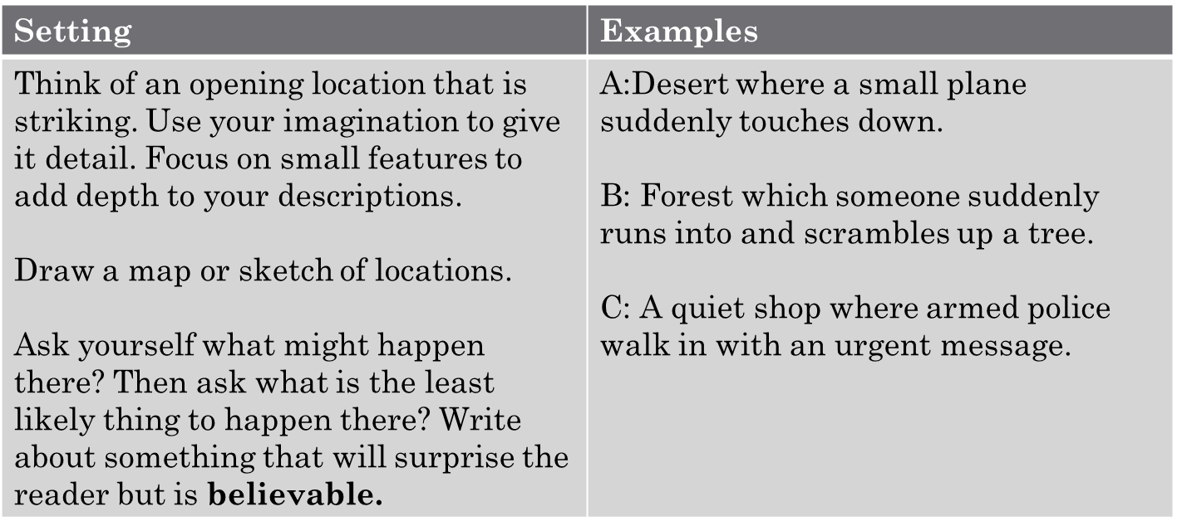
Getting Started

Slide 10
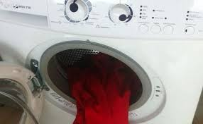
My favourite advice
Take the ordinary and make it different
Or
Take the different and make it ordinary.

Slide 11
Basics of Plot
Example
Man wires up his house with high tech security devices.
Burglar breaks in whilst the man is still testing them.
Burglar is trapped in the house – man doesn’t know. Man sets alarms and goes away.
Burglar tries to find a way out of the house without setting off the alarms.
Burglar sets off alarm and claims to be the house-owner when the police arrive. Man arrives home and had forgotten the passcode for the alarm.
Police almost arrest the Man giving the burglar time to escape.
Normality
Disruption to normality
Attempts to overcome the disruption/problem/issue
Problem is overcome/protagonist is beaten
New normality

Slide 12
Basics of Plot
Think of a basic step-by-step storyline. Your story needs CONFLICT.
Plan the first stage. Think about what could happen as a result.
Choose steps that might surprise your reader (whilst being realistic).
Write out your plot as a flow chart diagram – just the basic features for now.
Consider the final step in your story – how do you want it to end?
Normality
Disruption to normality
Attempts to overcome the disruption/problem/issue
Problem is overcome/protagonist is beaten
New normality

Slide 13
Conflict Plots
Man versus Man
Man versus society
Man versus Nature
Man versus Himself
Man versus God
Man caught in the middle
Man versus Woman

Slide 14
Overcoming the Monster: The hero learns of a great evil and goes on a journey to destroy it. Star Wars qualifies. Braveheart. Jaws. Any movie with Nazis in it. Some of the Rocky movies.
Rags to Riches: A sad-sack beginning that leads to a happily ever after. A lot of Dickens’ stuff fits here. Disney princess movies. Harry Potter. Almost every rom-com.
The Quest: Everybody loves a quest where the hero goes on a journey to find something, which can be a Lost Ark (literal of figurative), a body (Stand By Me), or even something unknown and unseen, which is known in Hollywood as a McGuffin. Sometimes the hero brings his entourage, too. A lot of epics are Quest stories Like The Goonies.
Voyage and Return: Like The Wizard of Oz or Back to the Future. Both Dorothy and Marty go to a weird place with weird rules but ultimately return home better off
Comedies For some reason, two people can’t be together, which creates all sorts of antics. They eventually figure it out. Almost every rom-com ever made. (Note: you can make anything into a comedy - For example, Monty Python is a funny Quest movie, but the category here refers to a specific kind of plot, not just anything with humour.)
Tragedies are like riches to rags, where the villain gets their comeuppance in the end. Macbeth and King Lear are classic examples.
Rebirth is like a tragedy but where the hero realizes his error before it’s too late, like in It’s a Wonderful Life.

Slide 15
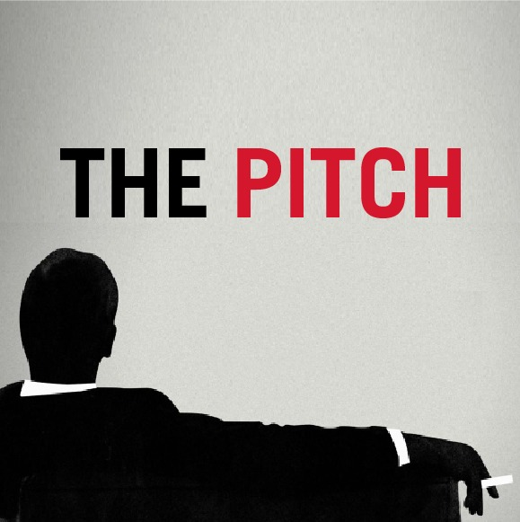

Slide 16
Pitching your Story Idea
Things to Include:
A clear outline (5 stages) of your plot.
1 clear setting where the bulk of the story will take place, with three small details that you will use to make the scene come to life.
A character biography for your protagonist and antagonist.
Jacob Stevenson: Bookish academic. Normally wears contacts but is forced to wear glasses due to a stigmatism.
Working class parents who are proud of him but don’t understand his genius – feels no-one knows him. Quiet, but when he talks people listen.
Eric Johanssen: The best boss you could ask for. Practically family. Trustworthy to a fault. Scandinavian in Britain – class issues. Slight stammer but otherwise confident.
Bruce Flynch: Young and ambitious. Pushes others and waits for them to reveal a weakness. A slight man, yet fearsome when angry. Prematurely greying. No family – few friends. Disliked on the force.

Slide 17
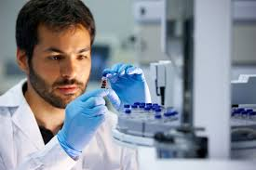
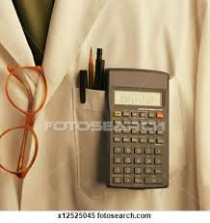
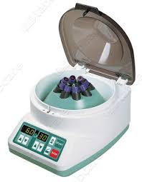
Pitching your Story Idea
Things to Include:
A clear outline (5 stages) of your plot.
1 clear setting where the bulk of the story will take place, with three small details that you will use to make the scene come to life.
A character biography for your protagonist and antagonist.
Setting:
Primarily based in a lab with a number of different workstations and a raised area/private office with opaque walls for the boss.
3 Small descriptions:
The stark, bleached white of the room strikes and fades.
Lab coats hung in uniform rows nestle capped pens and spectacles.
The glass barrier hushes the whirr and spin of the centrifuge.

Slide 18
Pitching your Story Idea
Things to Include:
A clear outline (5 stages) of your plot.
1 clear setting where the bulk of the story will take place, with three small details that you will use to make the scene come to life.
A character biography for your protagonist and antagonist.
Dr Jacob Stevenson is in his lab studying a sample of an anti-coagulant immuno-vaccine that is destined to cure cancer.
Detective Bruce Flynch disturbs the doctor’s work and informs him that his boss’ body has been found, covered in lacerations, in a squat in the dodgy area of town.
Stevenson is horrified and defensive – cannot believe his boss – Eric Johanssen - would be involved in anything underhand. Tensions flare. The detective leaves. Stevenson accesses his boss’ private computer files to find he has been communicating with a pharmaceutical company who, realising they are close to a breakthrough, want to block Johanssen’s company from releasing their cure. More money in treatment than curing.
The detective stands in the doorframe . He has seen everything on the screen. “Still think he’s whiter than white?”
Stevenson, fuelled by anger, usher the detective away. The detective leaves his card. The monitor on Stevenson’s testing station sparks up – 99.879% effective.

Slide 19
Good Beginnings
Talk to the reader – use first person narrative
Shock your reader
Create a tense atmosphere
Start with something odd
Use direct speech
Start in the middle of something
Make your reader laugh
Create a very clear picture
?
?
?
?
?
?
?
?
?
?

Slide 20
Example introduction
The sample froths before slowly coagulating under the piercing light of Dr Jacob Stevenson’s microscope, the cold metal scalpel scraping over glass as he steadily edges the tumourous flesh into position. Prepared for yet another disappointment, the doctor strokes pensively at his thick greying beard, enters the execution code on the lab pc and holds his breath.
The aging machine clunks to life, coughing at each calculation. An abrupt knock at the door breaks the monotone hum of the extractor fan above.
“Dammit, what now…”
The figure filling the doorframe was foreign to him – a slight, yet oddly aggressive looking shape. It stares intently at Stevenson, unspeaking. The black glass reflection of the lab catches its slight movements as it reaches into its trench coat pocket.
A voice grumbles to life as the shape of the man swaggers into the room.
“Mind if ah come in?”

Slide 21
Self Evaluation – Essay Checklist
Your opening grabs the reader’s attention straight away by starting in the middle of the action.
Your setting is realistic and identifiable.
You use sense descriptions to create a clear atmosphere.
You avoid “telling” (He opened the door) and instead show HOW the action takes place (The door creaked open as his hand tightened further on the brass handle).
You avoid cliché.
You build tension in key scenes by varying your use of language (word choice, imagery – simile/metaphor/personification, sentence length, repetition) for impact.
You use dialogue sparingly, giving each of your characters a clear voice and personality.
Your story is structured with a clear problem for your protagonist to overcome and details their attempts to do so.
Your story (either short story or novel opening) has a sense of resolution/progression.
Your work is technically accurate.
Common Problems: spelling (SP) / punctuation (Punct) / tense shifting (TS) / incorrect word choice or poor vocabulary (WC) / sentence structure errors (SS)

Slide 22
The Burger of Criticism
Positive comments
Things that can be done better
Things that don’t work
Things that don’t make sense
Positive comments

