Slide 1
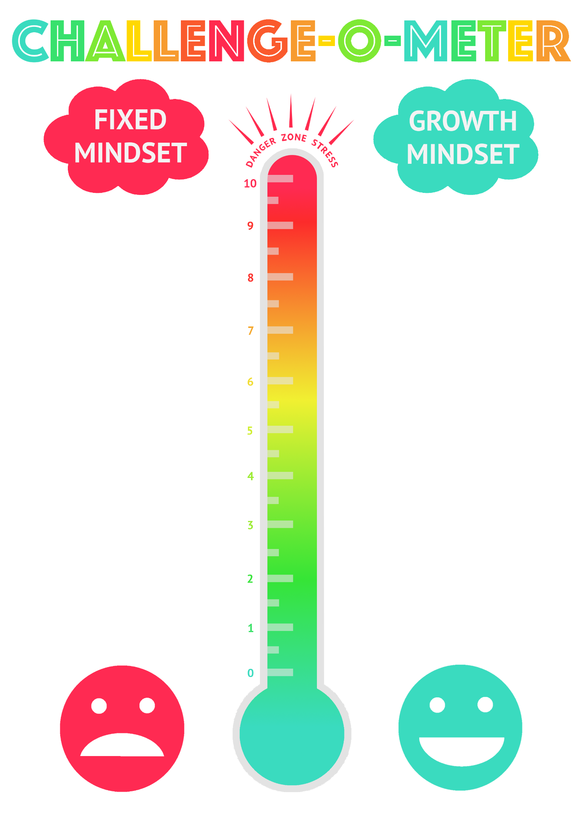
I give up!
I can’t do it!
I’m making mistakes, people will think I’m rubbish
This is tough, I’ll look for what I know is easy instead.
This feels risky, I may not look good if I make a mistake.
This is safe, I’ve done this well before, phew!
I like it here because it’s easy.
I can’t do it… YET!
I’ll keep trying harder
I’m making mistakes but I’m learning.
I’m getting better.
It’s still tough but I won’t give up.
How am I doing? What can I do to get even better?
What do I still need to practice to be my best?

