Slide 1












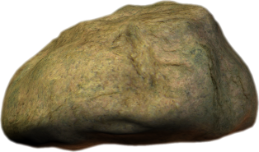
P1 and Nursery Joint Active
Learning Project 2019
EXPLORERS

Slide 2

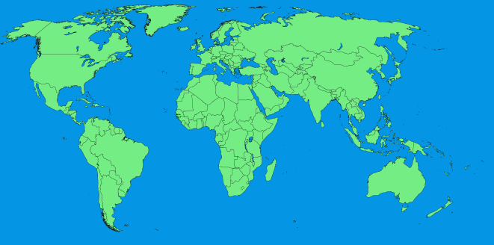




What is an explorer?
Explorers are people who find out about new places and the things that live there.

Slide 3
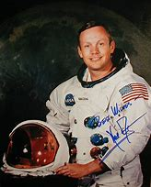
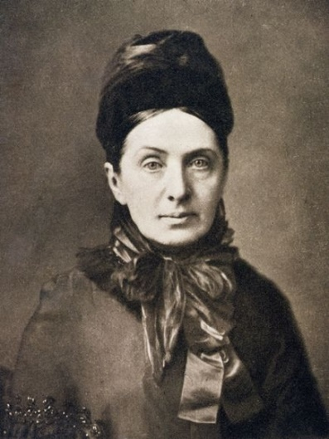
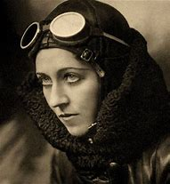
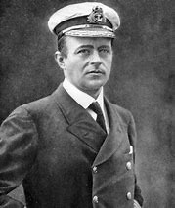
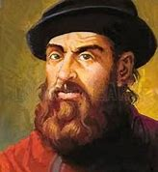
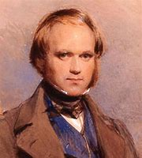
Some Famous Explorers

Slide 4



We will have 4 teams of explorers
The Telescopes
The Binoculars
The Microscopes
The Compasses

Slide 5
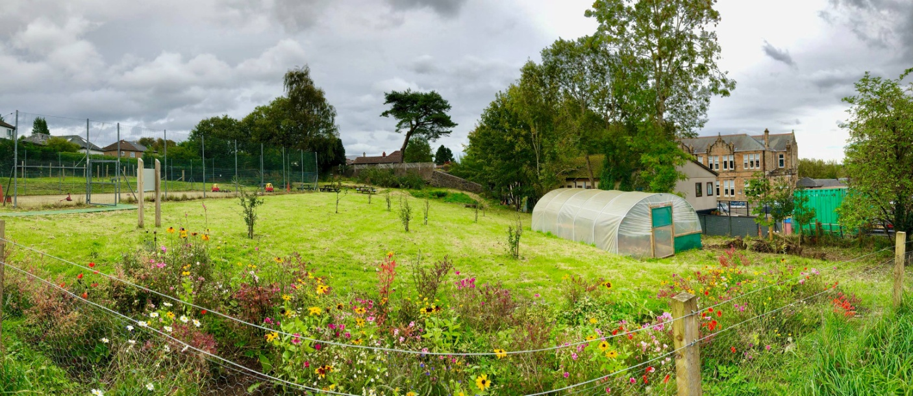
We will be exploring Orcadia
We are going to imagine that our orchard and garden are an exciting, unexplored far off land called Orcadia, that we are going to discover! I wonder who might live there and what we might find?

Slide 6
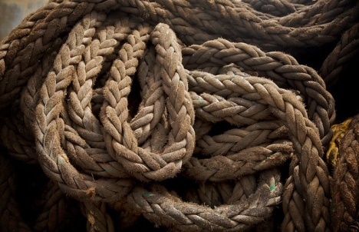







Explorers need rules
We will need to be kind to any animals and plants we discover
We will need to work together and be kind and helpful to each other
We will need to use our thinking brains to work out ways to solve any problems we might find
We need to be safe, and be careful with the tools we use, and in the things we do.

Slide 7
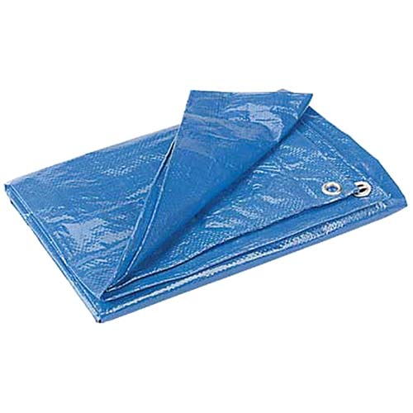
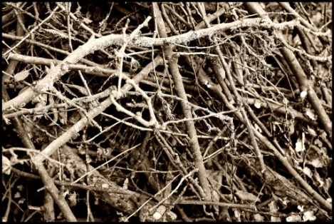


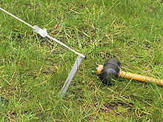


We will need to build a base camp!
Is there anything else you can think of that we might use?
We’ll be building explorers!!

Slide 8
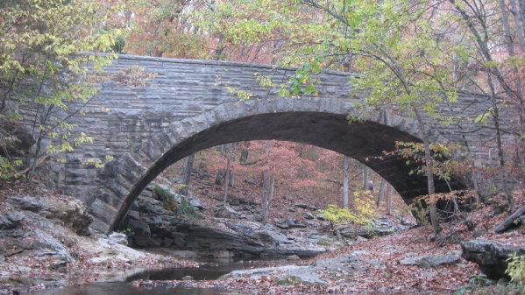

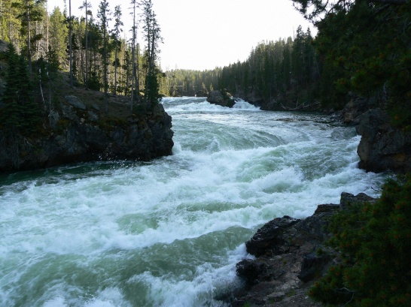

We will need to make a safe path over dangerous terrain
We’ll be engineering explorers!
Avoiding dangerous animals!

Slide 9
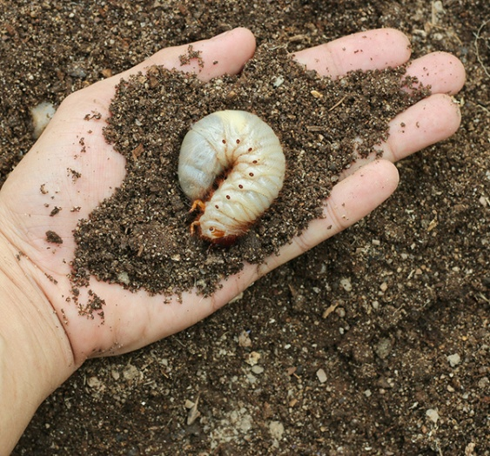
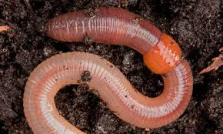

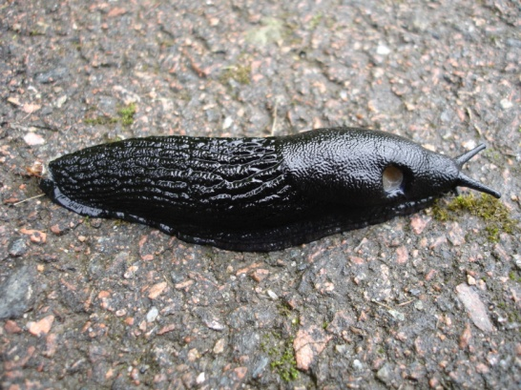
We’ll have to forage for food!
Only joking!!!!

Slide 10






We’ll have to forage for food!
That’s more like it!!! We’ll be cooking explorers!

Slide 11
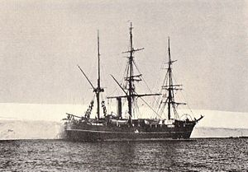






We’ll be going on a sea voyage!
And we’ll be telling the exciting story of where we went, what happened and what we discovered!

Slide 12
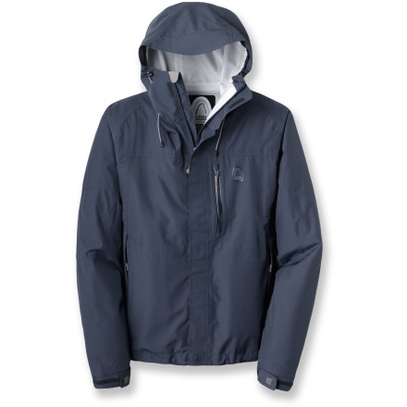
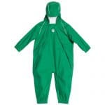


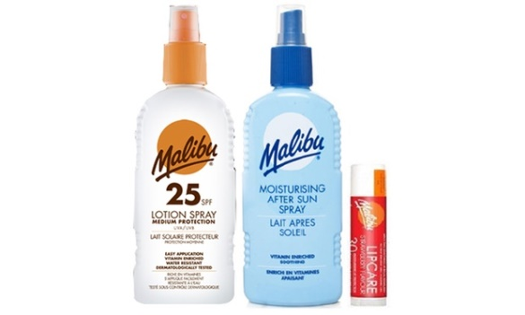

So next week…..we are off to Orcadia
We will need proper clothes because explorers go out in all weathers.
This means and or - if its wet .
Or and if it’s sunny!

Slide 13

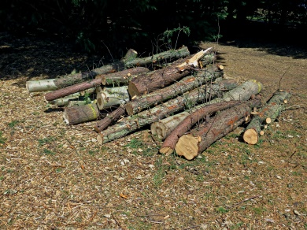
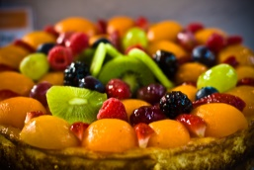


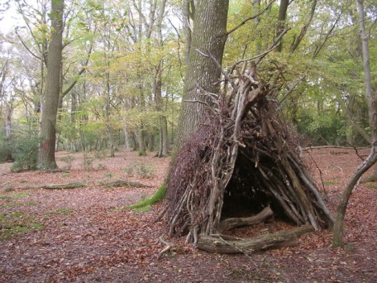

We are going to work together outdoors
We are going to learn and do exciting things
WE ARE GOING TO HAVE FUN!!!

