Slide 2
Intergenerational Learning.
Positive attitudes.
Definition of Family Learning
"Family Learning encourages family members to learn together as and within a family, with a focus on intergenerational learning. Family learning activities can also be specifically designed to enable parents to learn how to support their children's learning. 'Family learning is powerful methods of engagement and learning which can foster positive attitudes towards life-long learning, promote socio-economic resilience and challenge educational disadvantage. "
(Family Learning Network, 2016)
Notes:
SF –

Slide 3
Reflective Questions
How can we effectively engage families in the school environment?
How can we support parents/carers to support their young person?
How can we ensure meaningful family engagement?
How can we support families with developing strategies which lead to positive relationships, better earning potential and better behaviour?
Are there any aspects of already established programmes/initiatives which could transfer to our context?
How can family learning promote wellbeing and help families to deal with the impact of Covid-19 on their lives?
How will our future work with families help us to meet the needs of those most disadvantaged by Covid-19?
What contingencies can we put in place to communicate with parents, answer questions and help to address any anxieties they have?
Notes:
SF
(during the research phase)

Slide 4
Notes:
SF

Slide 5
Planning
Identify families strengths and need
1
Identify a shared goal for what we want to achieve
2
Identify relevant partner agencies
3
Develop a partnership agreement with agreed outcomes and agreed actions
4
Identify an appropriate or a new programme
5
Identify potential barriers to participation and how these will be mitigated
6
Plan and cost resources
7
Develop a baseline measurement to track process
8
Notes:
SF – introduce as factors we took into consideration during planning stage while we revisit at end of presentation.

Slide 6
We want to build on strength seen throughout Scotland
Notes:
SF – slide would benefit from being typed as it's blurry.

Slide 7
We define parental engagement as “parents’ engagement in their children’s lives to influence the children’s overall actions” (Kim 2009, 89).
Parental Engagement = “engagement” would seem to encompass more than just activity – there is some feeling of ownership of that activity which is greater than is present with simple involvement. This means that parental engagement will involve a greater commitment, a greater ownership of action, than parental involvement.
The characteristics of successful programmes to support parents are:
They focus on parents' behaviour as well as attitudes and needs
They include both parents and children
They offer group based programme
To be most effective, parental engagement needs to be rooted in the home, in an attitude that fosters learning in the home, as this has been shown to be most positively related to children’s achievement (Desforges and Abouchaar 2003; Sylva et al. 2003).
Notes:
DR
Engagement conveys a more equitable partnership where to be successful, we need to empower parents to feel part of their pupils' learning and make clear that they are just as powerful as staff in helping to shape their futures.
Janet Goodall & Caroline Montgomery (2014) Parental involvement to parental engagement: a continuum, Educational Review, 66:4, 399-410, DOI: 10.1080/00131911.2013.781576

Slide 8
Benefits of Parental Engagement
Such engagement can boost children’s self-esteem, increase motivation and engagement with learning and can lead to increased learning outcomes (Fan and Williams 2010; Fan, Williams, and Wolters 2011; Joe and Davis 2009; Kennedy 2009; Kim 2009; Lopez and Donovan 2009; Goodall and Vorhaus, 2011)
This is a move from the prioritisation of the school’s needs and desires to joint decisions between parents and schools. It does not represent a transfer of all agency from schools to parents but rather a more equitable distribution of agency with regard to children’s learning.
It creates a fuller picture of the young person for all parties as that picture is informed by knowledge from both school and home
This sort of dialogue can increase the trust between parents and the school (Lopez, Scribner, and Mahitivanichcha 2001) and begin to break down some of the barriers to parental engagement.
Pupils have an increased sense of belonging to their school community.
Notes:
DR
Not only would this partnership benefit the pupils in their attainment and help raise their self-esteem/confidence, it would also enable them to feel much more a part of the school. This would also enable parents to understand their child's learning journey and to see how they perform as a learner, which would help them to understand better where their child is; where they need to get to and how staff, parents and pupils can work together to achieve this.
Janet Goodall & Caroline Montgomery (2014) Parental involvement to parental engagement: a continuum, Educational Review, 66:4, 399-410, DOI: 10.1080/00131911.2013.781576

Slide 9
Research – Evidencing the Impact of Parenting Support
'One reason parental engagement is never “complete”, never something that can be ticked off a list and considered “done” is that each new academic year brings new cohorts of parents; children change as they age, and parental engagement with their learning, needs to adapt to these changes.’
The concept of agency, which, following Emirbayer and Mische (1998), we define as a process of social engagement informed by the past and oriented toward the future and the present and encompassing the possibility of choice and action.
It represents a change in relational agency, with the relationship being between parents and schools, and the object of the relationship being children’s learning
Parents at this point are engaged with the learning of their children not due to dictates from the school but because of their own perceptions of their role as parents (Peters et al. 2007). -
How do we get here?
Notes:
DR
AS part of our drive to encourage parents to actively engage and help guide the pupils through this, we need to show them how much of a positive impact they can make, not just in their school qualifications, but in their future achievements too. We can do this by embedding this as part of our sessions.
Janet Goodall & Caroline Montgomery (2014) Parental involvement to parental engagement: a continuum, Educational Review, 66:4, 399-410, DOI: 10.1080/00131911.2013.781576

Slide 10
Evaluation of Family Learning Projects
Improvement in literacy, numeracy and well-being of parents/young people.
Improvement in parents’ ability to help their children learn.
Enabling parents to access information and further their skills to help them with their parenting role.
Increasing the self-esteem and confidence of parents and children.
Notes:
DR
Family Learning has been proven to increase not only the literacy, numeracy and wellbeing of the pupils, but of the parents too. These 3 elements fit seamlessly into our remits and through working together on this, we can create a coherent linked approach which will benefit all.

Slide 11
Children benefitted from seeing their parent as a positive role model.​
The family as a whole spent more time together.​
Better networks lead to friendships, reduced isolation, increased employment, improved health, higher level of attainment.​
(as found by Family Learning – Family Club in Perth and Kinross.)
Notes:
DR

Slide 12
Research and Planning: National Improvement Hub – Practice Exemplars​
​
Areas in green denote key characteristics/features we wish to embed in our Family Learning Project​.
​
A family learning approach to reading – Pizza Reading in Renfrewshire.
Key Principles:
Time: 10 week blocks incorporating key activities e.g. crafts, reading etc.
Divides a session up into sections, focusing on key skills e.g. reading/writing etc.
Aimed at families with children in early primary school years.
Staffing: 2 literacy group workers
At the end of the block, families take home a Treasure Reading Box and all receive a certification of participation.
Notes:
SF

Slide 13
Family Fridays
Key Aims
Includes opportunities to build on/improve relationships with parents in a more relaxed manner.
Includes opportunities to borrow school resources to extend the child’s learning in the home environment.
Staff had recognised that there were some families that were hard to engage in the life of the school.
Staff wanted to offer an opportunity where parents could be involved in their child’s learning but also where staff could model activities and techniques to the parents.
Staff wanted to work alongside families to build capacity and support them in helping their child to learn and to encourage positive relationships with the families.
Mornings were deemed to be the best time as the majority of families were at school.
Notes:
SF

Slide 14
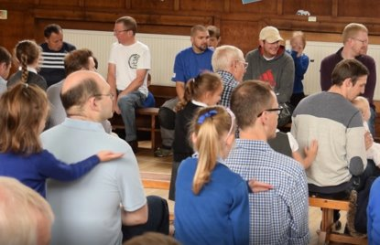
Family Learning, Clackmannanshire
Family learning group set up (ran weekly)
Families meet socially and participate in family learning activities
Programmes are developed in partnership with the families and staff to give a sense of ownership.
The programme targeted 12 adults (6 families) who had low self-esteem, mild mental health issues and were living in areas of deprivation.
Included Can’t Cook, Won’t Cook
Notes:
SF

Slide 15
Case Study 3 – Goodlyburn Primary
Men and Children Matters
Project set up to encourage the significant male figure in a child’s life to engage and achieve learning outcomes as a family. The project focuses on activities that men will take ownership of and enjoy with their children.
Aims
Fathers would hopefully engage more with projects in their community and form stronger bonds with their children and each other.
Fathers could take ownership of the project and opt to lead a session, by playing to their own skills/area of expertise.
Findings
Staff and families within this project have built up a relationship of trust enabling two way communication.
Notes:
SF

Slide 16
Fathers’ positive involvement in their children’s education has all sorts of potential benefits.
High levels of interest by a father in his child’s education, his high expectations for their achievement and his greater involvement with their schooling are associated with:
• Higher educational achievement
• Greater problem-solving skills
• Greater progress at school
• Better exam/test/class results
• More qualifications
• More enjoyment of school
• Participation in more extracurricular activities
• Better school attendance
• Fewer behavioural problems at school (e.g. reduced risk of suspension or exclusion)
All this is good for dads too - those that are involved in their children’s education have more confidence, self-esteem, are better at learning and have a better relationship with their child.
Notes:
DR
This confirms exactly how vital and invaluable it would be, if we can encourage our male parents to engage in our project. We would share this with them throughout our sessions as through demonstrating how positive an impact they can have on who their child is, and becomes, and, by sharing resources/methods and strategies with them, we could help to support them in this and to build their own confidence in working in partnership with their child.
Fathers network do work with schools – could we contact them to see how they could support the group? https://d3n8a8pro7vhmx.cloudfront.net/fathersnetwork/pages/393/attachments/original/1453204581/Factsheet-Families-WhyDadsMatterToSchoolAgeChildren.pdf?1453204581

Slide 17
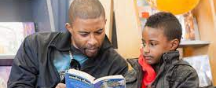
“Yeah, I guess it’s nice when your teachers are happy but your dad’s your dad!”
Pleasing his teachers was okay but what motivated him to try and behave, was his father’s approval.
Parental engagement with children’s learning – parents taking an interest in their children’s learning, talking to them about what they are learning, showing that they as parents value schools and schooling – is what will help raise achievement.
Notes:
DR 'Engaging Parents' – by Dr Janet Goodall https://learningfoundation.org.uk/5680-2/ Jane Goodall:
A few years ago, I was talking to a boy in year 7. He was already in a programme to prevent him from being excluded, and he was telling me that he was trying hard to behave well. I asked if his teachers were pleased with his progress. His answer summed up my area of research and has stayed with me –

Slide 18
• Fathers’ involvement with their children at ages 7 and 11 is related to exam performance at age 16.
• Fathers’ interest in their daughters’ schooling at age 10 is linked to educational attainment at aged 26.
• Having a father with little or no interest in his education reduces boys’ chances of escaping poverty by 25%.
• A father’s interest in his child’s education is more important in determining the child’s qualifications than contact with the police, poverty, family type, social class, housing type and the child’s personality.
Notes:
DR
Include my own experience of dad's input in learning.
The statistics showing the impact of male role models in a child's development clarify how much of a difference this can and will make to a child's potential.
Prepared by Jeremy Davies of the Fatherhood Institute

Slide 19
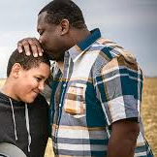
The amount of time that fathers spend with their children day-to-day has a greater effect on school marks than the amount of money they earn.
Fathers’ reading habits influence boys’ ability to read, their levels of interest and their reading choices.
Children whose fathers spend time with them, in terms of reading or going on outings, have higher IQs and are more socially mobile than those who receive little attention. The differences in life chances are still detectable by the age of 42.
Notes:
DR
This is true across all social classes – and whether the mother is highly involved too, or not.

Slide 20
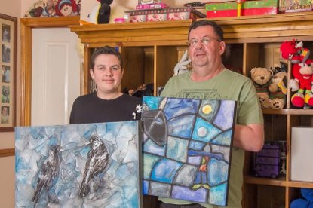
​
Children of involved fathers are more likely to enjoy school and have positive attitudes toward school. They are also less likely to fail a grade, have poor attendance, be suspended or expelled, or have behaviour problems at school. ​
High father involvement in childhood/adolescence is correlated with lower adolescent risk behaviour and criminality. ​
Fluctuations in adolescents’ satisfaction with the relationship with their father correlate with fluctuations in their psychological wellbeing. ​
We have known this for decades now, and yet it is also the case that mothers are often seen as the only parent with sole responsibility for not only child-care, but school attendance, performance in class and achievement.​
Notes:
Link to often the role of male carer in a child's life is not as recognised or celebrated as it should be.
DR

Slide 21
Notes:
DR – We wish to involve our male role models more meaningfully as demonstrated, they can have a lasting impact on their child's learning.
Preface the clip with the impact of a male role model on our young people.
Many examples on the National Improvement HUB are also focused on supporting and involving this target group so there is already so much evidence of impact/projects already successfully set up and running which we can use to feed into our own plans
It is clear more needs to be done to help strengthen and build our network with male parents and sadly, how dads are perceived in society/media, does not help our fathers feel validated.

Slide 22
Notes:
DR
Why are these images problematic? For instance in Education services and schools, both the following images head up a Curriculum for Excellence factfile – ‘Parents as partners’: Elsewhere in the Curriculum for Excellence materials there are 11 images of women and none of men (in Curriculum for excellence: pre-school into primary transitions)

Slide 23
Notes:
DR
The dad is seen as uninvolved, disinterested, absent or even worse, as abusive. Worryingly, this is often how fathers are depicted.

Slide 24
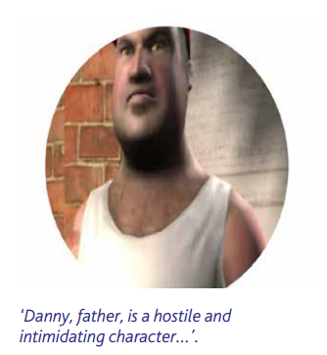
If every picture tells a story, or in the previous cases, sends a message that fathers are either non-existent or to be treated with suspicion, then the words and phrases used in these leaflets, booklets, on-line materials and other such documents also give a subtle (and sometime not so subtle) communication.
The four case studies in Building the Ambition: National Practice Guidance on Early Learning and Childcare, Children and Young People (Scotland) Act 2014 (Scottish Government, 2014) have no father present or available.
Notes:
DR
Image taken from: Centre for Child Protection at the University of Kent
Then lead into barriers that prevent dads from getting involved if these images/perception of the father figure are perpetuated in the media.

Slide 25
'How Dad Friendly is our school?’
Notes:
DR
However, we can use the evidence/research other family learning projects have shared and, conduct our own on our target male carers and we can turn this around and make all our parents feel valued, appreciated and significant.
Board of Achievement focused on dads and pupils. Bringing dads together so they don’t feel awkward. Reading/resources available to borrow.

Slide 26
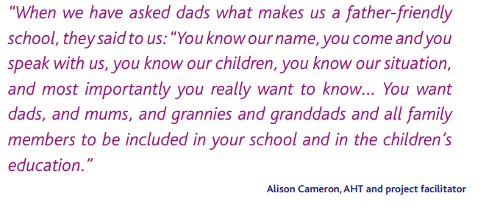
Notes:
SF
From key findings of the East Lothian Father-Friendly Schools Project. The project took place between January and June 2017

Slide 27
Barriers to engagement:
Dads’ work commitments mean they may not be available during 'standard' working hours
Even when they are available during the daytime, they may need extra encouragement to come along, in case people think they're out of work (for many men, this causes shame.)
They may not know services exist, especially if the publicity and marketing surrounding what you offer is not designed with men in mind. Unless you tell them clearly otherwise, many dads will assume your service is 'just for mums.’
If they don't live full-time with their children, they probably have only limited time with their children, and mainly (or only) at the weekend.
They're less likely to feel confident as parents and may feel wary of looking stupid in front of 'experts.'
Notes:
SF

Slide 28
Barriers and how to overcome?
Smith (2000), Hughes, Wikeley, and Nash (1994) and Vincent (1996) have highlighted the concern that a lack of consideration for the needs of families, such as times of meetings and facilities available, is a significant barrier to the active engagement of some parents.
Crozier and others have warned against one size fits all interventions for supporting parental engagement; not all parents are the same, have the same needs, face the same barriers or share the same perception of parental engagement (Crozier 2001 et al.)
Rudney (2005) explains that teachers can often make assumptions about groups of parents based on very little actual knowledge about them or their situation; this is particularly the case when parents and teachers do not share the same worldviews, experiences or social capital (Horvat, Weininger, and Lareau 2003; Kao and Rutherford 2007; Kim and Schneider 2005).
Bryk and Schneider (2002) discuss the lack of “relational trust” that can exist between parents and teachers, due to the social distance between teachers and poor parents, explaining that neither party has a full understanding of what the other is trying to achieve.
Peters, Seeds, Goldstein, and Coleman (2007) found that parents are aware of the importance of engaging with their children’s learning, yet have decreasing confidence in undertaking this role. Using interviews with staff, evidence was found that schools still see parental engagement as primarily focused on the school, with parents supporting the school (Harris and Goodall, 2008).
Notes:
SF
Janet Goodall & Caroline Montgomery (2014) Parental involvement to parental engagement: a continuum, Educational Review, 66:4, 399-410, DOI: 10.1080/00131911.2013.781576

Slide 29
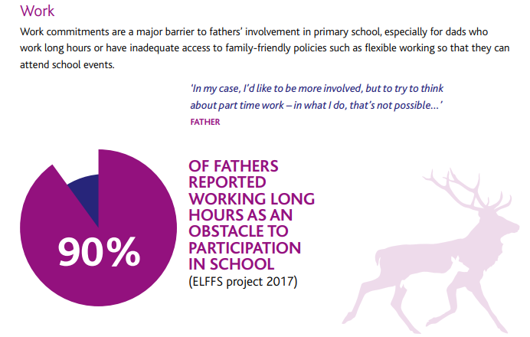
Notes:
SF – talk through we will need to overcome these obstacles/barriers once we have selected our grroups.

Slide 30
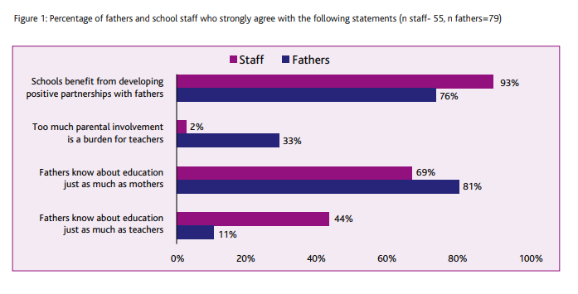
Notes:
SF
Survey done in conj. With Scottish Gov. And Fathering Network
Surveyed 116 dads and 56 staff members in the 6 participating schools.
Interviewed teachers, fathers and spoke to children.
Used info. From Milennium Cohort Study (MCS) - a large scale survey of children and their families.

Slide 31
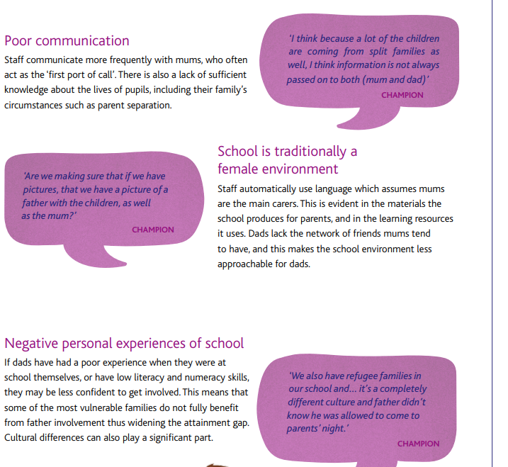
Notes:
SF

Slide 32
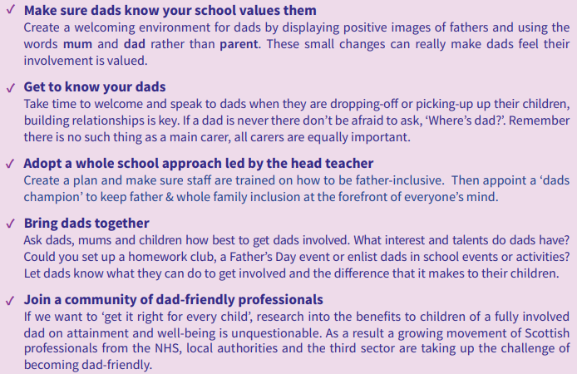
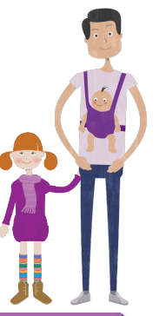
From studies across the UK we know that during lockdown the number of hours dads spent looking after their children almost doubled.
As a result, dads’ relationships with their children improved, they understood them better and they felt closer to them.
More than half said they were now more confident in their ability to support their children’s learning and two thirds said they wanted to change the way they parent in the future.
Top 5 Tips
Notes:
SF
Whole school approach? Staff all aware – training given to them too?

Slide 33
Mapping your dads
Take some time to map out the different types of dads you might have in your local community; then you’ll be in a stronger position to think about how you might shape your services with their particular needs in mind, and how you might maximise your ability to reach out to them.
Examples of ‘types’ of dad who might have different needs include:
• Older - younger
• Gay - straight
• White - black and minority ethnic
• Working - unemployed
• Religious - non-religious
• Disabled - able-bodied.
Notes:
SF

Slide 34
Ten Top Tips for recruiting more dads:
Proactively invite them
Tell them why it’s good for their children
Make your venue welcoming
Think about the format of your service
Information is power!
Get to know the local dads
Work out what dads want
Make your building father-friendly
Father-proof your marketing
Don’t give up!
Prepared by Jeremy Davies of the Fatherhood Institute
Notes:
SF
How to overcome and create a welcoming atmosphere for fathers – use info/tips from Fatherering Network pdfs.

Slide 35
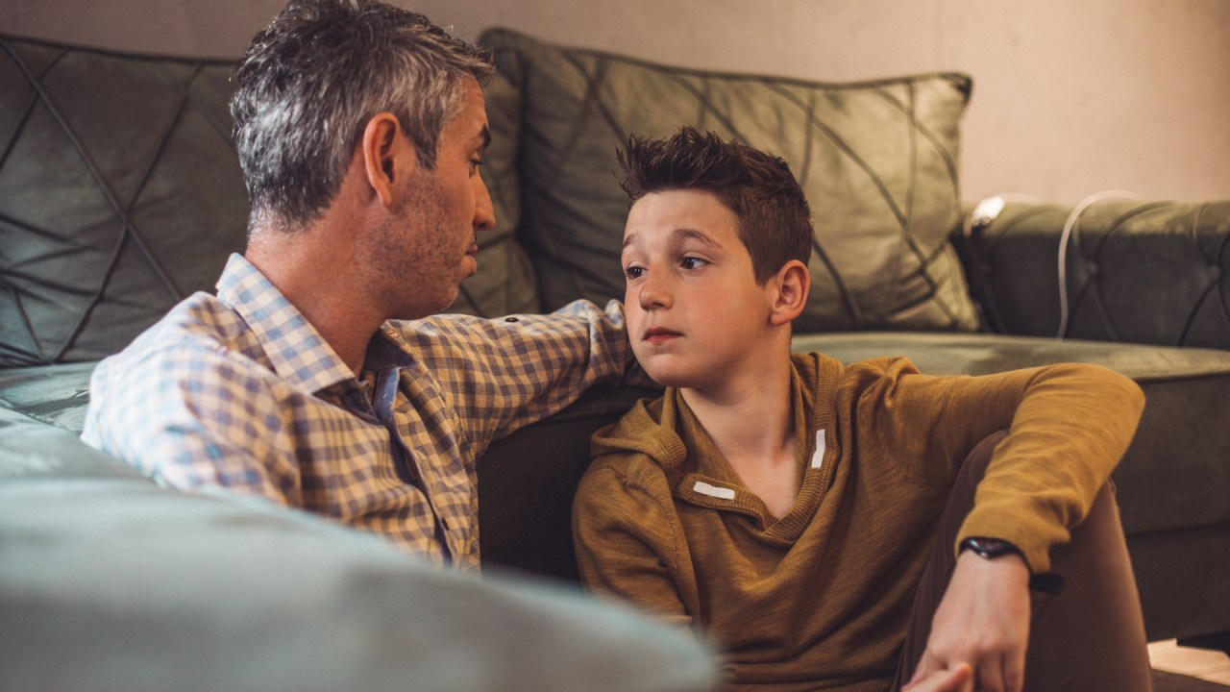
Many services fall into the trap of assuming that it's only possible to engage with fathers if there's a man on the team.
This is not the case.
Most dads say that skills and attitude are far more important than the gender of a worker - and some prefer a female worker.
In an ideal world you would have both male and female workers available - but the lack of a male worker should not put you off.
Remember, being father-inclusive is not about setting up a separate service for dads - it's about including them in all the services you offer
Notes:
SF
Can female staff engage with dads effectively... or do you need men on the team?

Slide 36
They may not themselves place a huge value on fathers' significance, so part of your job is to convince them that what they do as fathers is really important (and somewhere along the line you may need to offer space for them to offload about their relationship with their own father.)
Like some mothers, some fathers lack literacy and other communication skills, and/or are shy. There may be other social and cultural barriers too; think about ethnicity, religion, sexuality, disability.
Notes:
SF

Slide 37
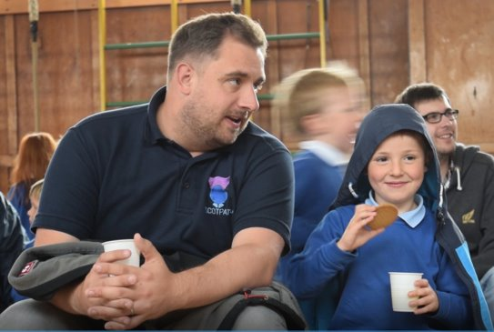
Aspects of this we could incorporate:
10 week block – 2 hours potentially (morning after Primary School Drop Off) (could incorporate 10 hour time-frames for unit accreditation – we would want to enter both parents/guardians and the young people so they could all achieve a sense of pride, satisfaction and increased sense of self-esteem that they have achieved SQA Units.)
Costings (out of RA Budget – SQA Entry fee for adults)
Treasure Box → could become a folder/scrap book of work done; photographs of families working together, storyboards; posters, art work etc. (something akin to the old ROA folders?)
Cost: Box file/plastic folder with poly pockets in it/key hand-outs/fact sheets)
Key skills/shared tasks – e.g. cooking competition – families competing against each other – following recipes/weighing out ingredients (Lit/Num Skills and Well-being through increase in self-esteem/confidence.)
Costings – ingredients etc.
Notes:
SF

Slide 38
Rationale
Integrates both SF’s and DR’s main remits (literacy, numeracy and well-being.)
Makes use of already concrete evidence (families requiring support who we both work with.)
To raise standards of literacy, numeracy and well-being for both young people and their families.
To improve parental skills in supporting their young person’s learning.
To provide opportunities for parents and young people to encourage a love of learning.
Notes:
DR

Slide 39
Our Proposal for Family Learning Stage 1
A weekly 2 hour session involving parents/pupils (to run out of HUB/B10 etc?)
Number of families (dads+pupils) – approx. 6-8?
Initial Staffing: (would open up to other staff/external partners after project is up and running.)
Each session would be broken down into small manageable slots (cf. Pizza Reading) which would incorporate/work on key skills/areas (Literacy, Numeracy and Health and Well-Being.)
Every session would follow the same basic structure (see next slide for an exemplar.)
Families/the group will work together on key tasks/activities which could be built around the requirements for Unit accreditation.
Everyone would work together and support one another.
Session content would be based on parent/pupil input (including the opportunity to lead on a task, which plays into their strengths etc.)
Notes:
DR

Slide 40
Sessions would vary, each week depending on interests of the groups.
They would revolve around key literary and numeracy skills while also looking at well-being concerns
Other elements could be added in, hopefully with families choosing to lead on an activity.
These sessions would be tailored for the individuals but would also give opportunities to achieve qualifications for young people and guardians.
Time allocated for Reading, Writing, Numeracy and Well-Being would be equal, across the block/term.
Notes:
DR
Well being concerns e.g. (e.g. too much screen time/late nights) and how to support pupils to reduce this (a well being survey would be needed in session 2, if not session 1.
(families leading: e.g. a craft, how to draw a manga character; how to bake/cook etc.)

Slide 41
The following could be invited to lead sessions once the group was established and up and running:
External Partners​
Moray Food Plus Group (have ran cooking sessions previously)​
SDS
School Pastors
Internal Partners:​
HE Teachers, Science Department, Art Department, Music, Technical Department etc.​
(each session a different skills/subject could be incorporated where families would learn something new and then work on this together (following a set of instructions.)​
​
​
Notes:
SF

Slide 42
To develop families’ confidence and self-esteem and to offer them tools/resources which they can they also use for home learning together.​
To increase confidence and enable meaningful parental involvement in all aspects of their young person’s education.​
To encourage a legacy of cultural change and to help to break down barriers for families towards learning and education.​
To empower participants to pursue new opportunities as a result of their involvement in family learning.
Notes:
SF – Aims of project

Slide 43
Exemplar Session Structure (using Pizza Reading as a model)
Time | Activity | Resources | Notes
10 minutes | Welcome | Tea/coffee/juice/cups/ biscuits | Families settle in with tea/coffee/juice etc. and then move onto homework if young people have any. Staff offer support too, if needed.
15-20 minutes | Icebreaker | A3 paper and marker pens | Pupils/parents create a poster together including key areas which will in turn, feed into future sessions. Key areas: interests/hobbies; what they enjoy(ed) at school and why; what helps them learn; key strengths; main barriers to learning; what they would like from the sessions and why; hopes/aspirations for the future
30 minutes | Reading | Books/short stories and paper | Staff, parents and pupils take turns at reading aloud. Could be done in groups (ability level, if needed.)
10 minutes | Discussion | Paper | Families take turns at taking notes from the discussion (plot summary, characters etc.)
30 minutes | Writing | Paper | Could be linked to text/main ideas in book or to lead into a Numeracy task.
20 minutes | Numeracy | Games/Puzzles
5 minutes | Summary |  | Sum up of session – sharing views/what went well/what would they like to do more.
Notes:
DR
Could include facts/info on the important/positive impact of fathers in their children's lives and use these to add to a noticeboard so all parties can see how beneficial it will be (inc.. Long term impact for the future.)

Slide 44
Possible Units: (all level 2-4)
Communication (if all 4 achieved, families could achieve the Communication Unit – F3GB 08, 09 or 10 - 40 hours in total):
Listening (could be beneficial for improving communication in families.) – F3GM 08 (Level 2)/F3GM 09 (Level 3)
Speaking – F3GN 08 (Level 2) or F3GN 09 (Level 3.)
Reading – F3GN 08 (Level 2) or F3GN 09 (Level 3.)
Writing – F3GR 08 (Level 2) or F3GR 09 (Level 3.)
Working with others – would fit in perfectly with the objective of Family Learning:
F3GE 09 (Level 2), F3GE 09 (Level 3), F3GE 10 (Level 4)
Problem Solving:
F3GD 08 (Level 2), F3GD 09 (Level 3), F3GD 10 (Level 4)
Notes:
SF
When would FA need to sign up for these to ensure these could be awarded in August 2022? - see Morven.

Slide 45
Embedding Core Skills Into Family Learning Programmes
Pupils and Adults would both be entered for SQA Accreditation.
Each unit would need 10 hours so would take up a considerable amount of the 2 hour slots.
Would need to incorporate the tasks within the time so that these naturally could occur over the sessions.
Would need to be careful in ensuring that the time that could be spent working together, was not impacted upon or took a back seat, so that the predominant focus was accreditation.
Notes:
SF
How could we ensure this did not occur?

Slide 46
Barriers to Engagement and ways we could overcome these
Meeting Times and Suitability --> asking families when most suitable to meet and going with the majority; possibility of a creche for families who also have young children, not yet at school.
Stigma of needing support --> mixing up families invited (some very involved/engaged, some not so) - we are interested in their views/their voice and that's why they have been picked.
Gender Bias --> females still predominately seen as lead care giver/nurturer in families – how can we enable/empower the male family members to see their importance?
Self-Confidence – stepfathers/dads now taking on lead role – how do we support them in this sudden shift?
Lack of trust – already strong relationships in place as a starting point.
Their opinions of school - especially if it was negative/seen as offering little value.
Resistance from lower income families.
Notes:
SF

Slide 47
Development Ideas for the future:
Dynamic Youth Award in Health and Well-Being?
Handling Children’s Behaviour Course – could this be offered later on, through the use of external agencies?
Staff invited to lead on a 20-30 minute task e.g. science experiment, PE families obstacle course – competing/working together; Cooking challenge (each family gets same ingredients and time to plan out what to make) etc.
Parents/guardians could then potentially become the staff in year 2.
External partners becoming involved e.g. Moray Food Plus Group for cooking sessions.
YPI structure of stalls for parents/families to go and visit/ask for advice in hall ) e.g. Internet Safety, Suicide/Self Harm Info/Agencies who can support/Moray College (e.g. for signing up for college option in S4.) This could also be lead by families who would then create a stall e.g. a game (e.g. fairground game/skill) which families could join in with.
Notes:
SF

Slide 48
Activities and Time Line – what, who and when?
Gather information from target groups (SF – In next fortnight)
Identify families (completed) and create shortlist to invite to sessions (DR/SF - next week.)
Invite sent to shortlisted families (DR – send out letter week 7 of term. No response = acceptance. Any who choose not to engage, due to come back before holidays and invites can go to other families.)
Research/familiarise ourselves with unit requirements. DR/SF – Sept/Oct.
Creation of lessons – DR/SF - end of Sept/start of Oct.
Sessions up and running after Oct Hols (DR/SF - in discussion with EM/DM.)
Info shared with staff too so they can see how the needs of the families/pupils are being addressed (DR - week 1 after Oct. Holidays.)
Notes:
DR
1. (e.g. survey or, at first meeting so that this info is then seen by the group as being embedded in the key direction of future sessions – Intro sessions/meet each other/overview of sessions/get their input which will then lead the direction of future sessions.
2. a group of young people where dads are main carer or, who have one parent as main carer. These would also likely be from families where the parents and/or young people did not always engage. We could also create a mixed group of engaging parents/pupils and less engaging, to try and pass on skills/input to build on parental participation.
3. with aims; overview of the plan; an exemplar session and accreditation/benefits to learning and, a request for the most suitable times (e.g. after Primary Drop Off.) Leaflet/Invite to parents/guardians/pupils at this point. Assume attendance unless state otherwise. Creche a possibility? -

Slide 49
Identify families strengths and need
1
Identify a shared goal for what we want to achieve
2
Identify relevant partner agencies
3
Develop a partnership agreement with agreed outcomes and agreed actions
4
Identify an appropriate or a new programme
5
Identify potential barriers to participation and how these will be mitigated
6
Plan and cost resources
7
Develop a baseline measurement to track process
8
Will be done after identified families are surveyed/contacted.
Will be done once stage 1 is up and running.
Will be done once final families are selected.
Notes:
DR

Slide 50
Notes:
Conclusion - DR
The good news is, any service can become father-inclusive. It won’t happen overnight –service providers need to change their mindset and start believing in dads, recognising their contributions to family life, and re-shaping their services to support them to positively connect with and develop positive relationships with their children.

