Slide 1
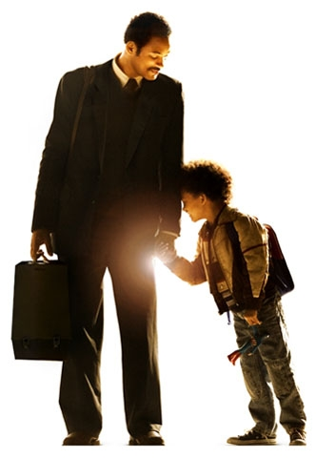
Happiness
http://desktop.fansshare.com/gallery/photos/16819700/films-like/?displaying
Notes:
Presentation about happiness and what we can do to help ourselves be a happier society
How can we find happiness?
Action for happiness is a project that is currently taking place- the movement is all about trying to create more happiness around them
Aim- to create more happiness and less misery

Slide 2
Action for Happiness
https://en.wikipedia.org/wiki/Dalai_Lama
Notes:
Dalai Lama is the patron of this movement- they are taking action to improve the wellbeing of members in their homes, schools, workplaces
Providing coursed and lots of resources for member to take care of themselves and try to improve their way of life.
We can each affect our happiness and the happiness of those around us… Happiness is contagious
What causes happiness?

Slide 3
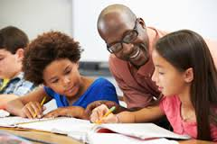
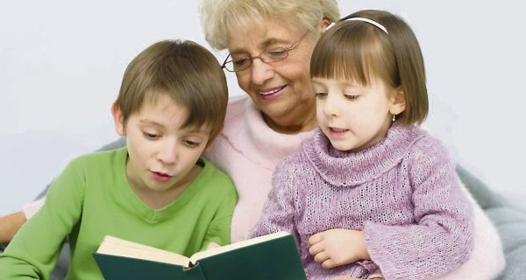
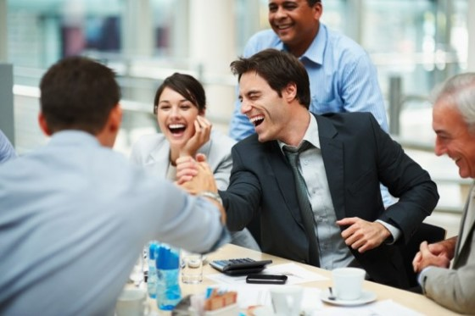
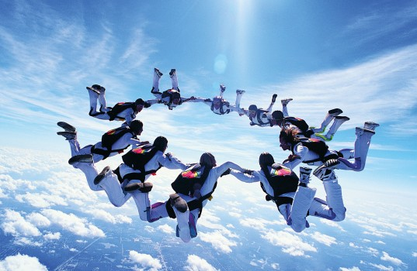
Positive relationships
Notes:
The relationships we have is the most important external contributor- want to achieve positive, loving and collaborative relationships. This is within all of the different communities you are part of. Need to be able to listen to each other and support in the best way you can. Within schools it is important for teachers to have a good relationship with the pupils so as the student can develop respect and trust. Parental involvement in school, braking the barrier between home and school, child will begin to understand that there is a community of people that are there to support and to help achieve

Slide 4
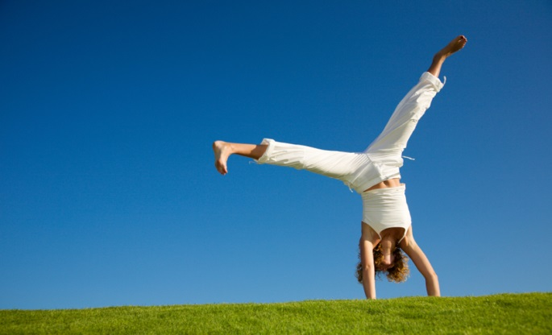
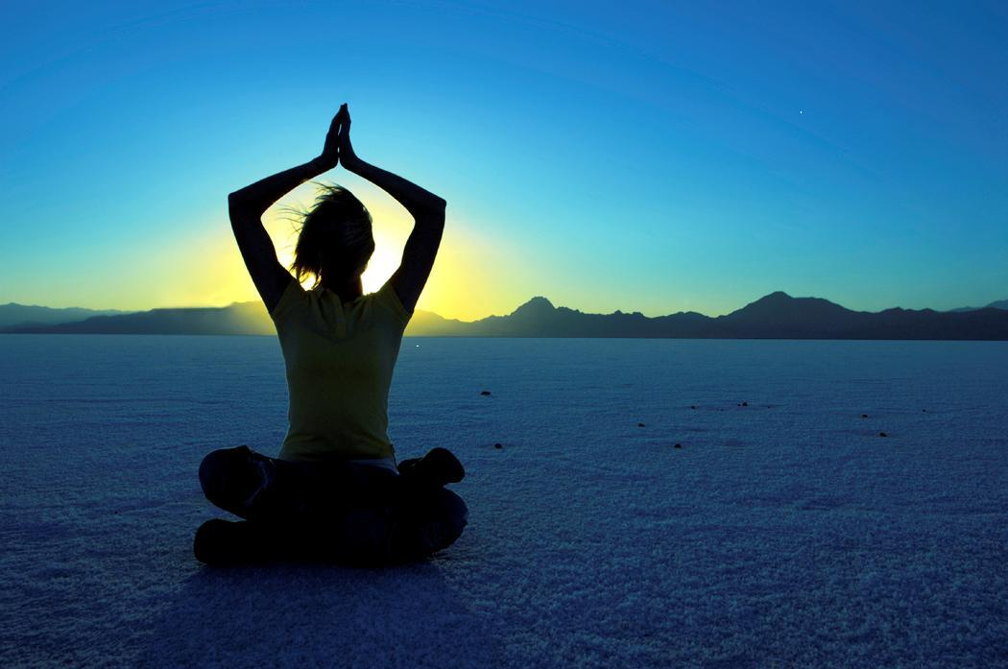
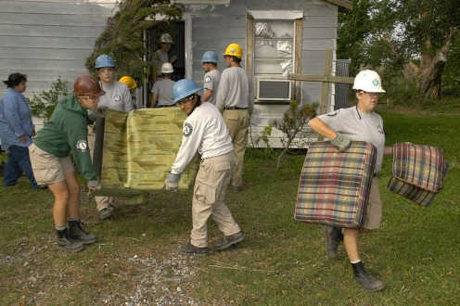
Good mental health
Notes:
connect – connect with the people around you: your family, friends, colleagues and neighbours. Spend time developing these relationships.
be active – you don't have to go to the gym. Take a walk, go cycling or play a game of football. Find the activity that you enjoy and make it a part of your life. Learn more in
keep learning – learning new skills can give you a sense of achievement and a new confidence. sign up for cooking course, start learning to play a musical instrument, or figure out how to fix your bike?
give to others – even the smallest act can count, whether it's a smile, a thank you or a kind word. Larger acts, such as volunteering at your local community centre, can improve your mental wellbeing and help you build new social networks.
be mindful – be more aware of the present moment, including your feelings and thoughts, your body and the world around you. Some people call this awareness "mindfulness", and it can positively change the way you feel about life and how you approach challenges.

Slide 5
Help others
Notes:
Helping others helps up connect together, sense of meaning
More accepting, creates a stronger community

