Slide 1
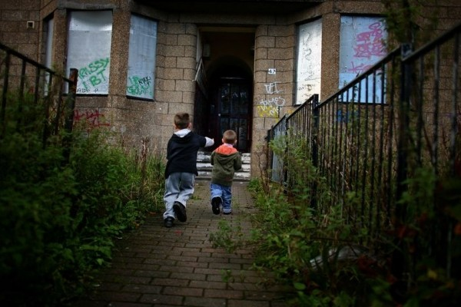
Herald & Times Group (2015)
Notes:
Herald & Times Group (2015) Relentless rising cost of housing means one in four Scottish children is left living in poverty. Available at: http://www.thenational.scot/news/relentless-rising-cost-of-housing-means-one-in-four-scottish-children-is-left-living-in-poverty.8598 (Accessed: 04/11/15)

Slide 2
BBC (2014)
Notes:
BBC (2014) Scottish Greens Urge Action Over Pay Inequality. Available at: http://www.bbc.co.uk/news/uk-scotland-scotland-politics-27266883 (Accessed: 04/11/15)

Slide 3
Energy Action Scotland (n.d)
Notes:
Energy Action Scotland (no date) Tackling Poverty in Scotland. Available at: http://www.eas.org.uk/page.php?id=2263 (Accessed: 04/11/15)

Slide 4
Education Scotland (n.d)
Notes:
Education Scotland (no date) Early Learning and Childcare. Available at: http://www.educationscotland.gov.uk/learningandteaching/earlylearningandchildcare/ (Accessed: 04/11/15)

Slide 5
Travel Easy Edinburgh (n.d)
Notes:
Travel Easy Edinburgh (no date) Scottish Tours. Available at: http://www.traveleasyedinburgh.co.uk/leisure-transport/scottish-tours/ (Accessed: 04/11/15)

