Slide 1
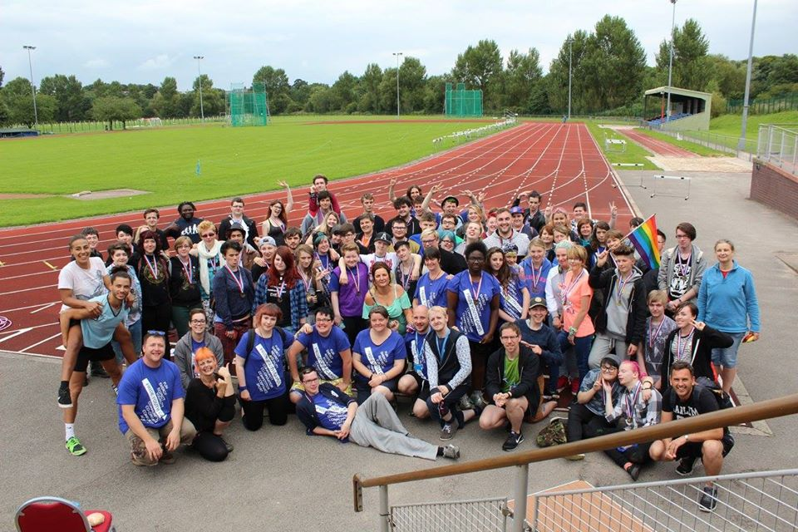
Pride Youth Games 2020

Slide 2
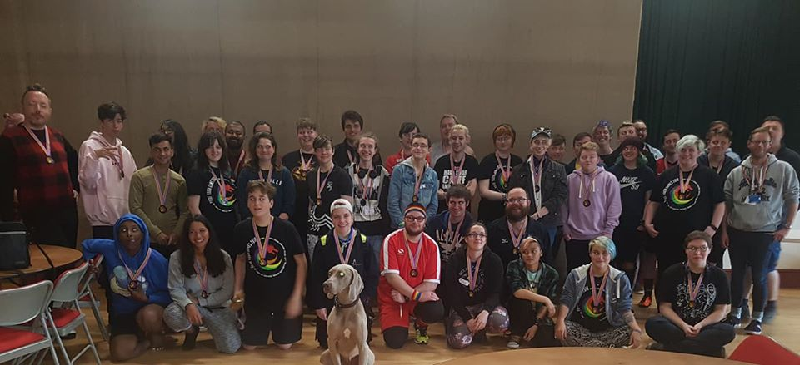
What is Pride Youth Games?
Pride Youth Games (PYG) is a FREE residential weekend for LGBTI young people from across the UK, aged 16-25, to take part in a range of sports and activities in an environment where they can feel safe, included and validated.

Slide 3
Pride Youth Games
Pride Youth Games are an annual event which take place in a different part of the UK every year. These are organised by Pride Sports in England, LGBT Sport Cymru in Wales and LEAP Sports in Scotland.
The Games have been to Carlisle, Stirling, Pembrokeshire and Manchester.
This year, the Pride Youth Games are back in Scotland.

Slide 4
Pride Youth Games 2020
This year, the Pride Youth Games will be held in the Sport Scotland Inverclyde National Training Centre in Largs, a seaside town in Ayrshire.
Friday 7th – Sunday 9th August 2020

Slide 5
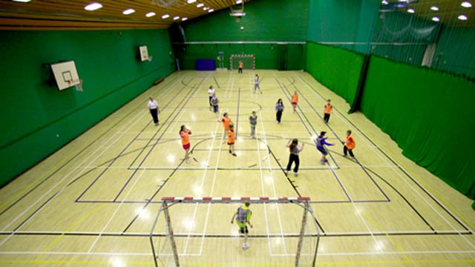
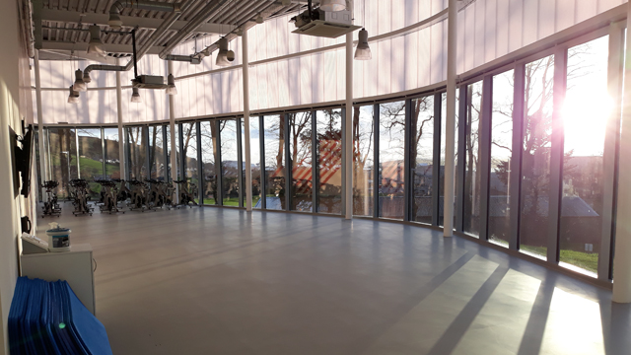
Sport Scotland Inverclyde National Training Centre
This training centre has state of the art facilities, including:
3G Football pitches
Fitness Suite
Sports and Gymnastics Halls
A target range
Golf driving range
Tennis courts
2 studios

Slide 6
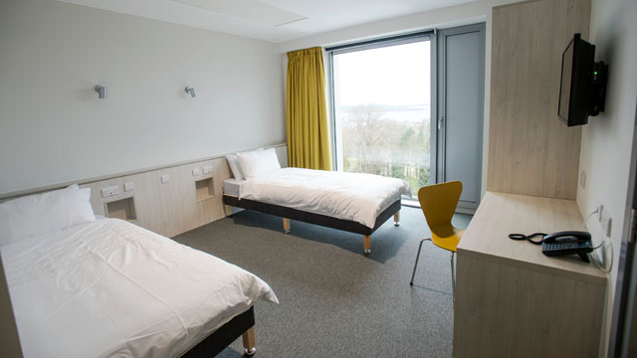
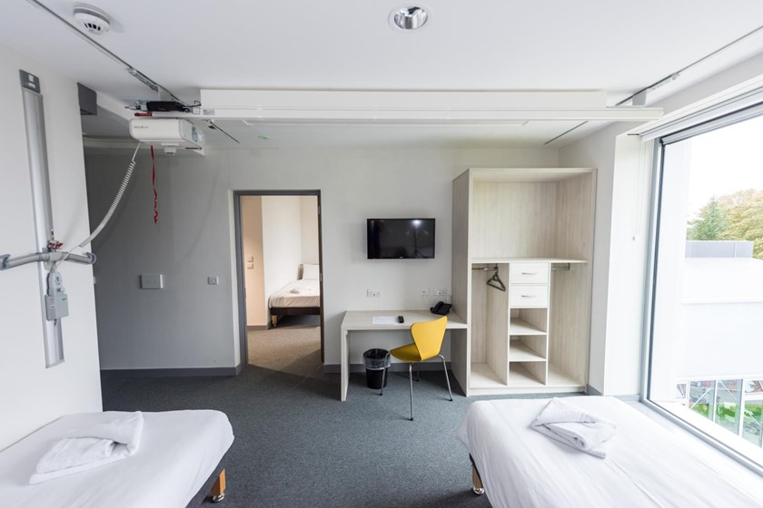
Accommodation
The Inverclyde National Training Centre has 60 twin rooms, each with an en-suite wet room, television and a view of the seaside or landscapes. All areas are accessible by lift. There is also wi-fi available.

Slide 7
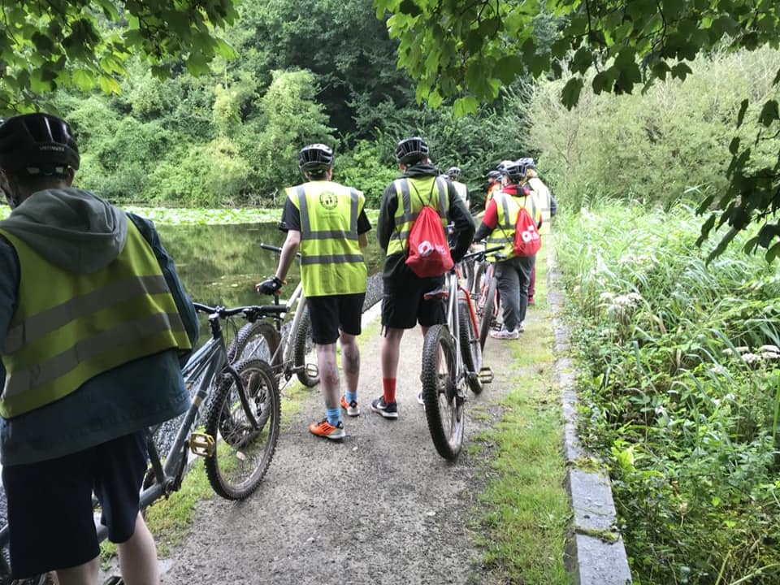
Why should you come to the Pride Youth Games?
The Pride Youth Games offer a variety of sports and activities which you can try, in a safe and welcoming environment. You don’t have to be “sporty”, it’s all about meeting with other LGBTI young people, taking part in sport and having FUN!

Slide 8
At previous Pride Youth Games, sports have included;
Football
Wheelchair Basketball
Badminton
Water Sports
Handball
Archery
Softball
Sports Day
Swimming
Roller Darby
Climbing

Slide 9
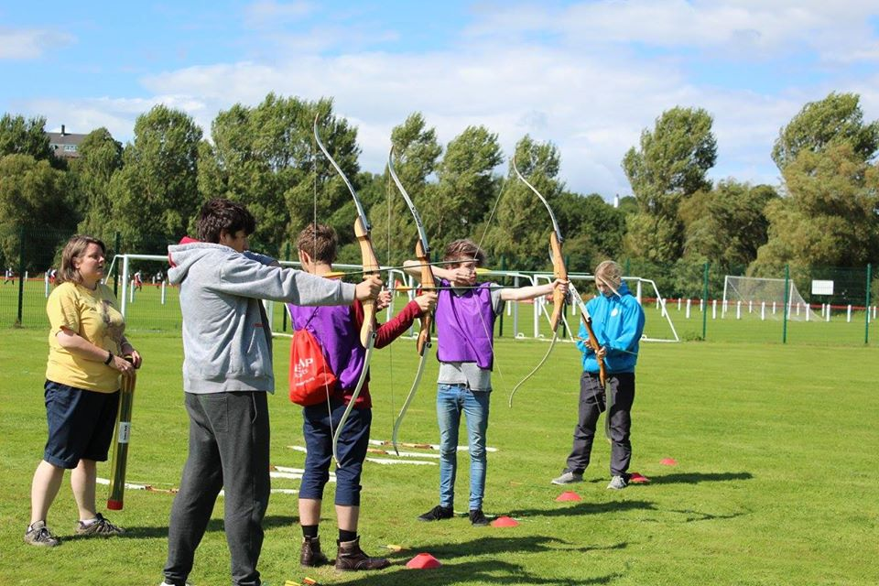
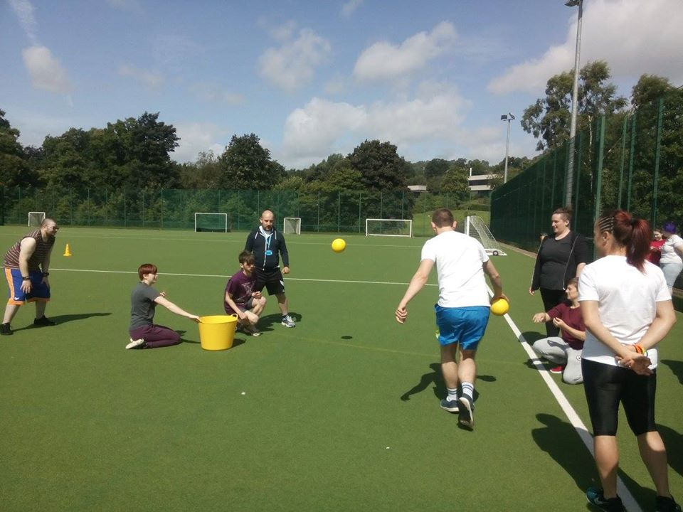
“It’s great being somewhere that I can enjoy sports and not worrying about changing rooms or anything.”
“I came so that I could do sports with people like me.”
“Something that I’m really looking forward to is just exploring new sports in a safe environment where I don’t have to pretend to be something I’m not.”

Slide 10
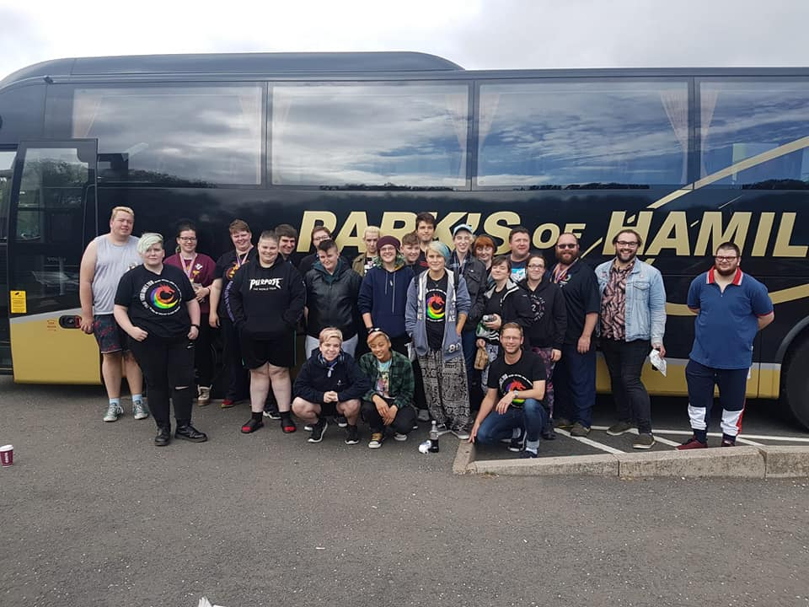
Where do I sign up?
If you are interested in coming to the residential, you can sign up online through the SurveyMonkey link.
There is no cost to the residential, with accommodation, food and activities all being provided. Transport can also be provided if it is needed as well.

