Slide 1
Keiss Primary School and Nursery
P1-3 Remote Learning Consultation
May 2020

Slide 2
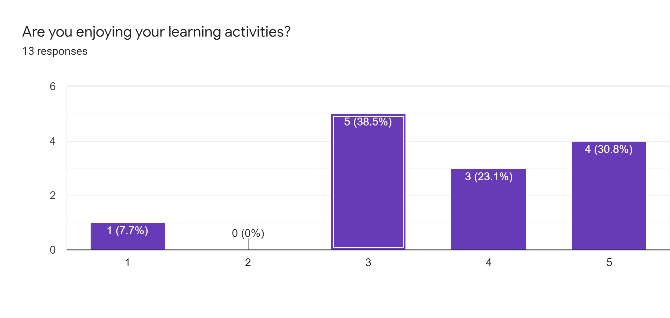
1 – A little bit.
5 – Yes, I am really enjoying my learning.

Slide 3
