Slide 1
#SCELTLP
Jayne Mays
My Leadership Journey
Teacher Leadership Programme
Notes:
You will have 10 minutes to tell your leadership journey. One minute to introduce yourself and three minutes for each of the following image slides.
Please note: You are not expected to tell the story of your enquiring approach in this presentation, this is the purpose of your poster. You may need to mention your enquiring approach, but you are encouraged to focus on your leadership learning through this programme.

Slide 2
Notes:
At the beginning of my Teacher Leadership journey, my head was full of ideas. Full of ideas for Digital Learning, Technologies and STEM. I was always thinking of and seeking out new and inventive ideas of things to do with my classes, how to get my colleagues on board and how to keep the pupils engaged as I wanted them to enjoy it as much as I did. It was overwhelming sometimes, and I felt there was no real definite path to go down. Over the past 3 years, I had been responsible within driving forward and embedding digital learning/technologies within our school. This was something we had achieved, and I guess if I’m honest I wasn’t sure where to turn next on our journey, and what our next steps as a school were.

Slide 3
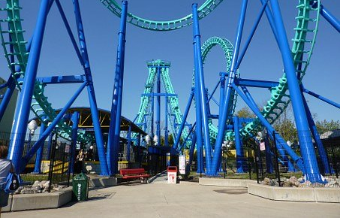
Notes:
Throughout my Teacher Leadership Journey enquiry, there were a lot of ups and downs. The ups and downs included the realisation that my enquiry was not playing out the way that I had initially planned due to circumstances in school. Another obstacle was Covid-19, the closure of the school meant that I could no longer gather my data that I was hoping to use as a comparison especially with only a small amount of the pupils involved in the research accessing online learning. These experiences have facilitated the development of flexibility and creativity in my thinking, allowing the issues that I faced to be solved. Luckily enough, I came out the other end with some data that I could use and share with colleagues as a starting point for the future of STEM in our school.

Slide 4
Notes:
This image represents the future for my Teacher Leadership Journey. The opportunity of participating in the Teacher Leadership Programme has supported the realisation of my interest in STEM subjects and explore this further. In other words the TLP has acted as a springboard onto something bigger and better than I envisioned at the beginning of my journey. Within five months of starting the TLP, I applied for, and was successful in gaining, a place in the PG Cert in STEM with Primary Engineer and the University of Strathclyde. My enquiry and PG Cert have gone hand in hand the past six months and I now hope to continue and deepen my enquiry further in my second module.

