Slide 1
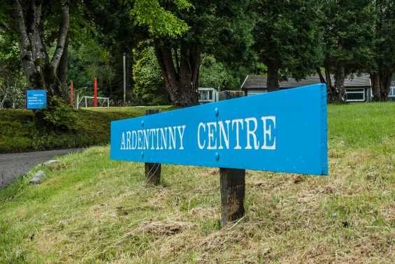
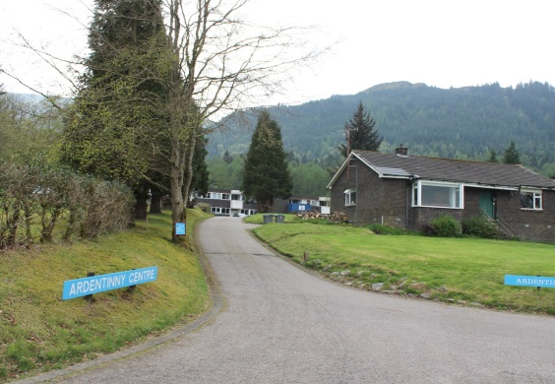
Ardentinny 2027 Residential Trip
10th-13th May 2027
Information Evening for Parents/Carers

Slide 2

Ardentinny Background
A Charitable Organisation (Non-profit)
Based in small village of Ardentinny near Dunoon
A successful record of over 20 years working with schools and young people
Strong links with our school
Work in partnership with schools to ensure a programme and approach tailored to the desired outcomes for pupils
- Develop resilience, personal achievement and challenge - Develop and strengthen relationships across P7
- Introduce a new range of skills through activity based opportunities
- Build self-esteem and an increased confidence
- Broaden children’s experiences
- Have a unique and unforgettable experience

Slide 3
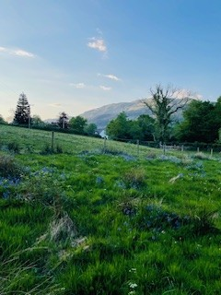
Key Information
Preparing for the trip (Kit List)
Money
Medicine (forms completed and medicine (labelled) handed in to school office before the day of the trip preferably)
Payments
Departure Details
First day arrangements
Dorms
Meals
Typical Day
Range of activities
Return Details
Questions

Slide 4
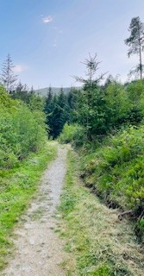
Preparing for the Trip – Kit list
Clothing
- Nightwear
- Underwear
- Socks, over ankle length (2/3 pairs per day)
- 3 or more fleeces or sweatshirts
- 5 T-shirts
- 3 long sleeved T-shirts
- 4 pairs of old trousers (not jeans) – 3 for activities and 1 for evenings
- 2 pairs of shorts
- 2 pairs of trainers (1 for wet activities)
- 1 pair of shoes or trainers for indoors
- Baseball cap / Hat
- Swimwear
- Clothing for Disco

Slide 5
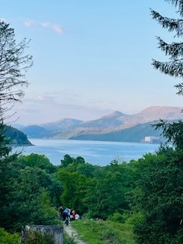
Kit list continued…
- Wash Bag (toothbrush, toothpaste, deodorant (roll on only), shampoo)
- 2 large towels
- Torch and batteries
- Plastic bottle for drinks
- Plastic container/lunch box
- Sunscreen
- Pencil, paper and book
- Small bag or rucksack
- Labelled plastic bags / bin liners (for wet items)
Spending money – no more than £10 in clearly labelled wallet

Slide 6

Please do not bring…
- Mobile phones and chargers
- Hairdryers/Straighteners (hairdryers will be provided by the centre)
- Radios/MP3 player
- TV’s/Electronic games
- Football strips
- Chewing Gum
- Aerosols (can set fire alarms off)
Fizzy drinks

Slide 7

Medicine
Additional Snacks
Forms completed and medicine (labelled) handed in to school office before the day of the trip preferably
For complex needs or concerns please contact Miss Lurinsky directly to arrange a meeting
Small amount of own snacks for between mealtimes e.g. 4 packets of crisps and/or cereal bars – no nuts!

Slide 8
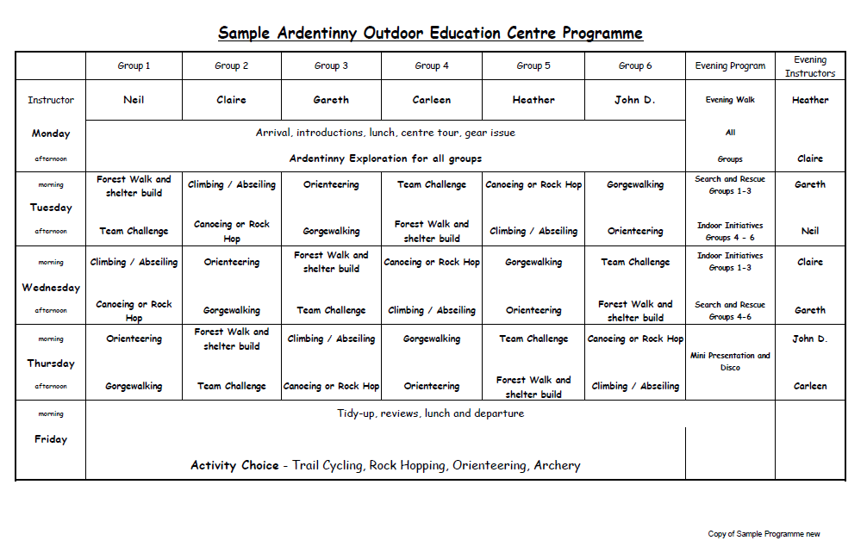
Sample Activity Timetable

Slide 9
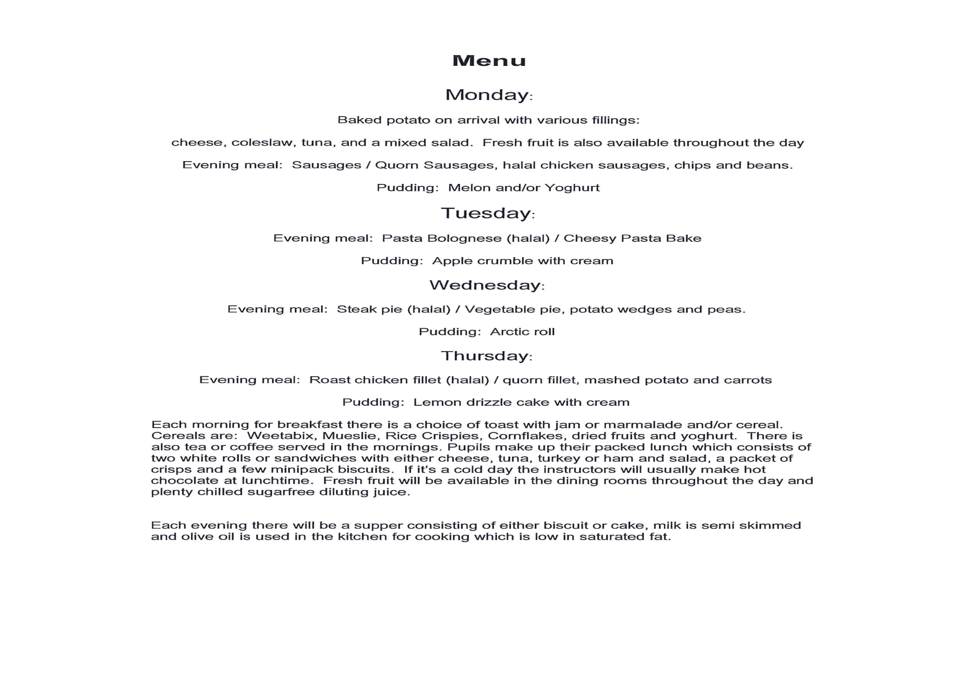
Sample Menu

Slide 10
Total Cost and suggested payment plan
£300 Overall Price – all payments made via Parent Pay
Date | Amount
23rd October 2026 | £60 Deposit
27th November 2026 | £48
26th December 2026 | £48
30th January 2027 | £48
27th February 2027 | £48
27th March 2027 £48 final payment

Slide 11
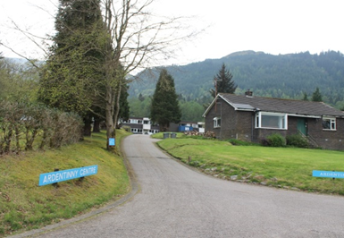
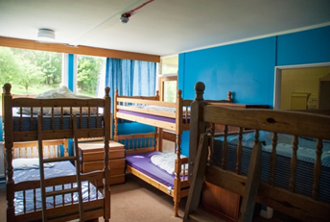
Departure Details
First day arrangements
Return Details
Dorms

Slide 12
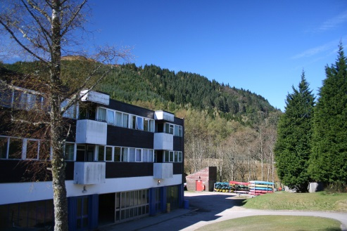
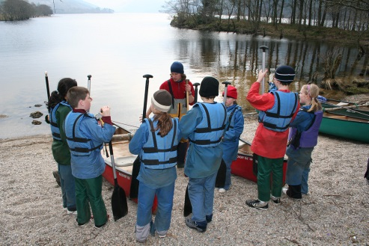
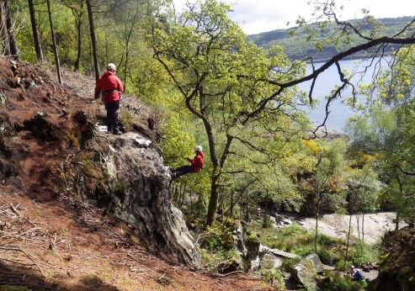
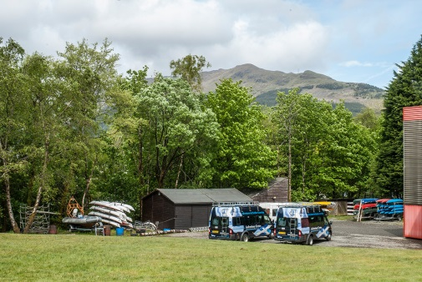
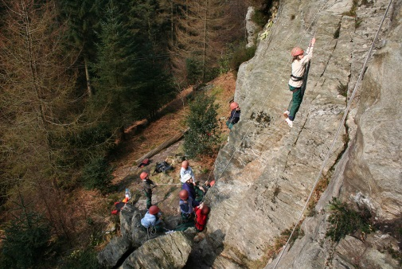

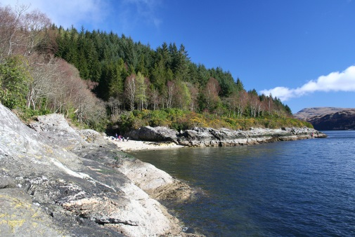
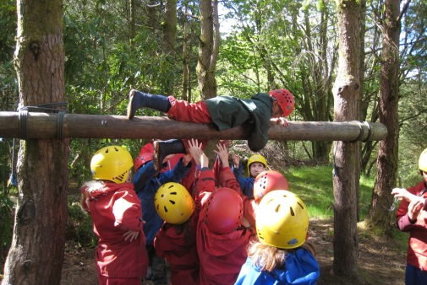
Photos

Slide 13
Thank you for coming along to find out about the trip!

