Slide 1
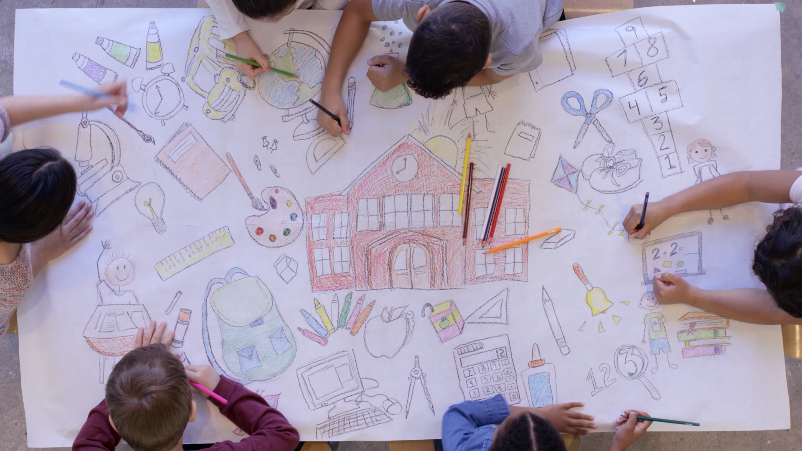
Hillhead Primary School Values

Slide 2
What is a value?
Why are they important?
🌟 What Are Values? 🌟
Values are the things that help us to understand what is important in life. They are like guiding stars on how to treat each other and make the best choices.
Why Are Values Important in Our School?
They help us work and play together happily
They make our school a safe and friendly place
They teach us how to be the best friend, best learner, and best person we can be.
When we live by our school values, we all shine!

Slide 3

Discussion Time
What are YOUR values?
Take a moment to ask yourself…
- What is important to you?
- What do you believe in?
- What kind of person do you want to be?

Slide 4

What are our School Values?
🌟Our School Values🌟
🤝 Respect Listen to others Respect school property Be kind and polite | Honesty Tell the truth Be trustworthy
🦁 Courage Try new things Speak up when something is wrong | ⚖️ Fairness Take turns Share and be fair to everyone

Slide 5

Respect
🌟 What Does Respect Look Like in Our School? 🌟
Examples of Respect:
Listening carefully when someone is speaking
Using kind words and saying “please” and “thank you”
Being polite to teachers and friends
Waiting your turn and sharing with others
Taking care of our classroom and school property
When we show respect, we make our school a happy place for everyone!

Slide 6

Honesty
🌟 What Does Honesty Look Like in Our School? 🌟
Examples of Honesty:
- Telling the truth even when it’s hard
- Admitting when you’ve made a mistake
- Being fair and truthful in games and activities
Honesty helps everyone trust each other and feel safe!

Slide 7

Courage
🌟 What Does Courage Look Like in Our School? 🌟
Examples of Courage:
- Raising your hand to ask or answer questions
- Trying something new even if it feels tricky
- Standing up for a friend who needs help
- Telling a teacher if something is wrong
- Keep going even when things are hard
Courage helps us grow and be brave every day!

Slide 8

Fairness
🌟 What Does Fairness Look Like in Our School? 🌟
Examples of Fairness:
- Taking turns when playing or talking
- Sharing with classmates
- Following the rules in games and activities
- Listening to everyone’s ideas
- Treating others the way you want to be treated
Fairness makes school fun and friendly for everyone!

Slide 9

Our 5th Value
🌟 Your Turn! 🌟
Now we want you to think of a 5th value for our school!
What else do you think is important for us to be happy, kind, and successful together?
It could be something like:
Creativity
Patience
Resilience
Or something YOU think is special to Hillhead!
Share your ideas — let’s make our school even better!

