Slide 1
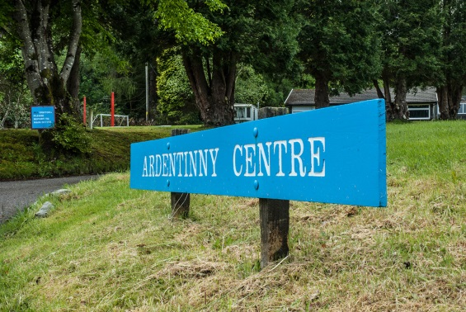
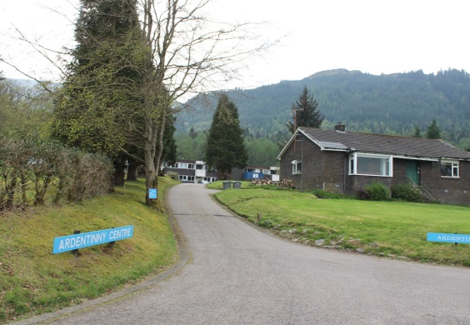
Ardentinny 2026 Residential Trip
11th-14th May 2026
Information Evening for Parents/Carers

Slide 2

Ardentinny Background
A Charitable Organisation (Non-profit)
Based in small village of Ardentinny near Dunoon
A successful record of over 20 years working with schools and young people
Strong links with our school
Work in partnership with schools to ensure a programme and approach tailored to the desired outcomes for pupils
- Develop resilience, personal achievement and challenge - Develop and strengthen relationships across P7
- Introduce a new range of skills through activity based opportunities
- Build self-esteem and an increased confidence
- Broaden children’s experiences
- Have a unique and unforgettable experience

Slide 3
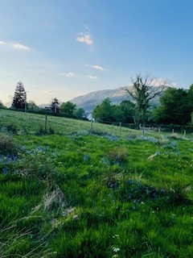
Key Information
Preparing for the trip (Kit List)
Money
Medicine (forms completed and medicine (labelled) handed in to school office before the day of the trip preferably)
Payments
Departure Details
First day arrangements
Dorms
Meals
Typical Day
Range of activities
Return Details
Questions

Slide 4
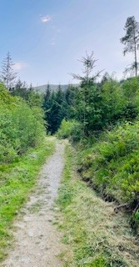
Preparing for the Trip – Kit list
Clothing
- Nightwear
- Underwear
- Socks, over ankle length (2/3 pairs per day)
- 3 or more fleeces or sweatshirts
- 5 T-shirts
- 3 long sleeved T-shirts
- 4 pairs of old trousers (not jeans) – 3 for activities and 1 for evenings
- 2 pairs of shorts
- 2 pairs of trainers (1 for wet activities)
- 1 pair of shoes or trainers for indoors
- Baseball cap / Hat
- Swimwear
- Clothing for Disco

Slide 5

Kit list continued…
- Wash Bag (toothbrush, toothpaste, deodorant (roll on only), shampoo)
- 2 large towels
- Torch and batteries
- Plastic bottle for drinks
- Plastic container/lunch box
- Sunscreen
- Pencil, paper and book
- Small bag or rucksack
- Labelled plastic bags / bin liners (for wet items)
Spending money – no more than £10 in clearly labelled wallet

Slide 6

Please do not bring…
- Mobile phones and chargers
- Hairdryers/Straighteners (hairdryers will be provided by the centre)
- Radios/MP3 player
- TV’s/Electronic games
- Football strips
- Chewing Gum
- Aerosols (can set fire alarms off)

Slide 7

Medicine
Additional Snacks
Forms completed and medicine (labelled) handed in to school office before the day of the trip preferably
For complex needs or concerns please contact Miss Lurinsky directly to arrange a meeting
Small amount of own snacks for between mealtimes e.g. crisps, cereal bars – no nuts!

Slide 8
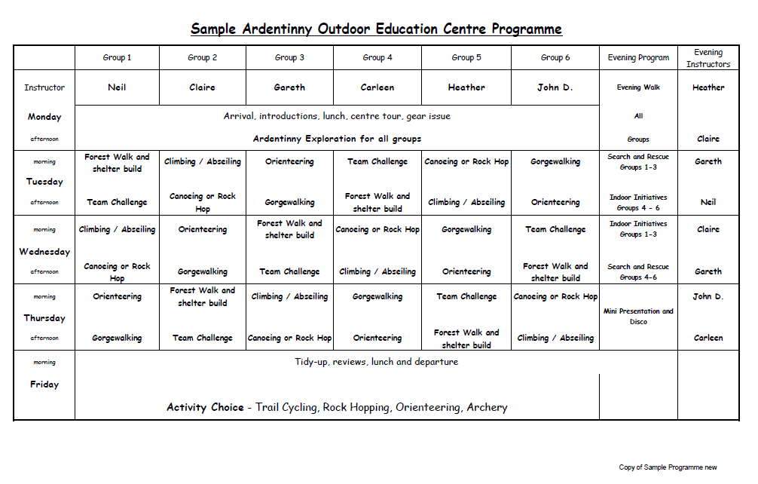
Sample Activity Timetable

Slide 9
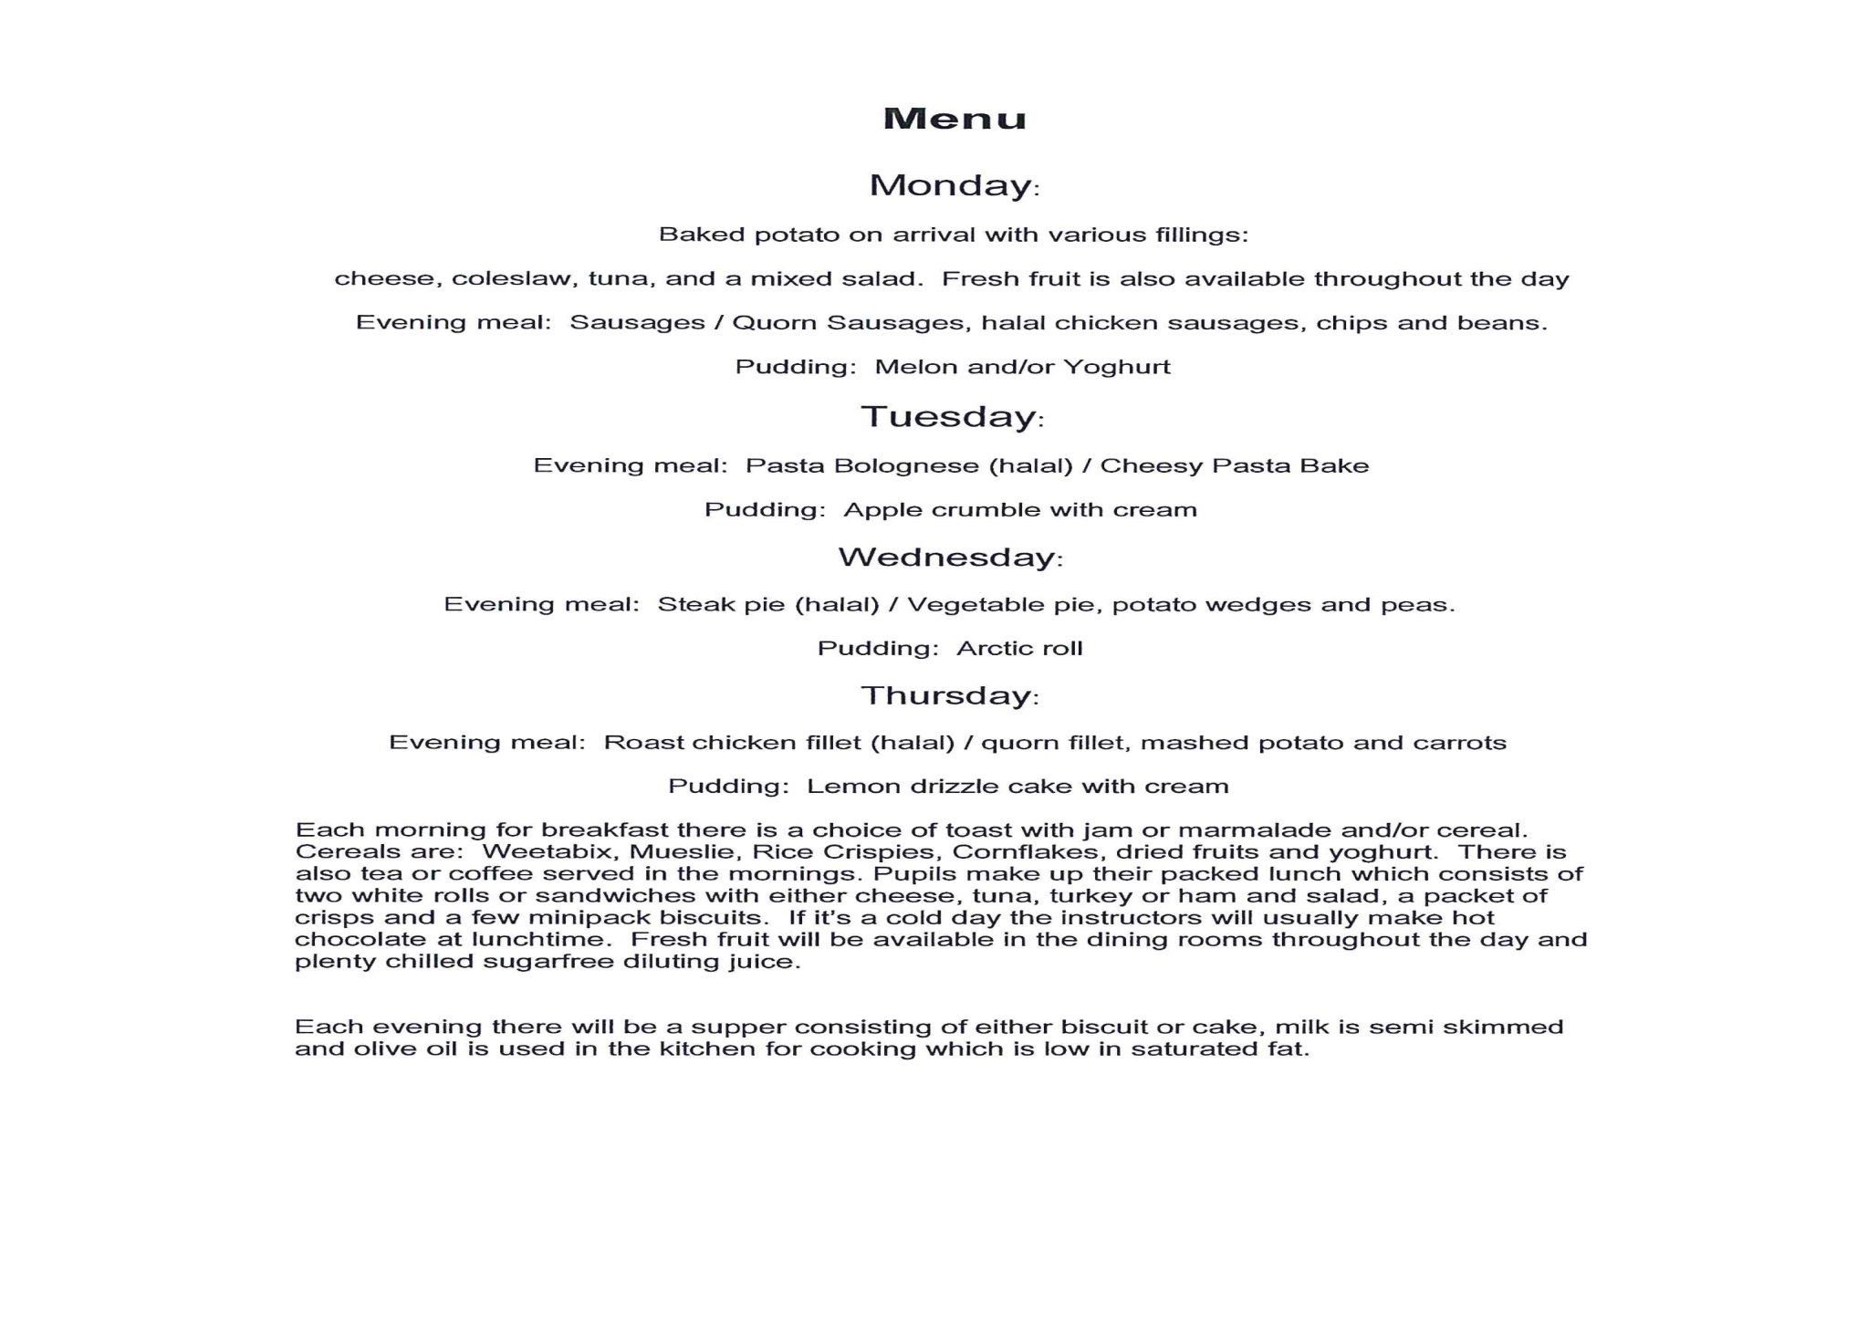
Sample Menu

Slide 10
Total Cost and suggested payment plan
£290 Overall Price – all payments made via Parent Pay
Date | Amount
24th October 2025 | £60 Deposit
28th November 2025 | £46
26th December 2025 | £46
30th January 2026 | £46
27th February 2026 | £46
27th March 2026 £46 final payment

Slide 11
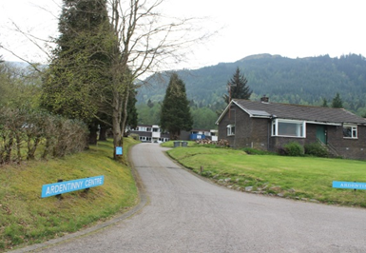
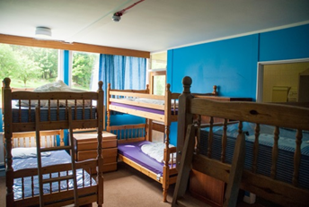
Departure Details
First day arrangements
Return Details
Dorms

Slide 12
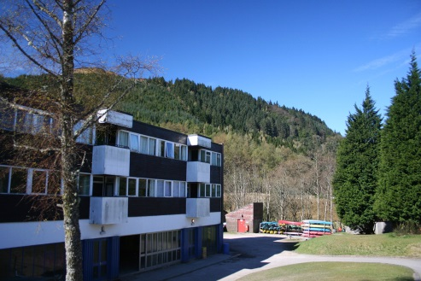
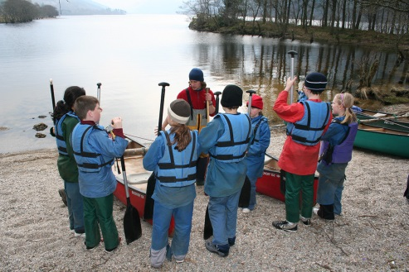
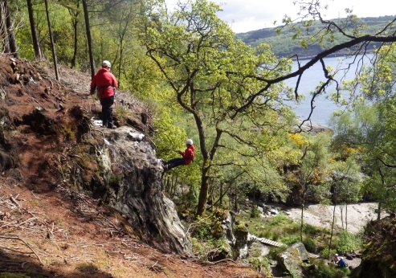
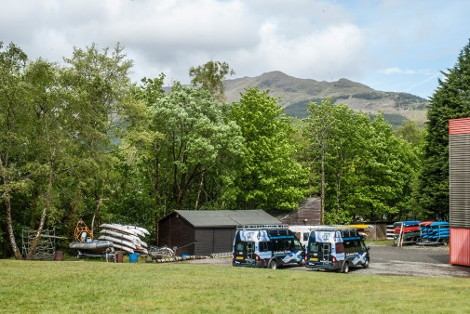
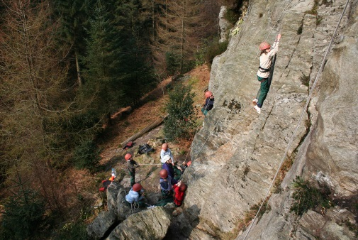

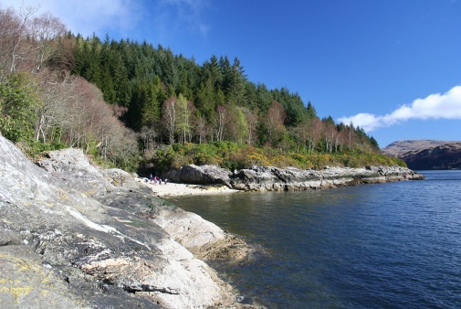
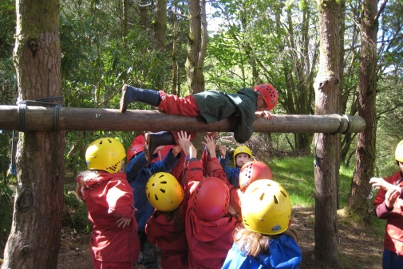
Photos

Slide 13
Thank you for coming along to find out about the trip!

Slide 14


Hillhead High School We Thrive Together
Hillhead Primary School Information Session
Tuesday 23rd September

Slide 15
Hillhead High School We Thrive Together
What we are all about as a school
Universal Transitions Programme
Enhanced Transitions Programme
Questions

Slide 16
Learning
+
Belonging
=
Thriving

Slide 17
What does Thriving look like?
Attending school
Participating in school life
Learning skills and attaining qualifications
Securing a positive, sustained destination

Slide 18
Key Staff - Transitions Programme
Mrs McAlaney – Head Teacher
Mr Carson (me) – Depute Head Teacher for S1 and S2
Miss Copland, Mrs McColm – Principal Teachers of Numeracy and Literacy
Mr Pache, Ms McGuire – Principal Teachers of Support for Learning
Mrs McLennan, Mr Greechan, Miss Hewitt, Ms Williams, Mrs Alexander – Principal Teachers of Pastoral Care
S2 Buddies, S6 Leadership Team – Pupil Teams who will support transition

Slide 19
Universal High School Transitions Programme
Term 1: DHT visit to each primary school (i.e. this evening’s sessions)
Term 2: Numeracy and Literacy visits; One day visit and information evening
Term 3: Numeracy and Literacy visits
Term 4: Three-day visit and information evening

Slide 20
Visits to Hillhead High School
One Day Visit and Information Evening:
Tuesday 25th November 2025
Three Day Visit and Information Evening:
Tuesday 19th May 2026
Wednesday 20th May 2026 (info eve)
Thursday 21st May 2026

Slide 21
Numeracy and Literacy Visits
Fortnightly visit to Hillhead High School on Thursday afternoons
Alternating between numeracy and literacy
Working with Miss Copland and Mrs McColm as well as pupils of Hillhead HS
Working on numeracy and literacy tasks with the underpinning theme of Belonging
Getting to know the building as well as key people in the school

Slide 22
Enhanced High School Transitions Programme
Term 1: DHT discussion
Term 2: Pupil Support and Pastoral Care meetings
Term 3: Parental Meetings
Term 4: Confirmed Placing Request Meetings

Slide 23
Learning
+
Belonging
=
Thriving
Any questions?
gw11carsonthomas3@glow.sch.uk

