Slide 1
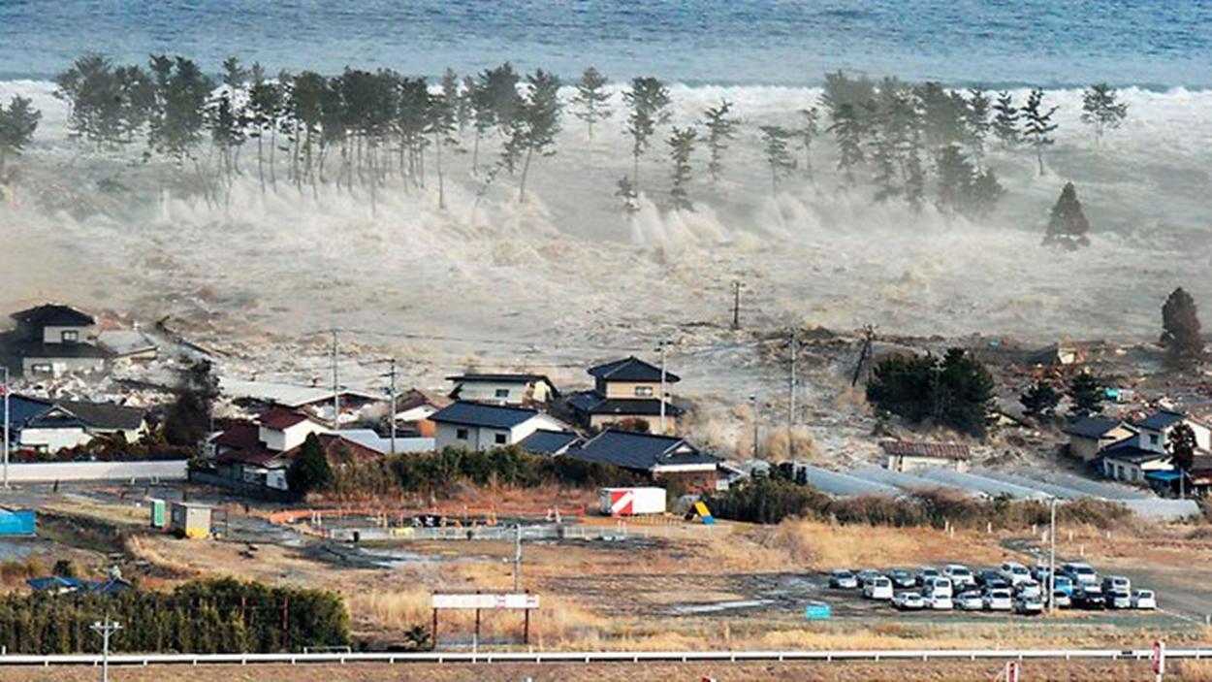
Tsunamis
Christie Mackay, Holly Farrell, Jenna Calder, Jenna Mcnulty & Sophi Binnie

Slide 2
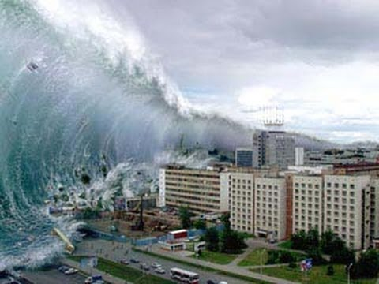
What is a tsunami?
The word tsunami comes from the Japanese word meaning "harbor wave."
A series of ocean waves that sends surges of water onto land.
They often reach heights of up to 100 feet; creating a wall of destructive water that causes catastrophic damage when brought ashore.
The speed of a tsunami wave over deep waters has been compared to the speed of a jet plane (600 mph approx.) and only decreases in speed when reaching shallow waters.
At this speed, tsunamis are able to cross the Pacific Ocean in less than a day. These long wavelengths mean that they lose very little energy on their way.
The series of wave surges can hit at intervals of 5 minutes to an hour and can last for several hours.

Slide 3
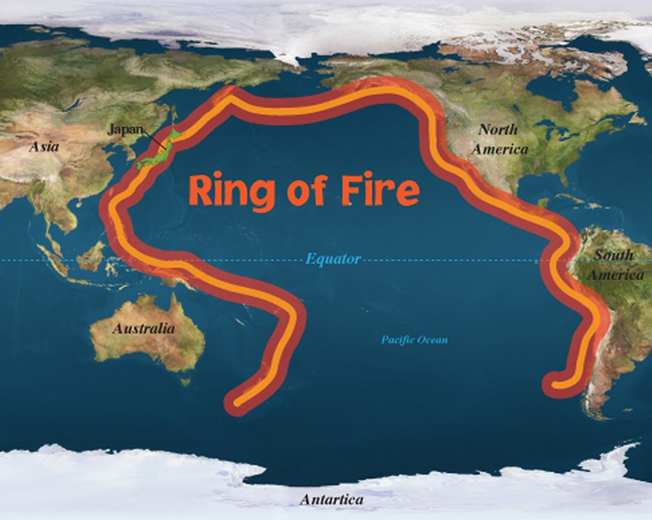
What is a tsunami?
80% of tsunamis occur in the Pacific Ocean within the ‘Ring of Fire’.
A string of volcanoes and sites of seismic activity or earthquakes.

Slide 4
How do they happen?
Tsunamis are caused by a disturbance such as an earthquake, volcanic eruption, landslide or meteorite impact.
Undersea Earthquakes
Volcanic Eruptions
Landslides
Meteorite Impact
Typically occur at boundaries between Earth’s tectonic plates, and cause water above to move up or down.
Waves are formed as the displaced water acts under the influence of gravity and attempts to find a stable position again.
Underwater volcanic eruptions create enough force to uplift the water column and cause a tsunami in the immediate source area.
Landslides are often caused by large earthquakes, and frequently form tsunamis as the water attempts to find a stable position.
Asteroid impacts disturb the water from above, as momentum from falling debris is transferred into the water as the debris falls.

Slide 5
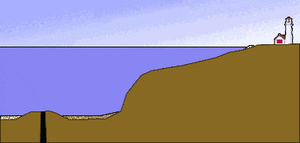
How do they happen?

Slide 6
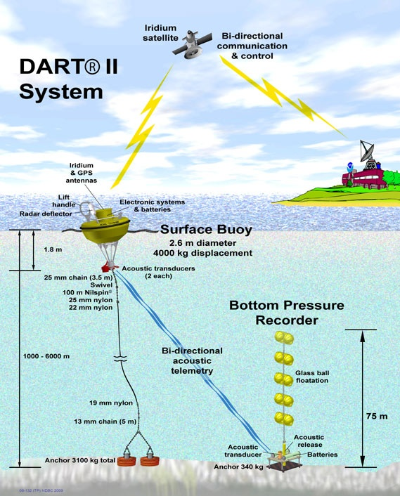
How are they detected?
Tsunami warning systems are attached to buoys in the ocean that transmit data about the ocean and serve as a warning system.
Tsunami buoy systems are made up of two parts; the pressure sensor which is anchored to the sea floor and the surface buoy. The sensor on the sea floor measures the change in the height of the water column above by measuring changes in the water pressure.

Slide 7
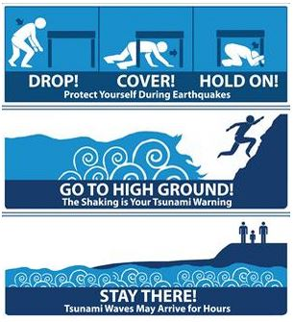
How do you prepare for a tsunami?
Plan an evacuation route from your home, school or workplace.
Practice your evacuation route.
Use a radio to keep informed of local watches and warnings.
Talk to your insurance agent.
Survival
If you hear an official tsunami warning or detect signs of a tsunami, evacuate immediately.
Take an already prepared emergency kit.
Get to higher ground as far inland as possible.

Slide 8
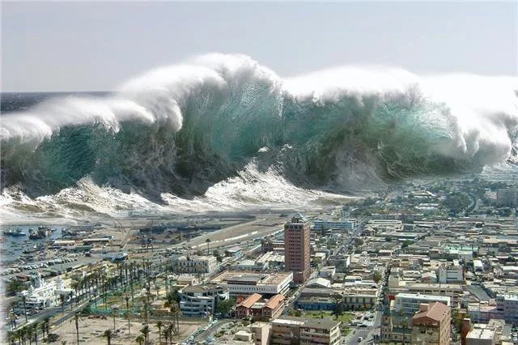
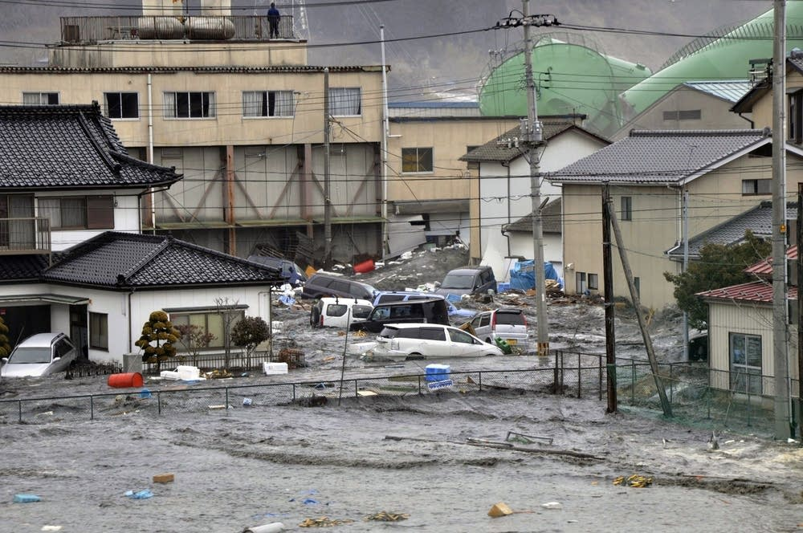
During
People living in coastal regions, towns and villages have no time to escape. The violent force of the tsunami results in instant death, most commonly by drowning.
Buildings collapsing, electrocution, and explosions from gas, damaged tanks and floating debris are other causes of death.

Slide 9
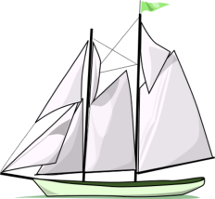
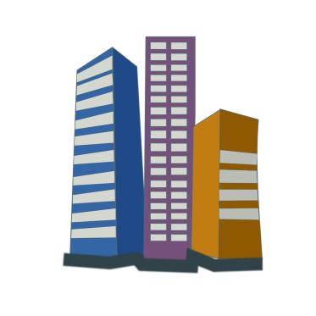
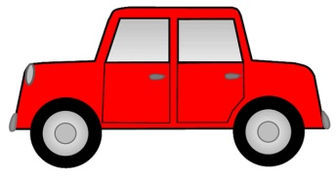
Aftermath
Destruction is caused by the smashing force of a wall of water travelling at high speed, and the destructive power of a large volume of water draining off the land and carrying all with it.
Objects and buildings are destroyed by the sheer weight and force of the water.
Tsunami waves destroy boats, buildings, bridges, cars, trees, telephone power lines- and just about anything that comes in its way.
Areas close to the coast are flooded with sea water, damaging the infrastructure such as sewage and fresh water supplies for drinking.
Flooding and contamination of drinking water can cause disease to spread in the affected areas.

Slide 10
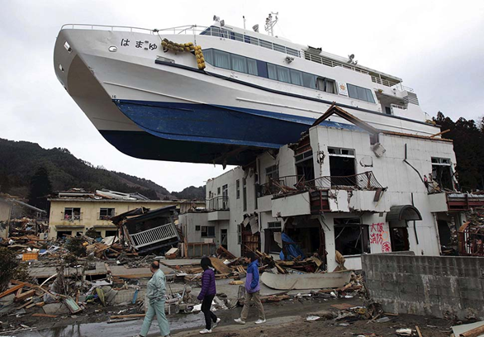
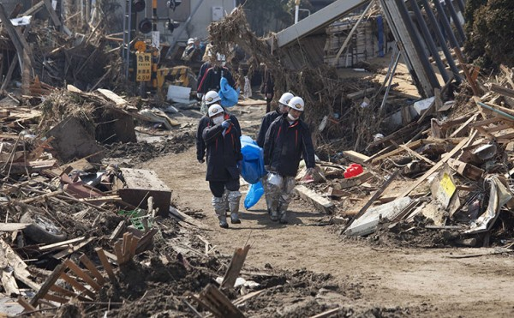
Aftermath
A tsunami changes the landscape. It destroys plants and habitats, and land animals are killed by drowning and sea animals are killed by pollution due to dangerous chemicals being washed into the sea.

Slide 11
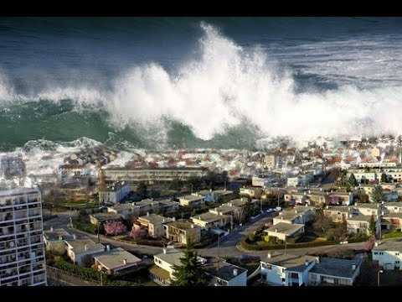
Case Study: Indian Ocean (26th Dec 2004)
https://www.youtube.com/watch?v=g15sZ_d2WUY

Slide 12
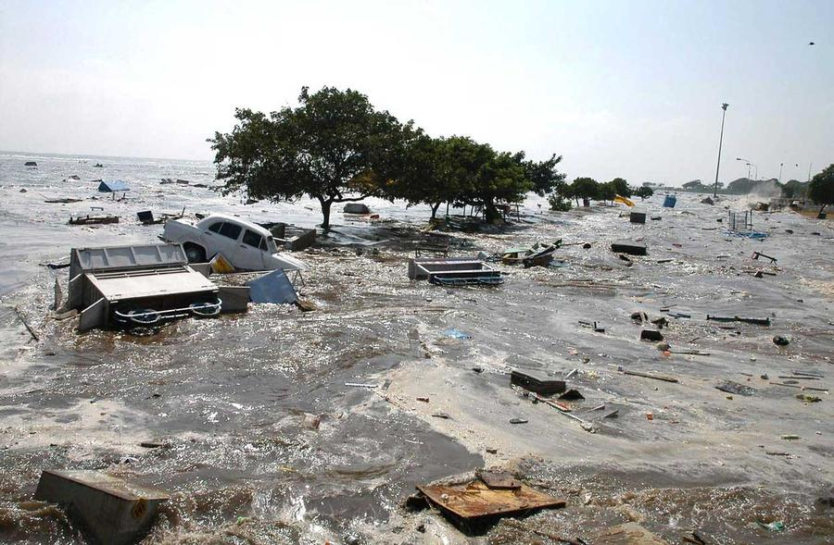
Case Study: Indian Ocean (26th Dec 2004)
Warning: Despite there being several hours between the earthquake and the impact of the tsunami, nearly all victims were taken completely by surprise. There were no tsunami warning systems in the Indian Ocean.
During: When the tsunami reached the shores, the height of the wave increased to 15 metres in some areas.
The tsunami travelled at speeds of up to 800km per hour.
After: Third largest earthquake ever recorded.
There were 230,000 deaths between 14 countries eg Thailand, Indonesia and Sri Lanka.
A great deal of humanitarian aid was needed due to the widespread damage of infrastructure, shortages of food and water, and economic damage.
The World Food Programme provided food aid to more than 1.3 million people.
Nations all over the world contributed funding for aid.

Slide 13
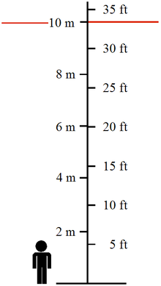
Diagram showing scale of tsunami in terms of height.

Slide 14
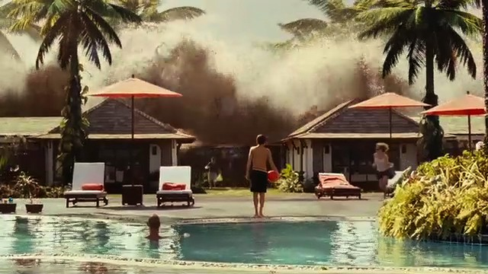
Video Clip
https://www.youtube.com/watch?v=4d-EYIZAqXc&spfreload=10
Video clip from the movie ‘The Impossible’ which demonstrates the real life events of the 26th of December 2004.
Shows how quickly a tsunami can occur and the possible reactions of the public.

