Slide 1
GMWP Training Session

Slide 2
GMWP Training Session
To become familiar with GMWP Glow Blog – Support Materials
Microsoft Glow Form – Open , duplicate & edit for own setting .
Use the results from the Glow Form with the Analysis Grid
Analyse and interpret the data .

Slide 3
To become familiar with the GMWP Glow Blog

Slide 6
Two documents that you will need to use the GMWP :
GMWP 20 Q – Microsoft Glow Form
( Can use a paper copy / picture version then transfer the information onto the Glow Form.
GMWP Analysis Grid

Slide 9
Use the Microsoft Glow Form Open , duplicate and edit according to your own setting

Slide 14
Use the results from the Microsoft Form with the GMWP Analysis Grid

Slide 16
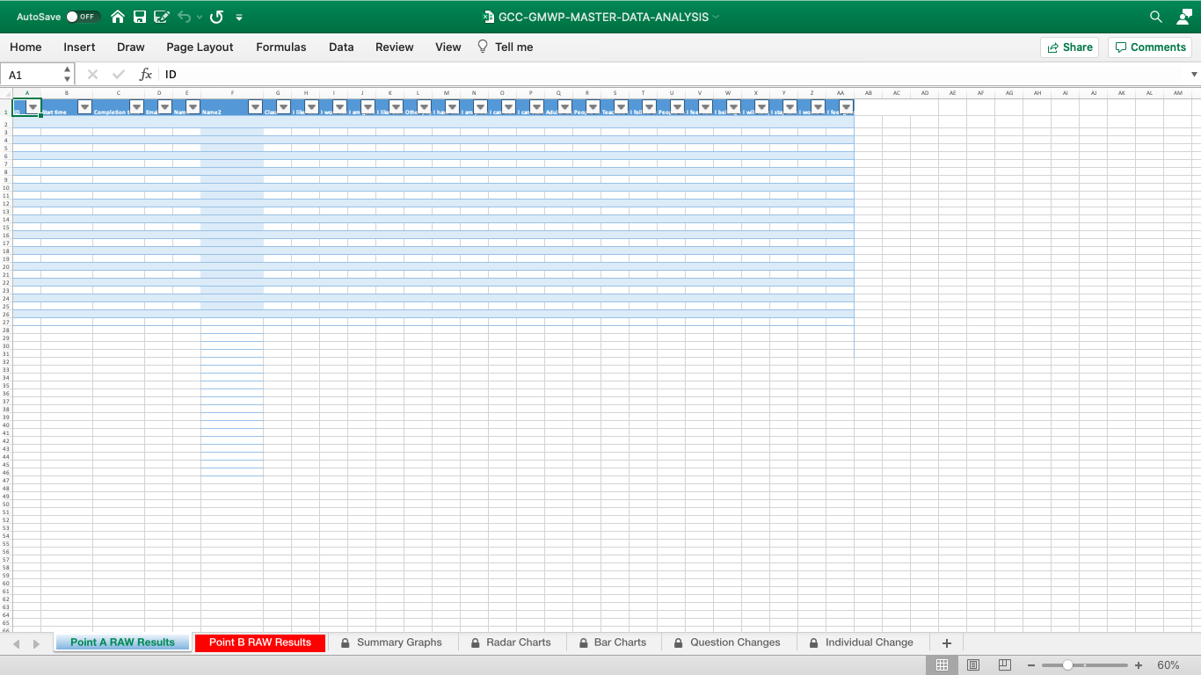

Slide 19
Analyse & interpret data . Use data with staff and pupils to plan next steps in learning

Slide 23
GMWP Glow Blog Additional Training Videos available

Slide 25
Email contact mnugent@st-brendans-pri.glasgow.sch.uk

