Slide 1


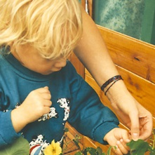
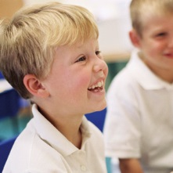
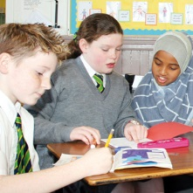
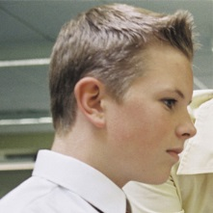
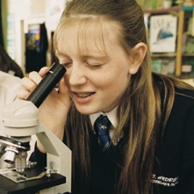
Anti-Bullying
Training 2023
“Call it what it is!”

Slide 2
The National Context
All establishments must use the SEEMiS Bullying and Equalities module.
All Local Authorities must be recording incidents of pupil peer to peer bullying.
No other methods of recording should be used (Pastoral Notes are not acceptable for recording Bullying Incidents).
Recording of Bullying Incidents are included in all school inspections.
At present Scottish Government does not collate local authority data (yet!)
Glasgow Education Services revised our guidance in October 2019
Notes:
The Scottsh Government wants all incidents of in school peer to peer Bullying to be recorded in a standardised way using the SEEMIS Bullying Recording Module. All Glasgow schools have access to this and there is an expectation that it is being used.
It is the responsibility of all school to record and investigate any incident where a young person perceives that they have been the subject of bullying
Recording incidents only in pastoral notes is not acceptable, you must use the Module. While schools may have concerns about recording and the possibility of league tables, it is more concerning where schools are not recording incidents as we know that bullying happens in all establishments.
HMI will be looking at Bullying recording as part of school inspections from December 2018.

Slide 3
Summary
Research by respectme indicates that 30% of young people reported being bullied yet our data does not reflect anywhere near this.
The revised anti-bullying policy was published in November 2019 and all establishments should have their own policy in place.
It is the responsibility of all staff to report and record any incidents of peer to peer bullying.
If a child or young person feels they have been the subject of bullying then it must be recorded and investigated.

Slide 4
Why we need this awareness training!
There is clear under recording of bullying . Schools are still not using the Bullying and Equalities module consistently.
The issue has nothing to do with the SEEMIS module or the recording procedures.
Staff are making judgements on whether to record a reported incident as bullying, this is unacceptable.
There is a risk to the Council that we are not following Scottish Government policy on bullying recording.

Slide 5
What have you seen someone be bullied for about their appearance?
Primary |  | Secondary
Skin Colour* Clothes* Colour of hair Weight* Acne* Glasses Sexuality Hijabs Height Teeth* Looks freckles Disabilities Accents | Ethnicity Gender Birthmarks Speech Ear size Nose size Hair style Piercings Fashion style Difference in opinion Being shy Voice Hand size Area they stay in Football team they support | Height* Race* Skin Nationality Fashion* Disability* Smell Eyes Hair Acne | Teeth* Nose Lips Eyebrows Glasses LGBTQ Weight Fake tan Hygiene Piercings Acne
Glasgow Schools Forum, December 2022 *mentioned more than once
Notes:
Before we participate in the group activity, it is worth reading some of our children and young peoples thoughts, feelings and views. The following 6 slides were created from the recent Glasgow Schools Forum when respectme asked some specific questions around body image and appearance bullying as part of their Changemaker series. Here’s what our young people said…
*said more than once

Slide 6
What types of bullying behaviour about appearance are you aware of?
Primary |  | Secondary
Physical - Punching and kicking * Online - threats, blackmailing* Name-calling Stealing property e.g. someone’s bike Holding them against a wall Passing mean notes Stealing their belongings* Imitating them Blaming someone for something they didn’t do Making jokes about them Leaving them out of activities * | Pushing them Harassing them Ignoring them Spreading rumours* Pulling their hair Taking photographs of them Following them home Stealing their phone Cutting hair Body shaming Staring at them Provoking them to get a reaction Biting them Repeating what they say | Physical violence* Online bullying* Pushing Kicking Swearing Harassment Death threats Spreading lies Racism* Homophobia Transphobia Name calling Stalking Stealing Spreading rumours

Slide 7
How does appearance bullying affect young people?
Primary |  | Secondary
Depression* Physical pain Sadness * Anxiety* Frightened* Hurt Offended Change the way they look Become insecure Compare themselves to others Become scared* They might stop eating* They don't want to do things anymore (anti-social) Suicidal * | They cry They don't want to go to school anymore* Become embarrassed Self-Harm Loneliness Damages self esteem Lose their friends Feel Ashamed Feeling not good enough Don’t feel worthy Makes them aggressive and lash back They want to avoid people Can affect their future | Self-harming* Starts to believe the bullies Think you're not good enough Suicidal thoughts* Depression* Anxiety* Scared* Less social* Nervous Insecure Angry Starving themself Sadness Not wanting to go to school Poor mental health Loss of trust Makes you want to change appearance

Slide 8
What do you think young people need from adults to feel better if they have been bullied about their appearance?
Primary |  | Secondary
Need reassurance that they're loved and they're fine the way they are A therapist* Respect from the adults The adults to speak with the bullies* The adults to show they care* The adult to be fair with them Attention Take it seriously The adults to believe them The teachers to take more responsibility Teachers should punish the bullies more* | Comfort them Do something the kids enjoy to cheer them up Take them out for food* Hear both sides then fix it Be more understanding Take more action Meditation Read with the children Give people a quiet space Class discussions Positive thinking Give people the need to be heard | Comfort* Reassurance* Support* Adult to be trustworthy Adult to be responsible Adults to be more aware To provide support groups Teachers to look out for it more Remove bullies from class | Don't give bullies special treatment Stand up for them Therapy Give advice Give them space Speak to the bully* Have lessons/ assemblies

Slide 9
What do you think adults in schools should do to prevent bullying about appearance?
Primary |  | Secondary
Expel / suspend the bully Pay more attention Speak to the victim More support (Childline) services Give the bully detention Anti-bullying lessons Bully the bully Put them on Santa’s naughty list Show the bully the consequences of bullying CCTV Have a dedicated adult you can talk to Stick up for the people being bullied Tell young people to stick up for themselves Let children know they can speak to them | Allow children to have time out the classroom Therapy Speak to parents Make posters and signs Raise more awareness Go to the police Anti-bullying assembly Make a record of how much the bully hurts someone PATHS - Problem solving steps Make bullies miss playtime No Golden time Confiscate iPad Spend time in mindfulness area Call the bullies parents Have an assembly on anti-bullying/anti-bullying lessons | Therapy animals - dogs Mental health classes Visits from organisations Bring in speakers Class discussions Anti-bullying classes* Listen to both sides Safe spaces be provided* Anti-bullying day More punishment for bullies Educate other adults

Slide 10
What do you think young people in schools could do to prevent bullying about appearance?
Primary |  | Secondary
Bully them back - too far - no! More rules Reassure people Talk about it in assembly* Have the right to stand up for yourself If friendships are toxic move to play with a different group Walk away Try and ignore it* Tell a teacher * Express your thoughts in a diary or on a video Talk to the bully Ask friends to speak to the bully Explain to the bully why it’s bad If its online, then block the bully | If you see someone bullying tell them to stop Tell people to think before they speak Protests to raise awareness Respect other religions and races Tell them the consequences Ask the bully if this is a good thing to do Look out for others Speak to a teacher before it gets worse Use your voice Self defence Create a safe environment Make posters * Treat everyone equal Tell them to stop | Educate that banter can turn into bullying Be kind and respectful Don't join in with bullies Stick up for yourself* Let others know they can talk to you Stick up for people being bullied* Create lunchtime equality groups Speak about personal experiences Tell an adult* Create posters* Speak to the bully about what they're doing Ignore the bully Speak in Assembly

Slide 11

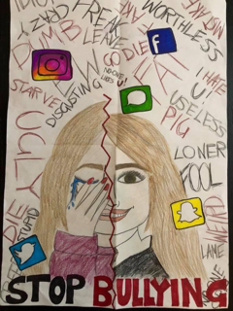
Group Activity
Notes:
Facilitators including QIOs and Eps with support groups with case studies and dialogue. Gathering feedback for plenary.

Slide 12
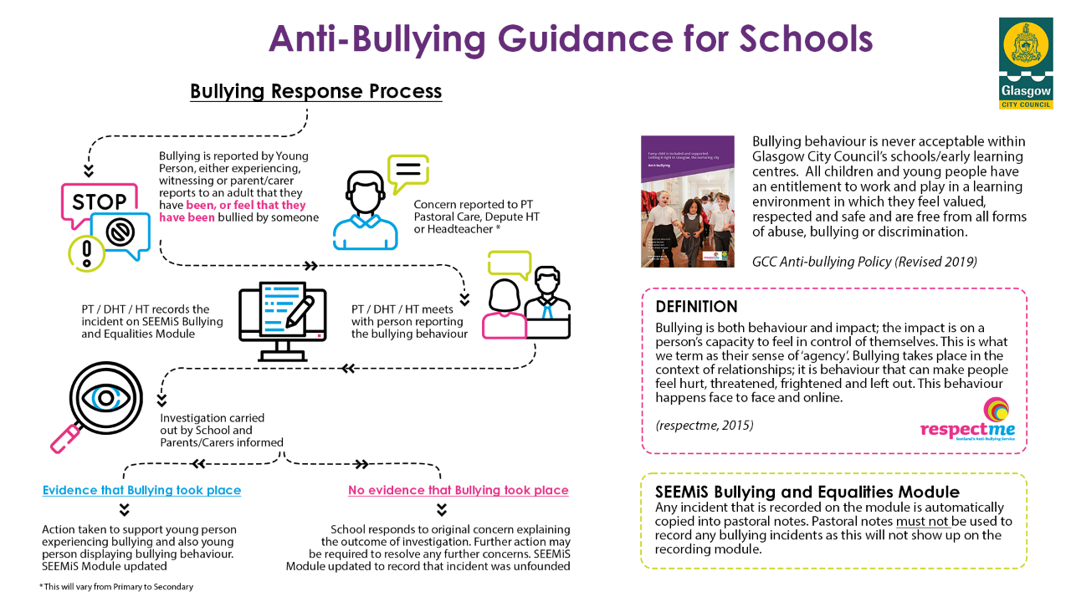
Notes:
Issue copies of Flowchart (x1) and Posters (x2).

Slide 13
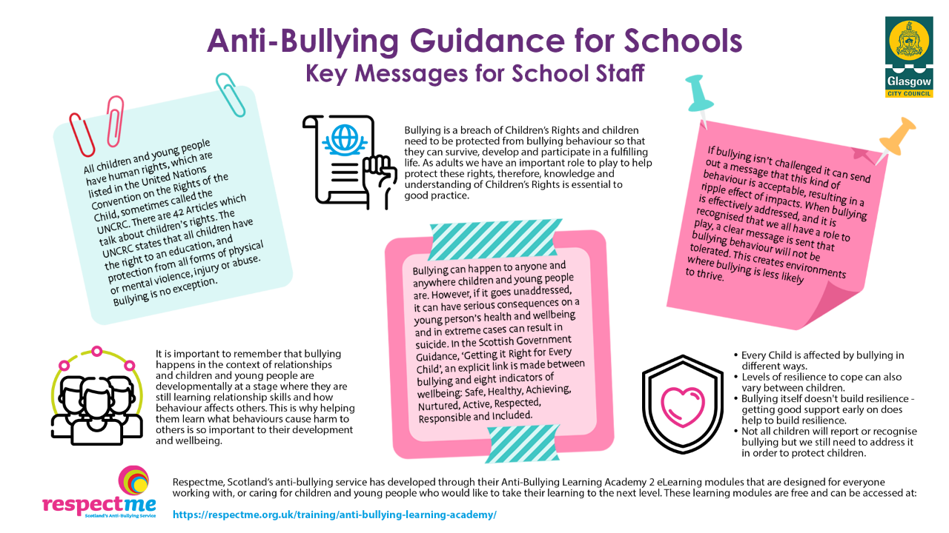

Slide 14
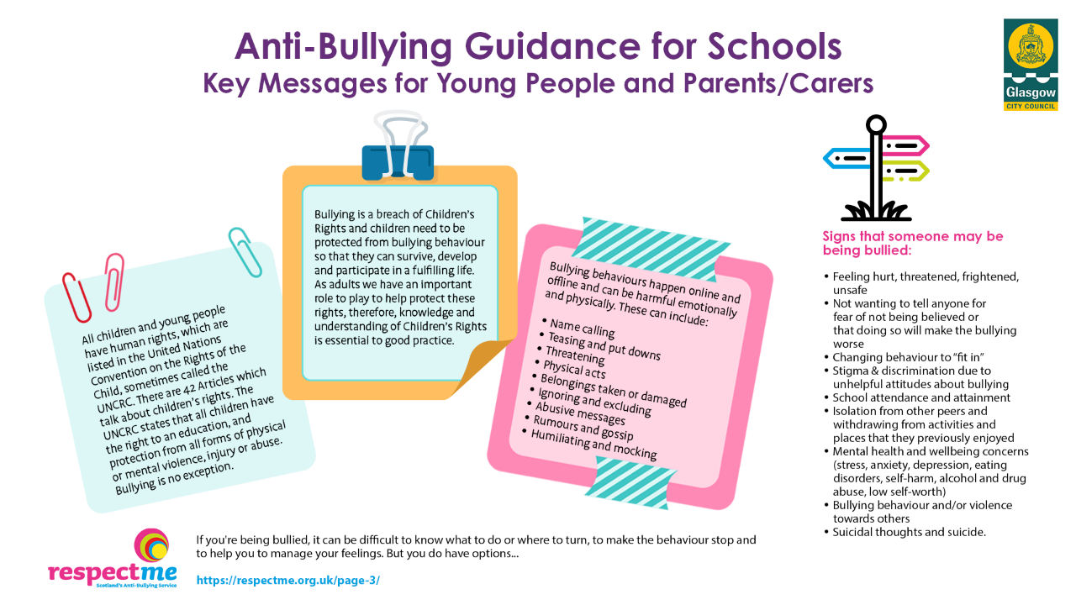

Slide 15

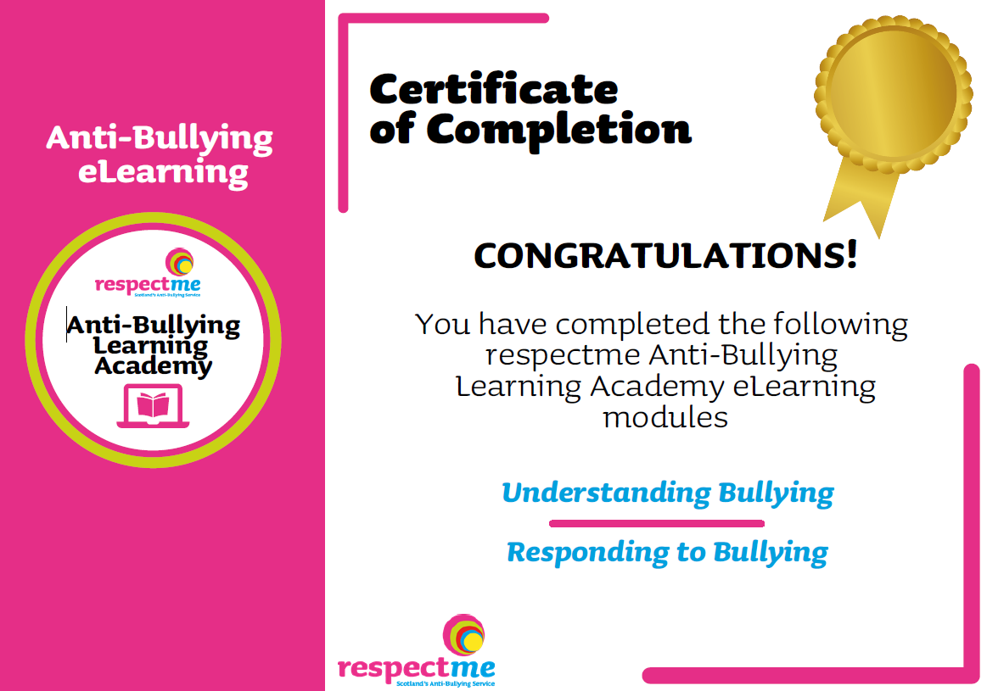
Lisa Armstrong, Interim Director respectme
Lorraine Glass, Interim Director respectme

Slide 16
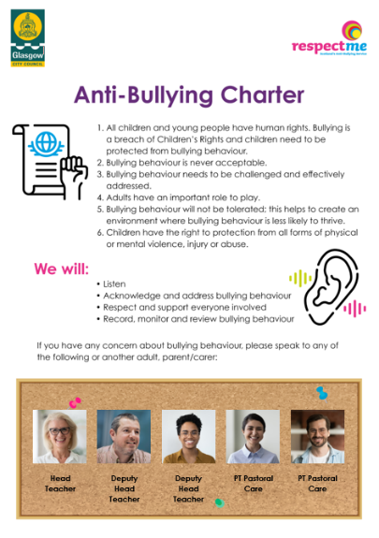
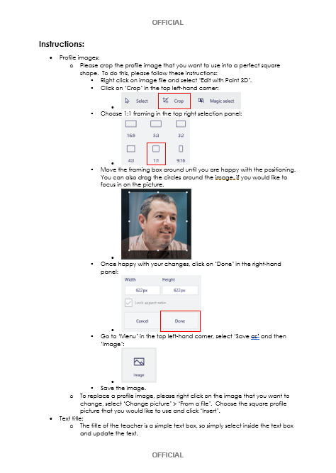
Anti-Bullying Charter
Notes:
Every Glasgow school should have their own school anti-bullying policy and having heard our children and young peoples thoughts, feelings and views in December we have established an Anti-Bullying Charter.
This should be displayed prominently and can be personalised with the photographs and names of SLT in each establishment. Issue paper copies for consultation – this will be shared at the next Glasgow Schools Forum.

Slide 17
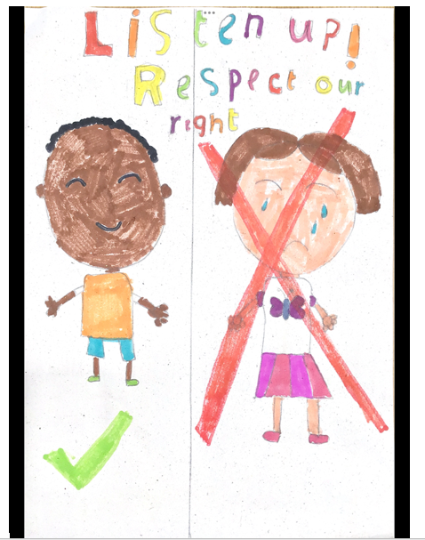
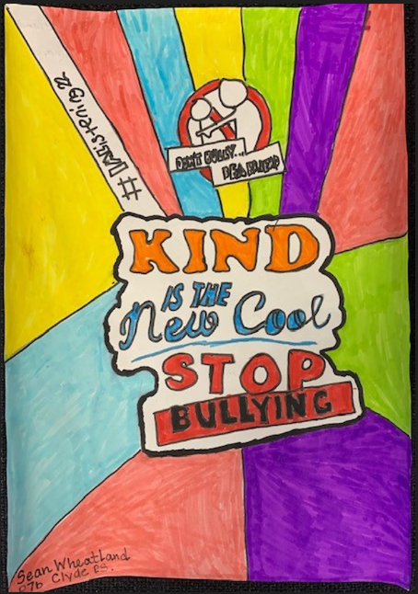
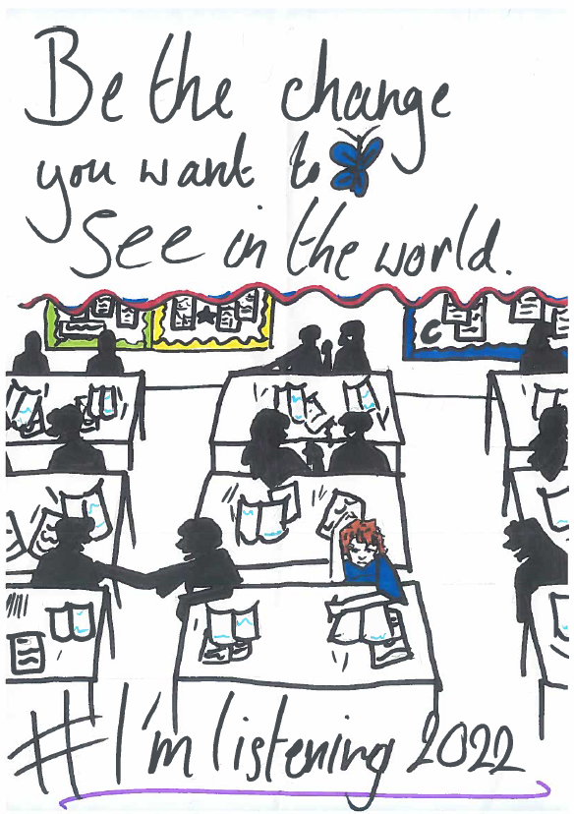
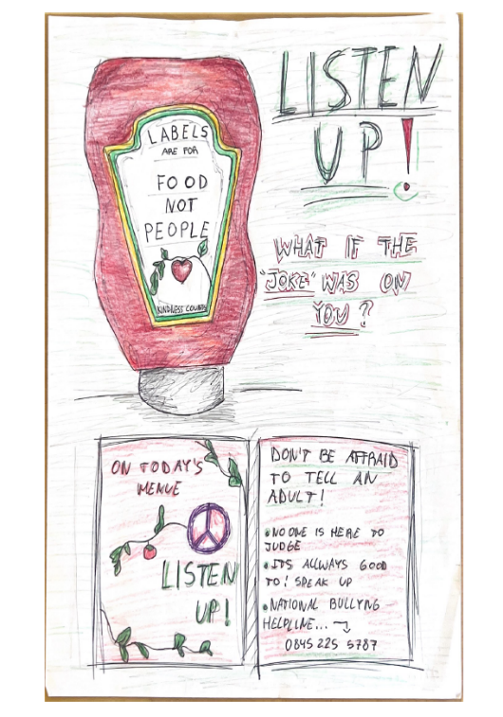
Next steps…
Notes:
What are your next steps?

Slide 18

Thank you barry.syme@glasgow.gov.uk jane.arthur@glasgow.gov.uk lisa.armstrong@samh.org.uk lorraine.glass@respectme.org.uk

