Slide 1
Celebrating Anti-Bullying
Achievements
Glasgow City Council South Schools, 12 Jan 2023
Lisa Armstrong, Interim Director
Lorraine Glass, Interim Director

Slide 2
respectme eLearning
Lisa Armstrong
Interim Director

Slide 3
respectme eLearning Modules- Understanding & Responding to Bullying

Slide 4
Module 1: Understanding Bullying
Identify why addressing bullying is essential
Describe what bullying is
Recognise types of bullying behaviour
Recognise the role of prejudice in bullying
Understand how promoting inclusion and positive relationships is key to preventing bullying

Slide 5
Module 2: Responding to Bullying
Understand a children’s rights based approach to supporting CYP
Identify unhelpful attitudes and responses to bullying
Understand how to support wellbeing for CYP affected by bullying
Recognise solution focused responses to bullying
Understand the important role of policy and procedures

Slide 6
How can our eLearning support you?
Culture & Ethos/Whole School Approach
Improvement planning
Policy Development
Staff Induction
Continuous Professional Development
Supporting senior phase youth leaders
Parent/Carer Engagement
Blended Learning Options

Slide 7
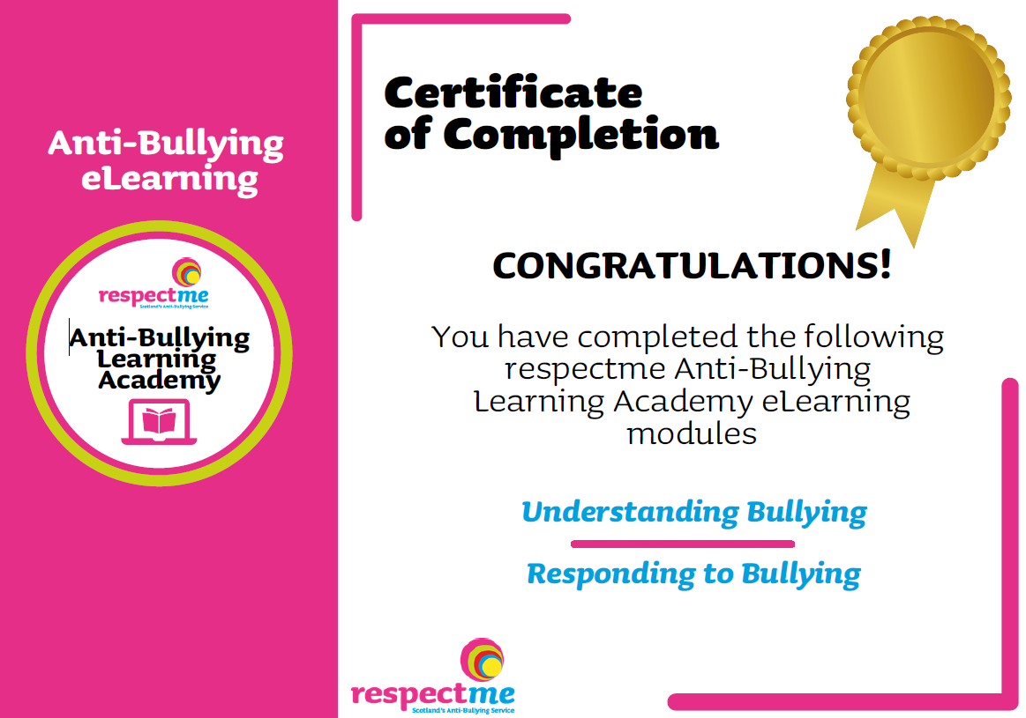
Evidencing the Learning

Slide 8
eLearning Enquiries
Lisa.armstrong@respectme.org.uk
training@respectme.org.uk

Slide 9
Policy & respectme reward
Lorraine Glass
Interim Director

Slide 10
Developing & Updating School Policy

Slide 11
Celebrating Anti-Bullying
Achievements
Designed for schools and children and people's services
respectme
reward
Review and enhance
your Anti-Bullying
Policy and Practice
NEW Self-Assessment
Toolkit - 5 Stage Process

Slide 12
Background to respectme reward
respectme repositioning
Design validated self-assessment toolkit
Pilot test content & process with Dumfries and
Galloway Council
External evaluation and recognition with UK award
Scale up for national roll-out

Slide 13
Pilot Evaluation Feedback
good fit with school quality improvement processes
purposeful - definitely not a 'tick box' exercise
well received by participants and linked to wider aims, eg UNCRC, parental engagement, pupil voice
respectme valued for their support, knowledge, reputation and objectivity
school leads liked triangulation of evidence, ease of data collection and rigour of analysis
impacts included informed planning of anti-bullying work, understanding of good practice embedded in ethos and relationships, personal development and learning

Slide 14
Working through the Toolkit
To achieve your respectme reward, you must complete these five stages:
Stage 1 – Application Process
Stage 2 – Evidence-Based Practice Portfolio
Stage 3 – Self-Assessment of Impact and Outcomes
Stage 4 – Reviewing Results
Stage 5 – Validation, Recognition and respectme reward

Slide 15
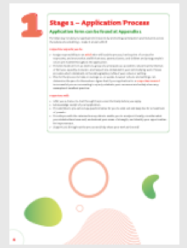
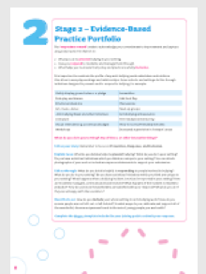
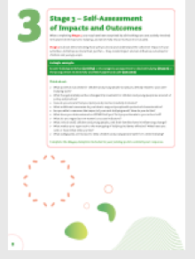
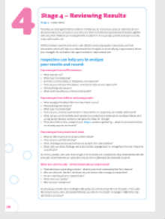
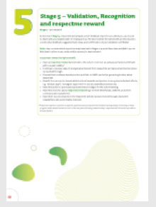
Working through the Toolkit

Slide 16
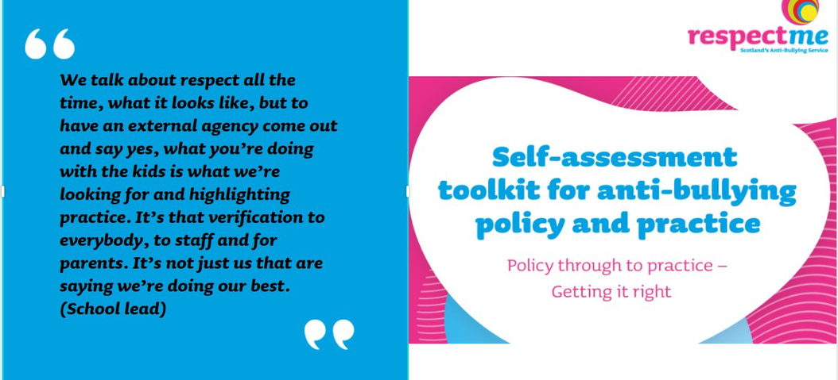
Celebrating Success and maintaining momentum
Youth Action Group

Slide 17
Questions and Answers

Slide 18
Thank You
and
Good Luck!
Lisa.Armstrong@respectme.org.uk
Lorraine.glass@respectme.org.uk
Una.McLean@respectme.org.uk

