Slide 1

Supporting Glasgow’s Learners
Glasgow City Council
Glasgow – UK Council of the year 2015
All Behaviour is Communication
Probationer Teachers
2019

Slide 2
Outline of this mornings programme
Classroom ethos and avoiding confrontation in the classroom. Impact on the teacher and the pupil.
Classroom based corrective actions and how to avoid defensive teaching and reactive sanctions.
Use of positive feedback and praise.
The Brain and The Arousal Cycle and how to de-escalate a situation. How to spot when a pupil is moving into crisis, how to respond when the pupil is in crisis and what to do next.
Debriefing and duty of care. What the teacher can expect from senior management if they are involved in an incident.

Slide 3
“I’ve come to a frightening conclusion that I am the decisive element in the classroom. It’s my personal approach that creates the climate. It’s my daily mood that makes the weather. As a teacher, I possess a tremendous power to make a child’s life miserable or joyous. I can be a tool of torture or an instrument of inspiration. I can humiliate or heal. In all situations, it is my response that decides whether a crisis will be escalated or de-escalated and a child humanized or dehumanized.”
Haim G. Ginott
Notes:
Haim G. Ginott (originally Ginzburg; 5 August 1922–4 November 1973) was a school teacher,^{[1]} a child psychologist and psychotherapist and a parent educator. He pioneered techniques for conversing with children that are still taught today. His book, Between Parent and Child,^{[1]} stayed on the best seller list for over a year and is still popular today. This book sets out to give "specific advice derived from basic communication principles that will guide parents in living with children in mutual respect and dignity."^{[1]}
He is famously quoted as saying:
"If you want your children to improve, let them overhear the nice things you say about them to others.“ how often do we really do this – for our children or for each other?:

Slide 4
Positive Model of Behaviour Management
Troubleshooting
Dealing with
problems
Time
Spent
Managing behaviour with
Classroom strategies
Management
Prevention
Creating a positive learning environment
High Quality Learning and Teaching
Birkett (2005)

Slide 5
Negative Model of Behaviour Management
Dealing with problems
Troubleshooting
Time
Spent
Managing behaviour with
Classroom strategies
Management
Creating a positive
Learning
environment
Prevention
Birkett (2005)

Slide 6
All Behaviour is Communication
Notes:
When considering this nurturing principle it is important to reflect on the fact that our behaviours take place within a relational context , so when we are thinking about children’s behaviours we must also be thinking about our own.
This is most likely not new to you but is stands repeating:
As this diagram illustrates the greatest part of our communication is not through the words we use but through how we use our bodies. Our tone of voice can be used to convey acceptance, warmth, curiosity or it can be used to convey suspicion, hostility, superiority.
Our body language is even more important – our stance, awareness of ‘personal space’ , open-ness or closed , state of tension or relaxation all communicate our feelings and thoughts and the physiological processes in our body.
So understanding and being aware of what we are communicating through our behaviours is essential in helping us understand what children are communicating. What needs do children have that can result in distress and behaviour challenges if they are not met?

Slide 7
Why do children become distressed?
Think about some reasons why children and young people become distressed, discuss with a partner.
Notes:
In this activity we are looking at how anger is expressed.
We are trying to get participants to think about the wide range of reasons as to why children become distressed and the importance of not jumping to one conclusion. We need to be thinking of distressed behaviour as a symptom of some underlying issue that we have not identified.
5 minutes in pairs with Post-Its
Ask for some feedback from the group.

Slide 8
Why do children become distressed?
Fight, flight, freeze response – threat (functional anger)
Stress and coping
Additional Support Needs
Developmental stage
Reinforcement?
Link to internal working model of themselves as shameful
Trauma / ACES
Other?
Notes:
Fight or flight response- innate primitive behavioural response to a threat
Stress and coping- the individuals level of stress and anxiety reaches a point where they have to have emotional release and this is seen as distress
Additional Support Needs – e.g. Autism Spectrum Disorder, Language and Communication Impairment, Visual or Hearing Impairment, Cognitive difficulties.
Developmental stage – e.g. Terrible 2s, delayed development, adolescent re-wiring
Reinforcement- child / young person has had previous behaviour reinforced , either positively or negatively so increasing likelihood of the behaviour being repeated.
Trauma- behaviour is linked to previous negative experience, attachment issues and can be triggered by environmental factors like sounds or smells.
NOTE:
Other might be context specific e.g. secondary colleagues may have to support young people who have been socialising heavily the night before – lack of sleep/ hung over or who are developing a tobacco addiction and really want a cigarette.
Please note this is not condoning such behaviours just recognising that they may be a part of a young person’s presentation.
Early years colleagues may be working with young children who are pre-verbal and who are experiencing frustration in making their needs known to adults.

Slide 9
Distressed versus Challenging Behaviour
All ‘Challenging Behaviour’ meets a need – for the individual it is a solution, not a problem!
ALWAYS ASK YOURSELF
What need does this behaviour meet for the other person ?
Will my intervention make things better or worse ?
Am I in control of myself ?
Notes:
We need to be aware of how we feel in the situation as we will react in response to what we are seeing and hearing.
As adults we feel that we have to do something as we perceive we are in charge. When we are challenged our natural emotions kick in and we can respond in ways that we would not normally. For example reactive or defensive responses, if a child or young person talks back at an adult and start to raise their voice then the adult will usually respond in a similar way.
Sometimes your intervention can significantly escalate the situation or even place the child or young person at greater risk.
Example: Pupil becomes distressed in class, runs out of the school and is chased by a member of staff. Pupil sees the staff member following him and tries to evade. He runs without thinking across a road looking behind him as teacher pursues him. He does not see a large truck approaching, fortunately the driver reacts in time and stops just in front of the pupil.

Slide 10
Defining behaviour?
What is the difference between challenging, distressed, aggressive or violent behaviour?
Depends on personal experience
Depends on the individual
Notes:
Ask the group the question.
Looking for a range of responses that highlight that individuals define challenging and aggressive behaviour differently . We apply our own personal experiences to this.
Challenging behaviour can be behavioural, communicative, medical, developmental.
If you work in an environment where there are regular incidents of distressed / challenging behaviour then your threshold is likely to be different to one where these incidents never happen. For example a Secure Unit, That is not to say that it is in any way acceptable but we need to be aware that people define behaviour differently.
We also need to be able to actually define behaviour in a clear way that others can understand.
If we think about Performance statements rather than Fuzzy statements.
A performance statement defines a behaviour in a way that anyone would be able to understand and see. For example: When distressed John will hit his hand off solid objects and hurt himself to a point where he will cry in pain.
When upset Sarah will throw objects and then try to hide under a table.
A fuzzy statement does not really describe the action but is more emotive and can be misinterpreted.
John just loses it and then goes mad!
Sarah goes off on one which really upsets the class!

Slide 11
Iceberg metaphor
Behaviour
Swearing, angry outbursts, running away
Fears and anxiety
Maladaptive stress response
Poor communication skills
Misinterpretation of events
Overloaded by stimulation (ASD)
Traumatic experiences (ACES)
Possible reasons/ communicative functions
Notes:
The behaviour you see and experience is the tip of the iceberg therefore we react to that.
What we need to do is look at what is below the water where the real issues are and that is what needs to be looked at.
This can be difficult in the heat of the moment but good knowledge of children and young people’s needs is essential as is good sharing of information , for example from class to class or playground to classroom.
This allows us to ‘stop and think’ when we see a youngster becoming distressed. What do you already know, what has worked previously, what should you not do, what is your own emotional reaction, are you in control…..?

Slide 12
Video Clip- Negative and Positive Teacher responses

Slide 13
Confrontation
Confrontation refers to a showdown between 2 or more parties
It often starts as a trivial incident or comment which escalates into a protracted and heated exchange
In a classroom it can lead to removal/ exclusion and disrupts learning and teaching

Slide 14
Think about a confrontation that you have witnessed or experienced and describe to the person next to you:-
What started the confrontation?
What was the outcome?
How did you feel?

Slide 15
Confrontation Video Clip

Slide 16
Feedback from Video Clip
How did that make you feel?
Who was right and who was wrong?
How could this have been avoided?
Who won?
Notes:
Ask the group to respond to the questions provided?

Slide 17
Impact of confrontation in the classroom
For the Adult
Anger – my authority has been challenged
Fear –who loses is weak, perceived by the audience
Embarrassment – having to seek help is an admission of failure
Anxiety – loss of rapport with pupil
Blame – something must be wrong with the pupil
Notes:
Let’s think about the classroom environment and the effects of confrontation in a class on the adult
This may be going through the adults mind:-
Anger- I am the teacher / SfLW and what I say goes, this child / young person is challenging me. I cannot let this go “!
Fear- “If I lose this argument then I feel threatened and other pupils will see this”
Embarrassment- “If I have to seek help from a colleague then I have basically shown that I cannot manage this on my own, others may talk about me?”
Anxiety-” I am here to teach and help pupils learn, I don’t want to fall out with this pupil but!!!”
Blame- “This is my class and the other children / young people are being disrupted by this behaviour, something must be wrong with the pupil because I did nothing wrong. Probably has ADHD!”

Slide 18
Impact of confrontation
For the Pupil
Anger – undermining my self worth
Fear – who loses is weak, perceived by the audience
Embarrassment – in front of peer group
Anxiety- loss of rapport with teacher
Blame – the teacher is nuts, has it in for me
Shamed
Notes:
Let’s think about the classroom environment and the effects of confrontation in a class on the pupil
This may be going through the pupil’s mind, may depend on the age of the child as adolescents perceive situations differently.
Anger- “Why is he / she going on at me and talking to me in that way?” “No one speaks to me like that”
Fear- “If I lose this argument then I feel threatened and others will see it”
Embarrassment- “I am being told off and embarrassed in front of my peers and they are looking and listening at me getting it from the teacher”
Anxiety-” I actually like the teacher/ adult but they are getting at me!”
Blame- “The teacher is nuts and is always looking at ways of getting me into trouble, I am always the one picked on!”

Slide 19
Think about this!
In all your years of working with young people, has a pupil ever stopped in the middle of a confrontation and said “ I’m sorry, you are right, I was wrong!”
The adult is the experienced person and it is the adult who has the status to be in control of the situation

Slide 20
Classroom based responses to off task behaviour
Using Post It notes list 10 ways of responding to a pupil who is not working on task that does not involve moving the pupil out of the class or seeking help from another teacher.
Think of a continuum of actions that you could use.
You have 15 minutes
Notes:
In groups for 10 minutes, use post it notes

Slide 21
Possible Options
“The Look”
Physical presence with non verbal correction
Proximity Praise or Behavioural Narration
Whole Class feedback
Use of pupil’s name
Verbal feedback / individual correction
Request to speak to pupil at end of lesson to follow up issue
Move pupil to another seat in the class
Demerit / Points Removal / Traffic Light warning
Referral to Principal Teacher / Year Head

Slide 22
The importance of planning responses in the classroom
Allows for quick correction of low level behaviour
Prevents rapid escalation
Maintain teacher control without becoming defensive
Reactive responses are more likely to get you into trouble
Helps transitions between teachers

Slide 23
Problem Times
Settling the class at start of a lesson
Transitions
Interruptions / Messages
Dead Time
Loss of equipment (pens, ruler, etc)
Closing the lesson

Slide 24
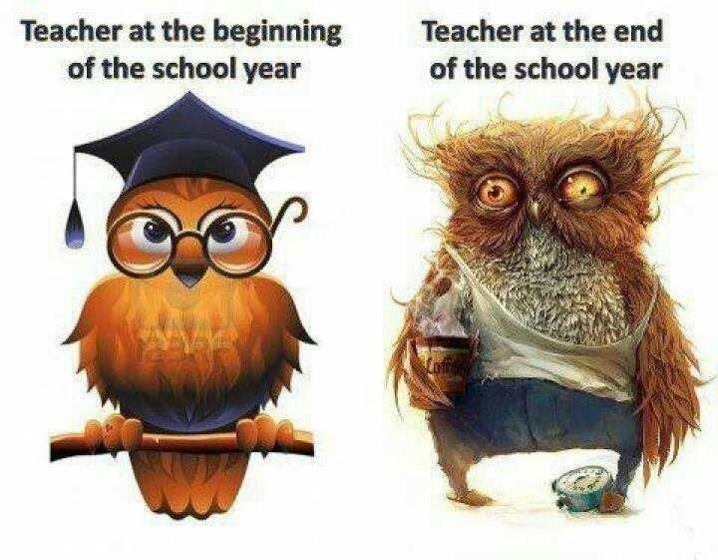
Some strategies to try

Slide 25
Setting a lesson-PRINT
Purpose
Resources
In/ Out of seat
Noise level
Time

Slide 26


Noise Level
What level of noise is acceptable to you as the teacher during the activity?
No Voice
Partner Voice
Group Voice
Classroom Voice
Playground Voice

Slide 27

Time
How long do I want this activity to last, when will it finish and how do I tell the pupil that it is time to finish?

Slide 28

Positive Feedback
When you are positive with pupils you create a positive learning environment where you will feel positive

Slide 29
How to give Effective Feedback
No strategy is more important to a teacher’s success in the classroom than the effective and consistent use of behavioural narration.

Slide 30
Behavioural Narration
The teacher “narrates” the behaviour of students who are following instructions
Teacher: “Walk back to your seat, take out your book and get to work on Page 18 without talking! Ready, go!”
Teacher: “ Barbara is walking back to her seat. Karen has her book out and is working without talking! Andrew is back in his seat and has also taken is book out and is also working without talking!”
Gives opportunity to repeat your instructions again and again.
Enables you to give positive feedback to students who are on task.
Provides a model for the visual learner or pupil who has difficulty processing multiple instructions.

Slide 31
Steps for using behavioural narration
1. Give clear directions to pupils
2. Immediately look for at least 3 pupils who are correctly following the directions.
3.Say the pupil’s names and narrate how they are following the directions.

Slide 32
Behavioural Narration vs Praise
Totally different concepts
Praise is judgemental, when you use it you make evaluative statements about the behaviour.
Behavioural narration is non-judgemental. You are describing the behaviour you are observing.
Behavioural narration helps students to be self-directed.
It also helps prevent pupils from misbehaving as it reduces the amount of correction needed for inappropriate behaviour. Focus on those who are doing as you asked.

Slide 33
Correcting Non Disruptive Off Task Behaviours
Many teachers ignore off task non disruptive behaviour hoping the pupil will magically get back on track.
“The Look” – Just giving a look that says “I’m aware of and disapprove of your behaviour”
Physical Proximity – walk over and stand close to the pupil.
Mentioning the pupil’s name while teaching may redirect his attention back on task.
Proximity Narration –Narrate the appropriate behaviour of nearby pupils e.g. “John and Fiona are both writing in the books!”, pick 2 pupils on either side of the pupil not on task.

Slide 34
Correcting Disruptive Off Task Behaviours
Most teachers are too quick to rely on the use of corrective feedback. They try to correct the behaviour of those pupils not doing as they were asked.
Why do teachers tend to focus negatively on the behaviour of pupils who do not do what they want?
CONCERN ABOUT LOSING CONTROL IN YOUR CLASSROOM

Slide 35
Problems with this approach
By giving attention to pupils who don’t listen to you, you are teaching them that the way to get your attention is to misbehave
You create a negative learning environment when you constantly focus on what pupils are doing wrong by nagging and threatening them to get them to behave.

Slide 36
A more effective way
1. Give clear directions to your pupils “I want you to sit down at your desk and start working without talking!”
2. Use behavioural narration, focussing on pupils who are following directions. DO NOT focus on the ones who are not working.
3. If pupils are still off task use corrective feedback immediately “ John, the directions were to get to work at your desk without talking. You have the choice to get to work, or we will have to talk at the interval!”
10 Second rule- You have only 10 seconds to correct the off task behaviour or disruption before other pupils pick up on it.

Slide 37
Guidelines for Giving Corrective Feedback
Provide corrective feedback in a calm, clear manner (think about how you would correct a child who has made a reading error)
Restate the directions – calmly look at the pupil and firmly restate the directions
Present corrective actions as a choice- “Sean you have a choice- stop talking and start reading, or you will have to sit by yourself at the time-out table. It’s your choice.
Correct the behaviour every time- be consistent as you would if teaching any subject
Plan the corrective item you will take – do not act impulsively

Slide 38
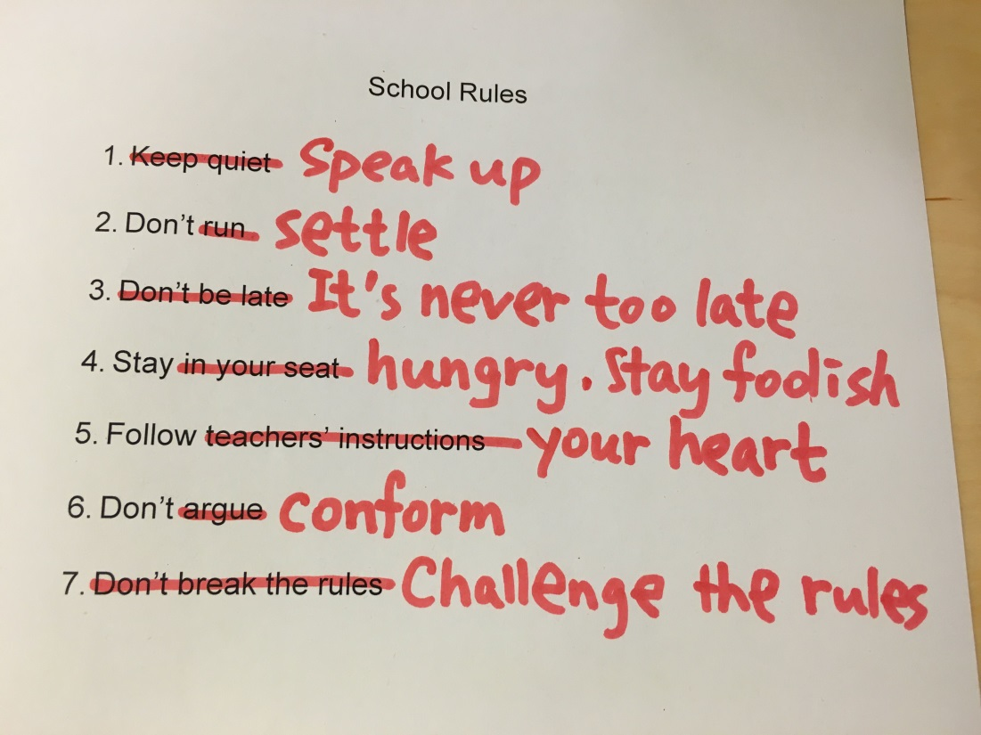
Rules
Whole School Rules and Class Rules should be the same, this will assist staff e.g. wearing baseball caps, bringing equipment, transitions
Keep them simple and a maximum of 5
Ensure that they are applied consistently throughout the school

Slide 39
Activity
In your group, write a maximum of 4 class rules that cover all aspects of classroom expectations.
5 minutes

Slide 40
Brain Physiology and the Arousal Cycle
Notes:
In this session we will be focussing on how Brain Physiology directly affects distressed and challenging behaviour.
We will look at what is termed the Arousal or Assault Cycle which clearly demonstrates the process that individuals go through when they become aggressively aroused with the potential for extremely challenging/harmful behaviours.
We will go through the various stages and look at what is going on and what actions should be taken to respond and possibly de-escalate the level of arousal.
The arousal cycle is a key aspect of Physical Intervention training and although we will not be looking at PI approaches it is essential to understand the process that leads a child / young person into what is termed “Crisis”.

Slide 41
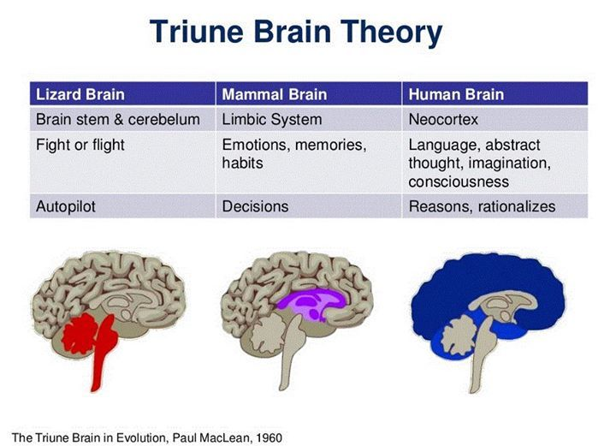
Brain Physiology?
Notes:
This slide shows how our brain has evolved.
The ‘lizard’ brain in our brainstem and cerebellum is concerned only about our survival and safety. It regulates our appetites, temperature, sleep patterns, hormones etc. and alerts us to danger when we are prompted to protect ourselves by fighting, flying (running away) or freezing (rabbit in the headlights, dissociating under extreme stress or in situations which trigger memories of extreme stress).
The ‘lizard’ brain works on auto pilot – we are not aware of all the physiological process that are happening all the time in our bodies and when our flight/fight/freeze response is triggered we react without thinking. In the past we had to, to survive!
NB ‘memories’ may be of things that happened when we were pre-verbal and so we can’t put them into language or may have been stored through any of our sensory channels so may be triggered by sounds or smells for example.
The ‘mammalian’ brain- the limbic system - is the area which processes our emotions and stores our memories. It is where our responses to interactions with others are generated and the emotional associations we make are stored e.g. the attachment relationships we develop throughout our lifespan. It is within this area of the brain that decisions are made – often these are not rational but are emotionally based, drawing on our memories of past events.
The ‘human’ brain – our neo cortex – is what gives us our ‘big heads’ and ability to reason and communicate ideas via language. It is here that the amazing worlds of our imagination are generated and it is here that our sense of ourselves as conscious individuals is sited. This ‘wrap around’ cortex is what mediates our responses to emotional triggers, it helps us to put a pause between a trigger and a response and allows us to think through options and consequences and consider impacts for ourselves and others.
FLIPPING YOUR LID – now make a fist with your thumb tucked inside……….

Slide 42
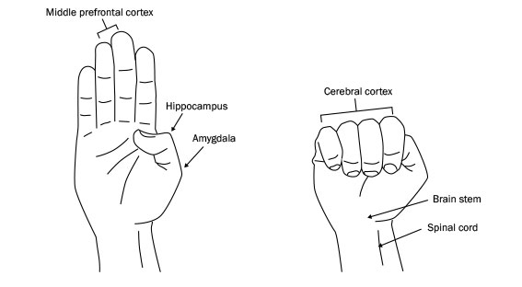
Use your hands to imagine your brain
Hand model courtesy of Dan Siegel
Notes:
Hold your hand up with palm facing out and the thumb tucked in (demonstrate)
Think about the brain unfolded, the top part of the fingers is the front part of your brain – the pre frontal cortex
Your thumb is the part of the brain buried deep inside e.g. the hippocampus and amygdala – the emotional centre
If you wrap your fingers around your thumb and tuck it all in your fist is a good representation of your brain:
Your wrist and the bottom of your hand is the spinal cord , leading into your brain stem.
Your fingers are the Cortex wrapping around and connecting with all those inner brain functions.
Millions of synapses are firing all the time.
So when our brains are functioning normally - when we are calm ,- our thinking brain, the pre frontal cortex ,is monitoring and regulating the impulses coming from our lizard and mammalian brain, that ‘s what gives us our big brains and makes us human.

Slide 43
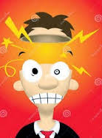
Now we look at what happens when…
When we get distressed we Flip Our Lid!
Notes:
Use your fist to demonstrated ‘flipping your lid’ . The fist opens and the connections are lost. Our ‘thinking brain’ is no longer in control.

Slide 44
If we flip our lid…
… the downstairs brain
- instantaneous response
Fight
  Remove the threat
Flight
  Remove self!
Freeze
  Infantilise to attract adult help
  Immobility, big eyes, smiles, perhaps incontinence
… and the upstairs brain
- strategies and behaviours
Aggression
  Safety through dominance
Absence
  Safety through concealment
  I run!
Appeasement
  Safety through manipulation
… SURVIVING not thriving
Notes:
This slide describes what is happening in our brain when we ‘flip our lid’ and the different possible responses:
Fight – we do our best to get rid of the threat to our safety, we use aggression to try to become dominant and chase the threat off or fight until it is eliminated.
Flight – we do our best to remove ourselves from the source of the threat, we run or hide so we are no longer visible and therefore safe.
Freeze – if we can’t fight or run or hide all that is left to do is freeze and try to appease/manipulate the threat. We become like little children (little creatures aren’t so much of a threat and bring out our more nurturing side). Our eyes widen, we smile a lot and may become incontinent.
Have you every seen a youngster laugh when they are in trouble? What did you think?
None of these behaviours in a child or young person (or indeed an adult!) indicate someone who is thriving – they are all about survival.

Slide 45
Putting the lid back on
Escalation
HPA (stress) axis
  adrenaline, cortisol, etc.
  rising blood pressure
  shallow breathing
  increased muscle tension
The downstairs brain is in charge
SURVIVAL
De-escalation
Vagus nerve
  oxytocin, dopamine, etc.
  lowering blood pressure
  deeper breathing
  reduced muscle tension
The upstairs brain is back in action
SAFETY
Notes:
So how do we get the lid back on and create a sense of safety again?
When we are in a state of threat (the ‘Escalation section above) it is our ‘sympathetic’ nervous system that is in control – adrenaline is pumping through our body, our cortisol (the stress hormone) levels are raised, this raises our blood pressure, our breathing becomes shallow (chest breathing) and our muscles tense. We are in survival mode.
So what we need to do to counteract this is stimulate the ‘parasympathetic’ nervous system – the one that calms you down. We can’t do this consciously , just as we can’t chose when our heart beats or how our food is digested, but we can use strategies that will do this for us.
Some of these include:
Counting down from 10 together
Deep breathing into our diaphragm.
Muscle relaxation – unclench your fists, drop your jaw, shrug your shoulders up and down, wiggle your toes, all reduce tension and increase the circulation of oxytocin and dopamine.
Movement – take a walk

Slide 46
Use of touch
Know the child well e.g. previous trauma
Think about how you move in and out of their own space
Part of wellbeing plan to support child
Discussed with parents
Never place yourself or the child at risk
Notes:
A gentle and appropriate touch can do this too but you have to be very careful about this, know the children very well (there might be sensory issues or past trauma that touch could trigger or the child might view this as an invasion of their personal space) and have discussed this as strategy with your leadership team and parents/carers. Never place the child or yourself at risk by using touch.
NOTE:
There is likely to be much discussion around this slide and many views,; it is particularly important to spend time with this and hear everyone. There are also likely to be people who will be keen to hear what the union view is.
Please stress that first and foremost this is about safety for everyone so don’t use touch if you yourself feel uncomfortable or if the child /young person (or the parent/carer) is likely to respond negatively.
It is also worth spending time here so that everyone is clear on what school management think and to highlight that considering use of gentle and appropriate touch – for example a ‘guiding away from’ or a gentle and reassuring pat – should always be part of a well considered and discussed plan that is shared by all appropriate parties. This is obviously context specific – thinking for children in early years or infant classes will be different to that for young people in upper primary and of secondary age.
It is also good to mention the ‘duty of care’ all employees have in taking reasonable steps – including appropriate physical intervention- to keep people safe.
See Physical Intervention guidelines.

Slide 47
Positive Model of Behaviour Management
Troubleshooting
Dealing with
problems
Time
Spent
Managing behaviour with
Classroom strategies
Management
Prevention
Creating a positive learning environment
High Quality Learning and Teaching
Birkett (2005)

Slide 48
Warning
The vast majority of pupils are fully engaged in learning, they behave well in class and act responsibly
Do not panic over the next section, you are likely never to need this knowledge in your teaching career but!

Slide 49
The Arousal Cycle
Trigger
Phase
Escalation
Phase
Crisis
Phase
Recovery
Phase
Post Crisis
Phase
Learning
Phase
Crisis
Additional
Outbursts
AROUSAL
Aggression
Anger
Anxiety
Baseline Behaviour
Exhaustion
TIME
Notes:
Lets look at the graph, 2 axis –Y Axis is Arousal Level (Physiological State) and X Axis is Time (Not indicated as this can vary from seconds, minutes to hours). The time line can be dependent on the individuals previous experience, level of distress, external factors and responses from others.
Along the top are 6 phases and in each phase different things are happening. If we understand and identify where an individual is within the cycle then you are more likely to disrupt or prevent the cycle from occurring.
Trigger phase- starts with Anxiety, the child / young person experiences elevated anxiety levels.
What is your idea of Anxiety?
For some children e.g. ASD they are likely to have elevated anxiety levels anyway as they try to deal with daily events. There is usually a trigger event e.g. being spoken to by an adult, being challenged, feeling threatened etc..
In the Escalation Phase comes Anger, this is generalised and may be seen as moody, unresponsive, cheeky, talking back but is usually not directed specifically at one person, there is often no eye contact and the body may well be turned away from the adult.
This is followed by Aggression and this is evident as it is now being directed at one person, body posture changes and you may well have eye contact. Voice level is raised and you might see physiological changes to breathing, tone, hand movements. Language may well be directed specifically at the adult.
If the escalation phase continues then it leads to what is called Assault and this is the start of Crisis Phase. In most case there is not actual physical assault but it often leads to the child becoming very distressed emotionally, possibly running away and out of class, hiding under a table etc.. At this point the child / young person is in Crisis and from an observers position you need to think of self protection and damage limitation.
During Crisis phase you should try to ensure the child / young person remains safe and you may have to remove other pupils from the room. If the child is willing to leave the room and go to another location such as the HT / DHT room then you must be aware that the level of arousal is still very high. This is the Recovery Phase and it takes time for the physiological changes to recover. It is essential that during this time the child / young person is not pressurised or challenged by staff as there is a high likelihood of additional assaults / distress. Staff should not attempt to discuss or discipline the child during the Recovery phase.
Eventually there is a very rapid fall in the level of arousal and this is the Post Crisis Phase which is followed by Exhaustion. This is literally correct as the child / young person feel tired and in some instances may fall asleep. Basically the body is recovering from the physiological changes that took place. After time the child/young person returns to the baseline level and this is Learning Phase. It is in this phase that any learning / discussion can take place but be careful that the cycle does not start all over again.

Slide 50
The Arousal Cycle
Trigger
Phase
Escalation
Phase
Crisis
Phase
Recovery
Phase
Post Crisis
Phase
Learning
Phase
Crisis
Additional
Outbursts
AROUSAL
Aggression
Anger
DANGER
Anxiety
PERCEIVED THREAT
Baseline Behaviour
Exhaustion
TIME
Notes:
Although the Cycle looks relatively simple one of the main problems is the timeline.
Some children can move through the cycle in minutes while others can take hours.
For example, you may have a pupil who has experienced an issue in the playground and is quite upset and has raised anxiety level. They return to their class and sit down. As the lesson progresses something acts as a trigger, it could be another pupil saying something or flicking the pupil, it might be the teacher asking a question. This can then lead to a rapid escalation phase where the child moves from Anxiety to Anger and Aggression within a matter of seconds, mainly because they came into the class with a heightened level of arousal.

Slide 51
Pupil and Adult Comparison
Trigger
Phase
Escalation
Phase
Crisis
Phase
Recovery
Phase
Post Crisis
Phase
Learning
Phase
Crisis
Adult in dark line
Additional
Outbursts
AROUSAL
Aggression
Aggression
Anger
Anger
Anxiety
Anxiety
Baseline Behaviour
Exhaustion
TIME
Exhaustion
Notes:
This graph shows how as the child / young person moves through the cycle that the adult also follows a similar cycle, particularly if they are not experienced or trained to deal with the situation.
As adults we need to be very attuned to our own responses, as children and young people escalate through these stages they have lost the ability too selfregulate i.e. manage their own feelings and responses (mammalian brain is no longer in charge).
As adults when we are well attuned to the child and managing our own responses appropriately we can work with the child and help co-regulate behaviour and therefore reduce levels of anxiety.

Slide 52
Response zones
Trigger
Phase
Escalation
Phase
Crisis
Phase
Recovery
Phase
Post Crisis
Phase
Learning
Phase
Crisis
C
Additional
Outbursts
AROUSAL
Aggression
E
B
Anger
D
Anxiety
A
Baseline Behaviour
Exhaustion
TIME
Notes:
If we break the cycle down into 5 zones and look at what is actually happening in each.

Slide 53
Emotion and Behaviour
Emotion | Behaviour | Message | Response
Anxiety (Zone A) | Withdrawal or agitation | I’m worried I’m frustrated | Active Listening, explore feelings, Problem Solve, Involve, redirect, relaxation strategies, anxiety management
Anger (Zone A/B) | Loud / Disruptive Critical, Swearing, Generalised Abuse | Listen to me Help Me | As above + divert, refocus, reassure, set limits, remove others
Aggression (Zone B/C) | Personalised Abuse Threats , Gesticulation, Space Invasion, Eye contact | I’m losing control Help me regain control | Set limits, unambiguous language, don’t question, divert, offer exits, seek help
Crisis (Zone C) | Destructive behaviour Towards people/ property / self | Can you control me? | Escape, Protect self and others, Seek Assistance,
Exhaustion (Zone D) | Tearful, Expressions of remorse / anger, regret, apologetic | I feel bad | Support, Monitor Secure the area
Post Incident (Zone E) | Return to baseline behaviour |  | Post incident review(s)
Notes:
This shows how the behaviour that is observed in each zone has a message value.
By understanding the message then this should direct the adults response.
The key to preventing or reducing distressed behaviour is trying to de-escalate within Zones A and B.
Once the child /young person is in Zone C then you have to be clear about what action will be taken and this is part of the child’s risk assessment plan.
Zone C Reference to Duty of Care – Do We Need A Slide?

Slide 54
Adult Response in each zone
Trigger
Phase
Escalation
Phase
Crisis
Phase
Recovery
Phase
Post Crisis
Phase
Learning
Phase
Crisis
C
Additional
Outbursts
AROUSAL
Self Protection
Aggression
E
Set limits
Divert/refocus
Re-assure
B
Post Incident
Review
Anger
D
Anxiety
Active listening – problem solve
A
Support
Monitor
Practical Help- explore feelings
Baseline Behaviour
Exhaustion
TIME
Notes:
If you can identify during the trigger-escalation phases the move from anxiety and anger, and intervene at that point then you are much more likely to prevent crisis being reached.

Slide 55


The Arousal Cycle
Trigger
Phase
Escalation
Phase
Crisis
Phase
Recovery
Phase
Post Crisis
Phase
Learning
Phase
Additional
Outbursts
CRISIS
AROUSAL
Aggression
Anger
Anxiety
Baseline Behaviour
Exhaustion
TIME

Slide 56
Phases of The Arousal Cycle
Trigger Phase:- departure from baseline behaviour in reaction to perceived threat (safety, self esteem, etc.). Warning signs may not be obvious yet.
Escalation Phase:- Behavioural signs become overt. Rationality and responsiveness to conciliatory interventions declines.
Crisis Phase:- Marked reduction in impulse control. Actively hostile behaviour and potential for physical assault. Physical violence may act to reduce arousal.

Slide 57
Phases of The Arousal Cycle
Recovery Phase:-Gradual return to baseline behaviour. However, heightened disposition to violence which may result in repeated assaults, especially where staff vigilance is relaxed.
Post Crisis Depression Phase:- Mental and physical exhaustion. Aggressor may become remorseful or tearful and experience a sense of shame. S/he may be open to positive interventions in order to relieve their sense of guilt or shame.

Slide 58
Phases of The Arousal Cycle
Learning Phase
a. Distressed child / young person may be helped to gain insight into their behaviour patterns and to develop alternative behaviours.
b. Participating Staff may be helped to review operational arrangements for managing distressed behaviours and supported in post incident emotional recovery process.
Notes:
Awareness of restorative approaches. Building and repairing relationships.
Is post Crisis reflection appropriate at time. Student still in recovery phase and
Cortisone/adrenaline etc. opportunity to still escalate.
Post Crisis, too tired, upset.
Is learning and reflection appropriate. Is return to class appropriate.
Only when baseline behaviour is re-established
Examples of outside classroom/HT office possible scenarios.
Importance of whole school approach to Nurture. Respect and Dignity.
Being Valued and sense of belonging
Passing staff and comments whilst waiting
Return to classroom and approaches by teacher
Return to Classroom and approaches by students

Slide 59
Duty of Care
Within realms of own ability
Proactive approach, to do nothing is un-acceptable
Legality: Greater or more significant harm to self and others/property
Foreseeability
Proportionality in response to crisis behaviour
Example Scenario: 2 pupils fighting in corridor
Example Scenario: Throwing a laptop

Slide 60
Lets have a look at some video scenarios
In groups discuss what behaviour is being communicated by the pupil and the teacher

Slide 61
Staff Debriefing
Duty of Care to staff
Violence Management Standard
Physical Intervention Guidelines
Times –when appropriate for staff and pupil
Who does this? Relationships!
No blame culture
Notes:
We have a duty to our staff to ensure that they are offered a debrief following an incident where they have felt threatened or have been injured.
Refer to the Physical Intervention Guidelines appendix which has a proforma and guidance on this.

Slide 62
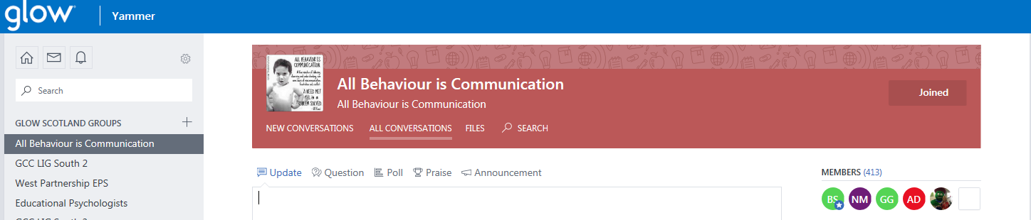
GLOW – Yammer- All Behaviour is Communication

Slide 63
And finally
Don’t
Do
Talk down to a pupil, either physically or verbally
Expect to get it right all the time
Expect that you can solve all problems, you won’t
Get drawn into a confrontation
Take time to know your pupils, learn their names
Treat them with respect
Be prepared
Create a nurturing learning environment
Seek and accept advice from others
Reflect on your practice
Have realistic goals on placement
Enjoy your successes

Slide 64
Remember
The most effective resource in teaching is the teacher!
Good Luck!

Slide 65
Questions?

Slide 66
Helpful links
Autism Toolbox http://www.autismtoolbox.co.uk/
Nurture in Glasgow http://www.goglasgow.org.uk/Pages/Show/816

Slide 67
Helpful links
ECIS http://www.goglasgow.org.uk/content/UserGenerated/file/Policies_Guidelines/SGL/ECIIS_PolicyGuidelines_June16.pdf
ACES & trauma
https://www.ted.com/talks/nadine_burke_harris_how_childhood_trauma_affects_health_across_a_lifetime

Slide 68
Helpful links
Dan Seigle – hand model of the brain:
https://www.google.co.uk/url?sa=t&rct=j&q=&esrc=s&source=web&cd=2&cad=rja&uact=8&ved=0ahUKEwiwhsyK9JnTAhWpB8AKHZpDBbgQtwIIIDAB&url=https%3A%2F%2Fwww.youtube.com%2Fwatch%3Fv%3Dgm9CIJ74Oxw&usg=AFQjCNFNt0x7Bst4MS58NW8e5czPX9UqUg

