Slide 1

Supporting Glasgow’s Learners
Glasgow City Council
Glasgow – UK Council of the year 2015
All Behaviour is Communication
Training for Trainers

Slide 2
Purpose of today
1. Prepare you to deliver this course to staff in your establishment
2. To discuss the content and support materials
3. To establish support and development groups in each LIG

Slide 3
Outline of Programme
Module 1. Nurture and Communication
Module 2. Responding to conflict and confrontation
Module 3. The Brain and The Arousal Cycle
Module 4. Risk Assessment and Planning
Each module takes an hour
Notes:
This programme is designed to be delivered over 4 sessions of 50-60 minutes.
It is aimed at all staff in schools. SfL Workers may wish to work with teaching staff on some of the activities.
Although it can be delivered over 1 day, there are opportunities for staff to reflect on what they have learned and take this back to their classroom. This serves as the basis for the next session.
The programme must be delivered in order and all 4 modules are required to complete the training course.

Slide 4
Positive Model of Behaviour Management
Troubleshooting
Dealing with
problems
Time
Spent
Managing behaviour with
Classroom strategies
Management
Prevention
Creating a positive learning environment
High Quality Learning and Teaching
Birkett (2005)

Slide 5
Negative Model of Behaviour Management
Dealing with problems
Troubleshooting
Time
Spent
Managing behaviour with
Classroom strategies
Management
Creating a positive
Learning
environment
Prevention
Birkett (2005)

Slide 6
“I’ve come to a frightening conclusion that I am the decisive element in the classroom. It’s my personal approach that creates the climate. It’s my daily mood that makes the weather. As a teacher, I possess a tremendous power to make a child’s life miserable or joyous. I can be a tool of torture or an instrument of inspiration. I can humiliate or heal. In all situations, it is my response that decides whether a crisis will be escalated or de-escalated and a child humanized or dehumanized.”
Haim G. Ginott
Notes:
Haim G. Ginott (originally Ginzburg; 5 August 1922–4 November 1973) was a school teacher,^{[1]} a child psychologist and psychotherapist and a parent educator. He pioneered techniques for conversing with children that are still taught today. His book, Between Parent and Child,^{[1]} stayed on the best seller list for over a year and is still popular today. This book sets out to give "specific advice derived from basic communication principles that will guide parents in living with children in mutual respect and dignity."^{[1]}
He is famously quoted as saying:
"If you want your children to improve, let them overhear the nice things you say about them to others.“ how often do we really do this – for our children or for each other?:

Slide 7
Module 1
Nurture and communication
Notes:
This first session looks at the importance of Nurture in the learning environment and how communication impacts directly on behaviour.
If you and your staff have already done a lot of work on the nurturing principles then this might be a ‘lighter touch ‘ section reminding your team about what you have already developed and why it is important to have this foundation in the context of understanding needs and managing more challenging situations.

Slide 8
Creating contexts for safe learning
Ethos and leadership – Solution Oriented Approaches (SOA), restorative approach, language and communication friendly, nurturing
High quality learning and teaching
Relational warmth – know the children
Attuned communication
Well informed staff – professional leaning
Good sharing of information
Clear, pro-active planning
Partnerships
Notes:
1. Whole-school vision and agreed core purpose will help all members of staff understand their role in supporting learners and share good practice in all aspects of school life. All members of staff become models for how we make and maintain relationships and deal with challenging situations when they arise.
2. Appropriate curriculum and an engaging classroom environment alongside good assessment and planning and knowledge of children’s additional support needs all help children to feel secure in school. They help foster predictable, fair and individualised relationships for all and underpin interactions that are perceived as warm, attuned and responsive to need.
3. Attuned communication between staff members and staff and children are indicative of professionals who are able to self reflect, understand their own emotional needs and reactions and make meaningful and positive ‘meaning making’ connections with others. Attuned communication allows us to self regulate and hence co-regulate for those children who need scaffolding and containment for overwhelming emotional reactions.
4. Professional learning opportunities for staff to gain knowledge , develop skills, share practical experiences and reflect on learning encourage staff to assume professional responsibility for all the learning and interactions in their classrooms. Supporting communication networks e.g. GLOW, attendance at support and development groups, hosting Open Doors sessions, all facilitate a ‘learning focused ‘ community of professionals. Our knowledge of attachment needs and the impact of trauma is particularly important for these modules.
5. Aspirational and optimistic expectations emphasise a strengths-based understanding of how to engage and motivate children. These are illustrated by clear expectations and boundaries, positive role modelling and an awareness of how mind-sets and language communicate the judgements we make about each other.
6. Partnerships with parents and other professionals based on mutual respect and understanding of the different roles each play in the lives of children are essential. Applying strengths-based/solution oriented thinking and restorative approaches to these relationships as well as to our work with children supports us in navigating times when relationships could become stressed and/or blaming.

Slide 9
Nurturing principles
1. Children and young people’s learning is understood developmentally
2. The classroom/school offers a safe base
3. The importance of nurture for the development of self esteem
4. Language is a vital means of communication
5. All behaviour is communication
6. The importance of transition in young people’s lives
© Nurture Network
Notes:
All staff should be familiar with the nurturing principles and should have had opportunities to reflect on how they are applied in their school and classrooms.
The principles are underpinned by attachment theory which aids our understanding of how children grow and develop in a relational context, making meaning from their interactions and developing their understanding of who they are as people.
Applying these principles fosters good classroom/playroom practice that benefits every child and young person.
Without an understanding of these principles and how they can be applied in the classroom we run the risk of further complicating the lives of vulnerable and upset children who can easily feel threatened, blamed and shamed. Such situations can trigger past experiences, evoke strong emotional responses and lead to overwhelming and ‘out of control’ behavioural responses.
Opportunities for staff groups to reflect on the principles will help staff identify when they are being enacted well, how they help us understand all children's learning and development needs and how to create learning contexts that are safe and secure for all.
What may be classed as transition? Day to day mobility, change, loss, work experience, home, changing activities, asking questions etc..

Slide 10
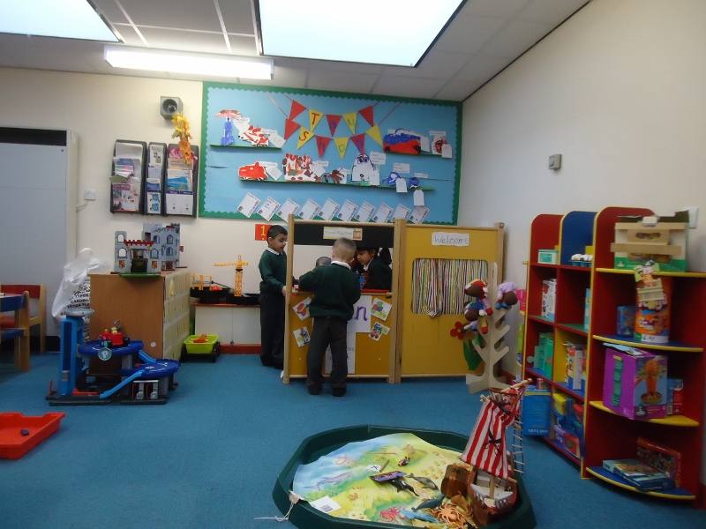
Activity 1
In groups, discuss what a nurturing classroom would look and feel like.
Notes:
10 minutes maximum, feedback through plenary.
Use Prompts below to elicit feedback.
What would you see?
What would you hear?
What would you feel?
Take feedback: one key point from each group to keep discussion flowing
This picture is of a Primary School space – what is it encouraging?
Co-operation
Curiosity
Exploration
Choice
Safety – ‘welcome’ and well organised, tidy and ordered
NOTE:
1) If you have already done a lot of work on Nurturing Principles then an alternative reflective activity would be to ask staff to rate how nurturing your school/their classroom/ playroom is on a scale of 1-10.
Supplementary questions on what you have done to get to that point on the scale and what you need to do next would complete the activity.
2) If staff are not familiar with the Nurturing Principles you may want to spend a little more time focussing on them and perhaps looking at one or two keys ones in more depth

Slide 11
All Behaviour is Communication
Notes:
When considering this nurturing principle it is important to reflect on the fact that our behaviours take place within a relational context , so when we are thinking about children’s behaviours we must also be thinking about our own.
This is most likely not new to you but is stands repeating:
As this diagram illustrates the greatest part of our communication is not through the words we use but through how we use our bodies. Our tone of voice can be used to convey acceptance, warmth, curiosity or it can be used to convey suspicion, hostility, superiority.
Our body language is even more important – our stance, awareness of ‘personal space’ , open-ness or closed , state of tension or relaxation all communicate our feelings and thoughts and the physiological processes in our body.
So understanding and being aware of what we are communicating through our behaviours is essential in helping us understand what children are communicating. What needs do children have that can result in distress and behaviour challenges if they are not met?

Slide 12
Why do children become distressed?
Think about some reasons why children and young people become distressed, discuss with a partner and write on a post-it.
Notes:
In this activity we are looking at how anger is expressed.
We are trying to get participants to think about the wide range of reasons as to why children become distressed and the importance of not jumping to one conclusion. We need to be thinking of distressed behaviour as a symptom of some underlying issue that we have not identified.
5 minutes in pairs with Post-Its
Ask for some feedback from the group.

Slide 13
Why do children become distressed?
Fight or flight response – threat (functional anger)
Stress and coping
Additional Support Needs
Developmental stage
Reinforcement?
Link to internal working model of themselves as shameful
Trauma
Other?
Notes:
Fight or flight response- innate primitive behavioural response to a threat
Stress and coping- the individuals level of stress and anxiety reaches a point where they have to have emotional release and this is seen as distress
Additional Support Needs – e.g. Autism Spectrum Disorder, Language and Communication Impairment, Visual or Hearing Impairment, Cognitive difficulties.
Developmental stage – e.g. Terrible 2s, delayed development, adolescent re-wiring
Reinforcement- child / young person has had previous behaviour reinforced , either positively or negatively so increasing likelihood of the behaviour being repeated.
Trauma- behaviour is linked to previous negative experience, attachment issues and can be triggered by environmental factors like sounds or smells.
NOTE:
Other might be context specific e.g. secondary colleagues may have to support young people who have been socialising heavily the night before – lack of sleep/ hung over or who are developing a tobacco addiction and really want a cigarette.
Please note this is not condoning such behaviours just recognising that they may be a part of a young person’s presentation.
Early years colleagues may be working with young children who are pre-verbal and who are experiencing frustration in making their needs known to adults.

Slide 14
Understanding Distressed / Challenging Behaviour
All ‘Distressed Behaviour’ meets a need – for the individual it is a solution, not a problem!
ALWAYS ASK YOURSELF
What need does this behaviour meet for the other person ?
Will my intervention make things better or worse ?
Am I in control of myself ?
Notes:
We need to be aware of how we feel in the situation as we will react in response to what we are seeing and hearing.
As adults we feel that we have to do something as we perceive we are in charge. When we are challenged our natural emotions kick in and we can respond in ways that we would not normally. For example reactive or defensive responses, if a child or young person talks back at an adult and start to raise their voice then the adult will usually respond in a similar way.
Sometimes your intervention can significantly escalate the situation or even place the child or young person at greater risk.
Example: Pupil becomes distressed in class, runs out of the school and is chased by a member of staff. Pupil sees the staff member following him and tries to evade. He runs without thinking across a road looking behind him as teacher pursues him. He does not see a large truck approaching, fortunately the driver reacts in time and stops just in front of the pupil.

Slide 15
Defining behaviour?
What is the difference between challenging, distressed, aggressive or violent behaviour?
Depends on personal experience
Depends on the individual
Notes:
Ask the group the question.
Looking for a range of responses that highlight that individuals define challenging and aggressive behaviour differently . We apply our own personal experiences to this.
Challenging behaviour can be behavioural, communicative, medical, developmental.
If you work in an environment where there are regular incidents of distressed / challenging behaviour then your threshold is likely to be different to one where these incidents never happen. For example a Secure Unit, That is not to say that it is in any way acceptable but we need to be aware that people define behaviour differently.
We also need to be able to actually define behaviour in a clear way that others can understand.
If we think about Performance statements rather than Fuzzy statements.
A performance statement defines a behaviour in a way that anyone would be able to understand and see. For example: When distressed John will hit his hand off solid objects and hurt himself to a point where he will cry in pain.
When upset Sarah will throw objects and then try to hide under a table.
A fuzzy statement does not really describe the action but is more emotive and can be misinterpreted.
John just loses it and then goes mad!
Sarah goes off on one which really upsets the class!

Slide 16
Iceberg metaphor
Behaviour
Angry outbursts, screaming, swearing,
Aggression, violence
Fears and phobias
Maladaptive stress response
Poor communication skills
Misinterpretation of events
Overloaded by stimulation
Traumatic experiences
Possible reasons/ communicative functions
Notes:
Refer back to previous activity on slide 9
The behaviour you see and experience is the tip of the iceberg therefore we react to that.
What we need to do is look at what is below the water where the real issues are and that is what needs to be looked at.
This can be difficult in the heat of the moment but good knowledge of children and young people’s needs is essential as is good sharing of information , for example from class to class or playground to classroom.
This allows us to ‘stop and think’ when we see a youngster becoming distressed. What do you already know, what has worked previously, what should you not do, what is your own emotional reaction, are you in control…..?

Slide 17
Homework- Reflection?
Think about a child / young person who displays distressed / challenging behaviours.
Think about the following:
How does this make you feel? List your feelings.
What is the context in which these behaviours are seen?
What is the impact /outcome of these behaviours? For the child / other pupils / yourself / other staff?
What needs could the child / young person be communicating?
What possible changes could be made to reduce the distressed / challenging behaviour?
Notes:
This is an individual task to be completed by the next training session.
Provide staff with a recording sheet with prompts as part of a reflective diary.
Option SfL Workers may wish to work along with Class Teacher.
Notice aspects of your school and classroom, (environment, planning, curriculum, resources) that are helping to support the pupil you have been thinking about.
PAUSE POINT FOR PRESENTERS
What issues has this section raised for you?
Do all your staff know about the nurturing principles, attachment and trauma reactions?
Are you confident that this knowledge is being applied by everyone?
Are you school’s approaches to wellbeing ‘trauma informed’?
Do you need to revisit policies and guidelines?
How are staff feeling? How are they (and you) nurtured?
Do you need to spend more time reflecting on this as a staff before you go on to the next module?

Slide 18
Module 2
Responding to conflict and confrontation
Use of Restorative Approaches
Notes:
In this session we will be focussing on how we respond to conflict- specifically how confrontations arise and how to use a restorative approach in response to an incident.

Slide 19
Activity
In pairs, discuss your “homework”
activity.
What was the main learning point for you
from the activity?
Notes:
5 minutes in pairs, plenary feedback 5 minutes
Flipchart to record key words?

Slide 20
Confrontation
Confrontation refers to a showdown between 2 or more parties
It often starts as a trivial incident or comment which escalates into a protracted and heated exchange

Slide 21
Activity
In pairs take 5 minutes to discuss what
kind of confrontations you find
particularly difficult to handle and why?
Notes:
5 Minutes, try to focus on personal experience not necessarily in the classroom
Examples may be
Getting cut up by another car in traffic
Dealing with staff in a shop
Trying to get through to a help desk when your broadband is not working

Slide 22
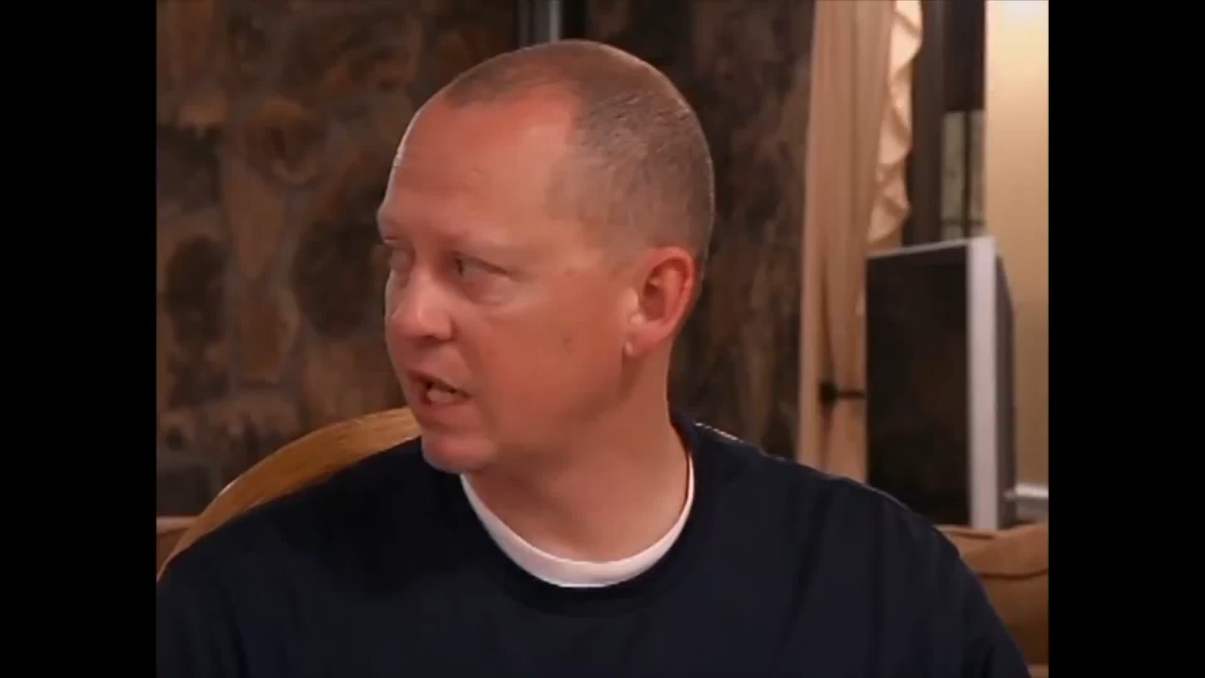

Slide 23
Feedback from Video Clip
How did that make you feel?
Who was right and who was wrong?
How could this have been avoided?
Who won?
Notes:
Ask the group to respond to the questions provided?

Slide 24
Impact of confrontation in the classroom
For the Adult
Anger – my authority has been challenged
Fear –who loses is weak, perceived by the audience
Embarrassment – having to seek help is an admission of failure
Anxiety – loss of rapport with pupil
Blame – something must be wrong with the pupil
Notes:
Let’s think about the classroom environment and the effects of confrontation in a class on the adult
This may be going through the adults mind:-
Anger- I am the teacher / SfLW and what I say goes, this child / young person is challenging me. I cannot let this go “!
Fear- “If I lose this argument then I feel threatened and other pupils will see this”
Embarrassment- “If I have to seek help from a colleague then I have basically shown that I cannot manage this on my own, others may talk about me?”
Anxiety-” I am here to teach and help pupils learn, I don’t want to fall out with this pupil but!!!”
Blame- “This is my class and the other children / young people are being disrupted by this behaviour, something must be wrong with the pupil because I did nothing wrong. Probably has ADHD!”

Slide 25
Impact of confrontation
For the Pupil
Anger – undermining my self worth
Fear – who loses is weak, perceived by the audience
Embarrassment – in front of peer group
Anxiety- loss of rapport with teacher
Blame – the teacher is nuts, has it in for me
Shamed
Notes:
Let’s think about the classroom environment and the effects of confrontation in a class on the pupil
This may be going through the pupil’s mind, may depend on the age of the child as adolescents perceive situations differently.
Anger- “Why is he / she going on at me and talking to me in that way?” “No one speaks to me like that”
Fear- “If I lose this argument then I feel threatened and others will see it”
Embarrassment- “I am being told off and embarrassed in front of my peers and they are looking and listening at me getting it from the teacher”
Anxiety-” I actually like the teacher/ adult but they are getting at me!”
Blame- “The teacher is nuts and is always looking at ways of getting me into trouble, I am always the one picked on!”

Slide 26
Think about this!
In all your years of working with young people, has a pupil ever stopped in the middle of a confrontation and said “ I’m sorry, you are right, I was wrong!”
The adult is the experienced person and it is the adult who has the status to be in control of the situation

Slide 27
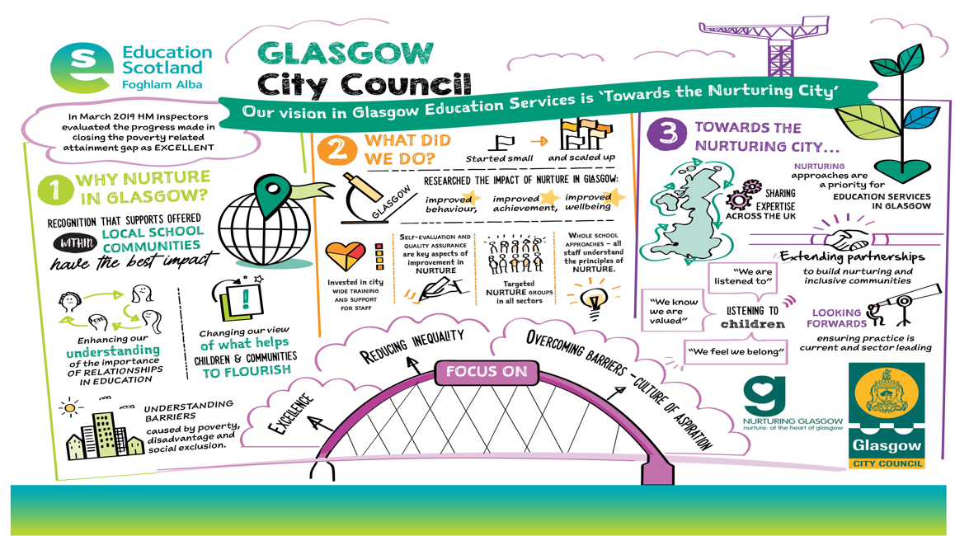
Restorative approaches are key to Nurture

Slide 28
Why do we need Restorative Approaches?
It gives a voice to pupils and staff who have been harmed
It helps develop pro-social behaviours such as empathy, responsibility, problem solving and understanding of consequences
It builds communities of care with relationships founded on trust and focused on support
It supports existing practice of making, maintaining and mending relationships with pupils who need support

Slide 29
Definition of Restorative Approaches
An approach to dealing with challenging behaviour and conflict
Focuses on building and repairing relationships
…rather than…
managing and controlling behaviour.

Slide 30
Behaviour and Learning
If a child doesn’t know how to read, we teach him/her to read.
If a child doesn’t know how to do maths problems, we teach him/her how to do maths problems.
If a child doesn’t know how to behave, we punish him/her?

Slide 31
How does the restorative way work?
…have their story
heard
…be a part of
deciding what needs
to happen next
…have their hurt
mended and start
again
Those who cause harm are able to…
…take
responsibility
for their
actions
…reflect on
what they did
…understand
how their
actions affect
other people
…put things
right and
start again
Those who are harmed are able to…

Slide 32
Social Discipline Window
WITH
HIGH
TO
Punitive
Restorative
authoritarian
blame
authoritative
empower
Control
(Limit Setting
Discipline)
        Neglectful
Permissive
indifferent
ignore
rescuing
excuse
NOT
FOR
LOW
Support
(Encouragement, Nurture)
HIGH
Blood, 2004
Adapted from Wachtel, 1999
Notes:
Low control – Low support =neglect (NOT doing anything)
High control – Low support = punishment (doing TO pupils)
Low control – High support = permissiveness (doing FOR the pupils)
High control – High support = restorative (working WITH the pupils)
Attributed to Ted Wachtel (iirp) & Paul McCold (criminologist - who has been involved in the evaluation of RP in the USA)
Point out two axes -
Vertical which can range from high to low is about rules, limit setting boundaries, parameters etc.
Horizontal - about support, encouragement, nurture etc.
Swinging pendulum from punitive to permissive - give examples
Neglectful - nobody wants
Restorative - which is where we want people to be
Talk thro To / With/ Not / For speak to each quadrant
Emphasise that this is NOT A NO BLAME APPROACH it’s about holding people accountable for their actions making them accept responsibility but supporting them in learning from what they have done to others - there are consequences to their actions both for themselves and others and helping them find a way of behaving differently next time.
32

Slide 33
5 Key Questions
1. Tell me what happened?
2. What were you thinking about at the time?
3. What have your thoughts been since?
4. Who else has been affected?
5. What do you think needs to happen next/what do you need to move forward?

Slide 34
Homework- Reflection
Now think about your case study
Think about a confrontation you have experienced / seen in school. This may have involved your case study.
How would applying a restorative approach have helped?
How could you do this?
What support would you need?
Notes:
Think about a confrontation you have experienced / seen in school. This may have involved your case study.
How would applying a restorative approach have helped?
How could you do this? Are there potential barriers?
What support would you need? Where could you seek that support?

Slide 35
Module 3
The Brain
The Arousal Cycle
Notes:
In this session we will be focussing on how we respond to conflict- specifically how confrontations arise and how to use a restorative approach in response to an incident.

Slide 36
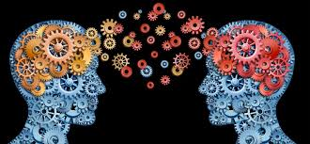
Welcome back……
Notes:
Before we get started on module 3 lets do a recap of what we learnt last session……

Slide 37
Module 1 Re-cap
Creating contexts for learning
Attachment, trauma and nurture informed practice
Assessment of and planning for additional support needs
Self reflection
Self and co-regulation
Why do we become distressed?
Notes:
NOTE:
THESE NEXT TWO SLIDES MAY NEED TO BE ADAPTED ACCORDING TO WHETHER MODULES ARE BEING COMPLETED SINGULARLY OR IN BLOCKS
Module 1….
We looked at the importance of the contexts we create across the whole establishment and in the classroom/playroom.
We considered the knowledge that we need to underpin our thinking . Knowledge of child development, of attachment and the impact of trauma and of how applying the nurturing principles will help us build those safe, predictable attachment-informed spaces for children to learn in.
We talked about the importance of good assessment and understanding of children's needs – remember the iceberg?
And of being reflective practitioners who were attuned to our own emotional responses and able to help the children we work with learn to regulate theirs.
We then looked at ‘all behaviour is communication’ to get a better understanding of the needs that a distressed child might be trying to communicate.

Slide 38
Module 2
Restorative approaches
If a child doesn’t know how to read, we teach him/her to read.
If a child doesn’t know how to do maths problems, we teach him/her how to do maths problems.
If a child doesn’t know how to behave, we punish him/her?
Notes:
In module two we looked at our understanding of and reactions to confrontation (remember the video) and then we focused specifically on restorative approaches – believing that children need support to learn how to get on with one another and how to negotiate the world of school.
RAs help to develop a relational context and support skill building for all

Slide 39
Module 3
Brain Physiology and the Arousal Cycle
Notes:
In this session we will be focussing on how Brain Physiology directly affects distressed and challenging behaviour.
We will look at what is termed the Arousal or Assault Cycle which clearly demonstrates the process that individuals go through when they become aggressively aroused with the potential for extremely challenging/harmful behaviours.
We will go through the various stages and look at what is going on and what actions should be taken to respond and possibly de-escalate the level of arousal.
The arousal cycle is a key aspect of Physical Intervention training and although we will not be looking at PI approaches it is essential to understand the process that leads a child / young person into what is termed “Crisis”.

Slide 40
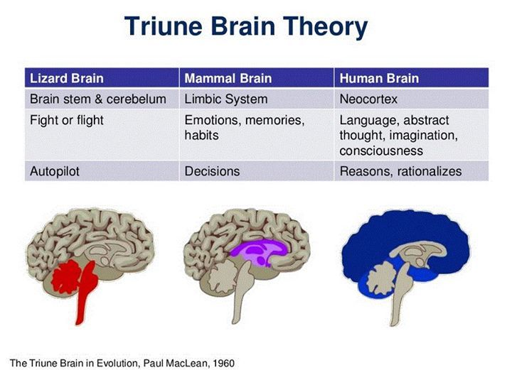
Brain Physiology?
Notes:
This slide shows how our brain has evolved.
The ‘lizard’ brain in our brainstem and cerebellum is concerned only about our survival and safety. It regulates our appetites, temperature, sleep patterns, hormones etc. and alerts us to danger when we are prompted to protect ourselves by fighting, flying (running away) or freezing (rabbit in the headlights, dissociating under extreme stress or in situations which trigger memories of extreme stress).
The ‘lizard’ brain works on auto pilot – we are not aware of all the physiological process that are happening all the time in our bodies and when our flight/fight/freeze response is triggered we react without thinking. In the past we had to, to survive!
NB ‘memories’ may be of things that happened when we were pre-verbal and so we can’t put them into language or may have been stored through any of our sensory channels so may be triggered by sounds or smells for example.
The ‘mammalian’ brain- the limbic system - is the area which processes our emotions and stores our memories. It is where our responses to interactions with others are generated and the emotional associations we make are stored e.g. the attachment relationships we develop throughout our lifespan. It is within this area of the brain that decisions are made – often these are not rational but are emotionally based, drawing on our memories of past events.
The ‘human’ brain – our neo cortex – is what gives us our ‘big heads’ and ability to reason and communicate ideas via language. It is here that the amazing worlds of our imagination are generated and it is here that our sense of ourselves as conscious individuals is sited. This ‘wrap around’ cortex is what mediates our responses to emotional triggers, it helps us to put a pause between a trigger and a response and allows us to think through options and consequences and consider impacts for ourselves and others.
FLIPPING YOUR LID – now make a fist with your thumb tucked inside……….

Slide 41
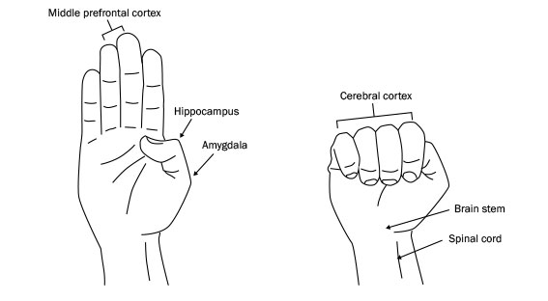
Use your hands to imagine your brain
Hand model courtesy of Dan Siegel
Notes:
Hold your hand up with palm facing out and the thumb tucked in (demonstrate)
Think about the brain unfolded, the top part of the fingers is the front part of your brain – the pre frontal cortex
Your thumb is the part of the brain buried deep inside e.g. the hippocampus and amygdala – the emotional centre
If you wrap your fingers around your thumb and tuck it all in your fist is a good representation of your brain:
Your wrist and the bottom of your hand is the spinal cord , leading into your brain stem.
Your fingers are the Cortex wrapping around and connecting with all those inner brain functions.
Millions of synapses are firing all the time.
So when our brains are functioning normally - when we are calm ,- our thinking brain, the pre frontal cortex ,is monitoring and regulating the impulses coming from our lizard and mammalian brain, that ‘s what gives us our big brains and makes us human.

Slide 42
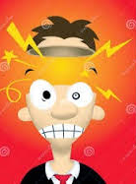
Now we look at what happens when…
When we get distressed we Flip Our Lid!
Notes:
Use your fist to demonstrated ‘flipping your lid’ . The fist opens and the connections are lost. Our ‘thinking brain’ is no longer in control.

Slide 43
If we flip our lid…
… the downstairs brain
- instantaneous response
Fight
  Remove the threat
Flight
  Remove self!
Freeze
  Infantilise to attract adult help
  Immobility, big eyes, smiles, perhaps incontinence
… and the upstairs brain
- strategies and behaviours
Aggression
  Safety through dominance
Absence
  Safety through concealment
  I run!
Appeasement
  Safety through manipulation
… SURVIVING not thriving
Notes:
This slide describes what is happening in our brain when we ‘flip our lid’ and the different possible responses:
Fight – we do our best to get rid of the threat to our safety, we use aggression to try to become dominant and chase the threat off or fight until it is eliminated.
Flight – we do our best to remove ourselves from the source of the threat, we run or hide so we are no longer visible and therefore safe.
Freeze – if we can’t fight or run or hide all that is left to do is freeze and try to appease/manipulate the threat. We become like little children (little creatures aren’t so much of a threat and bring out our more nurturing side). Our eyes widen, we smile a lot and may become incontinent.
Have you every seen a youngster laugh when they are in trouble? What did you think?
None of these behaviours in a child or young person (or indeed an adult!) indicate someone who is thriving – they are all about survival.

Slide 44
Putting the lid back on
Escalation
HPA (stress) axis
  adrenaline, cortisol, etc.
  rising blood pressure
  shallow breathing
  increased muscle tension
The downstairs brain is in charge
SURVIVAL
De-escalation
Vagus nerve
  oxytocin, dopamine, etc.
  lowering blood pressure
  deeper breathing
  reduced muscle tension
The upstairs brain is back in action
SAFETY
Notes:
So how do we get the lid back on and create a sense of safety again?
When we are in a state of threat (the ‘Escalation section above) it is our ‘sympathetic’ nervous system that is in control – adrenaline is pumping through our body, our cortisol (the stress hormone) levels are raised, this raises our blood pressure, our breathing becomes shallow (chest breathing) and our muscles tense. We are in survival mode.
So what we need to do to counteract this is stimulate the ‘parasympathetic’ nervous system – the one that calms you down. We can’t do this consciously , just as we can’t chose when our heart beats or how our food is digested, but we can use strategies that will do this for us.
Some of these include:
Counting down from 10 together
Deep breathing into our diaphragm.
Muscle relaxation – unclench your fists, drop your jaw, shrug your shoulders up and down, wiggle your toes, all reduce tension and increase the circulation of oxytocin and dopamine.
Movement – take a walk

Slide 45
Use of touch
Know the child well e.g. previous trauma
Think about how you move in and out of their own space
Part of wellbeing plan to support child
Discussed with parents
Never place yourself or the child at risk
Notes:
A gentle and appropriate touch can do this too but you have to be very careful about this, know the children very well (there might be sensory issues or past trauma that touch could trigger or the child might view this as an invasion of their personal space) and have discussed this as strategy with your leadership team and parents/carers. Never place the child or yourself at risk by using touch.
NOTE:
There is likely to be much discussion around this slide and many views,; it is particularly important to spend time with this and hear everyone. There are also likely to be people who will be keen to hear what the union view is.
Please stress that first and foremost this is about safety for everyone so don’t use touch if you yourself feel uncomfortable or if the child /young person (or the parent/carer) is likely to respond negatively.
It is also worth spending time here so that everyone is clear on what school management think and to highlight that considering use of gentle and appropriate touch – for example a ‘guiding away from’ or a gentle and reassuring pat – should always be part of a well considered and discussed plan that is shared by all appropriate parties. This is obviously context specific – thinking for children in early years or infant classes will be different to that for young people in upper primary and of secondary age.
It is also good to mention the ‘duty of care’ all employees have in taking reasonable steps – including appropriate physical intervention- to keep people safe.
See Physical Intervention guidelines.

Slide 46
Positive Model of Behaviour Management
Troubleshooting
Dealing with
problems
Time
Spent
Managing behaviour with
Classroom strategies
Management
Prevention
Creating a positive learning environment
High Quality Learning and Teaching
Birkett (2005)

Slide 47
The Arousal Cycle
Trigger
Phase
Escalation
Phase
Crisis
Phase
Recovery
Phase
Post Crisis
Phase
Learning
Phase
Crisis
Additional
Assaults
AROUSAL
Aggression
Anger
Anxiety
Baseline Behaviour
Exhaustion
TIME
Notes:
Lets look at the graph, 2 axis –Y Axis is Arousal Level (Physiological State) and X Axis is Time (Not indicated as this can vary from seconds, minutes to hours). The time line can be dependent on the individuals previous experience, level of distress, external factors and responses from others.
Along the top are 6 phases and in each phase different things are happening. If we understand and identify where an individual is within the cycle then you are more likely to disrupt or prevent the cycle from occurring.
Trigger phase- starts with Anxiety, the child / young person experiences elevated anxiety levels.
What is your idea of Anxiety?
For some children e.g. ASD they are likely to have elevated anxiety levels anyway as they try to deal with daily events. There is usually a trigger event e.g. being spoken to by an adult, being challenged, feeling threatened etc..
In the Escalation Phase comes Anger, this is generalised and may be seen as moody, unresponsive, cheeky, talking back but is usually not directed specifically at one person, there is often no eye contact and the body may well be turned away from the adult.
This is followed by Aggression and this is evident as it is now being directed at one person, body posture changes and you may well have eye contact. Voice level is raised and you might see physiological changes to breathing, tone, hand movements. Language may well be directed specifically at the adult.
If the escalation phase continues then it leads to what is called Assault and this is the start of Crisis Phase. In most case there is not actual physical assault but it often leads to the child becoming very distressed emotionally, possibly running away and out of class, hiding under a table etc.. At this point the child / young person is in Crisis and from an observers position you need to think of self protection and damage limitation.
During Crisis phase you should try to ensure the child / young person remains safe and you may have to remove other pupils from the room. If the child is willing to leave the room and go to another location such as the HT / DHT room then you must be aware that the level of arousal is still very high. This is the Recovery Phase and it takes time for the physiological changes to recover. It is essential that during this time the child / young person is not pressurised or challenged by staff as there is a high likelihood of additional assaults / distress. Staff should not attempt to discuss or discipline the child during the Recovery phase.
Eventually there is a very rapid fall in the level of arousal and this is the Post Crisis Phase which is followed by Exhaustion. This is literally correct as the child / young person feel tired and in some instances may fall asleep. Basically the body is recovering from the physiological changes that took place. After time the child/young person returns to the baseline level and this is Learning Phase. It is in this phase that any learning / discussion can take place but be careful that the cycle does not start all over again.

Slide 48
The Arousal Cycle
Trigger
Phase
Escalation
Phase
Crisis
Phase
Recovery
Phase
Post Crisis
Phase
Learning
Phase
Crisis
Additional
Outbursts
AROUSAL
Aggression
Anger
DANGER
Anxiety
PERCEIVED THREAT
Baseline Behaviour
Exhaustion
TIME
Notes:
Although the Cycle looks relatively simple one of the main problems is the timeline.
Some children can move through the cycle in minutes while others can take hours.
For example, you may have a pupil who has experienced an issue in the playground and is quite upset and has raised anxiety level. They return to their class and sit down. As the lesson progresses something acts as a trigger, it could be another pupil saying something or flicking the pupil, it might be the teacher asking a question. This can then lead to a rapid escalation phase where the child moves from Anxiety to Anger and Aggression within a matter of seconds, mainly because they came into the class with a heightened level of arousal.

Slide 49
Pupil and Adult Comparison
Trigger
Phase
Escalation
Phase
Crisis
Phase
Recovery
Phase
Post Crisis
Phase
Learning
Phase
Crisis
Adult in dark line
Additional
Outbursts
AROUSAL
Aggression
Aggression
Anger
Anger
Anxiety
Anxiety
Baseline Behaviour
Exhaustion
TIME
Exhaustion
Notes:
This graph shows how as the child / young person moves through the cycle that the adult also follows a similar cycle, particularly if they are not experienced or trained to deal with the situation.
As adults we need to be very attuned to our own responses, as children and young people escalate through these stages they have lost the ability too selfregulate i.e. manage their own feelings and responses (mammalian brain is no longer in charge).
As adults when we are well attuned to the child and managing our own responses appropriately we can work with the child and help co-regulate behaviour and therefore reduce levels of anxiety.

Slide 50
Response zones
Trigger
Phase
Escalation
Phase
Crisis
Phase
Recovery
Phase
Post Crisis
Phase
Learning
Phase
Crisis
C
Additional
Outbursts
AROUSAL
Aggression
E
B
Anger
D
Anxiety
A
Baseline Behaviour
Exhaustion
TIME
Notes:
If we break the cycle down into 5 zones and look at what is actually happening in each.

Slide 51
Emotion and Behaviour
Emotion | Behaviour | Message | Response
Anxiety (Zone A) | Withdrawal or agitation | I’m worried I’m frustrated | Active Listening, explore feelings, Problem Solve, Involve, redirect, relaxation strategies, anxiety management
Anger (Zone A/B) | Loud / Disruptive Critical, Swearing, Generalised Abuse | Listen to me Help Me | As above + divert, refocus, reassure, set limits, remove others
Aggression (Zone B/C) | Personalised Abuse Threats , Gesticulation, Space Invasion, Eye contact | I’m losing control Help me regain control | Set limits, unambiguous language, don’t question, divert, offer exits, seek help
Crisis (Zone C) | Destructive behaviour Towards people/ property / self | Can you control me? | Escape, Protect self and others, Seek Assistance,
Exhaustion (Zone D) | Tearful, Expressions of remorse / anger, regret, apologetic | I feel bad | Support, Monitor Secure the area
Post Incident (Zone E) | Return to baseline behaviour |  | Post incident review(s)
Notes:
This shows how the behaviour that is observed in each zone has a message value.
By understanding the message then this should direct the adults response.
The key to preventing or reducing distressed behaviour is trying to de-escalate within Zones A and B.
Once the child /young person is in Zone C then you have to be clear about what action will be taken and this is part of the child’s risk assessment plan.
Zone C Reference to Duty of Care – Do We Need A Slide?

Slide 52
Adult Response in each zone
Trigger
Phase
Escalation
Phase
Crisis
Phase
Recovery
Phase
Post Crisis
Phase
Learning
Phase
Crisis
C
Additional
Assaults
AROUSAL
Self Protection
Aggression
E
Set limits
Divert/refocus
Re-assure
B
Post Incident
Review
Anger
D
Anxiety
Active listening – problem solve
A
Support
Monitor
Practical Help- explore feelings
Baseline Behaviour
Exhaustion
TIME
Notes:
If you can identify during the trigger-escalation phases the move from anxiety and anger, and intervene at that point then you are much more likely to prevent crisis being reached.

Slide 53
Phases of The Arousal Cycle
Trigger Phase:- departure from baseline behaviour in reaction to perceived threat (safety, self esteem, etc.). Warning signs may not be obvious yet.
Escalation Phase:- Behavioural signs become overt. Rationality and responsiveness to conciliatory interventions declines.
Crisis Phase:- Marked reduction in impulse control. Actively hostile behaviour and potential for physical assault. Physical violence may act to reduce arousal.

Slide 54
Phases of The Arousal Cycle
Recovery Phase:-Gradual return to baseline behaviour. However, heightened disposition to violence which may result in repeated assaults, especially where staff vigilance is relaxed.
Post Crisis Depression Phase:- Mental and physical exhaustion. Aggressor may become remorseful or tearful and experience a sense of shame. S/he may be open to positive interventions in order to relieve their sense of guilt or shame.

Slide 55
Phases of The Arousal Cycle
Learning Phase
a. Distressed child / young person may be helped to gain insight into their behaviour patterns and to develop alternative behaviours.
b. Participating Staff may be helped to review operational arrangements for managing distressed behaviours and supported in post incident emotional recovery process.
Notes:
Awareness of restorative approaches. Building and repairing relationships.
Is post Crisis reflection appropriate at time. Student still in recovery phase and
Cortisone/adrenaline etc. opportunity to still escalate.
Post Crisis, too tired, upset.
Is learning and reflection appropriate. Is return to class appropriate.
Only when baseline behaviour is re-established
Examples of outside classroom/HT office possible scenarios.
Importance of whole school approach to Nurture. Respect and Dignity.
Being Valued and sense of belonging
Passing staff and comments whilst waiting
Return to classroom and approaches by teacher
Return to Classroom and approaches by students

Slide 56
Duty of Care
Within realms of own ability.
Proactive approach, to do nothing is un-acceptable.
Legality: Greater or more significant harm to self and others/property.
Foreseeability.
Proportionality in response to crisis behaviour
Health and Safety at Work Act

Slide 57
Staff Debriefing
Duty of Care to staff
Violence Management Standard
Physical Intervention Guidelines
Times –when appropriate for staff and pupil
Who does this? Relationships!
No blame culture
Notes:
We have a duty to our staff to ensure that they are offered a debrief following an incident where they have felt threatened or have been injured.
Refer to the Physical Intervention Guidelines appendix which has a proforma and guidance on this.

Slide 58
Video Clips
You have access to a range of video clips that can be used for reflective discussion with staff

Slide 59
Homework?
Think about your child / young person who displays distressed / challenging behaviours.
Think about the following:
Did the child / young person move through the arousal cycle?
Did you observe the various stages
Were you aware of moving through the arousal cycle?
How could the situation / incident have been dealt with differently -to de-escalate?
What support might you require?
Notes:
Individual task to be completed by next session. Provide staff with a recording sheet with prompts as part of a reflective diary.
Option SfLW may wish to work along with Class Teacher.

Slide 60
Module 4.
Risk assessment
Notes:
Give out some examples to discuss

Slide 61
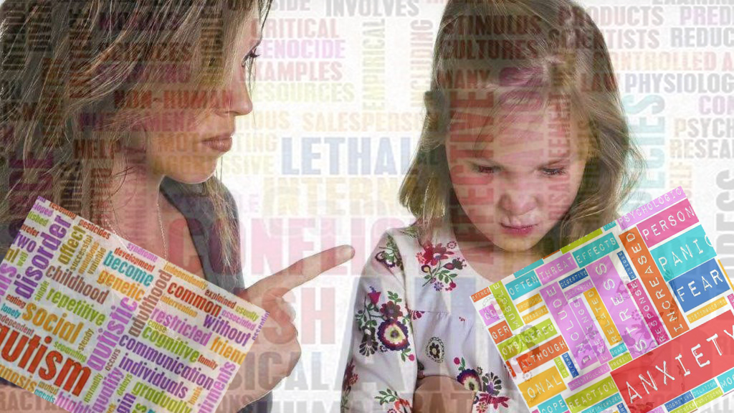
Risk Assessment
Notes:
Intro – Following on from the theory side involving nurture, attachment and arousal cycle we have heard in the previous three modules we now move onto the practical are involving managing and recording risk assessments in relation to distressed, challenging or violent behaviours or situations. Risk Assessment is not a complicated process and it should be seen as a proactive management tool and a support mechanism to safeguard staff and pupils. A risk assessment and revised risk assessments will provide information on behaviour, patterns and be an explanation as to what is happening, what works and where you might need to do a bit more. It is also intended to shape how we work to keep everybody safe.

Slide 62
Risk Assessment
Codes of Practice
Every Child is Included & Supported:-
  H&S Management Standard for distressed, challenging and violent behaviour
  Physical Intervention guidelines
  Reporting flow charts
  HANDS Reporting System
Notes:
Some of you might know that in ES there are a number of topic areas that have codes of practice with advice and guidance intended to support the risk assessments for example PE, Home Economics, Science, Technical. A decision was taken that for managing distressed, challenging and violent behaviors to be developed in a similar way. Therefore, whilst there will not be generic risk assessments for all behaviours there will be a set of guidance documents that will support you in understanding and managing challenging behavior. This guidance will be located on Glasgow Online site within Supporting Glasgow's learners and within the H&S pages.

Slide 63
Sensible Risk Management
IS IS NOT
ABOUT ABOUT
Ensuring that staff, pupils, visitors, contractors etc. are properly protected
Being Proactive
Examining what can cause harm and evaluate
Formalising findings and outcomes where appropriate
Manage risks responsibly
identifying risks and those responsible to put controls in place and realising that if we don’t then there is a risk of injury is likely with other consequences
Creating a totally risk free society
Creating unnecessary bureaucracy
Stopping important recreational and learning activities for pupils where the risks can be managed with a bit of effort
Ignoring things and hoping it will go away
Being risk averse and not doing things because you think of the legal responsibility consequences
Notes:
Risk assessment in Education is about managing significant risk and about allowing children to develop and in some respects to test themselves and experience boundaries. Risk assessment should not be seen as an additional because effectively you are all doing it anyway it is just about formalising it in a way that will in turn provide a support to development.

Slide 64
Risk Rating
SEVERITY
LIKELIHOOD
Slightly
harmful
TRIVIAL
TOLERABLE
MODERATE
Extremely
harmful
MODERATE
SUBSTANTIAL
INTOLERABLE
Highly unlikely
Unlikely
Likely
Harmful
TOLERABLE
MODERATE
SUBSTANTIAL
Notes:
? Do we provide a handout to explain categories.

Slide 65
Risk Assessment Recording an Assessment
Use risk assessment pro forma
Record Significant findings
Identify persons for managing and taking action
  Record timescales to complete actions
  Review on a Regular basis
  Record the Review date - but understand the need for dynamic review as and when situations arise, especially when managing distressed behaviours
Notes:
Review of risk assessment should be ongoing and live and not only referred to when incident occur. Remember controls are the positives in managing behaviours and need to be developed and included to guide and inform staff of what they should be doing. They should be a tool to reflect upon when assessments or plans are being revisited.

Slide 67
Activity
In groups take 1 case study
Discuss the questions posed
20 minutes

Slide 68
Sam
Sam is in his preschool year and is currently being assessed by the Local Autism Team for possible ASD. He attends 5 mornings but is struggling to cope with the free flow of nursery floor. He likes repetitive activities and prefers solitary play. He can respond well to one to one support but there are 30 children in the nursery and Sam does not like to being given direct instructions. Sam has good receptive language and expressive skills. When told that he cannot do something Sam can rapidly become distressed, or when asked by staff to move on from one activity to the next. He can become very agitated and will try to run away and if confronted will lash out by kicking or trying to hit staff. This can happen several times each session when he is asked to engage with other children, for example at story time or at snack time.
Sam's parents do not want to share what his behaviour at home is like, they will blame the nursery for asking him to do too much and want him to have more one to one support.
Sam has recently started to target another child who has additional support needs. He recently bit the other child when he tried to take a plastic shovel from Sam at the sand pit. This led to staff having to intervene and the other child's parents had to be contacted due to the injury.

Slide 69
Julie
Julie is in Primary 5 and lives with her grandparents who have custody and have looked after her for the past 6 years. Julie's mother has a long history of alcohol abuse and has weekly supervised access through Social Work Services, she does not have any contact with her father.
Julie's grandparents are elderly and although they do the best they can for Julie they find it difficult to manage her behaviour at home. Her grandfather takes an authoritarian approach and believes in a strong discipline.
Over the past year Julie has started to become distressed in class, this often coincides with access visits to her mother.
Julie's behaviour can escalate very quickly, she will swear at staff and try to leave the class. Recently she has run out of the class when distressed and has been found hiding in the stair well. Although she has not left the school, the SMT are worried that she may leave and put herself at risk.
On the last occasion the HT contacted the grandparents and her grandfather attended. This led to Julie becoming more distressed and her being taken home very upset.

Slide 70
Peter
Peter is a Primary 7 pupil. Staff are aware of his trauma history and possible attachment issues. His father was imprisoned for murder and his mother has mental health issues. His mother was recently hospitalised following an overdose and Peter was accommodated in a Children Unit in Glasgow. He is the youngest person there. He has a Social Worker and a referral to Notre Dame Centre has been made.
Over the past few months since starting P7, he has started to present with behaviours such as walking out of class and punching the corridor wall. The majority of staff are concerned for him and are being sensitive to his changing needs however not all staff are sympathetic towards his difficult history and do not fully understand why he receives what they view as ‘special’ treatment. The HT and DHT have tried to involve Peter in other schools activities when he shows positive behaviour.
He has become increasingly resistant to doing work, despite previously being engaged in similar activities he has also begun randomly tearing or throwing away his work books. This pattern of behaviour does not relate to any previous triggers. Staff recognise that there is a need to intervene however they do not feel confident in how to de-escalate or, when he reaches crisis point, what options they have.

Slide 71
Resources
Guidance on Physical Intervention
Health and Safety Guidance
Every Child is Included and Supported
Nurture Training
GLOW – Yammer- All Behaviour is Communication

Slide 72
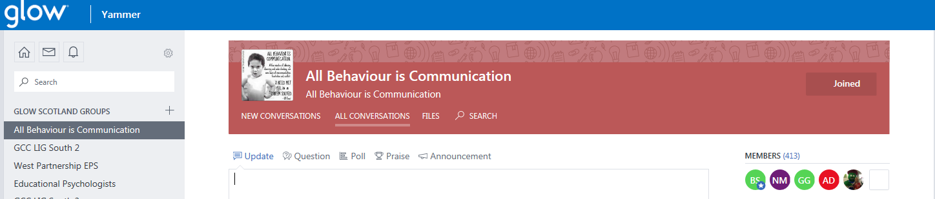
GLOW – Yammer- All Behaviour is Communication

Slide 73
Sources of support
Glasgow Psychological Service
Inclusion Team
Inclusion QIO’s
Early Years Assessment Service (EYAS)

Slide 74
Next Steps
Deliver training to all staff within your establishment
Record SAP number and return to Service HR
Support and development group in each LIG
Ongoing Training for new staff

Slide 75
Questions?

Slide 76
Helpful links
Autism Toolbox http://www.autismtoolbox.co.uk/
Nurture in Glasgow http://www.goglasgow.org.uk/Pages/Show/816

Slide 77
Helpful links
ECIS http://www.goglasgow.org.uk/content/UserGenerated/file/Policies_Guidelines/SGL/ECIIS_PolicyGuidelines_June16.pdf
ACES & trauma
https://www.ted.com/talks/nadine_burke_harris_how_childhood_trauma_affects_health_across_a_lifetime

Slide 78
Helpful links
Dan Seigle – hand model of the brain:
https://www.google.co.uk/url?sa=t&rct=j&q=&esrc=s&source=web&cd=2&cad=rja&uact=8&ved=0ahUKEwiwhsyK9JnTAhWpB8AKHZpDBbgQtwIIIDAB&url=https%3A%2F%2Fwww.youtube.com%2Fwatch%3Fv%3Dgm9CIJ74Oxw&usg=AFQjCNFNt0x7Bst4MS58NW8e5czPX9UqUg

