Slide 1
Early Learning and Childcare
National Induction Resource

Slide 2

This presentation provides support for newly appointed staff on the National Induction Resource.
The document places emphasis on ensuring that all children have access to a highly skilled and motivated workforce.
Click Ato dd text

Slide 3
Aims
To further your knowledge of the National Induction Resource (NIR)
To develop an understanding of what the NIR means for you in your role

Slide 4
What is the purpose of the NIR?
This induction resource, developed by the Scottish Government, provides new ELC employees with all the relevant information they need on what to expect in their first few months in post, including the most up-to date resources and best practice.
“We know that the most important driver of quality in ELC is a dedicated, highly skilled and well-qualified workforce, whose initial training and continued professional learning enables them to fulfil their own potential and equip our young children to do the same.”
Early Learning and Childcare – National Induction Resource: Scottish Government 2019

Slide 5
Overview
The National Induction Resource has been developed to specifically to support staff working in ELC settings. It sets out how employers can support them in their new role and includes links to the range of national resources which are available as support tools. It has been developed collaboratively with the range of national organisations supporting the profession.
The National Induction Resource comprises two sections:
Section One:
Background information on qualification routes, expectations and regulations
Section Two: ​
Reflective questions to help develop your practice
Induction Planning checklist ​

Slide 6
The Purpose Of The Induction Period ​
  There are some fundamental attributes that we expect from staff entering the Early Learning and Childcare sector. Regardless of the extent and nature of your previous experience, practitioners will have been recruited because they:
are highly motivated
demonstrate patience, compassion and fun
are eager to learn and develop
demonstrate compassion, warmth and kindness
understand the importance of safeguarding children and confidentiality
demonstrate strong personal values
For more on the key attributes that everyone working with children, young people and their families should have, see the Common Core Skills, Knowledge and Values

Slide 7
The purpose of induction is for employers to build on these attributes and to develop practitioners understanding
of the following:
Developing good
communication with
children, families
and colleagues.
Their responsibility in
respect of keeping
children safe
and child protection
Developing trusting relationships with
children and their
families.
Their responsibility in
respect of professional
registration and CPL
How to identify and
engage with learning opportunities.
The early learning
and childcare policy
context
The codes of practice
for social service workers.
Click on each puzzle piece to find out more

Slide 8


Continuous Professional Learning Calendar
Click on each picture to find out more

Slide 9
Qualification Routes, Expectations and Regulations
This section details:
The fundamental attributes, as well as additional key attributes, that are expected from staff entering the Early Learning and Childcare sector
The professional bodies and regulations you need to register with and adhere to
The qualifications you must have or be working towards as you progress through your ELC career
Information about tuition for training and expectations of your continuous professional development.
National resources to support your professional learning produced by a range of professional bodies that support the sector :
LEL BLOG
SSSC
Care Inspectorate Hub
Early Years Scotland
National Improvement Hub
National Day Nurseries NDNA) Scotland
Care and Learning Alliance

Slide 10
Career Progression Pathways
Team Leader
Modern Apprentice ELC
Support for Learning Worker
Child Development Officer
Depute Head of Centre
Head of Centre
Lead Practitioner of Attainment

Slide 11
“We do not learn from experience… we learn from reflecting on experience”
John Dewey
Section 2
Reflective Questions
This section supports staff to -
Reflect on the important role they play in a child’s life
Reinforce their individual responsibility and accountability
Be the best childcare worker possible
Understand how reflecting on their practice can help improve outcomes for children
Understand how their workplace can support them

Slide 12
Why have a workplace mentor?
It is critical that ELC staff continue to be valued and supported in providing care and high quality experiences for young children in the most creative and nurturing ways, ensuring they continue to feel included, valued and respected.’
Jane Brumpton, Chief Executive, Early Years Scotland
The National Induction Resource states that each new employee should be assigned a mentor who they can turn to for advice and support within the ELC setting

Slide 13
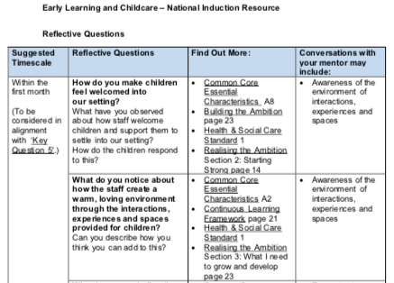
Notes:
The aim of this section of the National Induction Resource is to encourage you to reflect on the important role you play in a child’s life. It is designed to reinforce your individual responsibility and accountability to help you be the best childcare worker possible, to help you to understand how reflecting on your practice can help improve outcomes for children and how your workplace can support you.
Set of reflective questions each month for the first six months.
You should work through these questions with your workplace mentor who can give you advice and support which will help develop your skills and knowledge. They are written to promote discussion about your role in providing quality care and learning for children. Your mentor will work with you and support you in the work place by providing learning opportunities, guidance and role modelling.

Slide 14
Further Professional Engagement
National Practice Guidance – Realising the Ambition
  read about the key elements of quality here
Glasgow City Council – Leaders of Early Learning CLPL
  Glasgow Counts Training Overview
  Literacy for All Training Overview

Slide 15
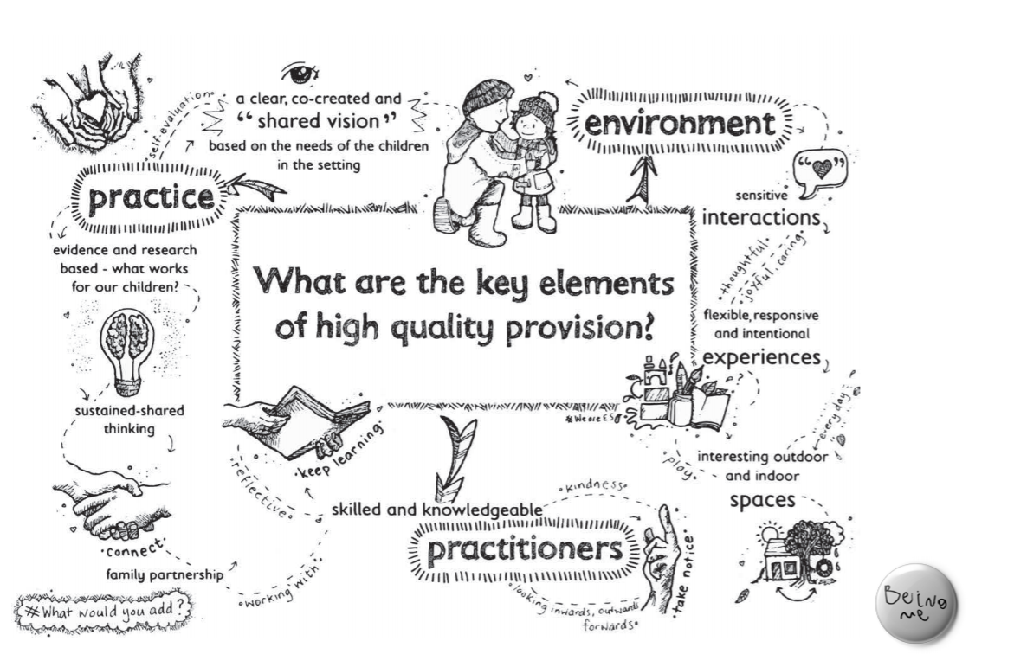


Slide 16




Glasgow Counts in our Playrooms
Session | Year 1 | Year 2
1 | Overview and Framework | Pattern
2 | Counting and subitising 1 | Shape and Space
3 | Counting and subitising 2 | Measure : Making Comparisons
4 | Calculating and PS 1 | Sorting , Matching and HD
5 | Calculating and PS 2
6 | Numeracy through Block Play

Slide 17


Literacy for All in our Playrooms
Session | Year 1 | Year 2
1 | Listening and Talking Overview | Developing Our Storytelling
2 | Early Literacy Strategies | Early Writing and Mark Making
3 | Phonological Awareness 1 | Literacy through Block Play
4 | Phonological Awareness 2 | Music and Phonological Awareness
5 | Meeting the needs of EAL Learners

Slide 18
“Reflective practice initiates and reinforces a cycle of ongoing learning during which early childhood educators are challenged to become more open in their thinking, to learn from professional experience, and to become more flexible and adaptable in their practice”
Jillian Rodd, Leadership in Early Childhood, p. 217

Slide 19
“Much of Glasgow’s population is known to be more deprived than the rest of Scotland. This is reflected in the city’s child population: 39% of Glasgow’s 100,000 children (2019) live in the 10% most deprived areas of Scotland, while only 4% live in the least deprived 10% of areas within Scotland.
https://www.understandingglasgow.com/indicators/children/population/overview
Notes:
Change Quote – Ask Michele
Scottish Government (2020a) Poverty and Income Inequality in Scotland 2016-19. Available at: https://www.gov.scot/publications/poverty-income-inequality-scotland-2016-19/pages/4/

Slide 20
Multiple Choice questions 8
Easy questions
Why do you have a mentor in your work place?
How many sections are in the NIR resource?
What is the name of the regulatory body for social service workers?
How many hours of CPL should you carry out over five years?
What are the three key elements of a high quality provision?
Over how many months should you aim to complete the reflective questions with your mentor?
Where can you find out about the key attributes that everyone working with children, young people and their families should have?
What does ELC stand for?

Slide 21
Developing good communication with children, families and colleagues
Recognise that the needs and strengths of children, young people and families are unique and will be influenced by their environment, backgrounds and circumstances
Include children, young people and families as active participants, listening to them, offering choices
Explain decisions and ensure children, young people and families fully understand them and their implications, especially if the final decision isn't what they hoped for.
Keep children, young people & families informed of progress
Understand the extent of your own role and be aware of the roles of colleagues
Respect and value the contribution of other workers
Know what information to share, when to share it and with whom
Reflective Questions
How confident are you communicating with parents?

Slide 22
Responsibilities in respect of keeping children safe and child protection
Understand appropriate child protection procedures and act accordingly
Consider the needs and potential risks for each child & young person in the context of where they live, their relationships and their wider world
Ensure children, young people and families understand what information will be kept in confidence; and why some information from or about them may be shared
Reflective Questions -
  Do you feel comfortable with your level of skills and knowledge in relation to child protection? Do you feel equipped to act if you needed to? If not, where can you go for help?
  Do you know which staff have specific child protection responsibilities?

Slide 23
Developing trusting relationships with children and their families.
Understand your impact on children, young people and families and how they might perceive you. Adapt your tone, language and behaviour to suit the circumstances.
Help identify and work with the needs and strengths in parents, carers and their networks in the interests of children and young people for whom they care.
Reflective Questions
How do you make children feel welcomed into our setting?
What do you notice about how the staff create a warm, loving environment for children?
How are you developing your relationships with parents and carers? Are you finding any of these relationships difficult or challenging? Why do you think this is?

Slide 24

There are some fundamental attributes that we expect from staff entering the Early Learning and Childcare sector. Regardless of the extent and nature of your previous experience, you will have been recruited because you:
are highly motivated and have a commitment to improving outcomes for children and families
Notes:
here are some fundamental attributes that we expect from staff entering the Early Learning and Childcare sector. Regardless of the extent and nature of your previous experience, you will have been recruited because you:
demonstrate patience, compassion and a sense of fun and enjoyment in working with young children;
are eager to learn and understand the need to develop your knowledge and skills;
demonstrate compassion, warmth and kindness in your interactions with children;
understand the trust afforded to you in safeguarding children and respect the need for confidentiality; and you
demonstrate strong personal values, both inside and outside of the work place.
For more on the key attributes that everyone working with children, young people and their families should have, see the ‘Common Core of skills, knowledge and values’.

Slide 25


There are some fundamental attributes that we expect from staff entering the Early Learning and Childcare sector. Regardless of the extent and nature of your previous experience, you will have been recruited because you:
demonstrate patience, compassion and a sense of fun and enjoyment in working with young children

Slide 26


There are some fundamental attributes that we expect from staff entering the Early Learning and Childcare sector. Regardless of the extent and nature of your previous experience, you will have been recruited because you:
are eager to learn and understand the need to develop your knowledge and skills

Slide 27




There are some fundamental attributes that we expect from staff entering the Early Learning and Childcare sector. Regardless of the extent and nature of your previous experience, you will have been recruited because you:
demonstrate compassion, warmth and kindness in your interactions with children
Notes:
are highly motivated and have a commitment to improving outcomes for children and families;
;
demonstrate compassion, warmth and kindness in your interactions with children;
understand the trust afforded to you in safeguarding children and respect the need for confidentiality; and you
demonstrate strong personal values, both inside and outside of the work place.
For more on the key attributes that everyone working with children, young people and their families should have, see the ‘Common Core of skills, knowledge and values’.

Slide 28



There are some fundamental attributes that we expect from staff entering the Early Learning and Childcare sector. Regardless of the extent and nature of your previous experience, you will have been recruited because you:
understand the trust afforded to you in safeguarding children and respect the need for confidentiality

Slide 29


There are some fundamental attributes that we expect from staff entering the Early Learning and Childcare sector. Regardless of the extent and nature of your previous experience, you will have been recruited because you:
demonstrate strong personal values, both inside and outside of the work place
Notes:
are highly motivated and have a commitment to improving outcomes for children and families;
demonstrate patience, compassion and a sense of fun and enjoyment in working with young children;
are eager to learn and understand the need to develop your knowledge and skills;
demonstrate compassion, warmth and kindness in your interactions with children;
understand the trust afforded to you in safeguarding children and respect the need for confidentiality; and you
For more on the key attributes that everyone working with children, young people and their families should have, see the ‘Common Core of skills, knowledge and values’.

Slide 30
Responsibilities in respect of professional registration and CPL
The Scottish Social Services Council (SSSC) is the regulatory body for social service workers, including those who work in the early learning and childcare profession. You can register with the SSSC only after you have started in your ELC role. Once you start a role, you have up to six months to register. There is an annual fee for registering with the SSSC and registration lasts for five years
The SSSC Code of Practice for Social Service Workers requires workers to take responsibility for maintaining and improving their knowledge and skills. The SSSC refer to CPL as Post Registration Training and Learning (PRTL). During every 5 year registration period the SSSC requires practitioners to complete 60 hours or 10 days of PRTL.
You should record your PRTL through your MYSSSC webpage. While it is important that record any learning and development you have undertaken, it is important that you reflect upon what you have learned and how this has impacted your work.
ELC settings have a statutory requirement to ensure that staff engage in appropriate training to undertake their role and will therefore be able to advise you on relevant CPL for your role and of courses that should be available to you locally
Reflective Questions
Can you reflect on an area of your practice that you would like to develop?

Slide 31
Identifying and engaging with learning opportunities
Experienced and well trained staff have the knowledge and ability to engage, instruct and support children’s learning from an early age and have the ability to make a real difference.
Include children, young people and families as active participants, listening to them, offering choices
Be aware of how children and young people develop, seek to understand vulnerability and promote resilience
Reflective Questions
What do you notice about children’s play experiences when the staff become involved?
Why do you think it is important for children to be actively involved in the planning process?
What do you think are the benefits of outdoor play and learning, for children and for staff?

Slide 32
The codes of practice for social service workers.
The SSSC have developed the ‘Codes of Practice for Social Service Workers and Employers’ (the Codes of Practice) which set out clear standards for professional conduct and practice that social service workers, including early year workers, must meet in their everyday work.
When you register with the SSSC you must agree to follow the SSSC Codes of Practice for Workers. You are responsible for making sure that your professional practice meets all of the required standards. This includes your practice within work as well as your conduct outside of your work. You should familiarise yourself with the Codes of Practice which can be found here. You should do this as soon as possible.
SSSC may take action against registered workers if they fail to meet the standards of character, conduct and competence necessary for them to do their job safely and effectively set out in the Codes of Practice.
Reflective Questions
What conduct and behaviour can children and their families expect of you?

Slide 33
SSSC has developed a new system for CPL which they formally referred to as Post Registration Training and Learning (PRTL). Through the new system you can record learning in a way which suits you, and a MyLearning App is also available to support this. Whilst it is important that you tell the SSSC about any learning and development you have undertaken, it is equally important that you tell them what you have learned and how this has impacted on your work.
ELC settings have a statutory requirement to ensure that staff engage in appropriate induction and training to undertake their role and this is something that the Care Inspectorate monitor in inspections. Your employers will therefore be able to advise you on relevant CPL for your role and of courses that should be available to you locally.

Slide 34
In addition to staff qualifications, CPL is an essential component of ELC quality. Evidence suggests that good quality CPL helps ensure staff are aware of best practice and continually supported in the workplace. This reduces staff turnover and there is even some evidence that this can have a greater impact on quality than practitioners’ initial training and education.
The SSSC Code of Practice for Social Service Workers requires workers to take responsibility for maintaining and improving their knowledge and skills. During every 5 year registration period the SSSC requires practitioners to complete 60 hours or 10 days of CPL. The amount of training and learning is in days and hours to show that the time does not have to be made up of full days of activity. For the purpose of CPL one day equals six hours.

Slide 35
The early learning and childcare policy context
Research shows that attending high quality ELC improves outcomes for children in the early years and gives them important skills and confidence to carry into their schooling. For instance, children who attended high quality settings in Scotland were more likely to show improvements in vocabulary skills between ages 3 and 5.
High quality ELC particularly benefits children living in more disadvantaged circumstances and so can make a real difference to closing the poverty-related attainment gap.
Research also shows that access to high quality, skilled practitioners is strongly associated with the best outcomes for children, both in terms of cognitive development and health/wellbeing. This is particularly the case for children affected by poverty, who have been shown to make more progress in settings where staff and managers were highly qualified.
Reflective Questions
What do you think are the aspects which make up high quality early learning and care?

Slide 36
New employees should assigned a mentor – someone to whom they can turn to for advice and support within the ELC setting. This could be a manager or another experienced colleague. Section two of the NIR resource sets out some reflective questions that staff might like to explore, together with their mentor, over the months ahead.
Each setting will also have its own induction procedures and so this list is by no means exhaustive or mandatory. The NIR also provides an example of an induction checklist that could be used and adapted as a reminder of some of the practical things that staff will need to know and find out about during your induction period.

Slide 37
Practitioners in high quality provision:
highly value and promote child initiated experiences and provide
spaces to capitalise on children’s interests and motivation,
tune in to child initiated activity and sensitively intervene to extend children’s inquiry, problem solving and thinking skills,
extend learning based on an understanding of developmental stage and interests, rather than providing adult directed activities that have little meaning for children, and,
enable children to lead their own learning, including planning projects and solving their own problems.

Slide 38
Environment
'The learning environment’ does not just refer to the physical environment of settings. It relates to the totality of the interactions, experiences and spaces (both outside and indoors) we provide for babies and young children.
We often talk about the environment in terms of physical spaces, but the key part of the environment for children is the human, social environment of positive nurturing interactions. Experiences are also part of the environment. Children need to learn things for themselves, but this does not mean they should always do so by themselves. We can, by following and building on children’s motivations and interests, support young children to make the most of the environment for learning and development.
We need to be confident that in promoting a happy, interesting and empowering learning environment, considering the interactions, experiences and spaces on offer, we as practitioners add value to what children already know and can do.

Slide 39
Practice
Knowledge of child development underpins effective practice and enables us to:
  understand that children learn best when engaged in meaningful first hand experiences that interest them,
  recognise that young children learn through play with responsive adults who plan experiences which extend learning and understanding, and,
  notice and understand behaviours that underpin early development, such as schematic play, and provide the right kinds of experiences which build on this learning.
The quality of adult-child interactions is key in developing effective practice. This includes how we:
  attune the interactions to the developmental stages of children, so that children are supported and also challenged,
  use a range of communication and interaction strategies including describing and commenting on learning and handing over conversational control to children,
  use skillful questions to extend learning, for example, “I wonder why..” I wonder if...”, and,
  work together with children to solve problems, clarify concepts, develop thinking. This is known as sustained shared thinking
  Quality settings have... a skilled workforce who engage in:
  reflection on practice in the setting; looking outwards to collaborate and learn from others. This includes taking time to visit other settings to share practice and moderate approaches, read about child development and attend professional learning.

Slide 40
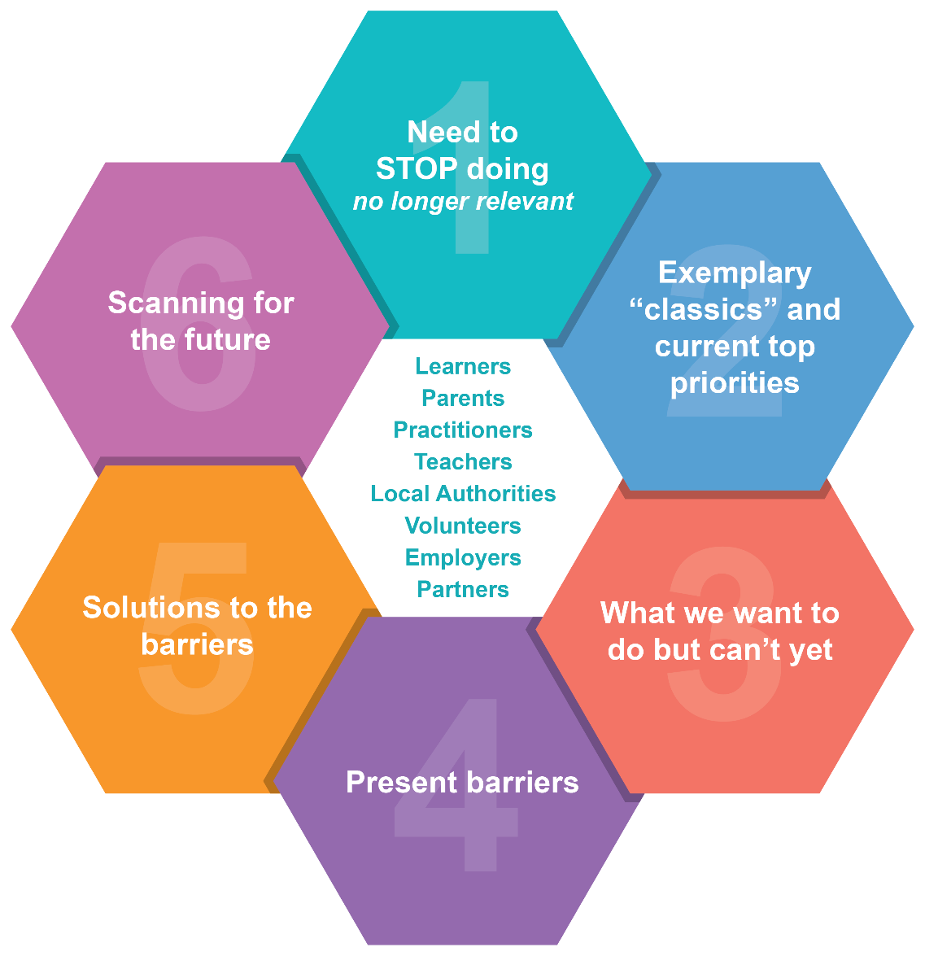
Points to ponder
Consider how you as a newly qualified member of staff reflect on practice within the setting?
What does your setting use?
Who leads those discussions?
What opportunities are there for you to be involved?
So what? What happens next?
Notes:
Adopt, Adapt, abandon

