Slide 1
Coping with
Loss, Grief and Bereavement

Slide 2
Take care of yourself
Experiences of bereavement and loss are common.
It can be difficult to think and talk about children and young people who have experienced bereavement and loss.
It can, at times, trigger strong thoughts and feelings for some of us.
Be aware of your own reactions and feel free to step out the room or talk afterwards.
What you share is your choice & responsibility.
Participate & support each other.
Respect the privacy of others, especially those not present.
Respect confidentiality from and to each other.
Accept others for who they are.

Slide 3
Aims of the day
To examine how we understand loss, grief and bereavement.
To explore theories of grief and strategies to support children and young people’s fostering of hope and coping with change.
To discuss the professional’s role in supporting someone facing loss or change.
Notes:
Lisa.
Outlined on agenda for the day

Slide 4
How do we understand loss, grief and bereavement?

Slide 5

Menti: What words come into your mind when thinking of loss and bereavement?
Notes:
Quite negative perception, personal impact in our lives.
Insert Menti QR Code and discuss people’s responses.

Slide 6
Definitions
Loss is the state of being deprived of something which is valued
Grief is the expression of an individual’s response to loss
Bereavement is the experience of those left behind after someone has died
Mourning is what you do to express your loss
Notes:
Common phrases / words can sometimes lose their meaning
It’s always worthwhile to revisit what we mean by the following terms
Please note: All of these definitions are active: a process of thoughts, feelings, needs, and actions
Grief is the response to loss, particularly to the loss of someone or some living thing that has died, to which a bond or affection was formed. Although conventionally focused on the emotional response to loss, grief also has physical, cognitive, behavioral, social, cultural, spiritual and philosophical dimensions. While the terms are often used interchangeably, bereavement refers to the state of loss, while grief is the reaction to that loss.
How does this apply to you?

Slide 7
Why focus on loss, grief and bereavement?
5x more likely to experience the bereavement of a parent when living in the lowest income households compared to living in the highest income households (Paul & Vaswani, 2020)
There is a complex interaction between bereavement and poverty on young people’s wellbeing and how they transition to adulthood (MacDonald and Shildrick, 2012)
Poverty can inhibit grief and repair work (Stroebe et al., 2006)
85% of young people in Glasgow leave with at least one Nat 5, this decreases to 35% for care experienced young people
Links to experiencing bereavement and becoming involved in the Criminal Justice System (Vaswani, 2014)

Slide 8
Cultural and Social Context of Grief
Culture: ethnicity;
religion / beliefs
Current circumstances:
Relationships; physical and mental health; finance etc.
personal experience and expression of grief
Family; education; employment etc.
Notes:
If we look at how we live in Scotland, the slide can help us understand the contexts in which we grieve and how many factors influence this.
Although the psychology of grief focuses on individuals, grief occurs in the context of social relationships and culture. The dynamic effects of the social and cultural context on individual grief are discussed from the perspective of symbolic interaction theory and family systems theory.
“It isn't the circumstances of the death that will predict a positive or negative outcome, it is the support they get at the time and after the death. This is the key component to anybody finding a way to rebuild their life.”

Slide 9
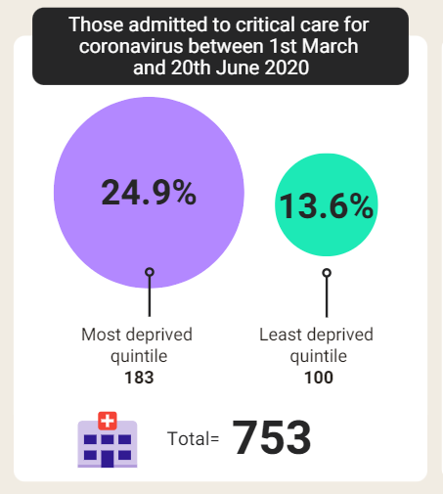
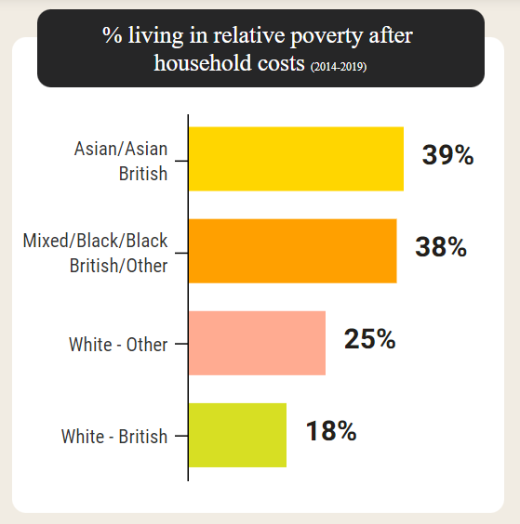
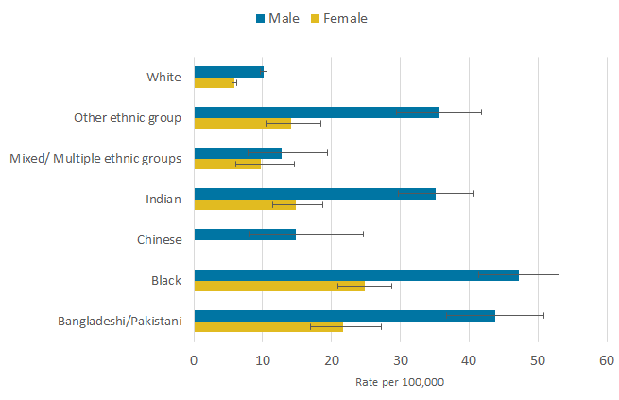
Impact of covid – exacerbating pre-existing difficulties
Lone et al., 2020
Scottish Government, 2020
Office of National Statistics, 2022
Notes:
So we know already that those living in poverty are more likely to experience a bereavement but coronavirus exacerbated this.
Data from Lone et al. was translated into mortality rates whereby there was a significant difference between those in the most deprived quintile and least.
The graph on the right looks at the inequalities between ethnicities. More likely to live in poverty if you are BAME.
Final graph shows the inequalities with covid deaths. 4.2 times higher among for Black females compared with White females. Females of Bangladeshi or Pakistani ethnic background had a death rate that was 3.7 times higher than that of White females.
Females of White ethnic background had a statistically significantly lower rate of death compared with females of Black, Bangladeshi or Pakistani, Indian, and Other ethnic backgrounds.

Slide 10
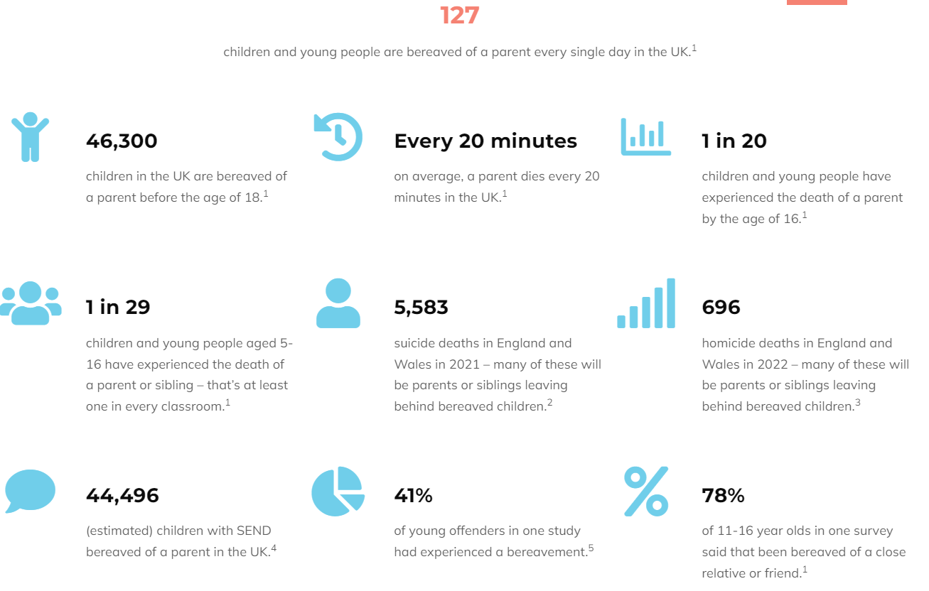

Notes:
From Winston’s Wish. Supporting CYP:
More likely to be bereaved if living in poverty - highlighting children with complex learning needs more likely to experience bereavement.
Our immediate response might be to try and make things better for children, but we need to recognise:
We have all have been through a hugely challenging experience and as a result have experienced many losses in our day to day lives
Focus on what we can do to help children make sense of, recover from and grow positively through this difficult time and how they can help themselves
COVID-19 impact - we have no certain route map out of this, unprecedented
Research shows us that adverse events in children’s lives can have a lasting impact but it is often the accompanying change and uncertainty that isn’t recognized and supported
Gibbs et al.,2014 Shepard et al., 2017
Acknowledging that not everyone will not have had the same experiences from the pandemic and that is ok

Slide 11


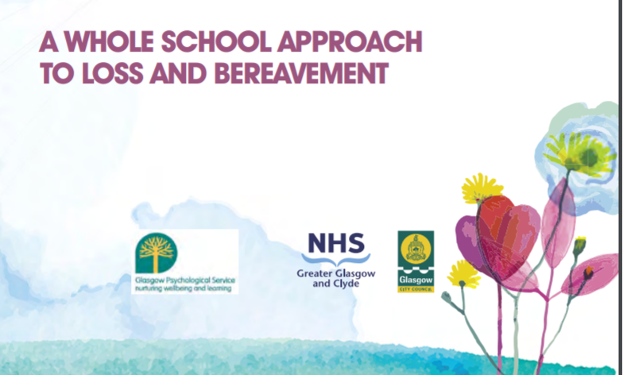

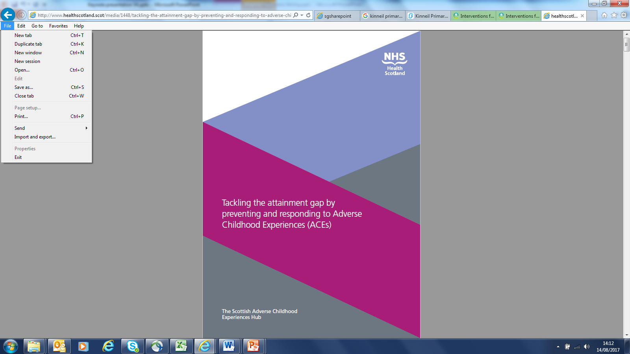


Notes:
The Context –
Embedded in legislation, a lot that isn’t mentioned explicitly, but good loss and bereavement policy essential to good mental health, attainment, nurture. All interconnected, national and local guidance bring this together.
Recently announced programme for government with preventing and mitigating ACEs featuring heavily. It is a moral imperative.
https://beta.gov.scot/publications/delivering-today-investing-tomorrow-governments-programme-scotland-2018-19/
They will do this by:
Tackling intergenerational approaches to support parents, families and children – investing in perinatal and infant mental health, expanding support to young mothers through family nurse partnership and supporting parent and child victims of domestic abuse.
Preventing and mitigating adverse childhood experiences for children and young people – investment in school nurses, counsellors and funding to support HWB interventions (attainment fund)
Developing an adversity and trauma informed workforce - national trauma training, testing potential approaches for enquiring with adults about ACEs and supporting schools to embed trauma informed and nurture approaches in response to ACEs
Increasing societal awareness and action across communities - working with Scottish Hub to raise awareness and support local communities to address ACEs and enable resilience
Link to Nicola Sturgeon Ted Talk on wellbeing - commitment to improving wb of our nation is clear – focus on healthy and happy population not just how wealthy we are – what governments should prioritise WB
Transforming Psychological Trauma Framework (NHS Education Scotland)
Published in 2017 this is a framework designed to be relevant to the broad Scottish workforce. Trauma is everyones business and advocated for many in Scottish workforce to be trauma informed and detailed a knowledge and skills framework depending on your contact with those who have experienced adversity and trauma: trauma informed, trauma skilled, trauma enhanced, trauma specialist. The training plan was just launched June 2019 as a companion document to the framework and provides organisations with guidance on how to develop high quality training – links with PFG and MH strategy which also outline the need for high quality training in this area.
Applying Nurture as a whole school approach
This self-evaluation framework provides a tool to support schools and early learning and childcare (ELC)settings who are applying a whole-school approach to nurture was published by Education Scotland in 2017. Links to work by K. Weare (2015) that highlights importance of approaches that adopt whole school thinking to promote social and emotional wellbeing.
https://education.gov.scot/improvement/self-evaluation/Applying%20nurture%20as%20a%20whole%20school%20approach%20-%20A%20framework%20to%20support%20self-evaluation
The Scottish Attainment Challenge is about achieving equity in education. This can be achieved by ensuring every child has the same opportunity to succeed, with a particular focus on closing the poverty-related attainment gap.
Mental Health Strategy 2017-27
https://www.gov.scot/Resource/0051/00516047.pdf
Recommended:
Action 1: Review Personal and Social Education (PSE), the role of pastoral guidance in local authority schools, and services for counselling for children and young people. This has been completed and report published August 2018:
Key strengths:
Positive ethos and relationships supporting CYP WB
Commitment to universal supports and access to a staff member who knows them well
Areas for improvement:
Continue to review the role of PTPC to ensure balance between universal and targeted supports
Ensure that CYP learning experiences in PSE/HWB are of a consistently high quality – improve tracking and monitoring approaches to CYP progress in PSE/HWB
Action 2: Roll out mental health training for those who support young people in educational settings
ACEs
Original US study found two thirds of adults had experienced 1 or more ACES, English and Welsh study – 50% had experienced one or more ACES. 1 in 5 in US study had 3 or more ACEs.
Both UK studies demonstrate strong links between early adverse experiences and poor health and social outcomes in adulthood. While there has not been a Scottish ACE survey, a Scottish Public Health Network report, suggested that prevalence rates are likely to be similar to those reported in these studies.
http://www.healthscotland.scot/publications/tackling-the-attainment-gap-by-preventing-and-responding-to-adverse-childhood-experiences
This paper (June 2017) has been produced to inform thinking about the impact of adverse childhood experiences and how to use the Pupil Equity Funding to reduce the attainment gap. It highlights key factors that play a role in children achieving their potential.
“Schools are in a fantastic position to help support children and mitigate some of the effects that ACEs may have by recognising the factors which might affect children, building trusting relationships with them…and responding in a psychologically informed manner.”
The documentary Resilience: The Biology of Stress and the Science of Hope follows progress in America following the seminal ACEs study. It reveals how toxic stress can have significant impact in brain and body development of children, putting them at a greater risk for mental and physical health problems, homelessness, prison time, and early death. It highlights how professionals in paediatrics, education, and other fields in the US are using the ACEs evidence and field-tested therapies to prevent
ACEs and protect children from the effects of toxic stress.
A Scottish national tour showed the film across Scotland. NHS Health Scotland continues to organise screenings and panel discussions across the country. Between November 2017 and March 2018 the film has been seen by more than 1,300 people all of whom participated in panel discussions after the screening.

Slide 12
Personal Loss Inventory
1. Think back on significant losses in your life. These could be the death of a loved person or pet; loss of relationships; beliefs; or any life event
2. Choose at least one from childhood and note your age at the time of the loss. Think about where you are developmentally and emotionally in respect to each of the losses
3. Also note one or two feelings which still come up about this loss experience
4. Discuss your experiences in your small groups if it feels right for you. Please be aware of your own needs when thinking about or discussing your personal experiences of loss; only discuss anything which you feel is okay to share and respect the confidentiality and experiences of others in the group. Your wellbeing is important!
Questions to think about:
My first loss… I was aged…I remember feeling…the thing I remember most is…who helped me with this…I coped with this loss by…my main coping style is…My most recent loss…
Notes:
Choice of small groups or if would prefer to not take part can sit with us for duration of task.
Feedback – how did it feel to share your story?

Slide 13
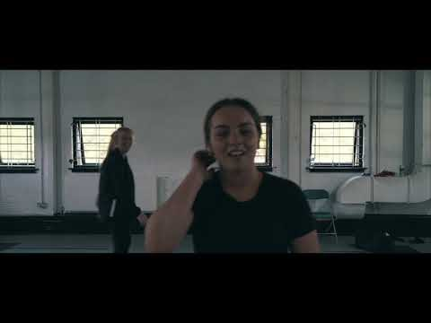
1st Event | 2nd Event | 3rd Event | 4th Event | 5th Event | 6th Event
Date | Date | Date | Date | Date | Date
Description | Description | Description | Description | Description | Description
Notes:
OGA clip was made by young people in Glasgow and just highlights the importance and the impact having OGA can have on a child/young person.

Slide 14
Losses…..
Additional losses
community
religion
family
identity
routines
memories
language
name
Self worth
Sense of self
Continuity
Coping with emotions
Foster Carer’s own losses
Other foster children’s changes
Position in new family
‘language’
Control
Touch
parents
siblings
extended family
friends
contact
home
school
neighbourhood
sports teams
previous fostering
or other placements
leaving care

Slide 15
Theories of Grief

Slide 16
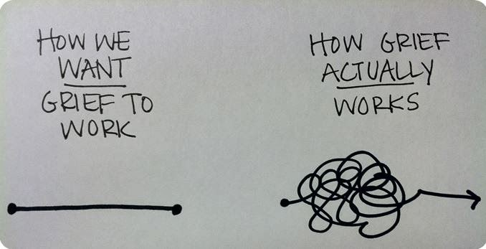
This Photo by Unknown Author is licensed under CC BY-NC-ND
Notes:
Grief has many themes, but we sometimes approach grief with the unrealistic expectation and need for grief to be straightforward.
Fantasy vs. Reality

Slide 17
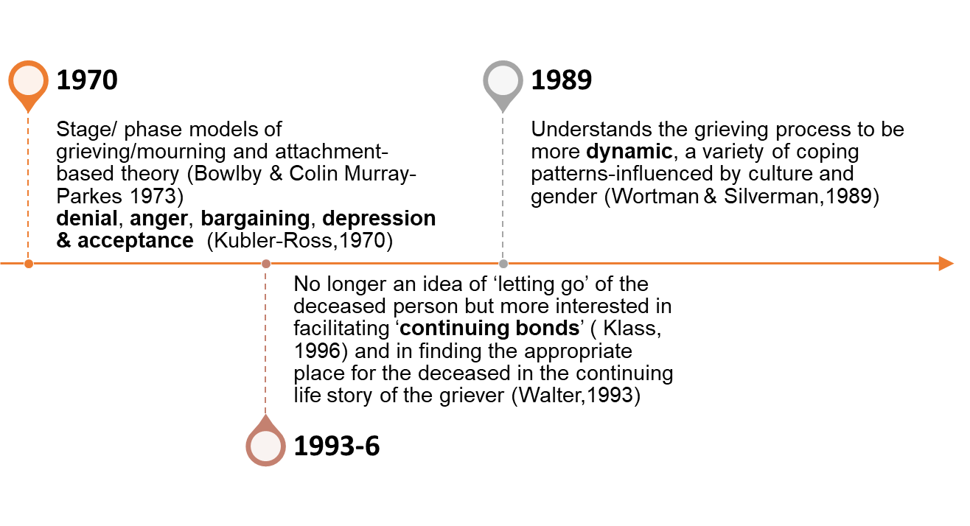
Theories of Grief
Notes:
The slides give a selected overview of theories of grief; contemporary attempts to make meaning out of loss experiences.
They all understand grief to involve a painful emotional adjustment which takes time and cannot be hurried along. This appears to be universally true, although each person’s grief experience will be unique.
Also, rather than being in contradiction to each other each theory helps to present a piece of the larger puzzle in the grief process demonstrating collectively that grief is a complex process that holds both universal characteristics and unique variations.

Slide 18

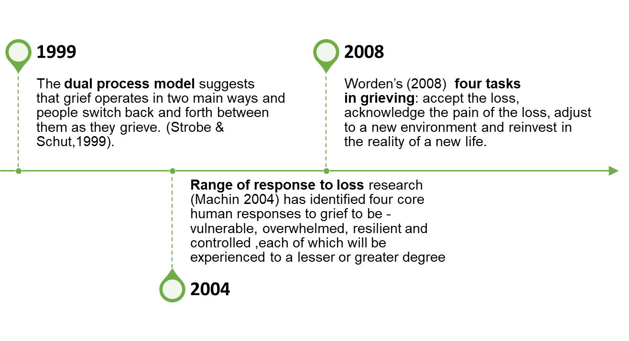
Theories of Grief continued

Slide 19
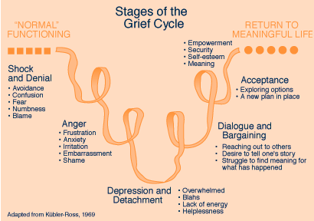
Stages of grief (Kubler-Ross, 1970)
Does Everyone experience these responses in this order?
Is there a designated end point?
Notes:
The grief cycle model is a useful perspective for understanding our own and other people’s emotional reaction to personal trauma and change, irrespective of the cause. The model was originally developed to explain the experience of those dying from terminal illness. It is now also widely used to explain the process of grief more broadly.
From this model’s perspective, it is important to note that grief is not a linear process. Grief is considered to be fluid and as a result it is believed that most people do not progress through the stages of this model in an orderly manner (Baxter & Diehl, 1998)

Slide 20
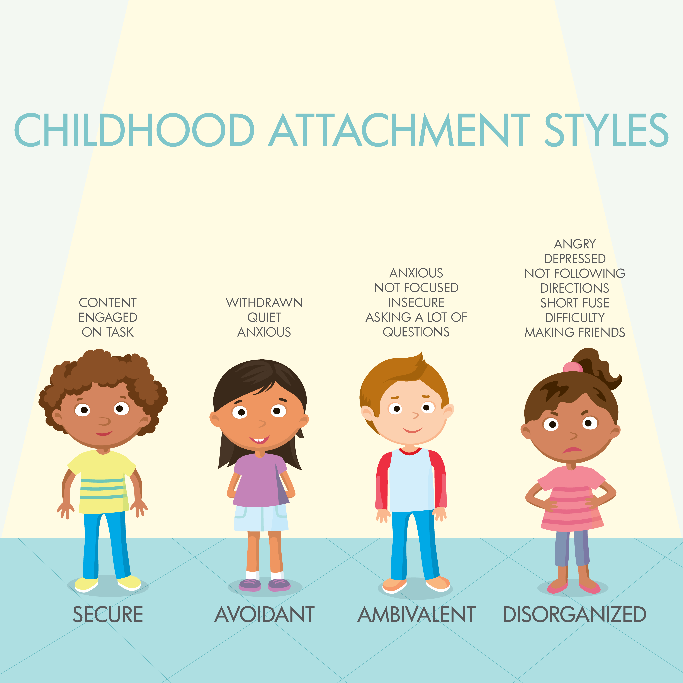
Attachment Theory
Attachment Theory is defined as a ‘lasting psychological connectedness between human beings’, Bowlby (1980).
The theory proposes that the establishment of relationships with caregivers is a critical feature of child development which has a lifelong influence on social relationships.
These factors can be crucial when the loss of a relationship occurs and can affect the grief experience
Notes:
Relationally based perspective of development. Bowlby's (1980)attachment theory focuses on intrapersonal processes in adaptation to relationship loss
Bowlby argues that attachments develop early in life and offer security and survival for the individual. It is when these affectional attachments are broken or lost, that individuals experience distress and emotional disturbance such as anxiety, crying and anger (Freeman, 2005). These emotions are often expressed as mourning. Bowlby suggests that there are four general phases of mourning that include: numbing, yearning and searching, disorganization, reorganization.

Slide 21

Bowlby and Parkes (1970) Four Stages of Mourning
Shock and Numbness: Immediately following the loss of a loved one; this is attributed to not being ready to accept the reality of a loss and can be used as a coping strategy
Yearning and Searching: A person experiences all types of emotion. The bereaved begin to yearn for the return of their loved one, as well as search for meaning in their loss
Disorganization and Despair: A person starts to accept the reality of their loss. They might feel the need to withdraw from their everyday life or from activities and hobbies they once enjoyed. They begin to understand that their old reality will never be the same, and leading to feelings of despair or hopelessness
Reorganisation and Recovery: The mourner begins to understand that their old life is forever changed, but they begin to accept their new “normal.” It doesn’t mean a person stops grieving — they’ll still have moments of sorrow and sadness — but they will also begin to have more positive memories about their relationship with their loved one
Notes:
Relationally based perspective of development. Bowlby's (1980)attachment theory focuses on intrapersonal processes in adaptation to relationship loss
Bowlby argues that attachments develop early in life and offer security and survival for the individual. It is when these affectional attachments are broken or lost, that individuals experience distress and emotional disturbance such as anxiety, crying and anger (Freeman, 2005). These emotions are often expressed as mourning. Bowlby suggests that there are four general phases of mourning that include: numbing, yearning and searching, disorganization, reorganization.

Slide 22
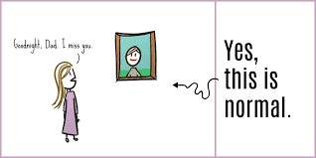
Continuing Bonds Theory Silverman & Klass (1996)
Death ends a life, not a relationship.
The bereaved remain psychologically and emotionally connected to the deceased.
This connection is developing and changing over time. Relationship is continuing.
Connections provide solace, comfort and support easing the transition from past to future.
Notes:
Silverman & Klass (1996) suggested a new paradigm, rooted in the observation of healthy grief that did not resolve by detaching from the deceased, but rather in creating a new relationship with the deceased. When a loved one dies you slowly find ways to adjust and redefine your relationship with that person, allowing for a continued bond with that person that will endure, in different ways and to varying degrees, throughout your life.

Slide 23
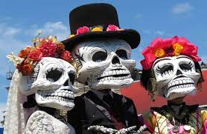




Notes:
The Day of the Dead (Día de Muertos or Día de los Muertos) is a holiday celebrated on the 1st and 2nd of November in Mexico and exemplifies the ongoing relationship that mourners can have with the dead. It has a much less solemn tone and is portrayed as a holiday of joyful celebration rather than mourning. The multi-day holiday involves family and friends gathering to pay respects and to remember friends and family members who have died. These celebrations can take a humorous tone, as celebrants remember funny events and anecdotes about the departed.
This has been shown in the Pixar film Coco (2017), which can be used in teaching to help children and YP understand expressions of loss and change.
What are your thoughts on this alternate expression of grief?

Slide 24
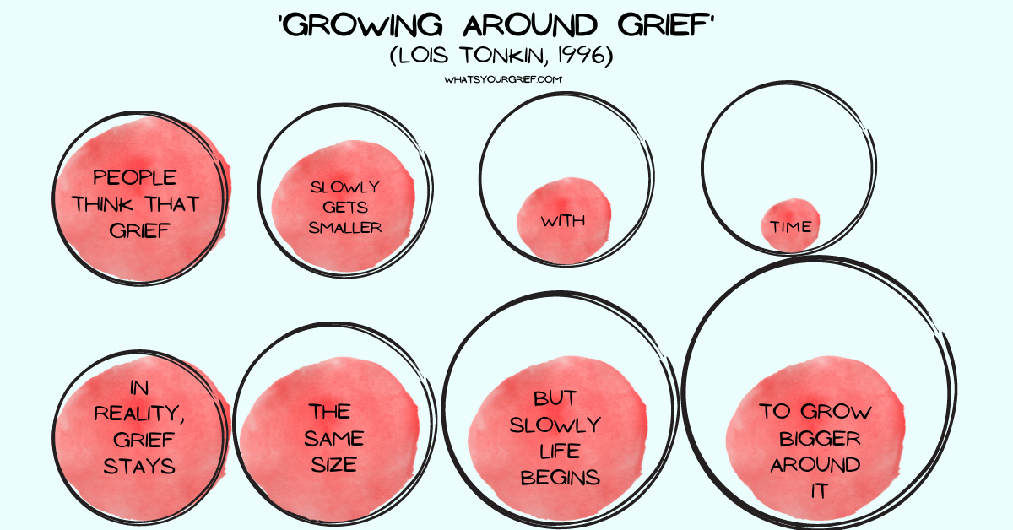
Growing Around Grief (Tonkin, 1996)
Notes:
Tonkin’s theory of grief suggests that over time, your grief will stay much the same, but your life will begin to grow around it. You will have new experiences, meet new people, and begin to find moments of enjoyment. Slowly, these moments may grow more frequent and the outer circle will grow a little bigger.

Slide 25
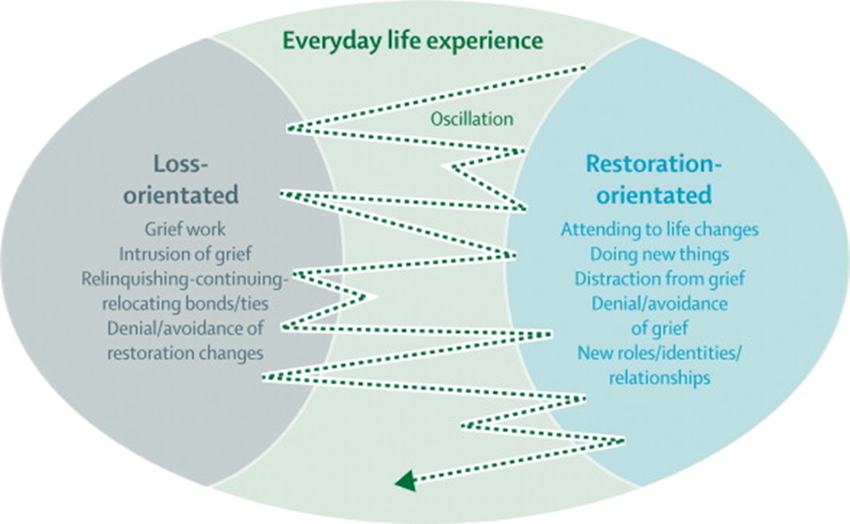
Dual Processing Model (Strobe & Schut, 1999)
Notes:
The dual process model of grief provides a holistic model of loss and grief, stating that both denying and avoiding are important parts of a healthy grieving process.
The dual process model of coping places no judgement on individuals within the grieving process as the counsellor will view the client with unconditional positive regard. No one method of coping (loss-orientated or restoration-orientated) is better than the other.
This is an inclusive and holistic model, focusing on lived experiences and normalising the grieving process.
The dual process model can help individuals to understand that what they are going through is 'normal'. They are not alone in their feelings of coping and not coping, facing things and avoiding them.
Shifting between these feelings is common and expected. It can help Individuals feel comforted that their feelings, actions and behaviours within the grieving process are natural.
Coping with grief and loss
The dual process model of grief focuses on stressors linked to grief.
The 2 types of stressors here are ‘loss orientated’ and ‘restoration orientated’.
Both require coping. Taking breaks within this coping is essential for people within the grieving process.
Examples of coping with loss:
Restoration-orientated focuses on the demands of living after the loss. It can be isolating and stressful learning new skills or tasks that the deceased person used to do.
These can involve:
Cooking
Financial affairs
DIY
Childcare
Finding employment
Household chores
Loss-orientated focuses on emotionally processing the loss of the person who has died.
This might involve:
Memories
Reminiscing
Yearning
Crying
Imagining
Oscillation (moving backwards and forwards) between facing and avoiding the loss is a key part of the dual process model.
This is viewed as a natural part of grief and presents a more accepting, holistic and inclusive approach to working through it. Individuals can find a balance between facing loss and re-engaging with life after loss.

Slide 26
Prolonged Grief in the DPM
Everyday life experience
Loss-
oriented
Restoration-
oriented
Grief work / rumination
Intrusion of grief
breaking-continuing-relocating bonds / ties
Denial/avoidance of restoration changes
Attending to life changes
Doing new things
Distraction from grief
Denial/avoidance of grief
New roles/ identities/ relationships
Disturbed oscillation:
Traumatic grief
Absent or inhibited grief
Chronic grief
Notes:
Chronic (prolonged?) grief
Long-lasting presence of symptoms associated with intense grief; absence of apparent progress in coming to terms with loss. Delayed/inhibited grief
Little / no sign of grieving early on in bereavement; does at later point
Absent grief
Nonappearance of overt symptoms typical of grief; continuation of life as though the event had not occurred
Window of tolerance

Slide 27
Personal Meaning Making: Neiymar (2001, 2009)
The 3 R’s Of Grief :
1 Retelling – Retelling the story of what has happened and about the loss until it changes
2.Rebuilding – Rebuilding the bond / relationship
3. Reinventing– Reinventing ourselves in the new context of our lives; integrating sadness and hope
“grieving is a process of reconstructing a world of meaning that has been challenged by loss”
Notes:
“Although most people successfully navigate bereavement and retain or return to pre-loss levels of functioning, a significant proportion struggle with protracted grief, and are unable to find meaning in the wake of an unsought transition. A coherent self-narrative that integrates the loss, while also permitting their life story to move forward along new lines.” (Neiymar, 2001, 2009)

Slide 28
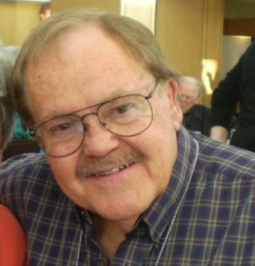

Worden conceptualises grief work into ‘tasks’ that demand something active of the grieving person.
Seasons for Growth
is built around the grief theory related to the work of
J. William Worden.
Notes:
Unlike most other grief theorists, Worden doesn’t talk about stages or phases but TASKS – work a griever needs to do.

Slide 29
1
2
3
4
4 Tasks …
Grief is a process
- not a state ...
(Grief Counselling, 1980 p. 10)
Notes:
Notice that Worden says: “Grief is a process, not a state.” Discussion? Comments? As Companions we are not “curing” people of their grief.

Slide 30
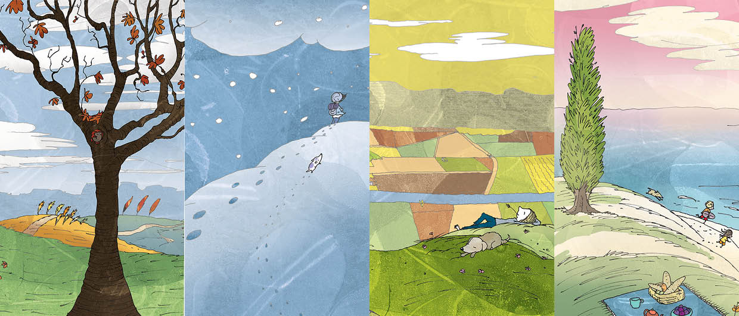
1. To accept the reality of the loss
Notes:
The first Task underpins the season of Autumn

Slide 31
1. To accept the reality of the loss
Initial coping strategy may be:
Denial
Disbelief
Avoidance
Confusion
Immediate response:
It can’t be true
I don’t believe it
It must be a mistake
Notes:
Introduce the first task. Use the example of an elderly couple where the husband dies. The death might have been sudden or following a long protracted illness. For our example here, let’s presume the death was sudden. What are the reactions of the wife? The sorts of statements that might be made would be:
“I don’t believe it.” “It can’t be true.” and later on: “I thought I heard his footsteps coming in the back door.”

Slide 32
1. To accept the reality of the loss
Challenges
Recognising the reality of the loss
Blockages
Denial, minimisation
Distraction, over-activity,
Denial through fantasy,
Feeling unsafe,
Over-identification with the deceased.
Notes:
Brainstorm participants’ experience of any of these.
The work of Task 1 is coming “full face” with the reality of the loss. To do this we need intellectual as well as emotional acceptance.

Slide 33
2. To process the pain of grief
Notes:
The second Task underpins the season of Winter

Slide 34

2. To process the pain of grief
Initial resistance may include disorientation, fear of losing control
Automatic Reactions:
Feeling anger at others, self, life, God. Experiencing guilt.
Saying things like:
“When is this going to end?”
“I wish I was not like this.”
“I cannot stop crying.”
Notes:
If we continue with the situation of an elderly couple where the husband dies, the wife might be saying something like these statements or suddenly bursting into tears as she recalls her loss.

Slide 35
2. To process the pain of grief
Challenges
Wanting to distract
from and avoid painful emotions through activity and self-medication
Not having emotional vocabulary or experience to express feelings
Feeling helpless, hopeless
Blockages
Stopping the feelings
Geographic cure
Euphoric response (continued feeling of presence of deceased)
Depression - avoid dealing with grief
Idealizing the deceased
Use of drugs/alcohol
Notes:
Again ask participants to reflect on their experience of dealing with any of these.
We can short circuit this task by:
not feeling – dulling all emotions
travelling to find a “geographic cure”
covering up grief reactions by work, doing other things
dulling the pain by alcohol/drugs

Slide 36
2. To process the pain of grief
Grieving people often try to avoid the pain by going round their grief.
“Sooner or later, some of those who avoid all conscious grieving, break down – usually with some form of depression”. (John Bowlby, 1980)
“... anything that continually allows the person
to avoid or suppress this pain can be expected to prolong the course of mourning”. (Colin Murray Parkes, 1972.)
Notes:
Society offers platitudes and counter-task measures like:
“Life is for the living – he/she wouldn’t want you to feel this way.”
“Don’t feel sorry for yourself – you don’t need to grieve – they are at peace now”.
“You’re young – you can have another child/get another job/build another house/re-marry”.
The statements highlight that it is important that people do “process the pain” or it can lead to a long period of mourning or even to depression.
The work is “going through” the pain, anxiety, anger, guilt, loneliness i.e. not denying the impact of the loss and the personal cost.

Slide 37

2. To process the pain of grief
Only people who are capable of loving strongly can also suffer great sorrow, but this same necessity of loving serves to counteract their grief and heals them.
- Tolstoy
Notes:
What does this statement mean to you?
The “attachment” that people have to the person or thing that they have lost makes their sorrow greater. Grief is felt because of a relationship and that relationship does not end with death but is changed.

Slide 38
3. To adjust to the environment
in which the significant person or object has been lost
Notes:
The third Task underpins the season of Spring

Slide 39

3. To adjust to the environment
in which the significant person or object has been lost
Initial resistance to this task may be because of the energy and creativity required to make the changes:
struggling with new roles and responsibilities.
Automatic response
might be:
“I’ve never done that before”
“I’m too old to learn that”
“I don’t want to risk failing”
Notes:
Again, imagine the elderly couple now that the husband has died. There are tasks that he would have done that still need to be attended to, e.g. it might have been the shopping, driving, the lawns, the banking.... The wife does not necessarily need to do them all now but has to arrange for them to be attended to somehow.

Slide 40
3. To adjust to the environment
in which the significant person or object has been lost
Subtasks:
External
Internal
Spiritual
  External
  living tasks
  e.g. finances, meals, parenting skills, environment/
  context, work
  Spiritual
  loss of direction, search for meaning
  challenge to basic beliefs
  learning to live without answers
  to “why”
  Internal
  Self-image, esteem, confidence, work efficacy
Notes:
The adjustments that need to be made in order to live using one’s potential may include adjusting one’s self-definition e.g. I was a stay-at-home person but now I have joined a club and go out by myself with new friends.
Risking failure when adjusting to new demands e.g. learning to drive, may increase confidence if success has been experienced. However if “failure” is experienced this may increase regression, lowered self-esteem and depression. There may be a desire to give up rather than consider other ways around the blockage. Support and encouragement is important to help people to keep working at this task.

Slide 41
3. To adjust to the environment
in which the significant person or object has been lost
Challenges
Loss of roles played by deceased
New view of the world
Secondary losses & changes
Finding new patterns
to replace old ones
Redefining new roles
& self in new roles
Blockages
Remaining helpless
Refusing to adopt
new roles
Staying stuck in
old roles
Refusing to acclimatise and adapt
Refusing to redefine self and new goals
Notes:
Discuss what these issues might mean or how they might be recognised.

Slide 42
4. To find an enduring connection
with what has been lost in the midst of embarking on life
Notes:
The fourth Task underpins the season of Summer

Slide 43
4. To find an enduring connection
with what has been lost in the midst of embarking on life
Initial resistance to this task may be fear of losing the balance between the past and the unknown future.
Automatic response might be:
“They’ll think I am betraying his/her memory.”
“I’ll never stop loving them so I’ll never love anyone else.”
“I won’t ever be hurt like that again so I won’t risk it.”
Notes:
Task Four challenges mourners to find a way of remembering/revering the memory of the deceased but in a way that does not prevent them from developing new relationships and interests.

Slide 44
4. To find an enduring connection
with what has been lost in the midst of embarking on life
Challenges
Accepting loss
Moving forward with life
Redefining self as whole
Loving again
Mourning is finished when the loved one is thought of without pain
Blockages
Refusing to reinvest in new love relationships
Continuing to remain unsociable
Focusing on what might have been
Notes:
Participants might be able to name examples from their own experience.
Sense of healing/acceptance, developing new environments, relationships, activities.
Completion of this task is recognised when the individual continues to weave the loss into the fabric of their evolving life. They have not lost the influences, values, inspiration of the one they’ve lost because they have re-invested into a new pattern of living.
They are liberated in finding other “loves” (people/activities, etc) without losing the love they feel for the lost one.

Slide 45
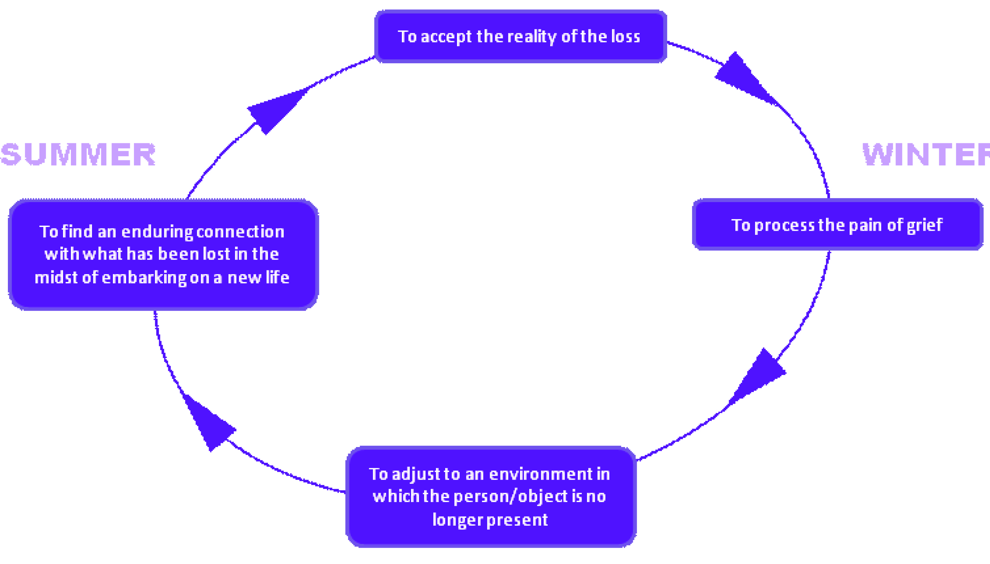
Worden’s Tasks of Grief
Notes:
While the tasks are numbered 1 to 4, it does not mean that they automatically follow in that order. The tasks are not phases so they can be re-visited in any order and continue to be worked on.
A grief can be faced with any task, at any time. Various tasks can be worked on at the same time. There is no time frame or sequence around the tasks.
Grieving is a fluid process.

Slide 46
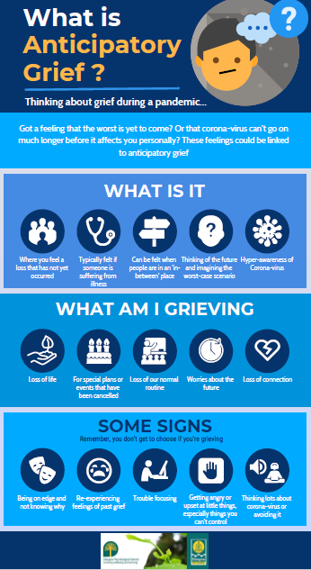
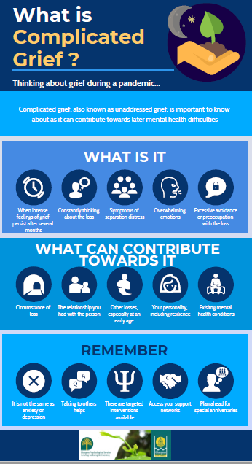
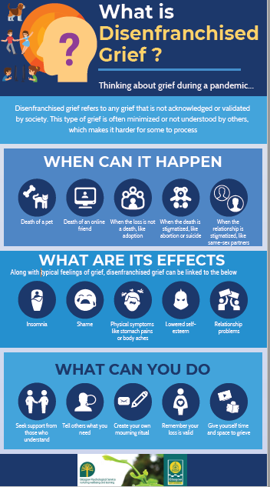
Notes:
Being aware of medicalising a normal grief reaction. Importance of relationships and key principles of loss and bereavement.
Speak to barriers of education – point of reference for education staff

Slide 47
Supporting Children and Young People’s Experiences of Loss, Change and Bereavement

Slide 48
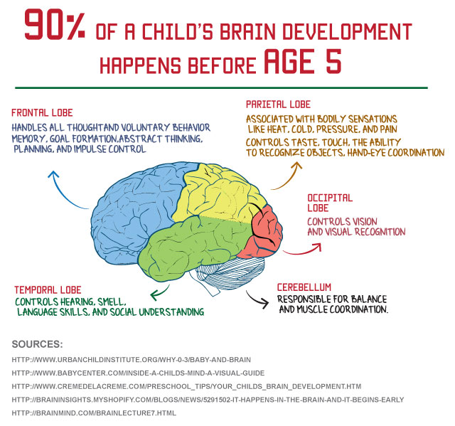
Developmental Stages of Grief
From 0-5 years
do not understand death is final
have difficulty with the abstract concept of death
Far-reaching consequence of death not apparent
magical thinking
From 5-10 years
develop an understanding that death is final
may assume dead person can still see or hear them
can show empathy to a bereaved friend
can become occupied with sense of justice/injustice
May experience a wide range of emotions including sadness, guilt, anger, shame, with possible pressure on boys to not express feelings
May worry they are to blame
Brain Development
Notes:
Developmental Stages of Grief.
Brain development in the early years (0-5) plays an important role in the development of children’s brain structure. Based on what neuroscience tells us, approximately 90 percent of a child’s brain development takes place between 0-5 years old. As such, a child’s experiences in the early years are critical to their development and growth into adulthood.
Children won’t yet understand that death is universal and will also happen to them – internal crisis.

Slide 49
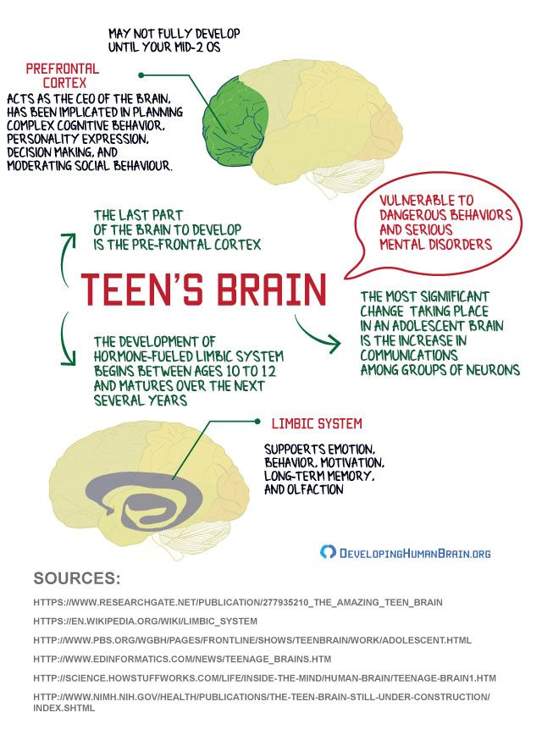
From 10 years to Adolescence
Concept of death becomes more abstract
Reflect on justice/injustice
Understanding of death is influenced by past experiences of death and by explanations given to them at this time
May have an adult understanding but lack experience and coping skills
May experience a wide range of emotions and have difficulty handling them
Impulsivity due to pre-frontal cortex still developing alongside risk-taking behaviour
Notes:
Adolescence is a time of striking change in the brain as well as the body. Environment and experiences during this time guide development of some of the human brain’s more complex functions, making the teen years a second critical period of brain development. Enhanced connectivity and an imbalance between the parts of the brain responsible for decision-making and self-control and those involved in motivation and emotion may lead teens to seek new experiences. This makes teens more likely to take risks and seek excitement.

Slide 50
Common reactions to Loss
Low motivation due to loss of meaning
Poor concentration
Physical complaints (somatic response)
Sleep Disturbance
Bed wetting
Clinginess
Emotional regression
Anxiety and Vulnerability
Vivid Memories
Sadness and longing
Feeling presence in room
Anger and acting out
Feelings of guilt, self-reproach and shame
Low energy
Changes in identity
Existential inquiry

Slide 51
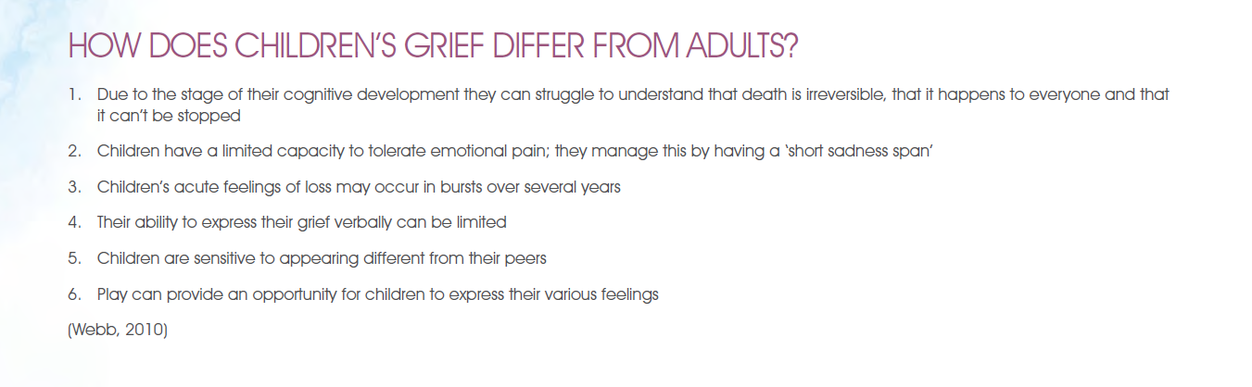
Notes:
Short Child Bereavement Puddle jumping video can be a helpful way to see children’s grief and how this might differ from how we cope with these feelings: https://www.youtube.com/watch?v=bmkbTnWSZ_U
CYP may experience the following which will affect how they process information and emotions:
Have less concentration
Be a lot more tired and therefore irritable
Have a heightened sensitivity to comments and remarks
Increased anxiety / vulnerability
Be so wrapped up in their own feelings that they fail to take the feelings of others into account, which can result in arguments and fights
Could have a lot of un-vented anger and frustration about the loss

Slide 52

Talking to Children who are bereaved
https://vimeo.com/167887527
Notes:
Video is made for health professionals but can provides a good overview of children’s views around being supported in their grief and can be applied to education as well.

Slide 53
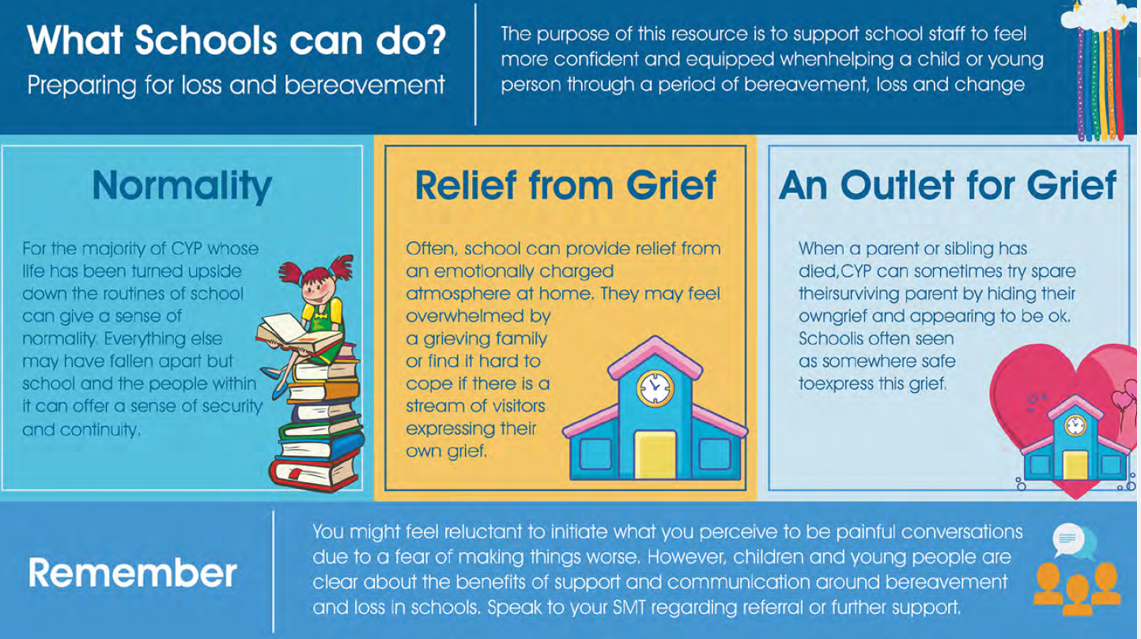

Slide 54
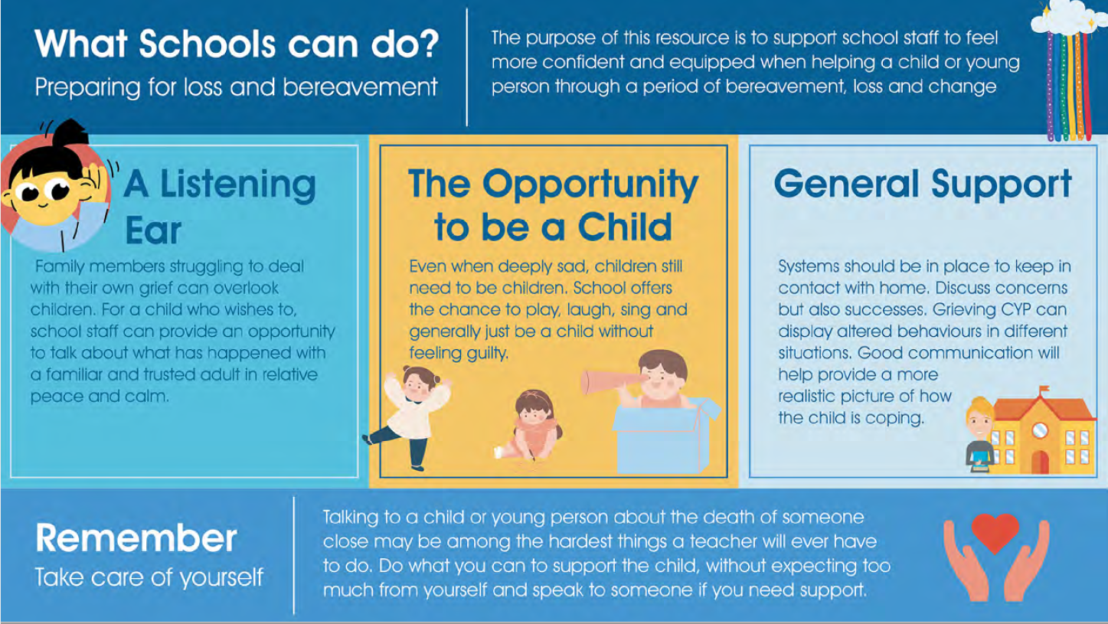

Slide 55
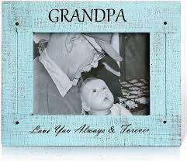

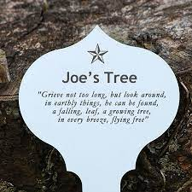
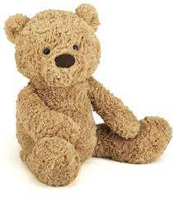
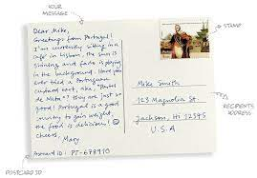
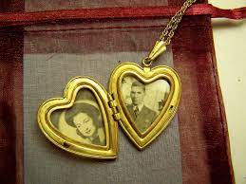


Notes:
Consider how to mark beginnings and endings.

Slide 56
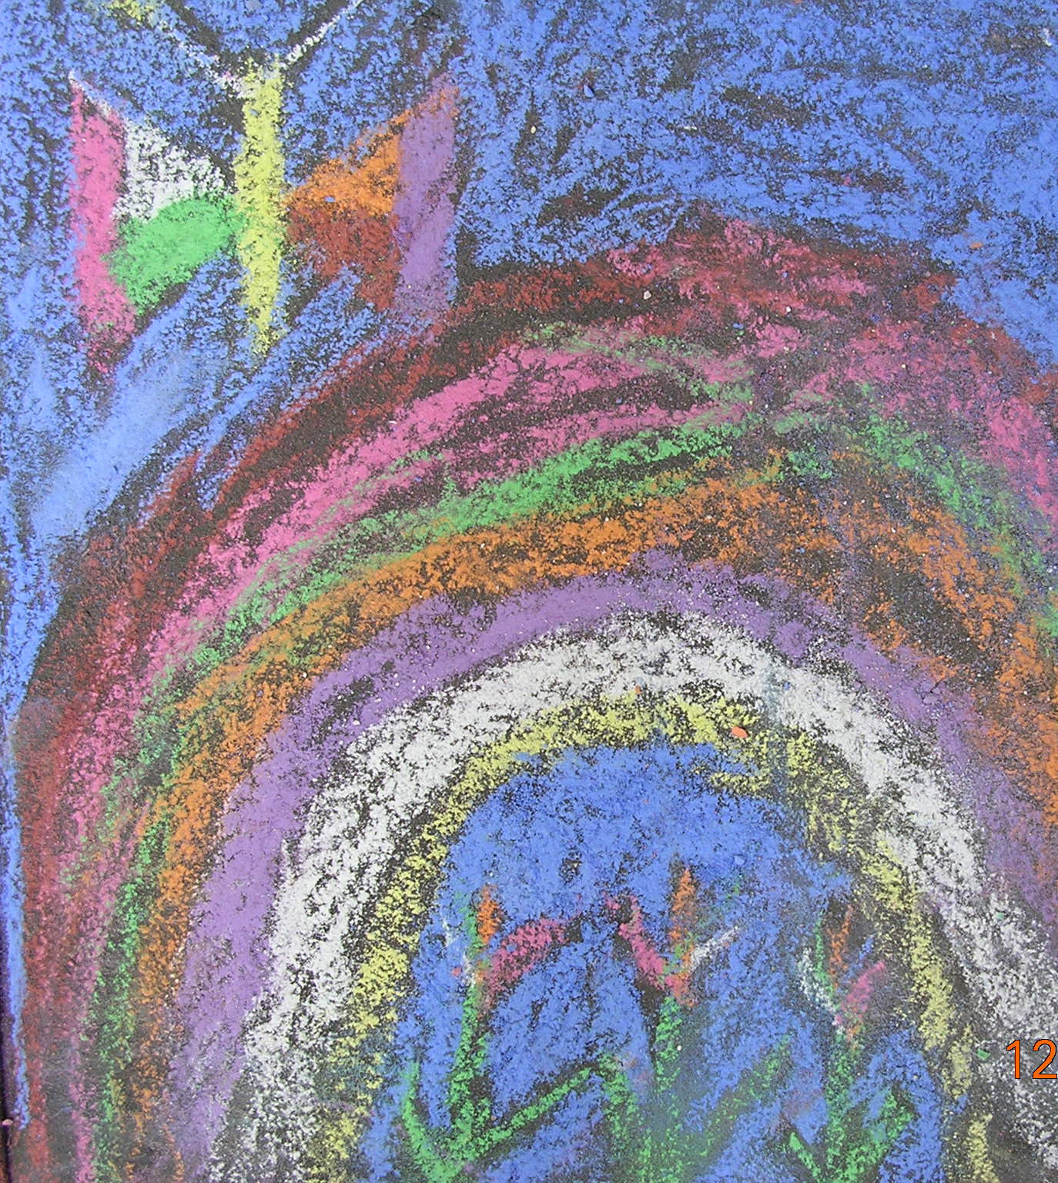
Three Golden Moments
Upon hearing of the death
Making initial contact
What to say
Clarify what the children/young people have been told

Slide 57

Three Golden Moments
The Funeral
Cultural and social differences
Do they know what will happen?
Preparation

Slide 58
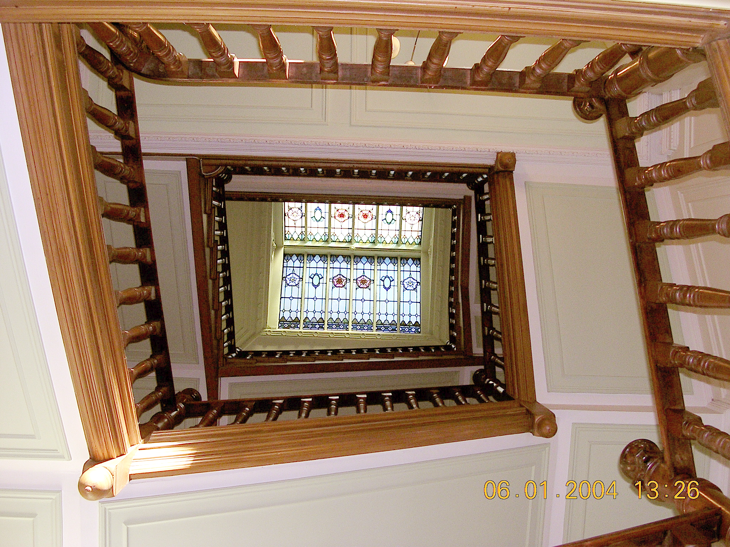
Three Golden Moments
The return to school and normal life
It is better to say something than nothing
Listening is better than talking
Being open and honest

Slide 59
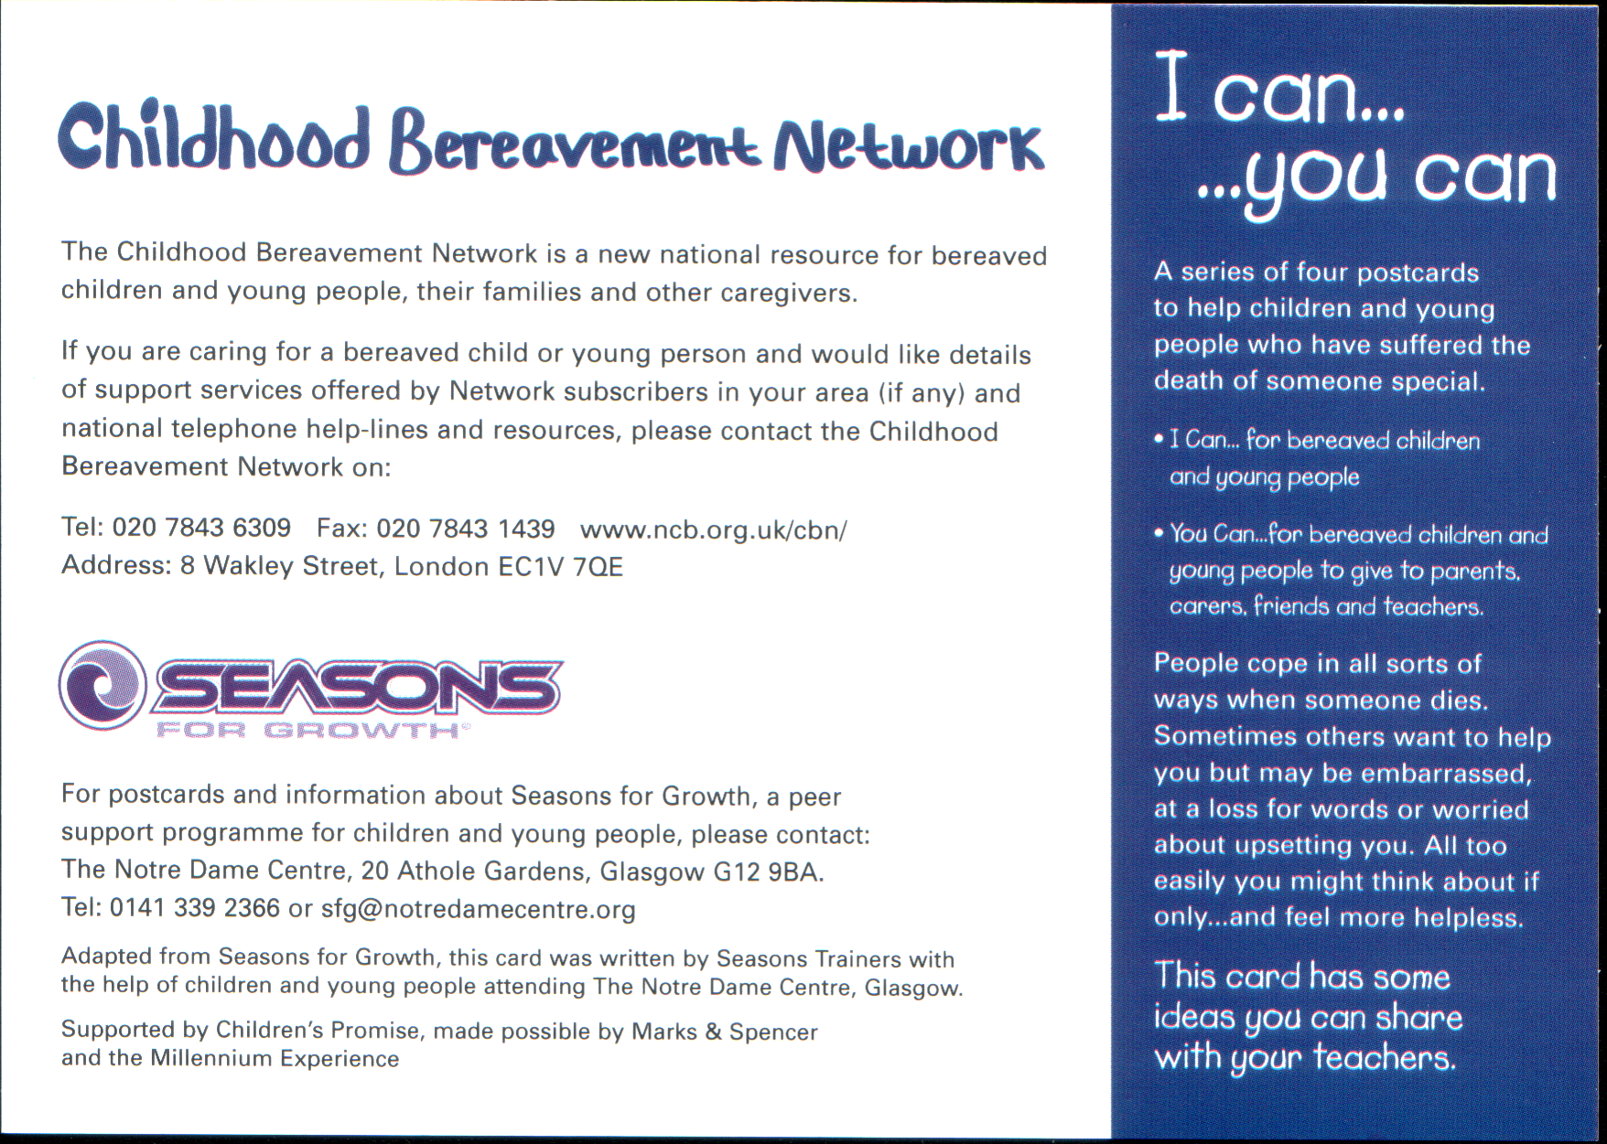

Slide 60
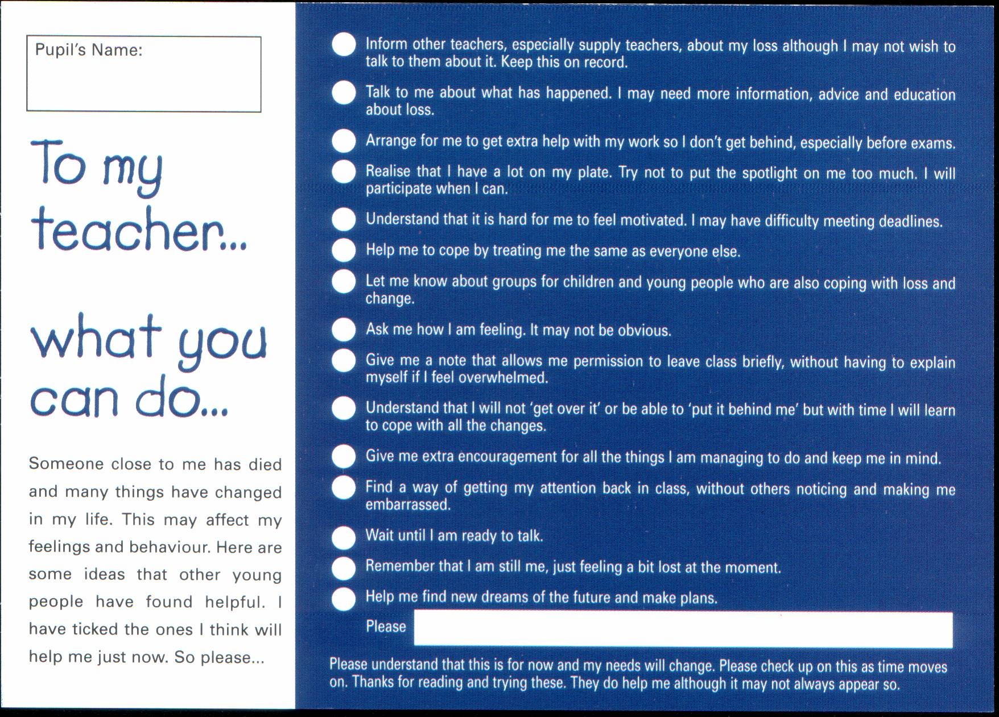

Slide 61

Think about yourselves!
Notes:
Psychologists define resilience as the process of adapting well in the face of adversity, trauma, tragedy, threats, or significant sources of stress—such as family and relationship problems, serious health problems, or workplace and financial stressors
Short Video from BCC Ideas:
https://www.youtube.com/watch?v=dgk7nmI_nXI
Dr Lucy Hone is a leading expert on resilience. Her own resilience was tested in the most horrific way when her daughter was killed in a car crash. She tells the story of how she has coped with the loss - and shares three key strategies for building resilience.

Slide 62
Menti Finishing Activity
Notes:
Returning to the initial Menti exercise, now reflecting on how we might think differently about loss and bereavement.

Slide 63
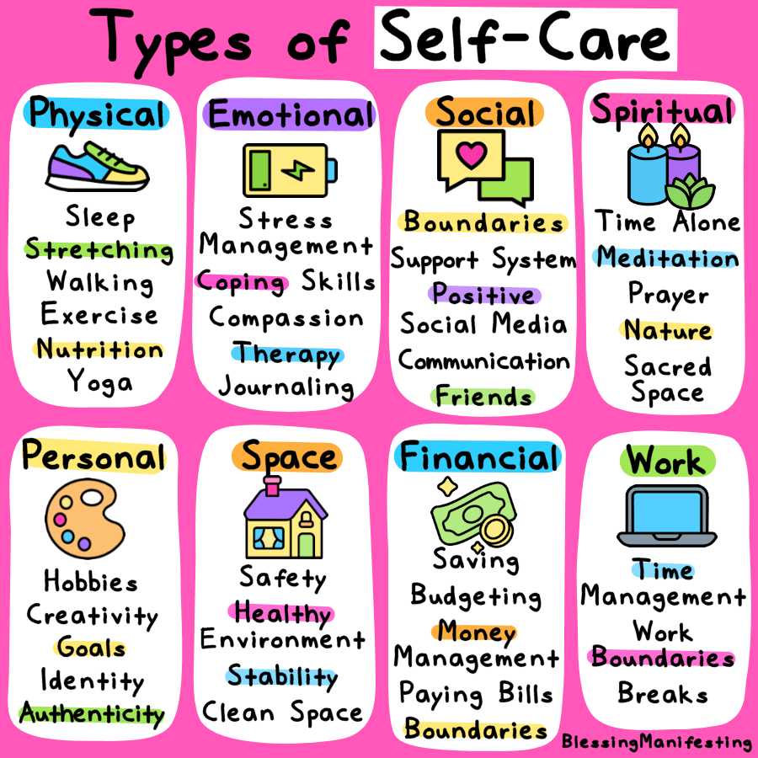
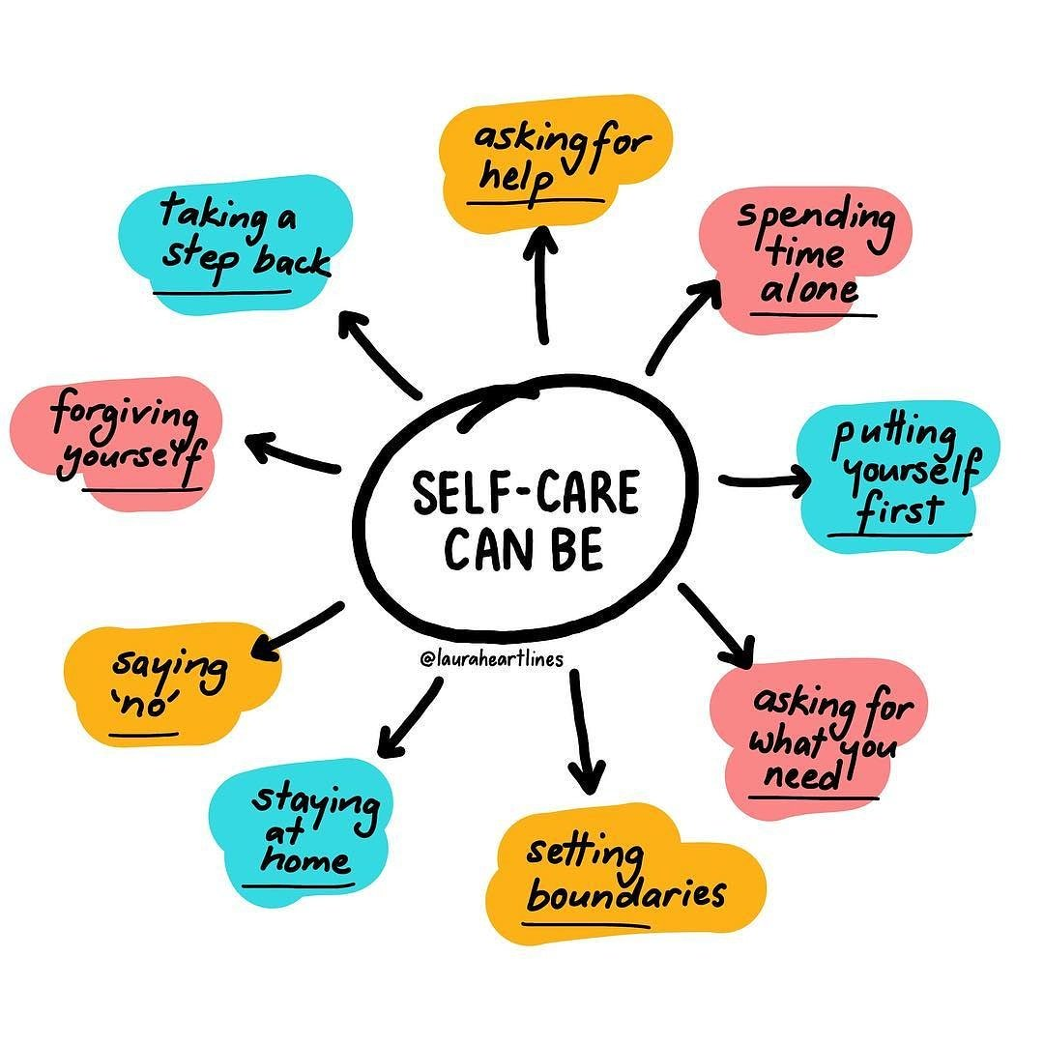
Self- Care…do it your way

Slide 64

Conclusion
Consistency, being persistent, being that key adult can help in navigating these issues
There is no right or wrong answer – but remember making the effort to start the conversation is the most important thing you can do.
Look after yourselves!

Slide 65
Any Reflections or Questions?
Notes:
Speakers to make themselves available for anyone needing time to talk things through/debrief.

