Slide 1
Empowering Youth Voices A youth voice and participation toolkit for practitioners working with children and young people

Slide 2
Acknowledgements
This toolkit has been developed from the successful Social Justice Ambassador programme within Stirling Council.
Much of this toolkit builds upon the same core concepts such as empowerment, skills development and peer-research. This toolkit supports children and young people to advocate for their peers on different themes and issues.
Thank you to the Stirling Youth Participation staff who shared resources to support the creation of this toolkit.

Slide 3
Purpose of Toolkit
This toolkit is designed to support practitioners in empowering children and young people to have their voices heard. This can take place in schools, youth groups, organisations and communities. This toolkit can be used with existing and new youth voice structures e.g. pupil councils, youth forums, champion boards, ambassador projects, leadership groups etc.
This toolkit utilises peer-research as a tool to develop children and young people’s skills, ability and confidence to consult their peers – so that they can:
Clearly understand the concept of youth voice and children's rights
Learn to work together as a group to represent their peers
Understand key elements of research such as data, planning, analysis, consultation, etc.
Develop questions, undertake research and capture the views of their peers on any particular theme.

Slide 4
Using this Toolkit
Practitioner judgement: Please use the sections and activities in this toolkit as you see fit. This toolkit has been designed to be adaptable and some slides may not be relevant/appropriate for certain groups.
You will find facilitator guidance and activity notes in the notes section of every slide.
This toolkit focuses on the overarching themes of youth voice and children's rights, however groups can use this toolkit as a basis to undertake social research on any given topic or theme.
Please note that this toolkit is in draft format, feedback will be used to continually develop the resource.

Slide 5
Using a pre-identified Theme
This toolkit can be used to support children and young people to undertake research on any particular theme.
Sometimes, the topic may already be identified and this toolkit can be worked through - however additional information on the identified topic will be required to ensure that the children and young people can genuinely participate in the research process.
If you already have a topic identified, you may wish to use the blank template slides at the end of this toolkit to add in information on the topic as appropriate.

Slide 6
Contents
Section 1 – Understanding Youth Voice
Section 2 – Children’s Rights
Section 3 – Working as a team
Section 4 – Becoming a social researcher
Section 5 – Identifying a theme and Research tools
Section 6 – Undertaking research
Section 7 – Analysing results and action planning

Slide 7
Empowering Youth Voices
Section 1 – Understanding Youth Voice
In this section you will learn about youth voice, decision making and why it's important.
Notes:
Section 1: Understanding Youth Voice
This section covers information on the Forth Valley and West Lothian geography including local authorities and region.
It highlights the regional Youth Voice Charter which was developed by young people and aims to give young people an understanding of this regional approach to youth voice.

Slide 8
Youth Voice
It is really important that adults speak to children and young people when they are making decisions that affect them.
This is called consultation and it should happen before any decisions are made.
We want adults who make decisions about education in Forth Valley and West Lothian to consult with young people in a genuine and meaningful way. We also want children and young people to feel like collaborators in actions taken that will affect their lives.
We know that young people sometimes feel like they are not listened to and their views are not taken seriously – we want you to help us change this!
Notes:
Facilitator Notes: Read through above slide, highlighting the importance of youth voice.
You should place emphasis on how consultation with children and young people allows change to happen - when it is done in a genuine, meaningful and representative way.

Slide 9
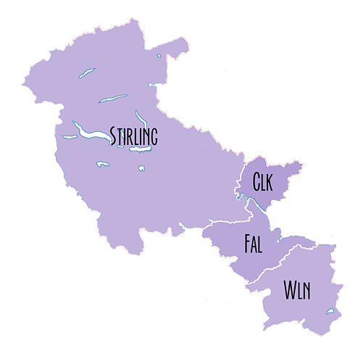
Our region
Our region - Forth Valley and West Lothian,
is made up of:
Stirling
Clackmannanshire
Falkirk and
West Lothian
Notes:
Facilitator Notes: This slide is introducing the idea of Stirling, Clacks, Falkirk and West Lothian are 4 local authorities belonging to a region.
You may wish to ask young people to locate where they are from, can they find it on this map, and have they heard of a region before?
You may wish to ask young people why it could be helpful to have a regional approach to young voice – for example, young people may have the same concerns across the area, and therefore strength in numbers to have their voices heard and recognised at a regional level.

Slide 10
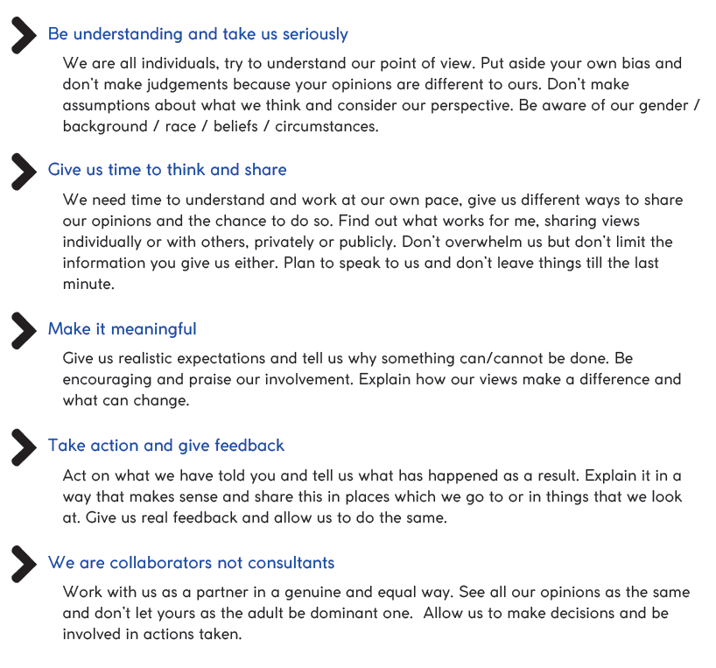
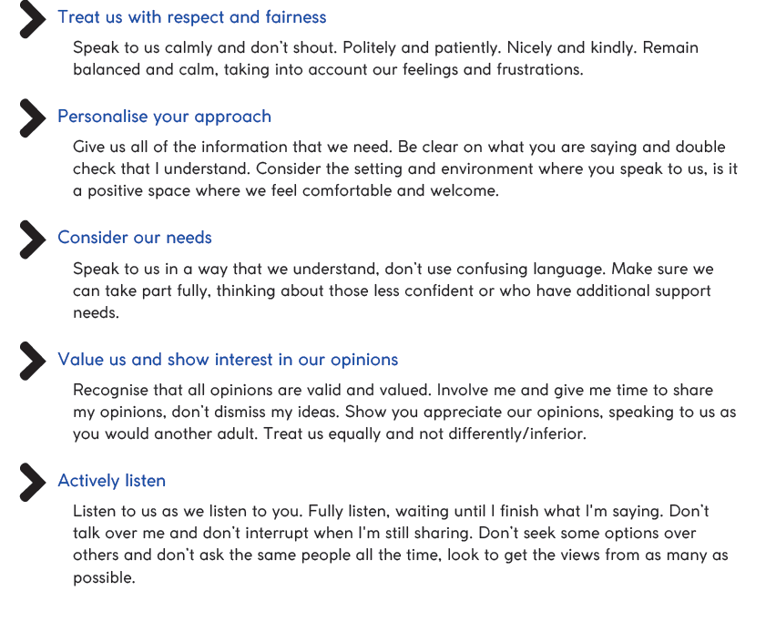
Our regional Youth Voice Charter
Notes:
Facilitator Notes: Show the group the charter and read through the statements. Which statements do the children and young people you work with feel are most important? Is there anything they feel is missing from the charter?
Explain to the group that this charter has been agreed across the region, and explain that these are the endorsed guiding principles that all staff who support youth voice within the 4 local authorities must adhere to.
Additional Information: This charter was created in Spring 2023 based on the views of over 650 children and young people. It was put together by individuals who are involved in youth voice groups (e.g. youth forums, pupil councils, Members of the Scottish Youth Parliament). Young people selected the final visual charter design.
This slide will be updated when charter design is confirmed.

Slide 11
Activity – Baseline Data
Draw, write, make a mind map or poster to answer these questions:
Why is it important to have your voice heard by adults?
Where do children and young people have opportunities to express their views and opinions?
Notes:
Activity: Ask young people to draw, write or make a mind map, illustrative poster or cartoon to answer one or both of these questions:
Why is it important to have your voice heard by adults?
Where do children and young people have opportunities to express their views and opinions?
Facilitator Notes: Discuss with young people why it is important to be heard, ask some of the group to explain why they think this.
You may wish to ask young people of examples when they have felt their voice has been heard on a matter that affected them. For example, a young person may have helped an adult make a decision in school or in the community.
School groups, pupil council, eco committees, youth groups and clubs in the community are all ways in which young people can have their voices heard.

Slide 12
Where voice makes a difference
Notes:
Facilitator Notes: Use the two examples below to highlight situations where the views of many children and young people are gathered on particular themes, showing that youth voice can make a extraordinary difference to the lives of children and young people.
Example 1 - Highlight how the voices of children and young people have allowed the creation of free bus travel for anyone aged 11-26 through their young scot card and younger through a NEC card.
This happened due to the number of children and young people who highlighted how transport was a worsening barrier. Their voices were listened to and resulted in the creation of this programme.
Example 2 – With continual pressure from the Scottish Youth Parliament, in 2014 the voting age was legally changed from 18 years old to 16 years old.
This allowed all 16 and 17 year olds to vote in Scottish elections and have their views heard for who they believe should govern the country.

Slide 13
Dear Decision Makers…
Notes:
Activity: Explain to the group that in Scotland, we have members of the Scottish Youth Parliament who are elected by their peers. They have made this video 'Dear Decision-Makers’ which is a letter to Scotland's Decision-makers taken from the Scottish Youth Parliament's 'From Scotland's Young People' manifesto for 2021-2026. Being a member of the Scottish youth parliament is one way to have your voice heard.
Access Dear Decision Makers Video on Youtube here: https://youtu.be/Qa8rUFGWM1U

Slide 14
Empowering Youth Voices
Section 2 – Children's Rights
In this section you will spend time exploring Children’s Rights and the UNCRC.
Notes:
Section 2 – Children's Rights
This section covers children's rights and the UNCRC. It explores why rights are important and encourages discussions about young people’s right to be heard.
It is important that children and young people can understand the importance of their rights in the context of youth voice.

Slide 15
How decisions are made
These are two documents that look at decision making in more detail:
Notes:
Facilitator Notes: You may wish to spend time looking at decision making in more detail. Further information can be found in these two resources:
soc10-you-decide.pdf (education.gov.scot)
This resource supports teachers and professionals working with young people to develop understanding, skills and participation with the term political literacy. Young people need to understand democratic processes and know how the people who we elect and represent us at local councils and parliaments make important decisions that affect almost every aspect of our daily lives
Democracy Matters: How Decisions Are Taken (www.gov.scot)
The Democracy Matters conversation has been set up to hear your voice and the voices of your friends and neighbours in a discussion about local communities deciding their own future. The levels of locally elected representation and local people’s involvement in decision-making varies across public services. This is a short overview of how decision are currently taken in Scotland. It is designed to help you take part in the conversation about local democracy. You’ll find information on key public sector organisations like the NHS, police, councils, the Scottish Government.
Practitioner video for further information on Political Literacy: What is political literacy? – YouTube

Slide 16
Children’s Rights
You may already be aware of the United Nations Convention on the Rights of the Child.
This contains 54 articles which explain your rights, including these three key articles:
Article 3
Best interests of the child
The best interests of the child must be a top priority in all decisions and actions that affect children.
Article 12
Respect for views of child
Every child has the right to express their views, feelings and wishes in all matters affecting them, and to have their views considered and taken seriously.
Article 13
Freedom of expression
Every child must be free to express their thoughts and opinions and to access all kinds of information, as long as it is within the law
Notes:
Activity: Discuss the three specific rights on the slide and explain that by using this toolkit and youth voice approach we are:
listening to your views, ​
making sure your views are part of our decision making​
providing you with the information and knowledge to make informed decisions and space to explore what your thoughts are on these subjects.
Discuss what young people already know about their rights, and ensure the young people know they have a right to have their voices heard and listened to.​
Perhaps consider asking young people to identify where they learn about their rights? Potentially through rights respecting schools if relevant?
Ask if children and young people feel their rights are respected, protected and fulfilled at school / in the community?​

Slide 17
Children’s Rights
We want all adults to make sure that your views and opinions are considered and taken seriously.
It is very important that young people are listened to in all matters that affect them – it is your right!
Notes:
Activity: This activity is introducing the concept of children's rights – it is every child’s right be heard and listened to.
Watch the video, discuss the group’s ideas on children’s rights and what is means to them. Also consider why they are important, especially for any specific groups of children?
How can rights help you? – Rights can help us question mistreatment within our society.
Why are rights important? – Rights are important so that children can live a good quality life.
This video is from Scottish Government and can be accessed on youtube here: https://youtu.be/vlakicbEit8
Additional Information:
Link to Children's Commissioner site for children and young people to learn about their rights - Home - The Children and Young People's Commissioner Scotland (cypcs.org.uk)
If you would like any further information or resources you can access the ThingLink developed by Forth Valley West Lothian regional UNCRC group:
UNCRC PL - overview (thinglink.com)
The sections which are most appropriate are:
What is UNCRC?
Why the UNCRC?
Both have videos which explain the concepts. Decide which you think will be most relevant to the children in your group.
If this above link does not work, you can access it via the Forth Valley West Lothian RIC page:
UNCRC – Forth Valley & West Lothian Regional Improvement Collaborative (glowscotland.org.uk)
Just click on Thinglink Children’s Rights Professional Learning.

Slide 18
What will this look like for you in this group?
These four elements are vital to Article 12:
Lundy Model
Notes:
Activity: Within the group, it is important for young people to feel secure to share their views.
These 4 elements (space, voice, audience and influence) are a pathway to ensure Article 12 is meaningfully protected, respected and fulfilled for every young person.
This is the Lundy model of participation, think about each statement and ask the group to think about what they need in order to feel they have the:​
Space: how can we make sure this feels like a safe space to explore our ideas?​
Voice: how can I help? And how can we help each other to express our ideas?​
Audience: How will you know if your views have been listened to?​
Influence: what will you see if your views are acted upon? How will you feel about this?​
You may wish to ask young people if any of these areas are more important? The answer is that they are all inter-related but it might be interesting to see if one element is more important to your group than others.​
Additional information: Young may wish to watch the Video from MSYP’s interview Laura Lundy here: Article 12 and young people's right to be heard — The Right Way
See here for the full Lundy Participation framework: Participation Framework - HUB na nÓg (hubnanog.ie)​
There are 2 stages of participation for Lundy:​
Stage 1: The right to express views​
Stage 2: The right to have views given due weight​
The full framework also includes checklists which could be useful, especially if you want to assess whether your children’s views of their participation change over time with this group: 5611-Hub_na_nÓg-Evaluation Form_group1 (hubnanog.ie)​
​

Slide 19
Children’s Rights
There are two specific articles in the United Nations Convention on the Rights of the Child about education.
Article 28: Every child has the right to an education - no matter who they are: regardless of race, gender or disability; if they’re in detention, or if they’re a refugee.
Article 29: Every child has the right to an education which develops their personality, respect for others’ rights and the environment.
Notes:
Activity: Discuss these two specific articles with the group, do they feel that these rights are respected, protected and fulfilled within their schools/education context?
UNCRC Articles Archive - The Children and Young People’s Commissioner Scotland (cypcs.org.uk)
There are lots of additional links to UNCRC information and resources for staff here: The UNCRC, Children's Rights and CLD – Wakelet

Slide 20
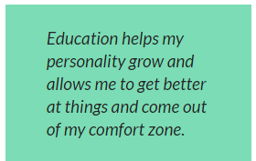
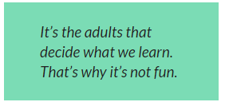
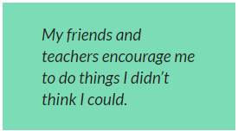
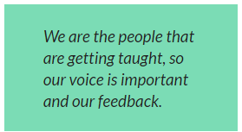
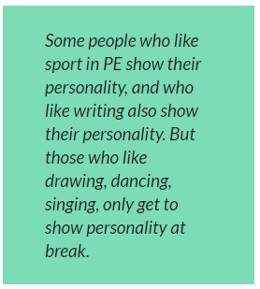
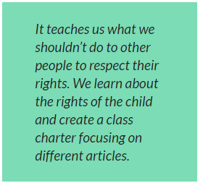
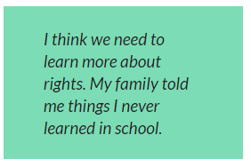
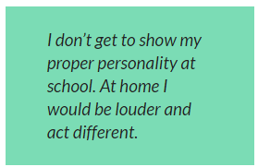
Children and Young People’s Views on Education
In 2021/2022, children and young people told Children's Parliament that:
Notes:
Activity: This is a discussion activity using responses from children and young people about education reform. This activity may link to discussions in the previous slide about how young people feel about Articles 29 and 29.
These are responses from the Children’s Parliament Education Reform: consulting with children and young people - Children's Parliament (childrensparliament.org.uk)
Talk through these statements as a group and use them as prompts to explore what ones young people agree and disagree with.
Additional Information:
The children's parliament education reform consultation asked children the following statements. You may wish to use these for form a discussion activity with the group:
Do you agree or disagree that you learn about these things when you are at school….
1. My education helps me to develop my personality, talents and abilities to their fullest potential. 2. My education helps me develop respect for human rights and freedoms. 3. My education helps me to develop respect for my parents/carers, my cultural identity and language. 4. My education helps me to develop respect for other countries and peoples. 5. My education prepares me for a responsible life in a free society, in the spirit of understanding, peace and tolerance. 6. My education helps me to develop respect for the natural environment. 7. My education helps me to develop respect for the national values of Scotland.
Then there were another 7 statements. They asked children to think about if they agreed or disagreed with them too.
They were more about whether children like learning and school and whether they have their say about their learning and life at school. In this report, they call these the happy at school and having my say statements. They said:
8. My education meets my needs as a learner. 9. My education will help me to realise my goals. 10. I am involved in making decisions about my learning. 11. The views of children should be taken seriously when schools are inspected. 12. My school is good at using technology to support my learning and assessments. 13. I enjoy learning. 14. I enjoy school.

Slide 21
Children's Right’s: what (not) to do
Watch this video from Children's Parliament Investigates…
How Professionals Make Rights Real
Notes:
Activity: Watch the video and discuss with the group - What do children and young people think of this video?
Can they think of other examples where they see adults making decisions without thinking about children and young peoples views?
Ask the group to think of a situation where a children or young person’s voice isn’t heard – and design a cartoon or a poster explaining how the adult could deal with the situation differently by listening to the child / young person.
Video link here – What (Not) To Do - Children's Parliament Investigates How Professionals Make Rights Real (youtube.com)
For more information on How Professionals Make Rights Real: Children's Parliament Investigates - How Professionals make rights real (childrensparliament.org.uk)
Additional resources here: Dignity In School – A home for school-based humans rights practise. (childrensparliament.org.uk)

Slide 22
Activate Your Rights
Notes:
Activity: Depending on your group, you may wish to use an activity from the Young Scot Activate Your Rights Pack – activities include rights bingo, card games and role play.
Young Scot Corporate - Activate Your Rights resources
https://youngscot.net/activate-your-rights-resources

Slide 23
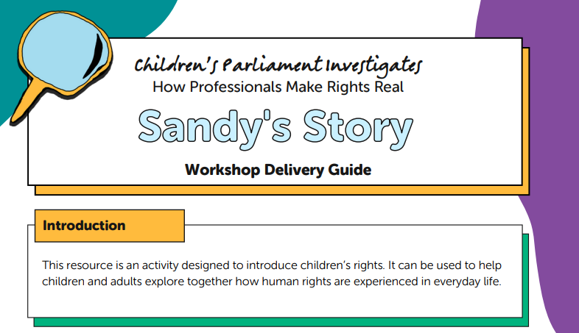
Sandy’s Story
Use the Activity Guide here:
Sandy's Story (childrensparliament.org.uk)
Notes:
Activity: Depending on your group, you may wish to use Sandy’s Story here:
Sandy's Story (childrensparliament.org.uk)
This resource was originally written for using with groups of adults and children together, but could work well with groups of children/young people of all ages.
It is an activity designed to introduce children’s rights. By telling Sandy’s Story it can be used to help children and adults explore together how human rights are experienced in everyday life.

Slide 24
Empowering Youth Voices
Section 3 – Working as a team
In this section you will undertake teamwork activities and spend time creating a team plan!
Notes:
Section 3: Working as a Team
This section covers teamwork and supports young people to develop strong approaches to work together and an increased ability to work as a team to reach a common goal.
Notes: In this section you will support the children and young people you are working with the develop a team dynamic. This is essential for them in their role going forward as they need work together when researching and consulting their peers on a particular theme. There may be other teambuilding activities that you would prefer to use than those included in this toolkit.

Slide 25
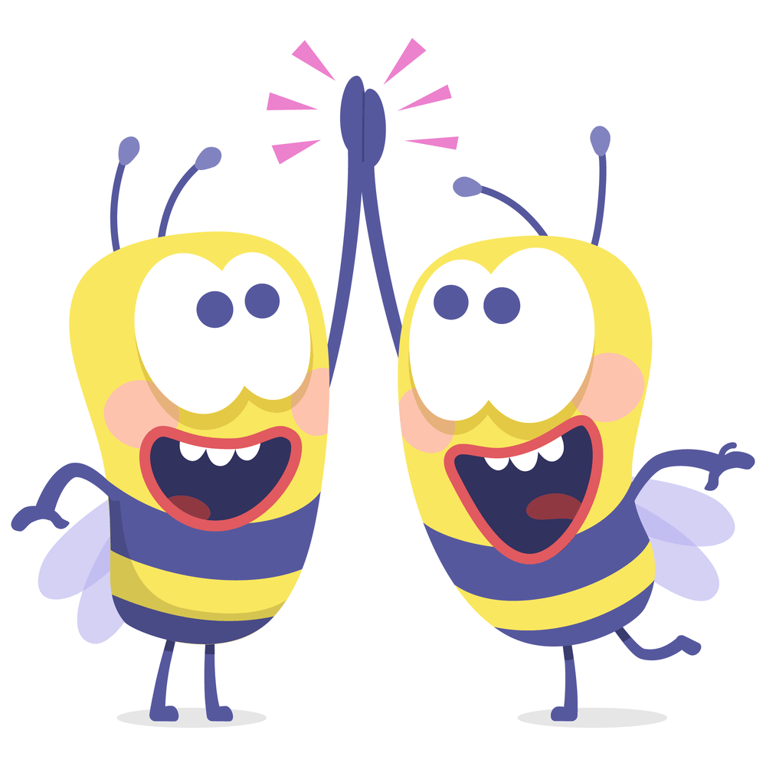
Count Up!
As a group, count up to twenty with your eyes closed and without any other communication. People cannot say more than one number at a time, and if two people speak at the same time, the group must start again!
Notes:
Activity: Count Up
Simple tasks that require team focus, cohesion, and awareness are great for any group working on team building. In Count Up, a team has to come together and count up to twenty with their eyes closed and without any other communication. People cannot say more than one number at a time, and if two people speak at the same time, the group must start over.
Though it seems simple, this team building exercise can really demonstrate the power of effective teamwork and is a great opener for a team building workshop.
In this short exercise, a group must count up to a certain number, taking turns in a random order, with no two people speaking at the same time. The task is simple, however, it takes focus, calm and awareness to succeed.
The exercise aims to generate calm and focused collective energy in a group.
Facilitator Note
If the group are struggling to count to twenty get them to count to ten first.

Slide 26
Would you rather?
Notes:
Activity: Would you Rather?
Encourage discussion between team members by asking them to decide what they would rather and why:
Would you rather live the rest of your life without your TV or phone?
Would you rather give up access to Instagram or Snapchat?
Would you rather have a video game come to life or you get trapped inside a video game?
Would you rather watch the same movie on repeat for the rest of your life or listen to the same two songs for the rest of your life?
Would you rather have free Wi-Fi wherever you go or unlimited battery life?
Would you rather have everything you think appear above your head or everything you do be streamed on YouTube.
Facilitator Note:
Utilise would you rather statements as appropriate with the age group and circumstances of the children and young people you are working with. Add in different statements as you see fit

Slide 27
What makes a good team?
Draw, write or make a mind map to answer these questions:
What makes a good team?
What makes a team work well?
Notes:
Activity:
Ask the group to think about and discuss what teams they can think of – sports teams, workplace or school teams, community groups, famous teams etc.
Ask the group to draw, write or mind map one or both of these questions:
What makes a good team?
What makes a team work well?
Facilitator Note:
Things that should be highlighted that make a good team include: Trust, good communication, patience, respect, understanding, energy/motivation, supportive teammates, everyone being included, friendly atmosphere,
Highlight that a team works well when everyone treats each other fairly and no one tries to push anyone around, dominate, be mean etc.
It’s also important to note that teams that work well are good at planning who is doing what, and not letting teammates down.

Slide 28
Open Fist Activity
Finding things that we have in common as a group!
Notes:
Activity: Open Fist
Finding you have things in common with other team members is one of the cornerstones of effective teamwork.
Open Fist is a simple, effective activity, to support young people to share facts about themselves and bond with others in the group.
Participants sit in a group. Ask participants to sit in a circle and raise their right fist.
Begin the activity. The first player calls out an interesting little known fact about themself. (Examples: I have travelled to London, I like science fiction novels, or I play the guitar.)
Ask the other participants to open one finger from their fist if this statement is also true for them.
Change players. Ask the first player to point to any other player who will then become the second player.
Repeat the process so that everyone has a chance to share a little-known fact or until someone's fist is fully open.
Encourage conversation. Allow time for participants to talk and learn more about what they have in common
Summary. Highlight how many in the group how have an open first and how this shows that everyone has so much in common
Activity from - Open Fist | SessionLab

Slide 29
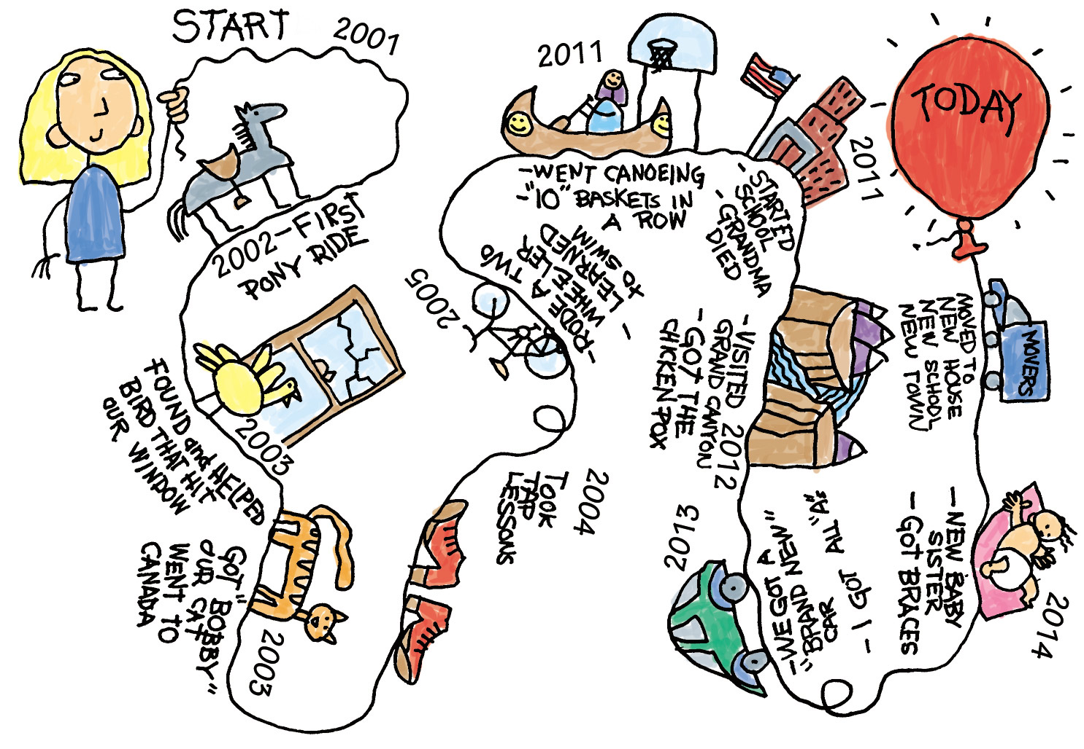
Life Mapping Activity
Notes:
Activity: Life Mapping
Recognising that both groups and individuals go through many twists, turns and changes throughout their life – use your knowledge of the group to decide if this activity will be a relevant / appropriate teambuilding activity.
Life Map encourages the group to draw or create a collage of their life story they can then share with the team.
This kind of deeper getting to know your exercise can really help bring a team together and allow for meaningful self-reflection too!
Materials Required: Paper and Pens/Pencil
Instructions
Set Up
Pass out materials, plan at least 20-40 min for participants to draw their maps, and at least 5 minutes for each participant to share and answer a couple questions.
Directions
This activity allows participants to share their life stories and serves as an ice breaker or getting to know you activity for groups that are newly formed or recently added new members. Each individual draws a "map" of their life starting from birth to the present using symbols to represent significant periods in their life. Many participants will say, "oh I can't draw!" and you can assure them quick stick figures, icons or words where necessary are fine - the point is the sharing not their drawing ability. Note: most people will underestimate how long it will take to share their story, so if you really only have 5 min per person, tell them they have 3 minutes to present, and use a time-keeper.
Alternatives
Draw the map using map symbols only (e.g. stop signs, do not enter, curves ahead, etc.) to represent significant periods in their life.
Create map collages using pictures cut from magazines or found online. Note: allow more time and additional materials for this option.
Activity from - Life map | SessionLab

Slide 30
The Parts that make a Team!
There are many important parts to making a team work.
Think about….
Who?
What?
Why?
When?
How?
Notes:
Activity: Creating a Team Plan
Explain to the group that it would be helpful to have a team plan so that the team are all in agreement about who, what, why, when and how of this project.
You may wish to re-iterate that all answers are valid in this activity and reflect back to earlier discussions about what makes a good team.
Who – Who is in the team, do we all know each other and recognise the skills that we bring?
What – What the team is, and what are we planning to do as a team?
Why – Why is it important? Why is the team doing what it’s doing? What’s the purpose of the group?
When – Timescales of the group, does it have an end-date or will this be a long term project?
How – How are we going to work together? Do the group want to create a group agreement? How the team is going to achieve what it needs to achieve: rules and activities
Facilitator Note: Having a team plan allows a good team to know what they are doing and who is doing what.
It helps a team keep focused on what they are looking to do but also when certain things should be done by.

Slide 31
The Parts that make a Team!
This Photo by Unknown Author is licensed under CC BY-SA
Notes:
Activity: Creating a Team Plan continued. This activity is to pull together a team plan or group agreement.
Continue discussing the Who, What, Why, When and How of the team and ask the team to create a plan.
You may wish to use flipchart paper and post it notes to create a plan or group agreement that you can refer back to as you move through this toolkit.

Slide 32
Empowering Youth Voices
Section 4 - Becoming a social researcher
In this section you will find out about the importance of ethics and trust and explore the skills and personal qualities needed to be a social researcher.
Notes:
Section 4 – Becoming a social researcher
This section covers the importance of ethics and trust and explores the skills and personal qualities needed to be a social researcher.

Slide 33
Becoming a researcher
Research is an amazing approach for allowing us to explore and understand different situations.
By undertaking a piece of research, you will gather thoughts and opinions of other children and young people on a certain topic.
This will allow more children and young people to have their voices heard on matters that affect them.
However, research also has to be approached with the greatest of RESPECT.
Notes:
Activity: Explain to the group that this section will be exploring research, and supporting them to become social researchers so that they can undertake a piece of research their peers.

Slide 34
Introducing Ethics
Notes:
Activity: This video introduces the concept of ethics, which we will cover in this section.
Please Note - We would advise you to watch this video before showing it to the group to determine suitability, as there is a trigger warning for depression and it may not be suitable for younger children.

Slide 35
Becoming a researcher
Ethics & Values
When you are undertaking a piece of research there are a few things to think about before starting...
Keeping data secure.
Not sharing sensitive information.
Consider how you will use the information you collect.
Not changing the meaning of raw data.
Protecting yourself and others.
Notes:
Activity: Reflect on the messages in the previous slide and ask group views on this.
Does this make sense to them?
Explore how would they feel if someone shared sensitive information about them?

Slide 36
Why trust is important in research
Trust is built in very small moments
The sliding doors moment….
There is an opportunity to gain trust and the opportunity to betray trust
Notes:
Facilitator Note: It is important to explain the sliding doors analogy to young people – when undertaking research, there is opportunity to gain trust and the opportunity to betray trust.
You can gain trust, but you can loose it just as quickly. Reflecting on the discussions from the previous slides, perhaps you may wish to share examples on when/how this could happen.

Slide 37
The Marble Jar of Trust
Tell us a time someone gained your trust
Tell us a time when you gained someone's trust
Notes:
Activity: The Marble Jar of Trust
Ask the group to think about a time either when someone has gained your trust or someone has trusted you.
What did they do? Or what did you do?
What did you do to make the person feel safe and secure? Or what did they do?
You may wish to draw out marble jars on paper, or use a real jar and marbles to illustrate this activity. Explain that trust, respect and value are all important to keep your marble jar full.
You will need to consider whether this activity could upset any of your group. Are they able to trust adults?
Further Information: Brene Brown uses the marble jar as a metaphor for teaching that trust is built slowly, over time, and in small moments. This metaphor is based on a story about Brené’s daughter, Ellen, and a difficult experience she had related to trust with her classmates in elementary school. After learning about the marble jar metaphor, students can start to identify what specific behaviors build trust and what behaviors might break trust or empty the marble jar.
There is a short video here: The Lesson Brené Brown's Daughter Learned About Trust | SuperSoul Sessions | Oprah Winfrey Network - YouTube

Slide 38
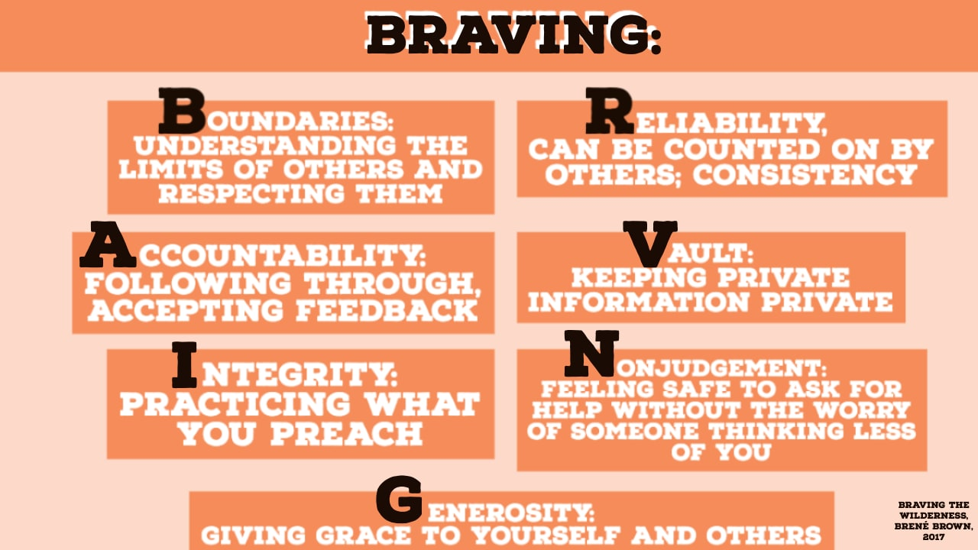
Blank
Notes:
Facilitator Notes: This slide is based on Brene Brown’s Anatomy of Trust.
Prior to this session, you may wish to watch the full length Brene Brown video (23 minutes) here: SuperSoul Sessions: The Anatomy of Trust - Brené Brown (brenebrown.com)
Talk through the acronym of BRAVING and discuss if it makes sense with the group.
Further Information:
BRAVING: An Acronym for Building Trust (from – Brené Brown on What it Really Means to Trust – Mindful)
To talk about trust, Brown uses the acronym BRAVING which stands for: boundaries, reliability, accountability, the vault, integrity, non-judgment, and generosity. Understanding that these are components of trust and how they work can help us really understand how we do or don’t trust others, or ourselves. She says she uses this acronym “because when we trust, we are braving connection with someone.”
Trust is choosing to make something important to you vulnerable to the actions of someone else.
Boundaries - To trust someone, Brown says, it’s essential that we are clear about our boundaries so they can understand and respect our limits. It’s also important that we understand the boundaries of others so trust can flow both ways.
Reliability - Reliability is when someone does what they say they’re going to do over and over again. They can’t just follow through on their word once, Brown says, reliability builds gradually.
Accountability - We trust people who own up to their mistakes, apologize, and make amends, she says. But others can only do that if we allow them. If we immediately write someone off when they make a mistake, or stop talking to them, we don’t give them a chance to step into their accountability.
The Vault - We cannot trust someone if they share our personal information with others without our permission. It needs to be as though that information is in a vault that’s only accessible to the folks we purposely told. By the same token, we need to hold the secrets, stories, and information of other people in confidence so they can trust us. Oftentimes, Brown says, we use gossip as a way to try to quickly find intimacy with someone. We feel like if we can secretly talk about others with them, we have a solid connection. Brown calls this “counterfeit trust.” If we are minding our own business and someone tells us confidential information about someone else, we know we can’t trust them. Others will think the same of us. Brown boils the vault down to: “You respect my story [and] you respect other people’s story.”
Integrity - “Integrity,” Brown says, “is choosing courage over comfort. It’s choosing what’s right over what’s fun, fast, or easy.” Integrity, she says, is more than just naming our values. It’s living according to our values. Integrity is choosing courage over comfort. It’s choosing what’s right over what’s fun, fast, or easy. Plus, when we live with integrity, we not only build trust with others, we build trust with ourselves.
Non-judgment - Non-judgment is about being vulnerable with someone without being judged by them, while they can be vulnerable and not be judged by us. This is hard, Brown says, because we tend to be better at giving help than asking for help. In fact, we tend to feel better about ourselves when we help someone, but think less of ourselves when we ask for help. “You cannot judge yourself for needing help, but not judge others for needing your help,” she points out. That’s what makes true reciprocal non-judgment difficult.
Generosity - Brown says, “our relationship is only a trusting relationship if you can assume the most generous thing about my words, intentions and behaviors, and then check in with me.” Which means that if we make a mistake, others will be up front about it, but assume we had good intentions. This might look like someone telling us that they are hurt that we didn’t call on an important day, but they assume we just forgot or were busy. This gives us a chance to be accountable. And this goes both ways. It’s important that we also check in and leave space for others to be accountable.
How to Trust Yourself
It’s important that we understand the complexity of trust and how to break it down so that we can identify why we do or don’t trust certain people. Instead of feeling stupid or naive for trusting someone when they turned out to be untrustworthy, we can identify what exactly went wrong.
Knowing this can help us build our self-trust, too. Brown gives the example of making a mistake. She says we can ask ourselves if we respected our boundaries, if we were reliable, if we held ourselves accountable, and if we were generous with ourselves.
“Because if braving relationships with other people is braving connection, self-trust is braving self-love. Self-respect is the wildest adventure we’ll ever take in our whole lives,” Brown says. If we don’t feel like we can trust ourselves, we can’t expect others to trust us, because we can’t give others what we don’t have.

Slide 39
Characteristics of a researcher
Notes:
Activity: Characteristics of a researcher
Using paper to draw it out, or in discussion - ask the young people to identify what are the characteristics of a good researcher?
Is it that they are open-minded, sensitive, compassionate?
Or is it that they have a genuine interest in the topic?
Maybe they like data and studying research?
The key is that anybody can be a researcher – as long as they understand the principles of ethics and understand the research methods.
It is important that researchers put the person at the heart – in this case it is important that the researchers have children and young people’s voices at the heart of their research.

Slide 40
Me as a researcher?
We would now like you to think of YOU as a researcher and fill in the boxes below...
Things I would do as a researcher...
Things I would NOT do as a researcher...
Notes:
Activity: Me as a Researcher
Ask the group to complete this activity either individually or together - to identity characteristics which they will have as researchers and those they will NOT have.
This could be on a jamboard (online) or on paper / flipchart.

Slide 41
Empowering Youth Voices
Section 5: Identifying a theme and Research tools
This section will cover different research tools and techniques!
Notes:
Section 5: Research Tools
This section aims to give the group an increased knowledge of tools a researcher needs, and in how to ask questions in research.

Slide 42
Identifying a research theme
You may already have a theme that you will be undertaking research on, this may have been given as part of a consultation request. If this is the case, please provide the group with information on the theme.
If you do not have a research theme identified, please use the next two slides to think about what you would like to do research on – is there a specific area that you would like to hear from children and young people?
Notes:
Notes: If the group have an identified area/theme for carrying out the research please ensure that they are well informed of the topic before undertaking the research.
For example, if the group are undertaking research on poverty, you may wish to share geographical poverty data, budget information, school attainment data etc to give the group an informed view of the topic.

Slide 43
Identifying a theme
These are some ideas of possible research topics.
Mental health?
Future dreams?
Accessing education?
Opportunities available after school?
Help with learning or exams?
Places to meet up or play?
Groups or clubs?
Notes:
Notes: If the group do not have a pre-identified theme , you may wish to use these slides to help identify a possible research theme. You may wish to refer back to section 1 and 2, talking about children and young people's right to be heard on matters that affect them to help decide on a topic.

Slide 44
Identifying a theme
Write down your theme ideas which you think are important for your setting, school, community or area.
Notes:
Notes: If the group do not have a pre-identified theme , you may wish to use these slides to help identify a possible research theme.

Slide 45
Research tools
The role of a researcher is like being a detective …
But remember you have to work out how valid each piece of evidence is ☺
Notes:
Activity: Discuss with the group why as researcher you need different pieces of evidence to help inform your thinking.
All the above are different tools which a researcher can use to gain further information on a topic. When undertaking a piece of research, we need to think about how valid and truthful our evidence sources are. Valid means when an idea is tested and proven, it is not just a person’s opinion and remind young people that everything on the internet is not always true or fact! You might want to talk about times when people have read something and believed it to be true and ask the group if they have examples of this.
Explore with the group the pros/cons, and how valid each one of these examples are:
Books?
Research in books?
Social media?
Search engines eg google?
Newspapers? Is there a difference across different newspapers?
YouTube?
Hearing from something from someone else?
Watching a video
Discuss: What might be the best approaches for using with your identifed theme and why?

Slide 46
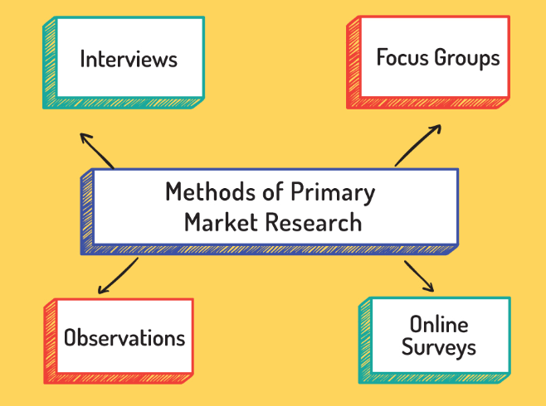
Researcher techniques & ideas
Have a think about what approaches you like best and why.
Notes:
Notes: Researcher Techniques
In pairs or a small group, do some research online about different researcher techniques.
Think about which approaches you like best and why.
Pick out one or two which you think you could use in your group to help with finding out more about your theme/ question.
Further information:
Questionnaires are frequently distributed via email, in-person, or post. This method of research works well when researchers already have some knowledge (and they might want to explore further) or they want to ask a more specific set of questions. They could ask open-ended questions which allow people to express their full ideas or closed questions that are questions with limited answers.
Interviews are one of the most popular primary research methods of gathering information. Respondents are invited to share their opinions on questions, ideas, products, etc. They can be one-on-one or small group interviews.
Surveys allow researchers to gather primary data from a large number of people all at once. They can be conducted through online, paper-based questionnaires, interviews, and focus groups.
Focus groups: this where researchers have small groups meet and discuss a topic in an informal setting.
Focus groups can also be likened to a group interview where one person leads the questions, and a few people are express their thoughts and opinions openly. When doing focus groups, the researcher needs to think about the diversity and experience of people involved in the group.
Observations are be done by watching people complete an activity, speaking with them about their experiences, or conducting interviews to obtain more relevant data. The reserachers don’t ask questions, they just observe what’s going on around them and record this.

Slide 47
The power of questions
Asking the right question can be tricky
By “right” we mean asking a question that doesn’t lead people to the answer that you are looking for…
or a question that doesn't confuse people or ask them to answer more than one thing at a time.
Activity: What is a good question?
Look at the 3 questions below
Read them aloud, within your group.
As a group decide what is the best question? And why?
Remember about ethics, why are you asking this and is it safe for someone to answer?
Do you think there should be school?
Describe what school is?
What is your experience of school?
Notes:
Notes: The power of questions
Follow the activity on the slide – they need to decide which question they like the best and why
Depending on the size of your group, you could split them into smaller groups for discussions.
Try and get them to explore what types of answers they could get from the questions; another question to ask them in order to illustrate the difference between the questions being asked is ‘how would they answer each of the questions?’. How did each question feel?
Discussion points - how important a question wording can be and the needs to be clear. People can take lots of different meanings from the same question if it is not asked in the right way.
You should always be considering what is it you are trying to find out from your questions and does everyone understand the question in the same way
Consider if the questions ethical and whether people are able to answer them using the approach you are using to ask the questions? Eg someone might answer differently in a focus group with their HT or family compared to answering using an anonymous questionnaire.

Slide 48
Styles of questions
1
2
CLOSED QUESTION
OPEN QUESTION
A question that only allows people to answer yes or no.
Allows people to answer in their own words.
1
2
?
CLOSED OPEN
DID YOUR GROUP PICK AN OPEN OR CLOSED QUESTION?
Notes:
Notes: open and closed questions
Explain the concepts of an open and closed question.
Now consider the questions on the previous slide and decide if they are open or closed questions. Which did you pick as the best question?
Closed and open ended questions can both suit your purposes depending on what information you are looking to explore with your participants. They have different purposes.
Closed-ended questions are appropriate in situations where you're looking for a quick, definitive answer, but they're not conversation starters.
When you're looking for an explanation or a rich level of detail, you'll want to use questions that are open-ended.

Slide 49
The difference between open & closed questions
GOOD OPEN QUESTION
BAD OPEN QUESTION
GOOD CLOSED QUESTION
BAD CLOSED QUESTION
Notes:
Notes: The difference between open and closed questions
Think of the aspects of good open and closed questions as well as bad open and closed questions and write them on slide above. There is information below which will help you with this.
If appropriate, you could ask your group to come up with good and bad closed/ open questions.
Further Information:
Good research questions should:
Read the questions out loud to see whether the wording is natural or can be improved.
Be focused on a single topic or very closely related topics
Keep language simple and questions short. If you need to explain anything, avoiding leading the respondent to any particular answer.
Avoid using jargon, acronyms, abbreviations and specialist terms.
Be specific when you ask about factors like frequency, so saying “daily”, “more than once a week” and so on, rather than “regularly”.
Test understanding and clarity of the questions on someone who is not involved in the research and who can look at it with fresh eyes. Try to ensure that you seek views from a mixed group of people of the kind you will be inviting to take part in the research so that you can find out early which questions work as you intended and which need revision. For example, ask some people in your class what they think of the questions.
Make your method of research accessible for everyone. How can you make sure everyone has the opportunity to answer your questions if they want to?
However you need to avoid:
Avoid double barrelled questions – questions which have two questions within them! Eg Do you think school is exciting and worthwhile? This is asking if the person thinks school is exciting but it is also asking if the person thinks school is worthwhile. The person could have two different answers to each of them
Avoid leading questions: Eg people can be drawn towards something that looks like the “right” answer. For this reason it is important to avoid suggesting one response is more desirable than another. Do not lead them by descriptions such as “People at Stirling PS love their school. How much do you love Stirling PS?”
Avoid asking too many questions as people get bored and then stop responding truthfully or at all

Slide 50
Empowering Youth Voices
Section 6: Undertaking research
In this section you will finalise the details of the research and carry it out!
Notes:
Section 6: Undertaking Research
Using our skills as a team and as researchers to see what children and young people think and what we can do to make a difference.

Slide 51
Thinking about a theme
From everything we have discussed, what has STUCK with you most?
Name at least 1 thing you want to know more about
Why?
Notes:
Notes:
This activity will help the group to identify certain areas of the topic that they wish to conduct research on - pick one of the themes that the group previously decided.
This may have been pre-identified, or identified on slides 43/44.
Spend 10 minutes doing some research on this theme – encourage the group to find out what information already exists on the topic.
The group can do this by using digital devices, asking adults, doing some reading or asking other children and young people.
Support the group to take some notes and then answer the boxes above based on what they found out surrounding their research.

Slide 52
Thinking about the research in our setting
How many people would you like to speak to?
What help do you think you might need?
How would you like to speak to them?
Notes:
Notes: thinking about research
Discuss these questions with the group:
If we are doing research on an important topic how many people should we speak to?
In what ways do we need to speak to them?
What help do you need to do this and make it easier?
Write answers from the group/class on a board or piece of large paper.
Highlight that research works best when a wide range of views are gathered and there are inclusive ways in which this is done.
Also research works best when not done alone, doing research with others makes it faster and more likely to be successful.

Slide 53
Mind map your ideas and actions
Questions we want to ask others?
What ways are we going to use to involve others in our research? Questionnaire? Focus group?
Theme
What is our plan to carry out our research?
Notes:
Notes: mind map the ideas
Either on an online jamboard or flipchart, do a mindmap pulling the group ideas together.
Remember this is about asking questions on this theme and what children and young people could do to improve this.
You may wish to refer back to the team plan, and now consider:
Who is doing what?
When is the best time to do it?
What is the best tool? Focus groups? Questionnaire on paper or using Google Forms?
When do we want it finished by?
Who and how are we going to collate the results?

Slide 54
Are our questions working for us?
Think about what kind of questions you would ask on a theme and if they make sense
Best way to check is ask someone who isn’t in your group.
If you ask someone within your group, they already know what things you are hoping to hear...
Look and see if they offer a mix of open & closed questions.
Can everyone answer them, especially if you are not there to help?
Notes:
Notes: Working out the questions
Based on the theme, support the group to come up with some questions that they would like to ask to conduct the research.
Ask the group to think about if they make sense and what type of questions they are. Can everyone easily understand and answer them?

Slide 55
Testing your questions…
Think about your target audience and identify who you would like to test your questions with.
Now it’s time to test your questions!
Notes:
Notes: Testing the questions
If possible test these questions out on other children and young people who aren’t involved in the group.
Do the questions work? Do you get answers that help your research?
Ask the group to come back and feedback to everyone on the results they got.

Slide 56
Confirm your final questions
It’s now time to confirm your final questions and research methods.
Notes:
Notes: Confirm the final questions
Write down the questions you have agreed that you want to ask others based on the theme. Did you change any of them based on feedback?
What types of other research methods are you going to do? How do you know these will work well?

Slide 57
It’s time to do the research!
You’ve identified the topic,
decided on the research methods,
and the questions you want to ask…
Now go ahead and carry it out!
Notes:
Notes: Do the research!
Now it’s time to put being a researcher into practice! Support the group in carrying out research on the identified theme.
Give the group the opportunity to ask their peers the questions they have came up with and also to collect information surrounding this theme.
As this requires the group to go and conduct this work we advise that you allow some time between this session and the next session for research to take place.

Slide 58
Empowering Youth Voices
Section 7: Analysing results and action planning
​In this section you will learn how to analyse the results of your research​ and explore ways to put the results of your research into action.
Notes:
Section 7: Putting what we have learned all together
Learning how to analyse the results of your research
Problem solving ways to put the results of the research into action

Slide 59
Looking at qualitative results
First things first, we need you to look at the research and do the following steps…
In the answers, look for things that are ‘similar’ comments. You may want to colour code these, we call them ‘themes’.
Now count/tally how often the ‘theme’ ‘similar comments’ are made.
The more times it’s said, the more important it is to the people you spoke to.
And the more often it was said, the greater focus it should have within your evidence and results.
- Can you find the key themes in your results?
Notes:
Notes: Qualitative Results
Follow this slide and support the group to look at the qualitative results and identify any similarities and themes.

Slide 60
Looking at quantitative results
Count how many times ‘yes’ or ‘no’ were said.
Then look at the total participants and work it out as a percentage.
The total participants answering ‘yes’ divided by the total number of participants, then times that number by 100.
– did you get a higher percentage of yes’s or no’s?
Notes:
Notes: Quantitative Results
Support the group to look at the quantitative results and identify any similarities and themes. Discuss if there are any results that surprise the group?

Slide 61
Analysing your results
Answer the following questions from your research:
How many people were involved in your research? Numbers according to age and gender if relevant?
Would it be helpful to use any graphs to illustrate the responses to your questions, particularly any closed questions?
Are there any themes to the responses to the questions you asked?
Is there a difference in how different groups of children answered the questions? For example in terms of gender, age, etc
Notes:
Notes: Analysing your results
Support the group to consider how they are going to analyse your results. - this could be on paper, or by using an online tool to collate the results.
It could be that some people would like to look at the numerical data and draw graphs, and others will like to look at the answers to the open ended questions and pull out any themes.
Encourage the team to work together and share out the roles as required.

Slide 62
What next?
Now we have all this information and research, what next?
Notes:
Notes: Agreeing next steps
This slide gives time to open up the discussion with the group on how they can use the research to make things better at school and/or in the community.
Young people may wish to creatively conclude their research results, such as making a poster with the results, filming a short video or writing a blog post about the research conclusions.

Slide 63
Let's make a plan!
Question | Answers
What do you want to change?
Why is it important to change this?
How will you know the change has been a success?
Actions to get there:
Support we need to make it successful:
Notes:
Notes: Making a plan
This activity gives space to create the final plan on what you are going to do.
Young people could draw out a table like this one and work together to answer the questions.
For your action plan it may be useful to think about:
Your aim – what are you wanting to change?
Why you feel this is important?
How will we know its been a success?
Actions?
Support we need to make it successful

Slide 64
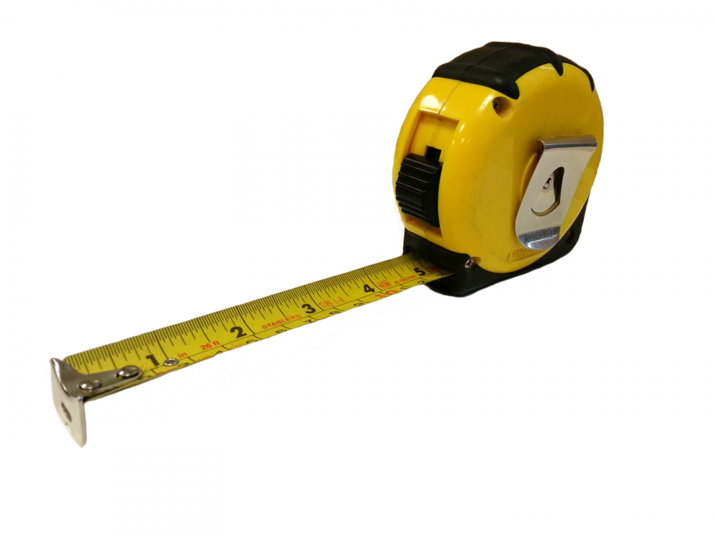
Keeping people informed
WHO?
REGULARLY MEASURING YOUR IMPACT
WHY IS FEEDBACK IMPORTANT?
Notes:
Notes: It is important to have a feedback loop to the people that you involved in your social research and tell them what you are going to do as a result of speaking to them.
This is important because it means that people will feel their opinions are valued, they will feel a sense of belonging in terms of what you are doing next and they are more likely to participate in more research again.
They will also be more likely to want to be involved in anything you are doing next because they have a sense of ownership because they have been included in the decision making.
Discussion Activity:
Explain to the group why it is important to feedback to people on what you have found out and what you are going to do about it.
ask why they think it is important to do this? See info below for concepts to consider sharing
who do they think they need to feedback to? And what is the best way to do this?
do you need to consider how often you will feedback on the action plan/ project work?

Slide 65
Presenting the research results
Notes:
Notes: Presenting the Research Results
Now you have reached the end of this resource - Depending on the topic, the group may have different ways that they wish to present their findings.
This may be by hosting an event, speaking to local authority officers or heads of establishments, writing a report, making a presentation or poster.
Agree with the group how they would like to present their findings and who they would like to share them with – this may be a good opportunity to link with the local authority & regional youth voice development groups.

Slide 66
Template Slides
If you already have a topic identified, you may wish to use these blank template slides to add in information on the topic as appropriate.
Notes:
If you already have a topic identified, you may wish to use the blank template slides at the end of this toolkit to add in information on the topic as appropriate.

Slide 67
Template Slides
If you already have a topic identified, you may wish to use these blank template slides to add in information on the topic as appropriate.
Notes:
If you already have a topic identified, you may wish to use the blank template slides at the end of this toolkit to add in information on the topic as appropriate.

Slide 68
Template Slides
If you already have a topic identified, you may wish to use these blank template slides to add in information on the topic as appropriate.
Notes:
If you already have a topic identified, you may wish to use the blank template slides at the end of this toolkit to add in information on the topic as appropriate.

