Slide 2
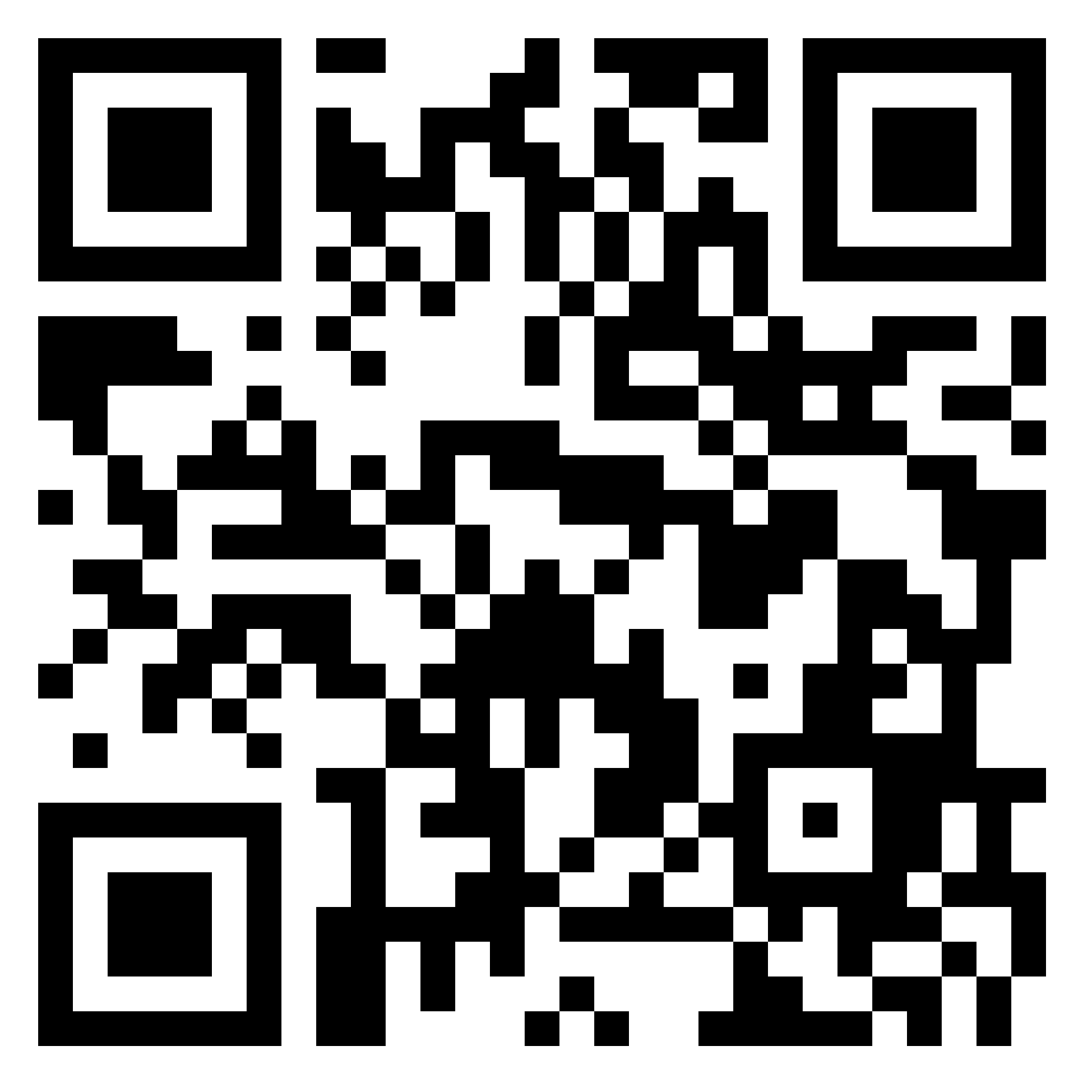
Achievement
When was the last time you achieved something?
How did it make you feel?
Notes:
https://padlet.com/juliebeckett1/achievement-project-iq1ououb8rgus6nx

Slide 3
Achievement Project Outcomes
Investigate how children and young people’s personal achievements, beyond the formal school curriculum, are currently recognised and recorded across schools and community learning and development (CLD) providers.
Identify ways to share and support practice across schools and CLD providers.
Project approach focused on 5 Key Questions.
Notes:
How do schools and their CLD providers currently recognise children and young people’s personal achievements (out with the formal curriculum)?
The findings indicate a strong commitment across schools and CLD partners to recognising and recording all children and young people’s achievements. There are some examples of very effective practice. Gaps identified were around the lack of awareness of opportunities available; the focus on school-based activities only; and the tendency for some schools to focus only on awards recorded on Insight.
What support do children and young people have, in school and in their communities, to reflect on and record their own personal achievements?
The findings indicate that all participants recognised the importance of children and young people having ownership of their own achievements and the skills developed in their own personal learning journey. Some use local methods to record this in the absence of a nationally recognised approach to record achievements,
What data do all providers currently gather at a local level? To what extent are individual children and young people’s achievements tracked?
The findings indicate an inconsistent and disconnected picture meaning that the full range of children and young people’s personal achievements are not currently being fully recognised. The data sources referenced by participants included: Insight data (schools); local schools gathering their own achievement data; performance management data (CLD teams); data gathered by youth award providers; and national youth award completion figures reported annually by the Awards Network. Disconnected systems are creating challenges for both recording and sharing data between schools and CLD providers.
What effective practice and/or professional learning can be shared / adopted across the region by schools and CLD providers?
The findings indicate that establishments where youth work and school partnerships were strongest, offered the greatest range and depth of achievement-based opportunities and youth awards. There were some good examples of co-design of achievement opportunities, with young people and between schools and CLD partners. Participants identified a range of professional learning needs for both school and CLD practitioners. The National Youth Work Outcomes and Skills Framework was seen as an increasingly valuable tool for both CLD and schools to use together.
How could this pilot inform national discussions?
The partners involved identified key national policy and practice developments and reforms. They committed to using the findings from this project to inform their contributions to those developments.

Slide 4
Achievement Project Report Location
The report marks a piece of research conducted by Education Scotland with the support of key stakeholders.
It can be found on the Education Scotland website within the Practitioner Resource area and in the Knowledge and Research sub section.
Notes:
How do schools and their CLD providers currently recognise children and young people’s personal achievements (out with the formal curriculum)?
The findings indicate a strong commitment across schools and CLD partners to recognising and recording all children and young people’s achievements. There are some examples of very effective practice. Gaps identified were around the lack of awareness of opportunities available; the focus on school-based activities only; and the tendency for some schools to focus only on awards recorded on Insight.
What support do children and young people have, in school and in their communities, to reflect on and record their own personal achievements?
The findings indicate that all participants recognised the importance of children and young people having ownership of their own achievements and the skills developed in their own personal learning journey. Some use local methods to record this in the absence of a nationally recognised approach to record achievements,
What data do all providers currently gather at a local level? To what extent are individual children and young people’s achievements tracked?
The findings indicate an inconsistent and disconnected picture meaning that the full range of children and young people’s personal achievements are not currently being fully recognised. The data sources referenced by participants included: Insight data (schools); local schools gathering their own achievement data; performance management data (CLD teams); data gathered by youth award providers; and national youth award completion figures reported annually by the Awards Network. Disconnected systems are creating challenges for both recording and sharing data between schools and CLD providers.
What effective practice and/or professional learning can be shared / adopted across the region by schools and CLD providers?
The findings indicate that establishments where youth work and school partnerships were strongest, offered the greatest range and depth of achievement-based opportunities and youth awards. There were some good examples of co-design of achievement opportunities, with young people and between schools and CLD partners. Participants identified a range of professional learning needs for both school and CLD practitioners. The National Youth Work Outcomes and Skills Framework was seen as an increasingly valuable tool for both CLD and schools to use together.
How could this pilot inform national discussions?
The partners involved identified key national policy and practice developments and reforms. They committed to using the findings from this project to inform their contributions to those developments.

Slide 5
1. How do schools and their CLD partners currently recognise children and young people’s personal achievements (out with the ‘formal curriculum’)?​
Almost all schools and CLD practitioners felt that achievements out with school should contribute to what educational success looks like for children and young people.​
The types of achievement recognised by schools were mostly activities offered through school, including sports, drama, art, music and environment groups and pupil councils.​
Recognition of achievement appeared to be more established in schools where there are designated staff with responsibilities for promoting and developing achievement​. Schools with direct involvement with CLD providers have a stronger recognition of achievement that occurs out with the school building. ​
“Schools are accepting that the journey in youthwork is part of attainment.” ​
“You sometimes feel like we’re being asked by the schools to go in and patch over the cracks, and they don’t engage as we’d like in conversations about learning goals and attainment.”

Slide 6
2. What support do children and young people have, in school and in their communities, to reflect on and record their own personal achievements? ​
The findings indicate that all participants recognised the importance of children and young people having ownership of their own achievements and the skills developed in their own personal learning journey. Some use local methods to record this in the absence of a nationally recognised approach to record achievements.
Youth awards provide a recognised route for acknowledging achievement that is utilised by both schools and CLD providers.​
The Youth Work Outcome and Skills Framework by YouthLink Scotland has been used successfully in some youth work situations to allow skills mapping and reflection.​
Partnerships are crucial to provide achievement opportunities. ​
Notes:
The findings indicate that all participants recognised the importance of children and young people having ownership of their own achievements and the skills developed in their own personal learning journey. Some use local methods to record this in the absence of a nationally recognised approach to record achievements,

Slide 7
3. What data do schools, local authority CLD teams and their partners; and national youth awards providers currently gather at a local level? To what extent are individual children and young people’s achievements tracked?​
Data sources referenced by participants that record children and young people’s achievements out with the formal curriculum were Insight, school and CLD provider data, local authority performance management systems, third sector and national youth award completion figures.
The differences and gaps between data sources demonstrated that the achievements of children and young people are not fully realised across the system.​
All participants agreed that disconnected systems create challenges for both recording and sharing data between schools and CLD providers​.
“We’re not really working together to record progress and achievements.”​
Notes:
Data sources referenced by participants that record children and young people’s achievements out with the formal curriculum were:​
Insight data - schools recognised that Insight does not support the capture of a board range of achievement opportunities ​
Some examples of schools and their partners gathering local data ​
Local authority CLD area teams performance management data​
Data provided by 3rd sector youth award providers – only some broken down by local authority. ​
National youth award completion figures reported annually by the Awards Network​

Slide 8
3. Continued – A review of Insight Data
Schools are more likely to recognise and value children and young people’s achievements through youth work when they result in awards or Insight tariff points:​
“It’s been a journey for schools to recognise non-accredited attainment”​
“There’s too much focus on stats.”​
Insight data is only capturing a small percentage of youth awards being achieved by children and young people.​ Nearly all schools recognised that Insight does not support the capture of a board range of achievement opportunities or youth awards.
Beyond Insight: Several schools gather data on participation in achievement opportunities and use this data to target learners who live in areas of deprivation.

Slide 9
4. What effective practice and professional learning can be shared and adopted across the region?​
Achievement opportunities are most successfully embedded in schools and CLD when there is a lead practitioner responsible for its implementation. ​
Most schools lacked knowledge and confidence in providing youth awards.​
Some schools are keen to partner with CLD providers to embed and create opportunities, and work together to develop a means of evidencing impact of participation. Potentially using the Youth Work Skills and Outcomes Framework. ​
More consistent ways of gathering and tracking data could be shared across schools and CLD providers to ensure children and young people's achievements are captured and recognised throughout their learning journey. ​
Notes:
The findings indicate that establishments where youth work and school partnerships were strongest, offered the greatest range and depth of achievement-based opportunities and youth awards. There were some good examples of co-design of achievement opportunities, with young people and between schools and CLD partners. Participants identified a range of professional learning needs for both school and CLD practitioners. The National Youth Work Outcomes and Skills Framework was seen as an increasingly valuable tool for both CLD and schools to use together.

Slide 10
5. How will our regional pilot inform regional and national messages?
The partners involved identified key national policy and practice developments and reforms. They committed to using the findings from this project to inform their contributions to those developments.
It’s our Future: Independent Review of Qualifications and Assessment ​
Fit for the Future: developing a post-school learning system to fuel economic transformation ​
Scottish Attainment Challenge: framework for recovery and accelerating progress​
Scottish Government’s review of Insight​
Ongoing work with Education Scotland’s Curriculum Innovation team to co-design new approaches to help learners gather evidence on achievements – in school and in their communities – using e-portfolios
Notes:
the expected new national youth work strategy ​
Work being done by Education Scotland’s Curriculum Innovation team to co-design new approaches to help learners gather evidence on all their learning achievements – in school and in their communities – using e-portfolios​
the national Youth Work Outcomes & Skills Framework developed by YouthLink Scotland​
ongoing work by The Awards Network to gather data on the impacts of youth awards​
National Key Performance Indicators (KPis) developed by CLD Managers Scotland​

Slide 11
Recommendations
​Schools should seek to designate an educator, such as a DHT, PT, or teacher with additional duties, with responsibility for leading on developing and promoting achievement opportunities and increasing staff awareness of youth awards
Schools should also have a member of staff with responsibility for linking with CLD providers, youth work and youth award partners
Schools and CLD providers should develop local collaborative partnerships to support the development of achievement opportunities and youth awards. This should involve staff upskilling, shadowing and practice sharing opportunities at a local level. Partnership agreements should be co-designed and regularly evaluated
Schools and CLD partners, including youth work providers and youth award providers, should work together to build a common language to recognise children and young people’s personal achievements – in school and in their communities
Schools should use tracking tools to monitor who participates in achievement opportunities to better target which children and young people are not involved, especially those who would benefit the most

Slide 12
Recommendations
Schools should consult with children and young people to identify types of personal achievement opportunities that pupils would like to see offered, for example by conducting an annual census
CLD providers and schools should work on developing approaches to allow children and young people to reflect on, record and recognise their achievements consistently. This should include creating time and space to allow children and young people to routinely articulate, share and celebrate their achievements within and out with school
This pilot has demonstrated that the Youth Work Outcome and Skills Framework is a valuable tool to support shared planning and evaluation between youth work partners and schools. It also allows for accurate and meaningful skills mapping for children and young people. Professional learning and support in FVWL to increase awareness and use of the Framework should be a priority
Around half of schools are already using a range of innovative approaches to recognise and celebrate some of children and young people’s achievements. There is scope for schools and their partners to share learning on this
The Awards Network should provide a regional feedback opportunity regularly to RICs surround the data they gather and share. Awards Network partners should capture postcode data to ensure accuracy of specific local and regional information

Slide 13
Our Actions
In Forth Valley and West Lothian we will:​
Share findings and practice via regional webinar​ and support
Using the pilot findings to inform the priorities in the FV&WL RIC ​
Cross-sectoral professional learning: upskilling practitioners in personal achievement-based opportunities​
Professional learning and support to utilise the Youth Work Outcome and Skills framework.
Nationally we will:​
Share findings with Scottish Government policy teams ​
Inform direction of national work around measuring attainment; Profiling; and the 'value' placed on achievements​
Feed findings into the review of Insight and other steps towards education reform​

Slide 14
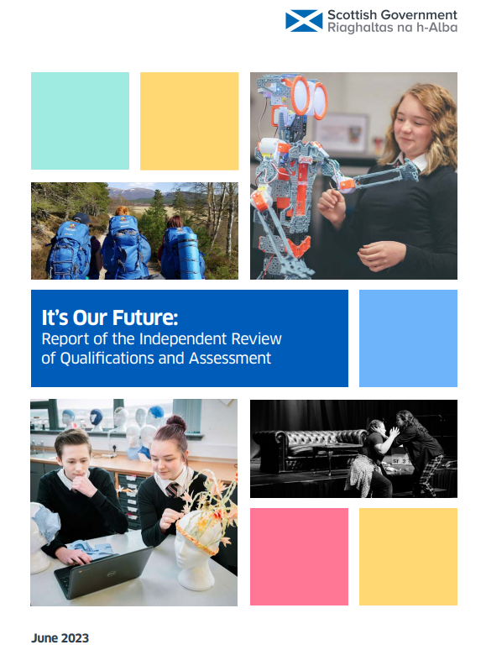
It’s Our Future: Report of the Independent Review of Qualifications and Assessment
“To ensure that the importance of this area of work is recognised, is well co-ordinated and has status, a promoted post should be established for those leading this work in schools and colleges.”
“While information on learners’ out-of school achievement would be valuable if dependable, it should not be collected by teachers as this would provide added pressure to an already heavy workload.”

Slide 15
Attainment and Achievement – learning from youth work and school partnerships
Marielle Bruce
Youth Work & Schools Manager
YouthLink Scotland
The national agency for youth work

Slide 16
YouthLink Scotland
Scottish Attainment Challenge national programme
Our intended outcomes:
As part of the education system, young people have access to effective support and learning through youth work both in school and in their communities, which is improving outcomes and accelerating progress towards tackling the poverty-related attainment gap
Sustainable, effective collaboration between youth work and schools.
The education system recognises and values young people’s achievements and development of skills, including opportunities for learning in the community and/or in collaboration with youth work.

Slide 17
Youth Work and education
Alongside schools, youth work improves the wellbeing, readiness to learn and educational outcomes of children and young people
https://www.gov.scot/publications/pupil-equity-funding-national-operational-guidance-2023/
Youth work offers young people opportunities for personal learning and achievement, within school and in the wider community. Personal learning helps young people to develop knowledge, attitudes and skills for learning, life and work. This can be an important pathway to support engagement and raise attainment within the context of the SAC.

Slide 18
Recognising Achievement: Views of young people in the National Discussion
Over 700 young people taking part in youth work said:
Youth work is part of their education
It helps them engage with learning
The relationship with a youth worker is key and the non-formal, youth work approach
Youth work helps young people develop CfE capacities
And ‘life relevant’ skills
83% of young people said their skills, qualities, experiences and achievements gained through youth work were very important or important to their future
88% of young people said their skills and achievements through youth work should be recorded and acknowledged alongside formal qualifications

Slide 19
Recognising and Recording Achievement in Forth Valley and West Lothian:
Reflections on Practice from Youth Workers and Young People Participating in Youth Work
Youth workers believe they help young people to notice and value a wide range of personal achievements.
Both youth workers and young people say that some of the most important steps that young people take in youth work – especially early in their youth work journey – are acknowledged and celebrated in a youth work setting.
Youth workers value the focus and structure offered by youth awards and SQA accredited qualifications to support learning and recognition of achievement. However, other approaches and tools are needed too:
“We only use accredited learning where it’s appropriate – gaining accreditation is never the purpose – it’s primarily about the skills.”

Slide 20
How do youth workers support young people to recognise their learning and achievements?
Youth workers build trust that enables honest, open conversations about progress
Youth workers are trained to gather careful observations of young people’s progress
Youth workers are skilled at structuring and facilitating reflective learning opportunities for young people in a range of creative ways
Youth workers encourage and enable young people to build reflective learning habits (the structure of youth awards also helps with this)
Youth workers celebrate young people’s individual and collective successes
Frameworks such as National Youth Work Outcomes and Skills Framework and Youth Awards

Slide 21
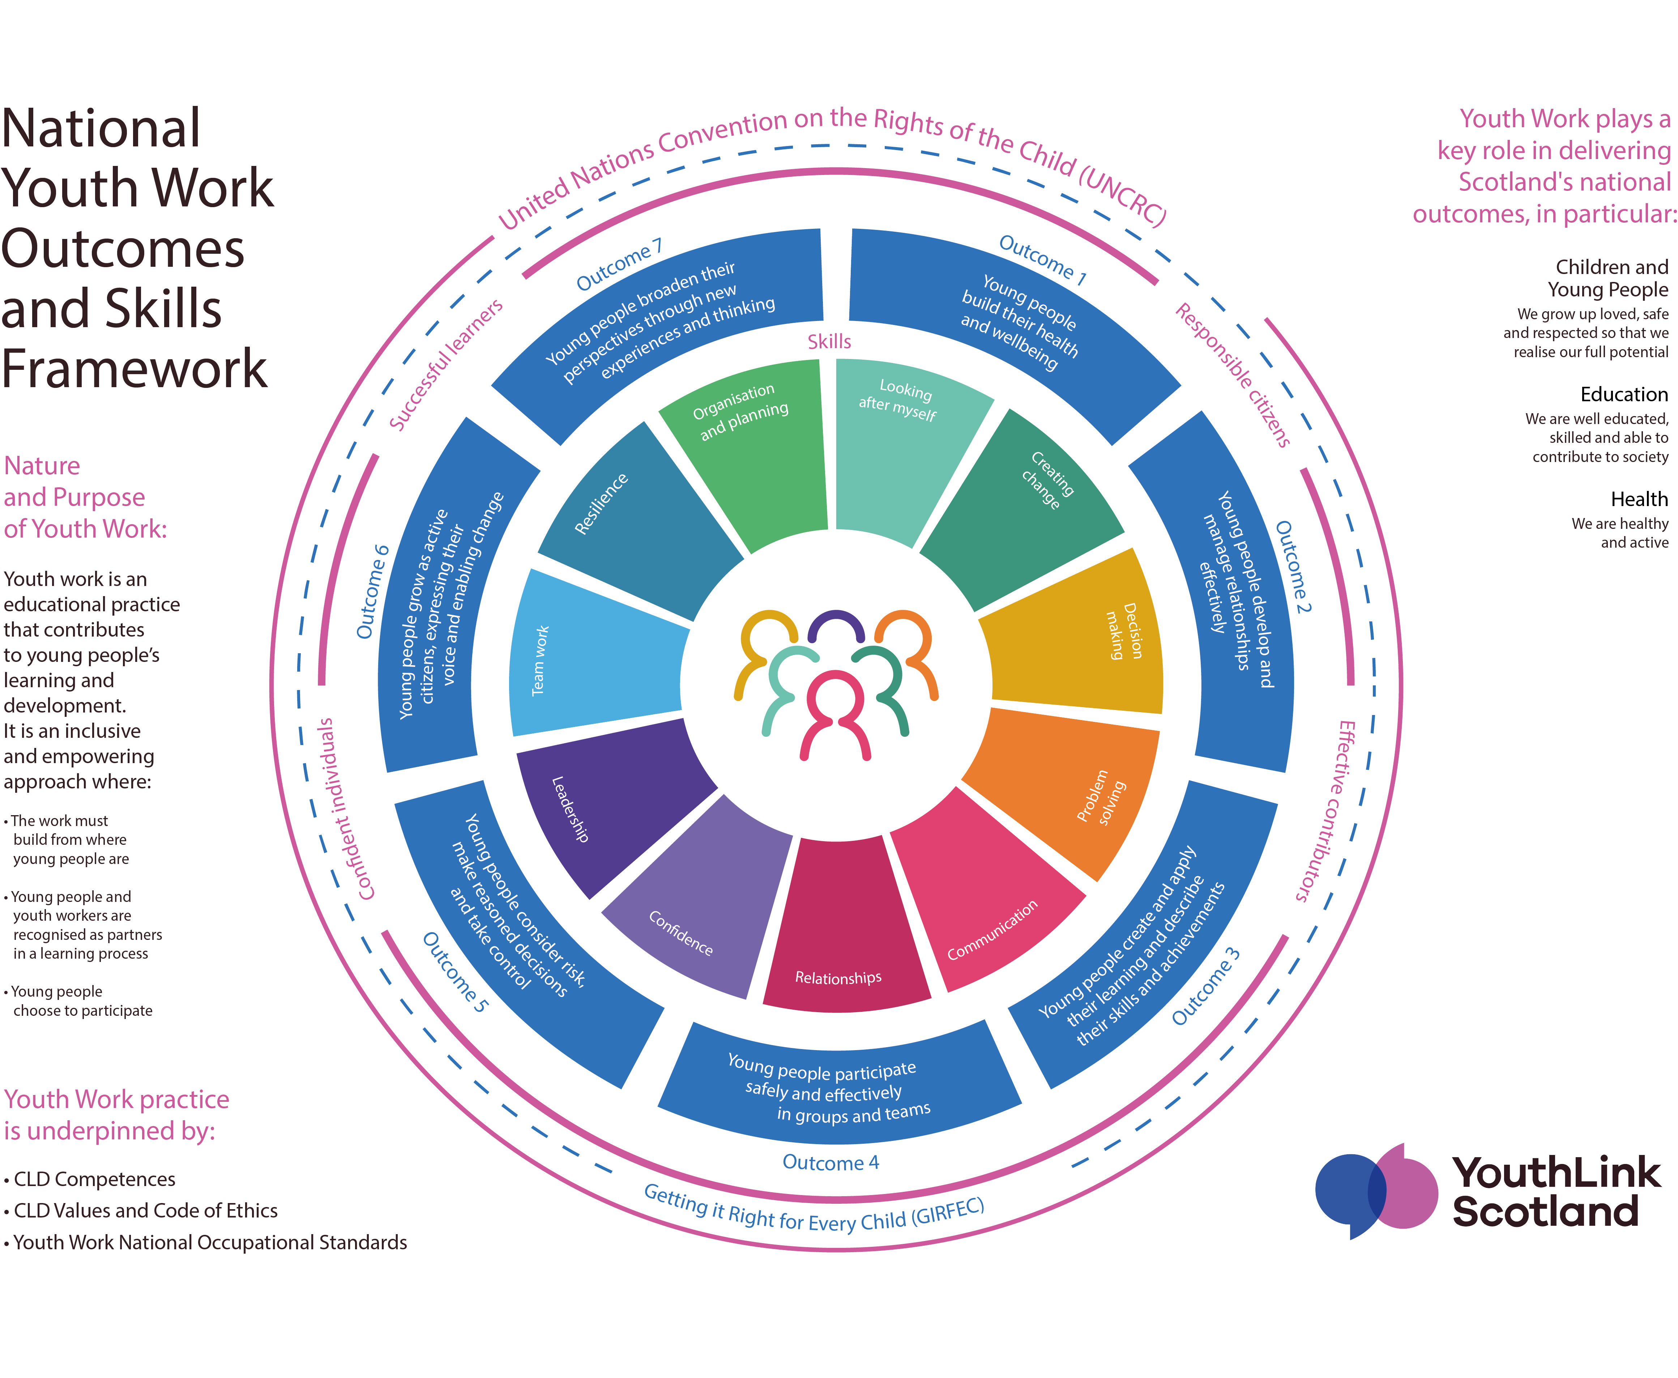
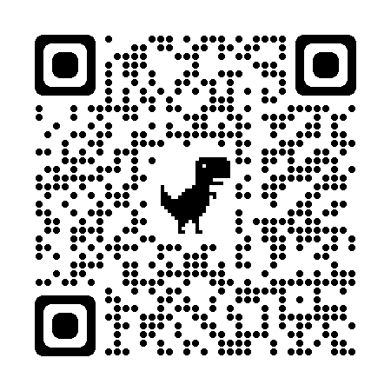

Slide 22
National Youth Work Outcomes
Young people build their health and wellbeing
Young people develop and manage relationships effectively
Young people create and apply their learning and describe their skills and achievements
Young people participate safely and effectively in groups and teams
Young people consider risk, make reasoned decisions and take control
Young people grow as active citizens, expressing their voice and enabling change
Young people broaden their perspectives through new experiences and thinking

Slide 23
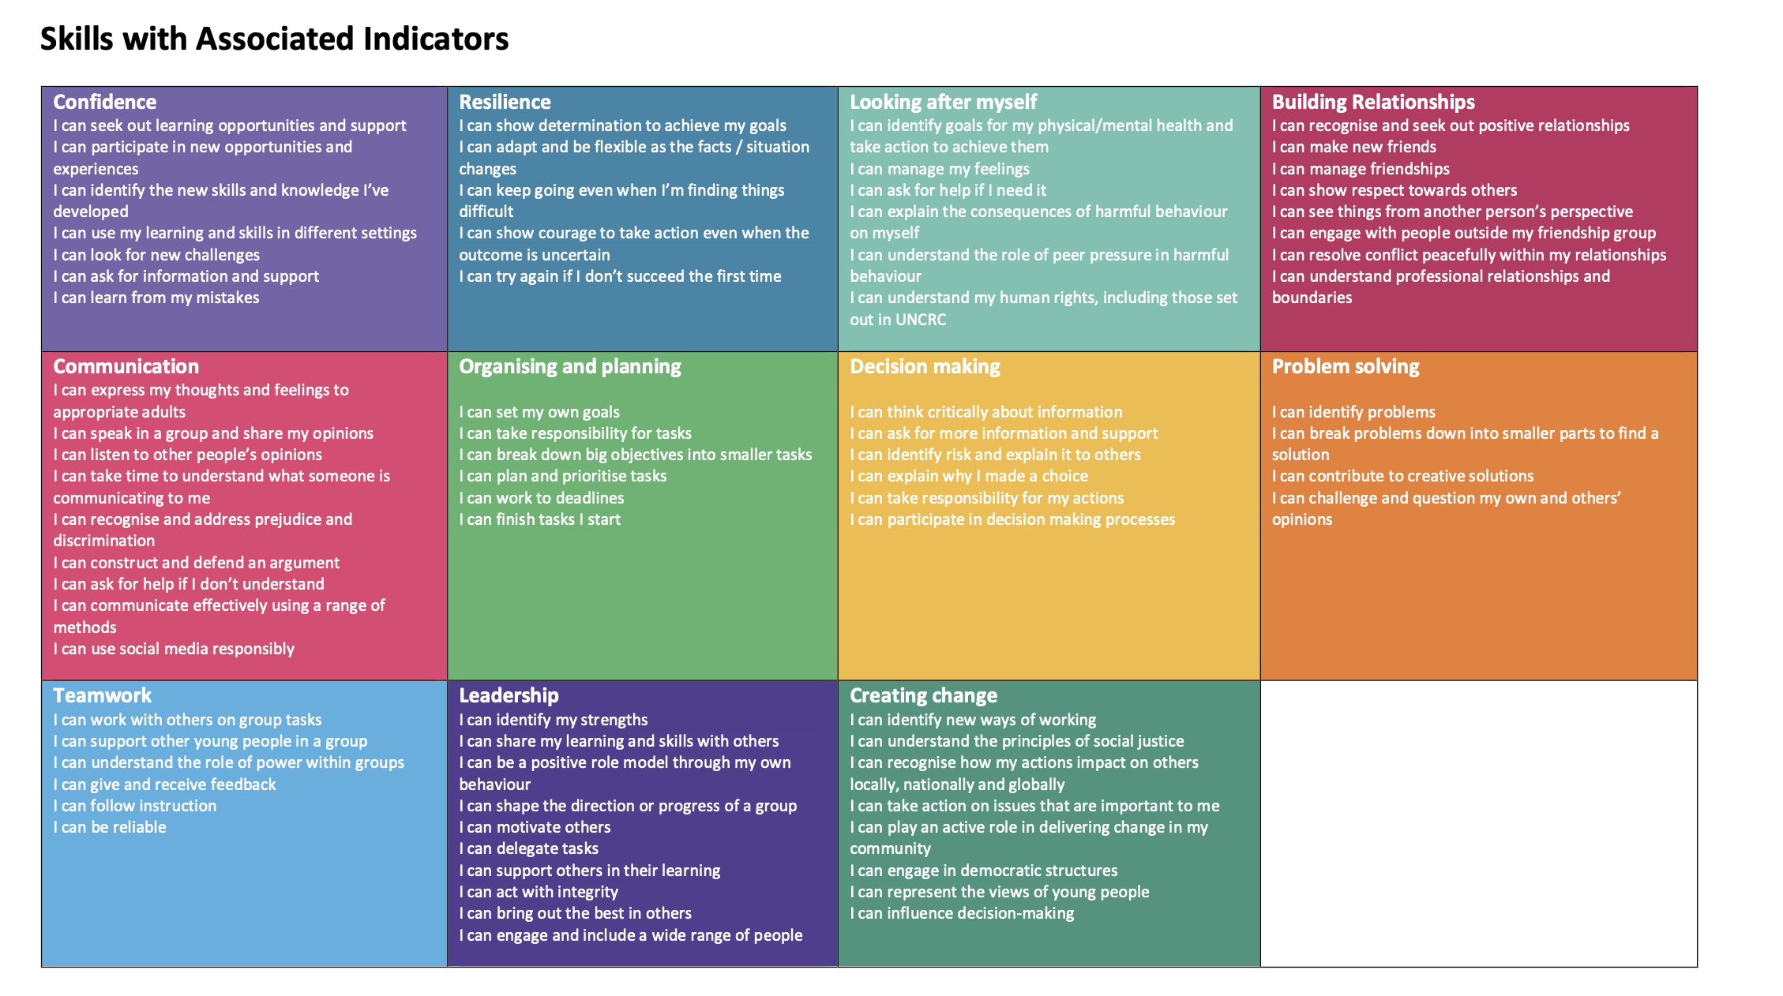
Youth Work Outcomes & Skills Framework | YouthLink Scotland

Slide 24
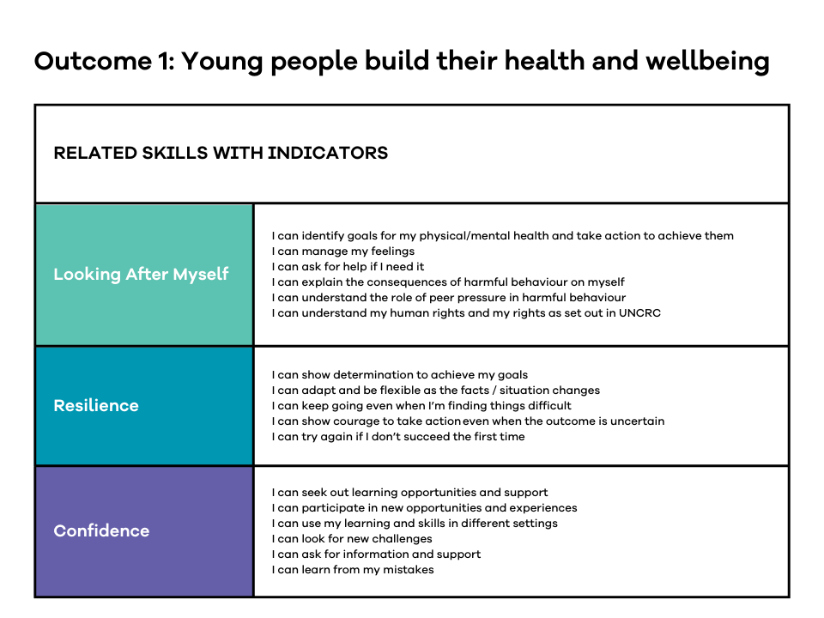

Slide 25
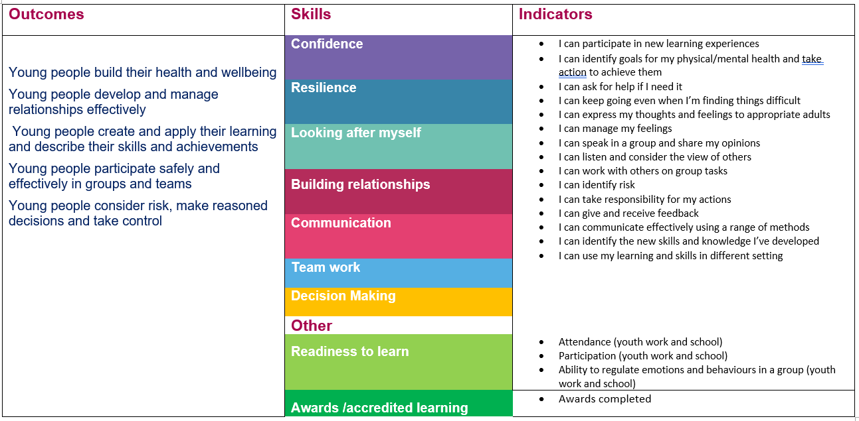
Tracking achievement in partnership with schools
Notes:
NB this is the subset of outcomes, skills and indicators that we’re using for the West Partnership dashboard pilot – the partnerships worked together to agree on the skills and indicators that felt more relevant to all of them in the targeted work they are doing…you could put this with the slide on the west partnership stuff if you like?

Slide 26
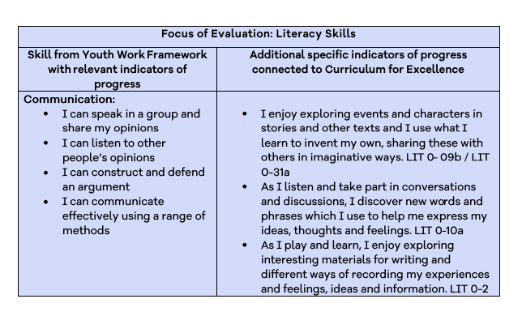
Other Outcomes

Slide 27
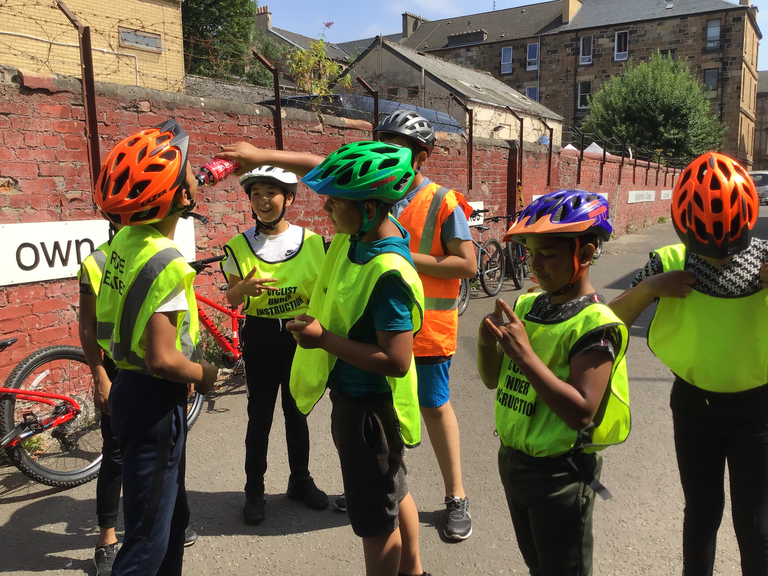
Evaluation Principles in Youth Work
Young people at the centre
Strengths-based.
Collaborative
‘Done with’ not ‘done to’
Focused on learning
Notes:
Whatever our measures – the process of evaluation needs to happen in a way that is aligned with the youth work values and approach – not surveys or tick boxes. The process of evaluation should support reflective conversations with young people that help them to notice and articulate the progress they are making.

Slide 28
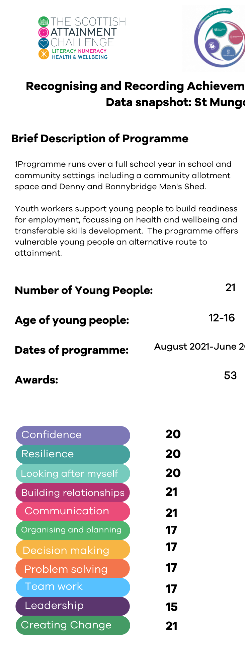
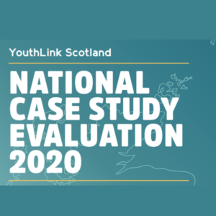
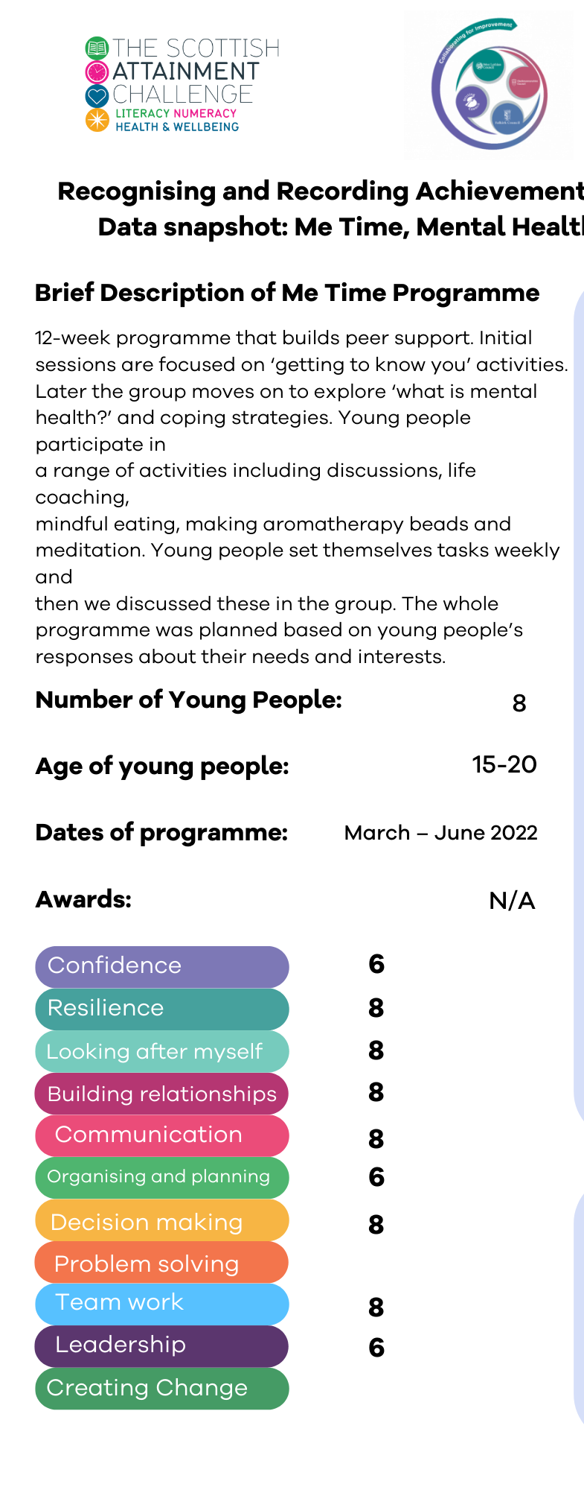
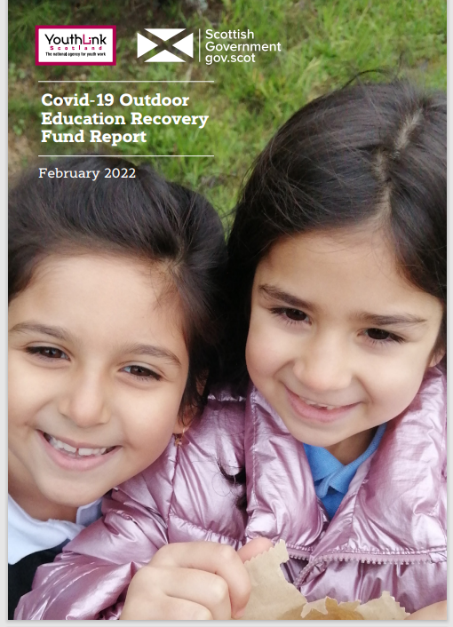
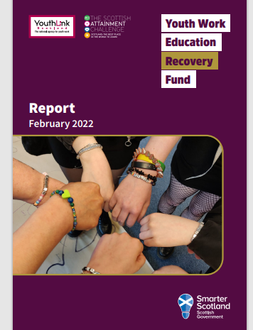
Sharing Stories of Achievement
Notes:
Having a common language for tracking achievement means that we can build a collective picture of young people’s of achievement across school and community settings – and across geographies – we were able to do that successfully in 2022 with youth work projects across Scotland for the Youth Work Education Recovery Fund and…we’re currently working on a couple of interesting pilots to further develop the approach…

Slide 29
Place-based approach
In Alva, Clackmannanshire, the learning community we’re piloting a skills-based approach to tracking achievement across youth work and school settings, structured around the National Youth Work Outcomes and Skills Framework.
Notes:
In Alva, Clackmannanshire, the learning community we’re piloting a skills-based approach to tracking achievement across youth work and school settings, structured around the National Youth Work Outcomes and Skills Framework. We’re working with the school team local youth work organisation OYCI and aiming to take a youth-led approach to tracking achievements over this school session

Slide 30
What young people in Alva are saying…
“It would be better for me to have a conversation about this – easier than writing.”
“If young people supported young people you could have more one-to-one conversations about this which would be better – you learn a lot more when it feels personal.”
“Being able to look back to when you were in S1 and track your skills from there would give you confidence.”
“If all of my progress – from football, from Columba and other things was in one place, I’d see it clearer and it might give me more goals.”
Notes:
When we spoke to young people in Alva Academy about using the framework as a tool to, they really saw the value and were really thoughtful about how this could be implemented so it is meaningful to them. What they said about ‘the how’ aligns with our principles around doing evaluation in a youth work way – ie young people at the centre, collaborative, focused on learning

Slide 31
Regional approach
With the West Partnership regional improvement collaborative, we’re working with 5 youth work and school partnerships to pilot a simple new dashboard that will collate evidence of impact, structured around key outcomes and skills from the National Youth Work Outcomes and Skills Framework.
Notes:
With the West Partnership regional improvement collaborative, we’re working with 5 youth work and school partnerships to pilot a simple new dashboard that will collate evidence of impact, structured around key outcomes and skills from the National Youth Work Outcomes and Skills Framework. Once we’ve piloted the dashboard, we’ll work with the Education Scotland CLD Team and the RIC’s Wellbeing for Learning Workstream team to gather data from a wider range of partnerships across the West Region. YouthLink Scotland is also working with JP Morgan through their ‘Force for Good’ programme to build more comprehensive and bespoke dashboard software that encompasses the whole Outcomes and Skills framework. We’re hoping to trial this though a ‘readiness to learn’ evaluation that our Youth Work and Schools team will be undertaking in late 2023.

Slide 32
Youth Work and Schools – Professional Learning Resources
New Resources
Evaluation Principles in Youth Work
Step-by-Step Guide
Templates

Slide 33
Making connections
Kate Somervail – Duke of Edinburgh Award
Tila McDonald – Awards Network

Slide 34
Discussion
Opportunities, Challenges and Connections?
Notes:
How would these work in your setting?
https://padlet.com/juliebeckett1/achievement-project-iq1ououb8rgus6nx
https://padlet.com/juliebeckett1/achievement-project-iq1ououb8rgus6nx

Slide 35
Support from Education Scotland?
Notes:
Professional learning- how do we do it?
How will this complement existing priorities within your setting and across the RIC? How do we embed this across the RIC?
Support to implement?

Slide 36
Please share your details on a contact form! Contact us: Jamie.Dungavell@educationscotland.gov.scot Julie.beckett@educationscotland.gov.scot
Notes:
Practical tools, readiness checklist, capacity for change, offer from us / gauge interest? – capture this?contact sheet.

