Slide 1
Guidance
The content of this presentation is suitable for learners at second level and beyond.
There are notes to accompany each slide and to help facilitate discussions (including for the true or false quiz)
Where possible, try to make links to your school and community context to make the presentation and relatable and relevant to your learners.
The focus should be on the wider benefits of attending school such as friendships, wellbeing, skills – rather than the academic benefits.

Slide 2
Attendance Matters

Slide 4
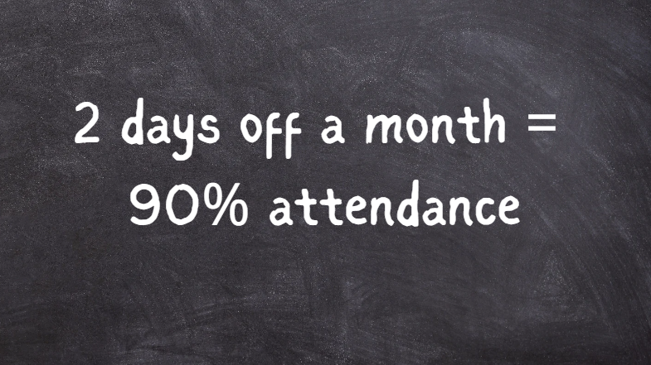

Slide 5
Notes:
2 days off a month = 90% attendance TRUE – this adds up to almost 4 weeks of lost learning across a whole school year and almost 120 hours of learning. If you have 90% attendance every year from the start of primary school by the time you reach s3 you will have lost over 1 year of education.

Slide 6
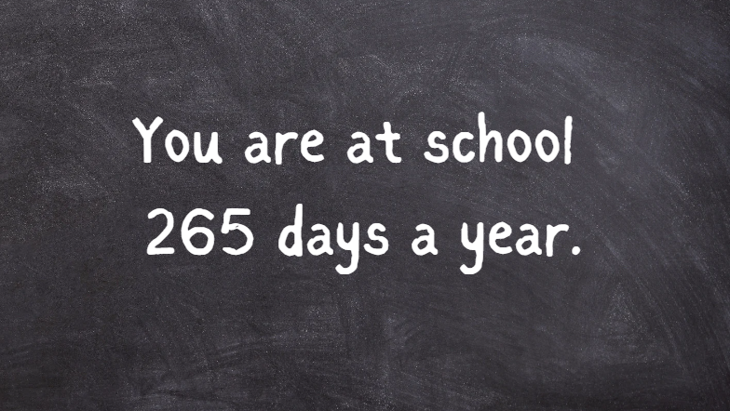

Slide 7
Notes:
You are at school 265 days a year. FALSE – Scottish pupils attend school 190 days per year. That gives you 175 days where you are not in school. This is equivalent to just over half of your time (52%) in one year spent in school, meaning you have lots of time the rest of the year to do other activities.

Slide 9
Notes:
Attendance only matters at secondary school. FALSE – good attendance in the early years gives pupils the best chance of success in the future and sets up good habits and routines. Everything that you learn in primary school is a building block for what you will learn in secondary. If you miss lots of time in primary school then some of those building blocks will be missing.

Slide 11
Notes:
Being late for school is an attendance problem. TRUE – regularly missing the start of the school day soon adds up to lost learning time.

Slide 12
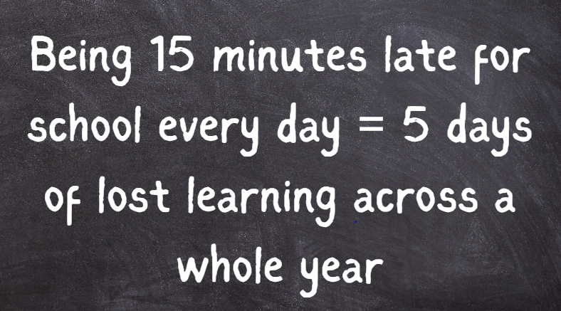

Slide 13
Notes:
Being 15 minutes late for school every day = 5 days of lost learning across a whole year. FALSE – It equals almost 10 days of lost learning. *** Show late data on the next slide.

Slide 14
If a child is 5 minutes late a day they miss
25 minutes per week
1 hour 40 minutes per month
5 hours per term
16 hours 5 minutes per year (equivalent to over 3 days)
If a child is 10 minutes late they miss
50 minutes per week
3 hours 20 minutes per month
10 hours per term
32 hours 30 minutes per year (equivalent to over 6 days)
If a child is 15 minutes late they miss
1 hour 15 minutes per week
5 hours per month
15 hours per term (around 3 days)
48 hours 45 minutes a year (equivalent to over 9 school days)

Slide 15
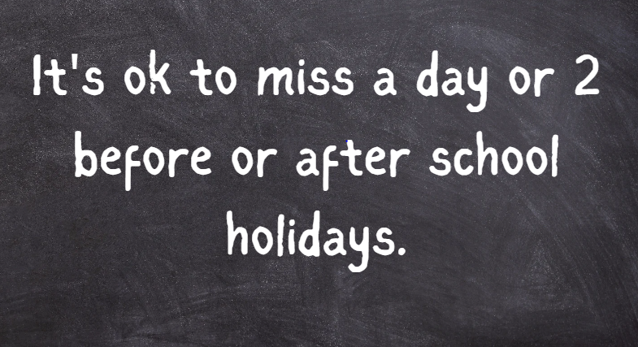

Slide 16
Notes:
It's ok to miss a day or 2 before or after school holidays. FALSE – research from England shows that pupils who miss the first days back after a holiday are more likely to be frequently absent.

Slide 18
Notes:
Learners who attend school regularly are likely to live longer. TRUE – attending school regularly is associated with many benefits in adulthood and greater life expectancy is one of them. Can pupils think why this might be?

Slide 19
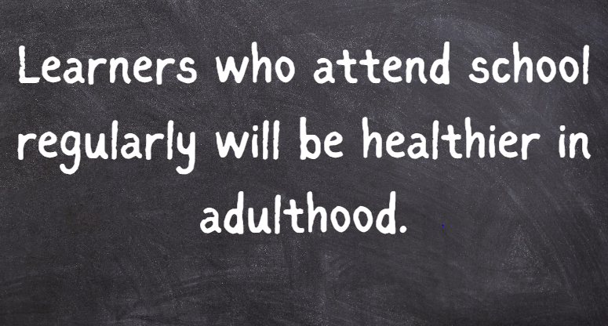

Slide 20
Notes:
Learners who attend school regularly will be healthier in adulthood. TRUE – attending school regularly is linked to better mental and physical health in adulthood. Education helps you to understand ways to stay healthy such as regular exercise, nutritious food. Education also helps you to develop strategies to deal with challenges, meaning you are less likely to suffer from mental health conditions. Having access to an increased amount of disposable income means that you can afford to buy healthier foods and access facilities such as gyms/ swimming pools etc to support maintaining your physical health.

Slide 22
Notes:
It is ok to miss school if you are avoiding a subject that you don't like e.g maths/ PE. FALSE – There is no safe ‘threshold’ for attending school. If you really dislike a subject then you should speak to an adult about why you dislike it and ask for help. Trying hard with subjects that you find challenging helps you to develop resilience and perseverance, which are great skills to have for the future.

Slide 24
Notes:
Attending school regularly improves your chances of getting a well-paid job when you leave school. TRUE – learners who attend school regularly have a much greater chance of having a well-paid, secure job when they leave school. Also, the more you attend school the greater choices available to you when you leave school.

Slide 26
Notes:
We learned at home during the COVID pandemic so staying at home and learning online now is acceptable. FALSE – there are many benefits to attending school to learn such as developing social skills, working collaboratively to learn, access to resources to support learning, direct support from adults when you need it.

Slide 27
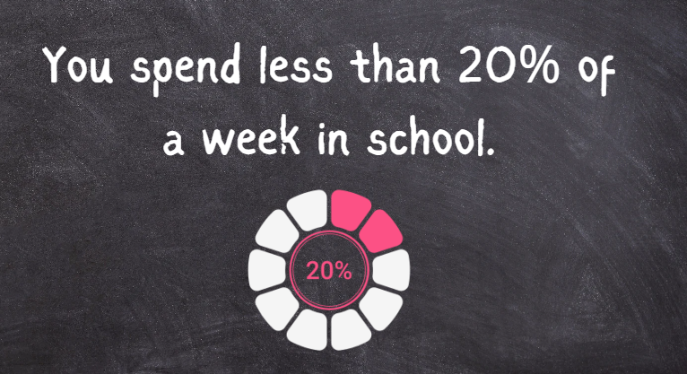

Slide 28
Notes:
You spend less than 20% of a week in school. TRUE. It is actually less than 15%. There are 168 hours in a week and you spend 25 hours in school in primary and 27 hours in secondary.
Ask pupils if there was anything within the quiz which surprised them. Did anything make them think differently?

Slide 29
What do you want for your future?
What do you need to get there?
Notes:
Discussion task.
Allow learners to discuss what they would like for the future. This does not only mean what job they might like to do, but also what kind of opportunities and lifestyle they would like e.g being able to travel abroad, being able to have a season ticket for their favourite football team, having a nice house etc.
Pupils should also consider what do they need to get the things they want – money, education, skills.
Allow opportunities for pupils to feedback following the discussion.

Slide 30
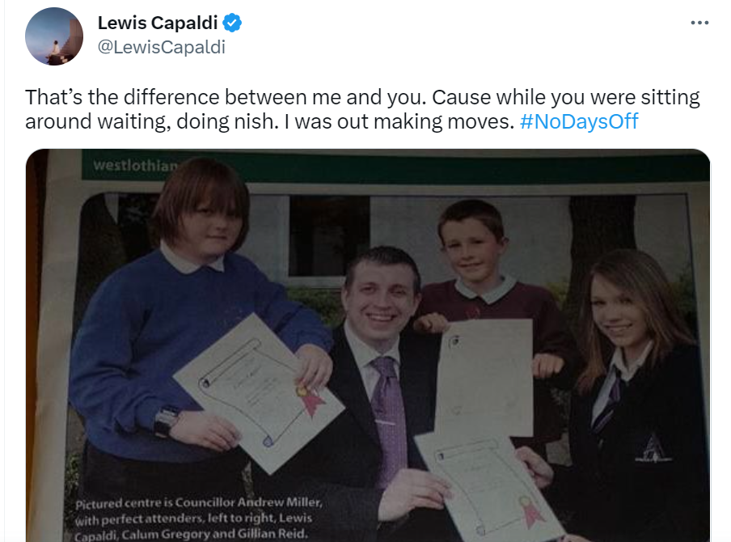
#nodaysoff
Notes:
Ask pupils if they recognise anyone in the pictures.
Lewis Capaldi was given an award for having had no days off at primary school – 100% attendance.
Consider the success and achievements that Lewis has had. Would this have been the same if he had been frequently absent from school? What positive habits/ behaviours do you think that school helped him to develop which helped him to be so successful later on in life?

Slide 31
Why does attendance matter?
Notes:
Ask pupils to share their thoughts.
If most answers focus on getting a good job or having money, ask pupils to consider if there are any other benefits to attending school besides getting a well paid job when you leave school.

Slide 32
friendships
skills
habits
values
pathways
health and wellbeing
experiences
belonging
Notes:
Click through each of the stars (8 in total) and discuss how attending school contributes to each of these. Some ideas are given below, however you can link these to your own school context.
Friendships – many adults are still friends with people they went to school with. When asked about what is good about school many young people talk about friends as being a very important part of their school experience.
Skills – not just knowledge, but transferrable skills that you will use throughout your life such as collaboration, communication, creativity, critical thinking
Habits – positive habits such as perseverance (or resilience), effective use of time management, taking responsibility for your actions, developing independence, setting and achieving goals
Values – link to specific school values
Pathways – greater opportunities for a range of choices when you leave school
Health and wellbeing – mental and physical, link to data within the quiz
Experiences – school camps, outdoor education, trips, in school learning opportunities
Belonging – being part of a school community helps prepare you to be part of a bigger community/ global citizen as you grow and become an adult. School should be a place where people beyond your family care for you and want you to be the best that you can be.

Slide 33
Imagine if …
A bus doesn’t start their job on time
In the school nativity – there is only 1 wise man because 2 didn’t want to come
A heart surgeon decides to take the day off to stay at home and play the X Box instead of going to work
The school dinner lady decides to take a day off because she can’t be bothered coming in
The top goal scorer for your favourite team only turns up when it is a home match because they don’t like travelling
Notes:
Click through each scenario in turn and ask pupils to think about the consequences of each.
Do pupils recognise why the values, attitudes and habits around good school attendance will transfer beyond their years in school? And how they could have a significant impact on their lives as well as the lives of others.
Link to world of work – what will employers be looking for in terms of behaviours and attitudes? Time keeping, working set hours, responsibility. What would happen if these were not in place?

Slide 34
What happens when you miss school?
Notes:
Ask 1 pupil to volunteer to carry out a drama activity and 1 pupil to leave the room.
The pupil who is doing the drama activity will then be taught how to wash an elephant.
Guide the pupil through mime actions on how to wash an elephant;
Wash the ears – front and back
Wash the trunk in a circular motion
Wash the tusks
Clean the body and legs on one side
Clean the tail
Clean the body and legs on the other side.
Invite the pupil who has been out of the room back in and ask the pupil who remained to demonstrate what they learned without talking. The pupil who left the room has to try to work out what the lesson they missed was.
Discuss with pupils what the intention of the drama activity was – i.e it is hard to catch up when you are off school. What is the impact of being off school on learners and on the teacher?

Slide 35
What can you do?
routine
sleep
talk
organisation
responsibility
help
Notes:
Click through each of the stars (6 in total) and discuss how pupils can achieve better attendance. Some ideas are given below, however you can link these to your own school context.
Routine – go to bed and get up at the same time each day, have a morning routine – get dressed, eat breakfast, brush teeth
Sleep – ensure quality sleep, go to bed at a reasonable time and minimise devices/ screen time in the hour before going to sleep
Talk – if you have any issues about attending school talk to a trusted adult who can help
Organisation – be prepared with what you need for school in advance, have your snack, PE kit etc ready the night before
Responsibility – take responsibility for getting to school (if possible)
Help – can you help others get to school on time? If a friend is always late, could you offer to walk with them so that they have to be up and ready for when you arrive?

Slide 36
Notes:
Think about the messages within these posters.
You would go to school if your life depended on it – it does.

Slide 37
Notes:
Discuss the meaning of this quote.
Any issues/ situations/ problems that you encounter – can be solved through education.
Examples
Racism
War/ conflict
Bullying
Gender stereotyping

Slide 38
Notes:
Song/ rap video on attendance. Click on picture to go to the video.

