Slide 1
Supporting attendance through effective assessment
HEATHER MCLEAN, STIRLING EDUCATIONAL PSYCHOLOGY
JACQUI WARD, EDUCATION SCOTLAND

Slide 2
The context
WHAT IS MEANT BY SCHOOL ATTENDANCE?
Attendance is “participation in a programme of educational activities arranged and agreed by the school”
Scottish Government 2007, p4
Scottish Government, 2019

Slide 3
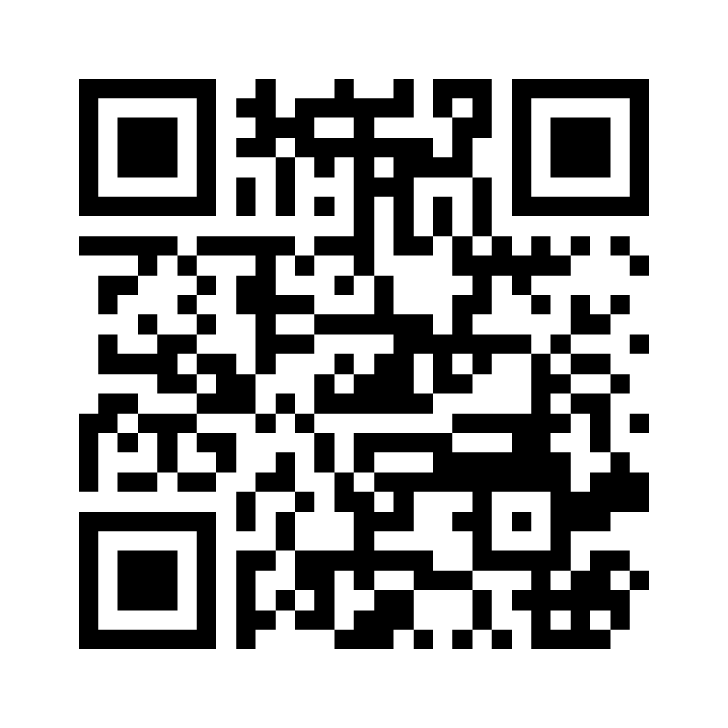
Mentimeter
What terms do you use/have you heard to describe challenges with school attendance?
Go to Menti.com
Enter the code 8663 3251
https://www.menti.com/aluhr5me3s5p
Attendance terms - Mentimeter

Slide 4
Language matters – moving beyond within child models
School refusal behaviour
We need to consider:
Avoiding situating the problem within the child
Language which infers blame
Are we pre-empting?
Being curious
What do young people tell us?
Baker and Bishop (2015), Elliot and Place (2019)
School non attendance behaviour
School phobia/truancy

Slide 5
A range of behaviours observed
CYP rarely leaves their bedroom
Prolonged absence
Increased sporadic absence
Notable pattern of absence
Occasional absence
from school
Missing a small number of lessons
Being late to school
Hertfordshire Council, 2021, Thambirajah et al 2008
Can include occasional avoidance or full attendance with distressed behaviour at home

Slide 6
Underlying risks and reasons for school attendance challenges
Individual
The underlying reasons are usually multifactorial
Home
School
(e.g. Baker and Bishop, 2015, Havik et al 2015,
Ingul et al, 2018)

Slide 7
Underlying reasons: some examples
Individual | Home | School
Illness Mental health difficulty e.g. anxiety Experiencing separation difficulties Being at a transition point Experiencing difficulties with learning | Ill health within the family Changes in the family setting Loss and bereavement Being a young carer Availability of other peers | Bullying The curriculum Transition supports Transport Relationships
Further examples: Tina Rae (2020), West Sussex Council (2022)

Slide 8
Considering resilience and the protective factors
Individual
What strengths and resources are already there?
Home
School
e.g. West Sussex Council (2022)

Slide 9
The response to intervention model
Kearney and Graczyk (2014)
Tier
three
Intervention for those already displaying a school non attendance problem
Tier
two
Targeted support for students at risk of an attendance problem
Tier
one
Universal promoting attendance and prevention

Slide 10
Early intervention and prevention
LOOKING AT DATA
Considering thresholds
Exploring patterns
Looking through a variety of lenses
Poverty
ASN
Vulnerable groups

Slide 11
Early intervention and prevention
Young people at the centre
THE SCHOOL CLIMATE
Parents and carers
Hearing the voices of all in the community to consider key factors including:
The environment including felt safety
Relationships with and among staff
Relationships among peers
Curriculum
Participation
(e.g. see Lauchlan, 2003, Ingur et al. 2019,
Pellegrini, 2007, Kearney and Graczyk, 2014)
School staff
Partners and the wider community
Consider climate surveys
ThingLink

Slide 12
Targeted assessment and intervention

Slide 13
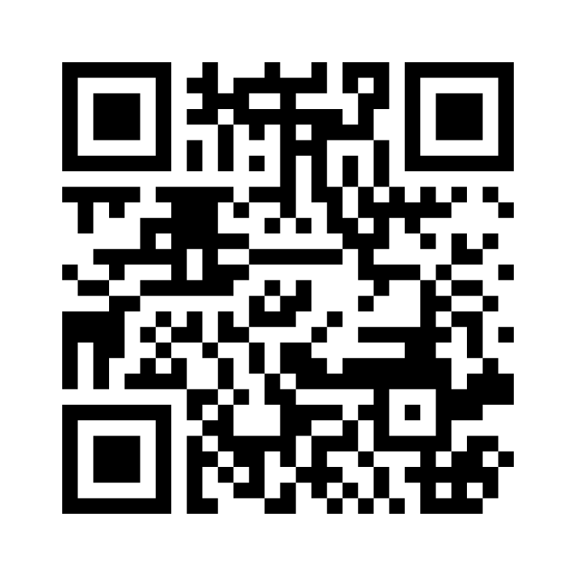
Mentimeter -
What assessment processes are you already using?
Go to menti.com
Enter code 8122 4569
https://www.menti.com/alzut66oy4h2
Assessment attendance - Mentimeter

Slide 14
A functional approach to assessment
A functional approach to non-attendance such as the model proposed by Kearney (2001) may provide a way forward. Kearney and Silverman (1990) developed a model which suggests that the possible reasons CYPs may be reluctant to attend school can generally be categorised into four main areas:
A
The CYP wants to avoid things at school that make them feel anxious or depressed
B
The CYP wants to avoid difficult social situations or to avoid being evaluated
C
The CYP wants to gain attention from parents / caregivers
D
The CYP wants to gain tangible rewards outside of school

Slide 15
Assessment - a dynamic process
Step 1
Gathering Information
Step 2
Clarify Function
Step 3
Planning supports

Slide 16
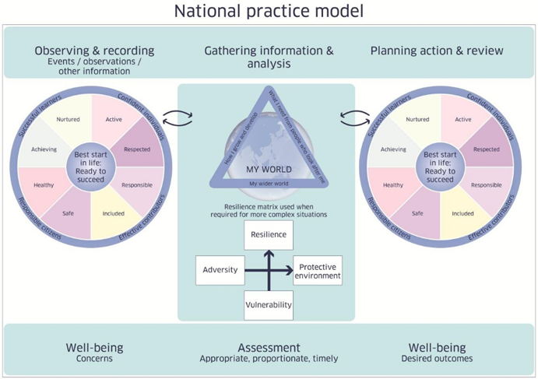
Keeping the young person’s voice at the centre
Scottish Government, 2022

Slide 17
Push and pull factors
School | Home
PUSH Towards attending school | PULL Away from school
PULL Away from school | PUSH Towards staying at home
e.g. West Sussex Guidance, 2022

Slide 18
Some ideas for assessment with young people
Exploring personal strengths e.g. strengths cards
Myself as a learner Scale (MALS)
Exploring the function of non attendance
School Refusal Assessment Scale – R (C)
Particular assessments e.g. Spence Anxiety Scale
Exploring risk and resilience e.g. School Wellbeing Cards (Dr J Holder)
Graphing the journey
Exploring the learning context
Red, amber, green timetable
Emotional thermometers/scales
Maps of school/talk though of school day
Drawing the ideal school
Consider carefully other Additional Support Needs which may impact on gathering views

Slide 19
Further ideas for assessment
Parent versions of questionnaires e.g. SRAS-R, Spence Anxiety Scale
Round robin of staff with key questions
Liaison with key staff from transition
Assessments of learning to consider progress in curriculum
Analysis of school reports
School connectedness questionnaires
Key questions for parents e.g. Sunday night/Monday morning (see Herts, 2021, Rae, 2020)
Parents as collaborators e.g. Drawing the ideal Safe School (Dudley EPS, 2020)
Consider when multiagency collaboration is needed

Slide 20
The School Refusal Assessment Scale - Revised
Developed by Kearney and Silverman (1993), Revised Kearney and Albano (2007)
Free to access online
Has a parent/carer version and young person’s version
Each statement is answered on a 6 point scale from never to always
Allows consideration of which functions are most predominant for each individual

Slide 21
SRAS – R – Some Considerations
The language when presenting this to a young person
The importance of the conversation
Considering different views and being curious
Can be used as part of the information gathering process, not on it’s own
Reliability and validity

Slide 22
What next? Planning to support assessment
USING INFORMATION TO SUPPORT PLANNING
Bringing together the views of everyone to formulate a plan
Ensure the plan addresses the key functions
Keep the young person at the heart of this
Think about building upon strengths
Focus on the push and pull factors to support
Keep the 5 GIRFEC questions in mind – consider when partners are needed
Parents and carers
Young person
School staff
Partners

Slide 23
Discussion – Next steps
What is one thing you could take forward to support attendance in the context you are working in?

Slide 24
Questions?

Slide 25
References and Helpful Resources
Baker, M. and Bishop, F., L. (2015) Out of school: a phenomenological exploration of extended non-attendance, Educational Psychology in Practice, 31:4, 354-368,
Dudley Educational Psychology Service (2020). Drawing the Ideal Safe School.
Elliott, J.G. and Place, M. (2019) 'Practitioner review : school refusal : developments in conceptualisation and treatment since 2000.', Journal of child psychology and psychiatry., 60 (1). pp. 4-15.
Forth Valley Interactive Assessment Guidance Tool (2022) ThingLink
Havik, T., Bru, E., & Ertesvåg, S. K. (2015). School factors associated with school refusal- and truancy-related reasons for school non-attendance. Social Psychology of Education: An International Journal, 18(2), 221–240
Hertfordshire County Council: Integrated Services for Learning. (2021). Emotionally Based School Avoidance: Guidance for schools.
Ingul, J. M., Havik, T., & Heyne, D. (2019). Emerging school refusal: A school-based framework for identifying early signs and risk factors. Cognitive and Behavioral Practice, 26(1), 46-62.
Kearney, C. A. (2001). School refusal behavior in youth: A functional approach to assessment and treatment. American Psychological Association
Kearney, C. A. and Albano, A M (2007). When children refuse school: Assessment. Oxford University Press.

Slide 26
References and Helpful Resources
Kearney, C. A., & Graczyk, P. (2014). A response to intervention model to promote school attendance and decrease school absenteeism. Child & Youth Care Forum, 43(1), 1–25.
Kearney, C. A. and Silverman, W. K (1993). Measuring the function of school refusal behaviour: The School Refusal Assessment Scale, Journal of Clinical Child Psychology, 24 (4): 235-245
Kearney, C.A. and Silverman, W.K. (1990) A preliminary analysis of a functional model of assessment and treatment of school refusal behaviour. Behaviour Modification 14, 340-366.
Lauchlan, F. (2003). Responding to chronic non-attendance: A review of intervention approaches. Educational Psychology in Practice, 19(2), 133.
Pellegrini, D. (2007). School non-attendance: definitions, meanings, responses, interventions. Educational Psychology in Practice, 23(1), 63-77.
Rae, T. (2020). Understanding and supporting children and young people with Emotionally Based School Avoidance (EBSA)
Scottish Government (2022). Getting it right for every child (GIRFEC) Practice Guidance 1 – Using the National Practice Model
Scottish Government (2019). Presumption to provide education in a mainstream setting: guidance.
Scottish Government (2007). Included, Engaged, Involved. Part One: Attendance in Scottish Schools.
Thambirajah M,S., Grandison K.J., and De-Hayes L. (2008) Understanding School refusal: a handbook for professionals in education, Health and Social Care. Jessica Kingsley, London, UK.
West Sussex Council (2022). EBSA Guidance Document Updated. Emotionally Based School Avoidance | West Sussex Services for Schools

