Slide 1
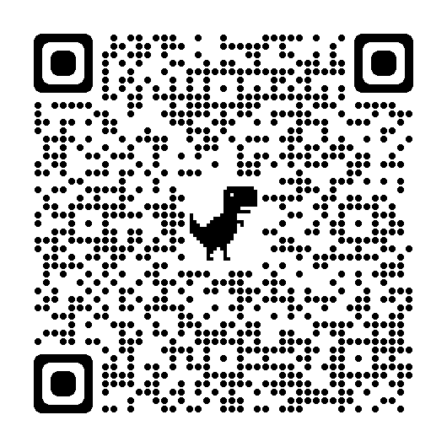
Attendance
Clackmannanshire
Family Wellbeing Partnership
Colin Bruce
Chief Education Officer

Slide 2
What it is………..and what it’s not.
An opportunity for partners to listen to some approaches that are making improvements (barriers)
An opportunity to discuss approaches with other staff
Development of effective
strategies that could be explored further in your own setting
Something that is worth us working together on – Collaboration
An off the shelf approach with no real significance to the needs of the staff/learners
A bolt on package which takes little or no account of the needs of the school/authority and its community
A series of tips with little reference to the learning process and no impact upon whole school development
A replacement of our current approaches
The silver bullet

Slide 3
In each of the windows, what behaviours would you see from 1) staff? and 2) pupils?
HIGH
A
B
Challenge / (Control)
Low Support, High Challenge
High Support, High Challenge
C
D
Support
Low Support, Low Challenge
High Support, Low Challenge
Wachtel & McCold
LOW
HIGH

Slide 4
Staff Feedback
HIGH
Confrontation
Authoritarian
Win-Lose
Stigmatizing
Consistent
Responsive
Flexible
Accountable
Responsible
Cooperation
Negotiation
Challenge/
(Control)
Uncaring
Tired
Burnt Out
Given Up
Chaotic
Inconsistent
Excusing
Giving In
Blurred Boundaries
Rescuing
LOW
Support
HIGH

Slide 5
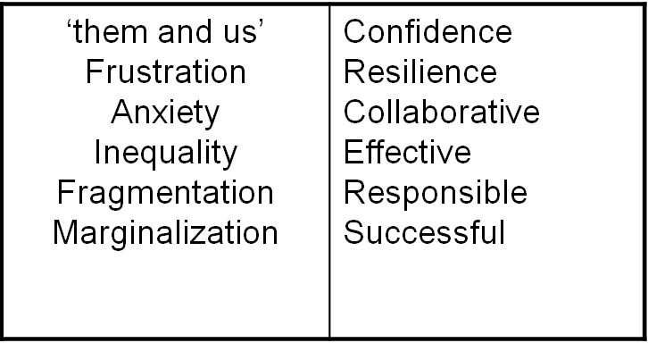
Pupils Feedback
‘Them and us
Frustration
Inequality
Marginalisation
HIGH
Challenge
Stagnation
Disinterest
Demotivation
Disruption
Over dependence
Ineffective
Reliance
Uncertainty
LOW
Support
(Encouragement, Nurture)
HIGH

Slide 6
Jamboardhttps://jamboard.google.com/d/1BvRfpnMiO9YxNVw5bUnS-2WOygIDnEPXlm4OIfJ9Kog/edit?usp=sharing

Slide 7
Where?
Look aboot ye!

Slide 8
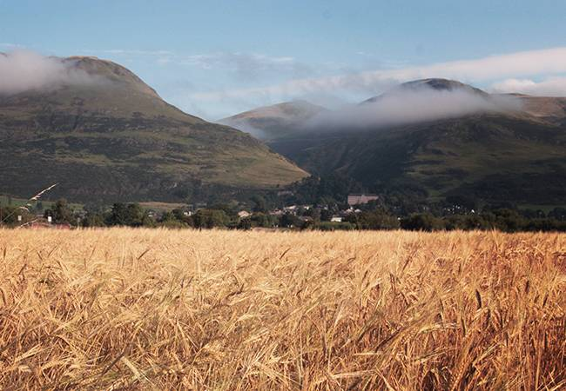

Slide 9
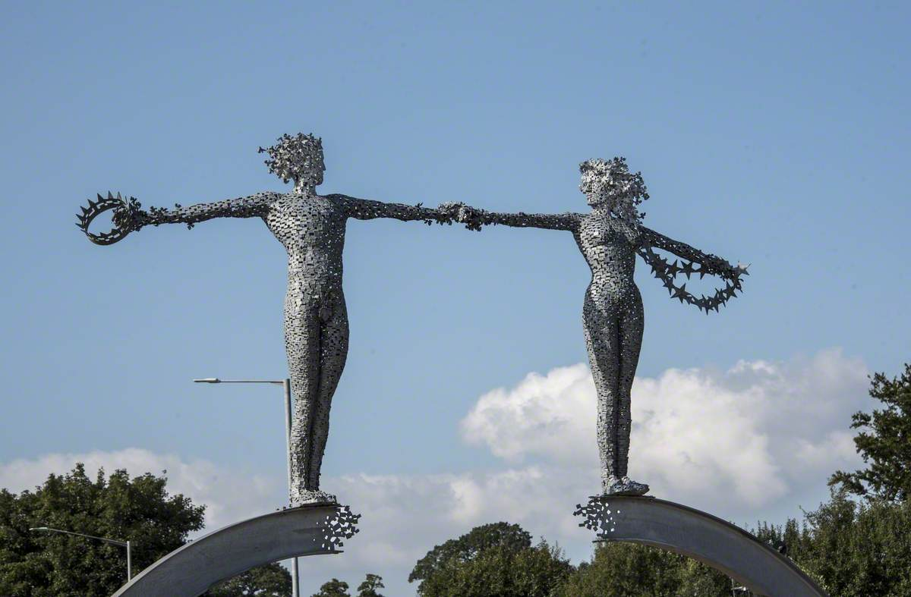
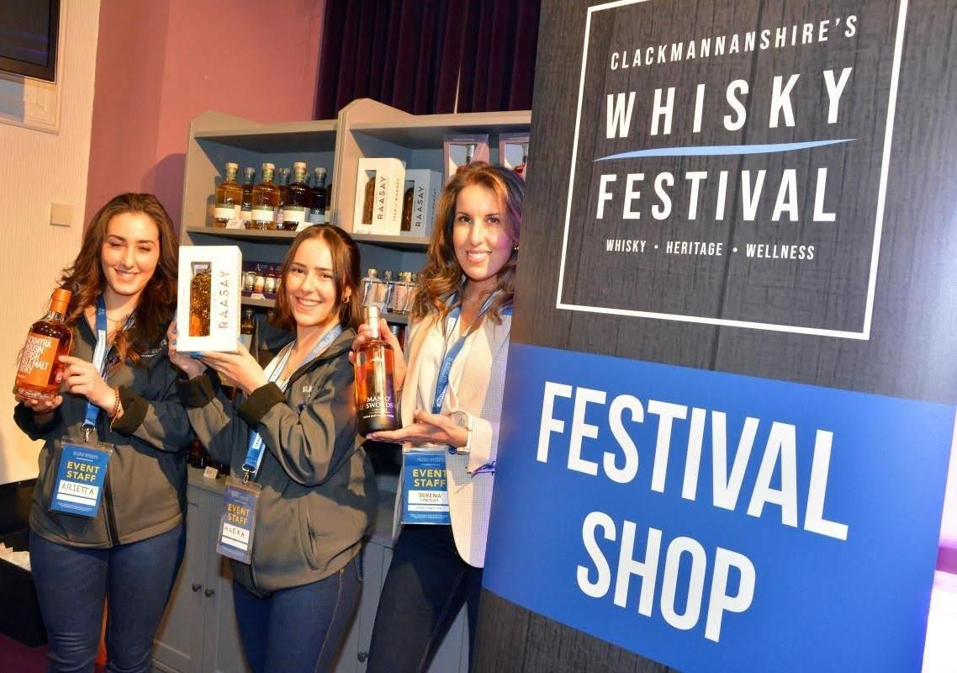
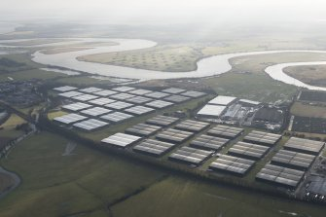

Slide 10
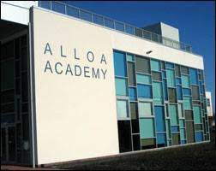
Establishments

Slide 12
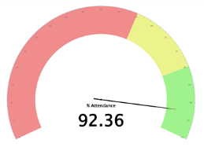
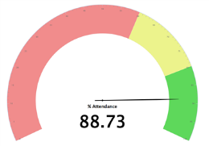
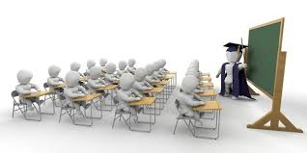
Clackmannanshire Education Services - Profile
Over 6600 pupils
ESTABLISHMENTS
4 standalone ELCs
18 Primary Schools
3 Secondary Schools
3 Special Schools [Primary School Support Service, Secondary School Support Service & Lochies]
Current Attendance [as of March 2023]
Census Data: 6668 pupils [as of March 2023 – 6632 pupils]
Overall slightly more male learners than female learners
52% : 48%
Primary: more male learners than female learners
53% : 47%
Secondary: more female learners than male learners (slight reverse)
49% : 51%
Attendance beginning to increase
Primary
Secondary
4% Care Experienced
4% Young Carers
32% learners in SIMD Q1
26% learners entitled to Free School Meals (FSM)
34% learners with Additional Support Needs (ASN)
Last published stats [2020/21]
Primary 93.9% [Scottish average – 94%]
Secondary: 91.4% [Scottish average – 89.1%]
SIMD Q1: 89.3% [Scottish average 88.7%]
Current SIMD Q1 – 88.3%
Higher than Scottish average
24% Social Emotional & Behavioural Difficulty
16% Dyslexia
10% Autism Spectrum Disorder
10% English as Additional Language
9% Family Issues
Impact of COVID particularly on secondary school learner’s attendance
NO school inclusions since 2019/20

Slide 13
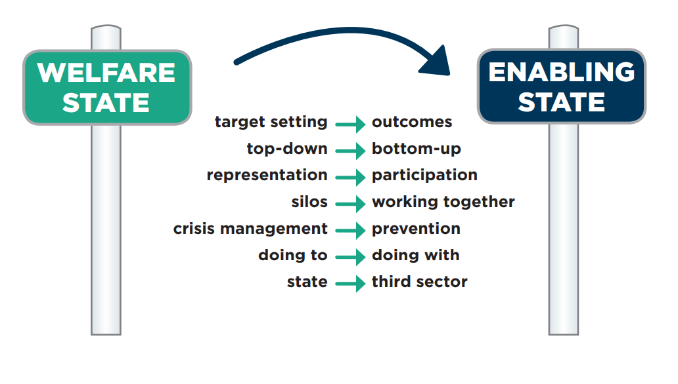
The Change

Slide 14
What is the Social Innovation Partnership (SIP)?
Established in 2016, the SIP seeks to contribute to the creation of a fairer and more equal Scotland.
SIP tackles poverty by designing and scaling new approaches that focus on increasing people’s wellbeing and capabilities, supporting them to live flourishing lives.
Collaboration between Scottish Government and The Hunter Foundation from 2018 – ongoing.

Slide 15
Scottish Government - Flourishing Lives Model

Slide 16
Clackmannanshire Family Wellbeing Partnership (FWP) (Funded by the SIP)
Community Around the School
Childcare
STRIVE (Safe Guarding through Rapid Intervention)
Employability and Employment
Values Based Leadership - Throughout

Slide 17
Values Based Leadership
Since 2018, Columba 1400 has supported VBL experiences for:
50+ head teachers and deputy heads through the Head Teachers Leadership Academy
local families and communities
over 130 key staff members (senior leaders and front line staff) as well as elected officials and partners have participated in Columba 1400 VBL experiences focusing on how we can all work together to improve the wellbeing and capabilities of children and families in Clackmannanshire.
A STRIVE (Safeguarding through rapid intervention) a multi-agency public sector team working to improve the current system of safeguarding vulnerable people in Clackmannanshire also participated in a VBL experience.
young people in our three secondary schools with all participants reporting increased confidence as a result.
The VBL approach is a vehicle for creating the conditions for individual and collective change. Columba 1400’s philosophy is that:
‘leadership is not to put the greatness back into humanity but to elicit it, for the greatness is there already’

Slide 18
Community Around The School

Slide 19
If a young person finds difficulty with numbers /
numeracy we …
If a young person finds difficulty with reading /
literacy we …
Notes:
If you were asked to respond as to your perceptions as to the response of a ‘traditional’ school what would it be?– And now in your school?

Slide 20
If a young person finds difficulty with attending school we…
Notes:
If you were asked to respond as to your perceptions as to the response of a ‘traditional’ school what would it be?– And now in your school?

Slide 21
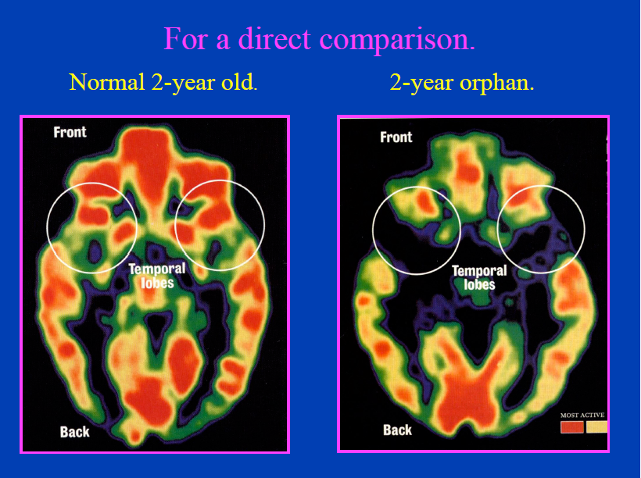

Slide 22
It’s good to talk
In a relationally poor household 2/3 year old children will have a vocabulary of c. ??? words
In a relationally rich household 2/3 year old children will have a vocabulary of c. ??? words.
Task 2 - In pairs, discuss.
Notes:
As described by Dr Bruce Perry, a leading American neuroscientist, relationally rich households have many adults interacting positively and regularly with babies and children. This will include hugs, cuddles, praise, encouragement………
This was provided, traditionally, by the extended family – aunts, uncles, grandparents….- Most children nowadays do not have this as the norm.

Slide 23
It’s good to talk
In a relationally poor household 2/3 year old children will have a vocabulary of c.100 words
In a relationally rich household 2/3 year old children will have a vocabulary of c. 400 words.
…………….it matters!
Notes:
As described by Dr Bruce Perry, a leading American neuroscientist, relationally rich households have many adults interacting positively and regularly with babies and children. This will include hugs, cuddles, praise, encouragement………
This was provided, traditionally, by the extended family – aunts, uncles, grandparents….- Most children nowadays do not have this as the norm.

Slide 24
FWP: Scope to Flourish
The Capabilities Approach assesses people's wellbeing and scope to flourish in terms of 4 main questions:
1. What are people able to do and to be? (Internal capabilities & human connections)
2. What opportunities are available to them? (External conditions)
3. What matters to them? What do they have reason to value? (Voice & agency)
4. What adjustments need to be made to create equal opportunities for all? (Public policy challenges re. person-centred approaches)

Slide 25
Change Models
Experiential | Family-focused | Attainment/Employment | Addressing systemic barriers
Stirling University & Alloa Academy Project – NHS Scotland Academy | Adult Learning at Alloa Academy – Literacy & Employability programme includes family cooking | NHS Scotland Academy – pathways to Health and Social Care roles | Columba 1400 Values Based Leadership
Columba 1400 Community & Residential Experiences | Alloa Community Empowerment – The Lens | Environment Services Work Experience | Engagement and Welfare Programme
Duke of Edinburgh Award Scheme | The Bowmar Bookies – literacy support | MCR Pathways – care experienced young people | School mentoring and support programmes
Community Events – e.g. Bingo Tea & Books | Clax P & C (Parents & Carers) - ASN support | Career Ready Programme (S5-6) | Adult Learning programmes
Without Exception – fun, out of school experiences | Without Exception - EASN support

Slide 26
Impact Story: Selda - Adult Learning
PERSONAL WELLBEING | COMMUNITY & BELONGING | OPPORTUNITY CONVERSION
Enhanced social networks & friendships | Places and spaces where Selda chooses to be: e.g. school & Bowmar Centre. | Qualifications gained: Level 4 ESOL; Employability; Level 4 Literacy and Employability.
Improved English and confidence | Choice of activities out with her home: adult learning; cooking; school events; Bowmar Centre. | With increased confidence and improving English, Selda co-ran a cookery session – also sharing cultural information.
Easier engagement with school – through enhanced relationships with staff and improved English | Peer support and networks through adult learning & work at The Bowmar. | Selda has gained work (4 hours per week funded by Strathclyde University) preparing and cooking food for weekly literacy sessions at The Bowmar Centre.
 | Opportunities for volunteering and "giving back". | Selda is involved in The Lens bid – to extend community learning opportunities at Alloa Academy (after school).
 | Community liaison and leadership opportunities. | With funding from The Lens, Selda will co-run cookery sessions at Alloa Academy (after school) - part of empowerment programme.

Slide 28
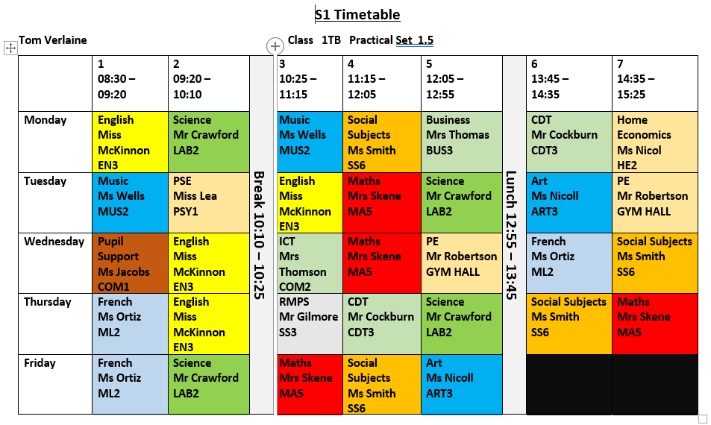
Community Around the School

Slide 29
What offers could be made in the red zone to support attendance and what partnerships do you need?
Amber – Does the curriculum need adapted to support attendance?
Green – What about after school hours including holidays to improve engagement?
Notes:
Purpose of activity.
To encourage thinking about the culture of the school / establishment / practice…..what do we need to create an environment that encourages emotional well being?

