Slide 1
An Introduction to Emotionally-Based School Avoidance
Richard Lockhart (Educational Psychologist)
Caroline Gos (Educational Psychologist)
Alice Hewlett (Educational Psychologist in Training)
West Lothian Educational Psychology Service
Attendance Symposium
Strathclyde University
27th March 2023

Slide 2
Outline of Workshop
What is EBSA?
Four Factors of EBSA
Cognitive Behavioural Approaches
Avoidance Cycle
Assess, Plan, Do, Review

Slide 3
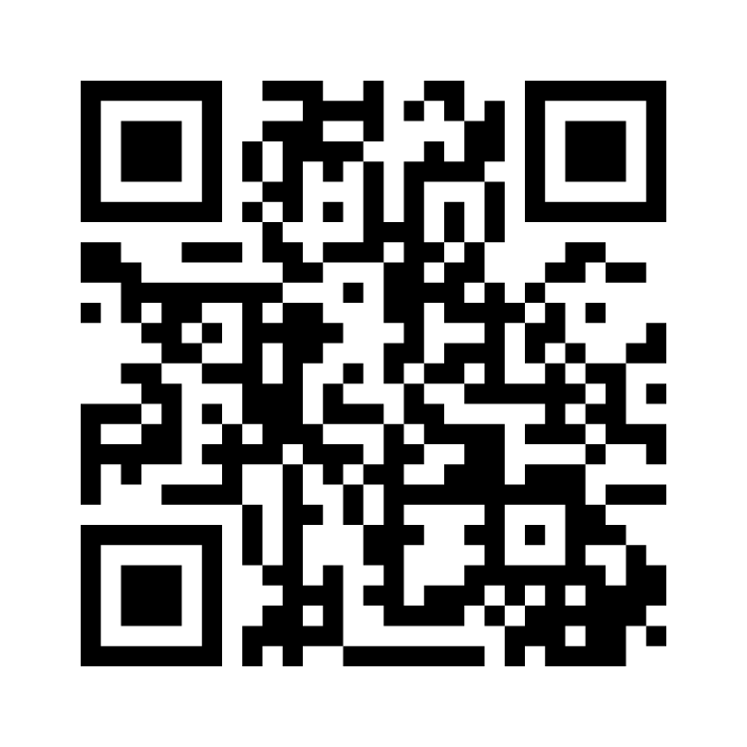
Why do some children struggle to attend school? What have you encountered in your practice?
www.menti.com
Voting code: 8576 9638

Slide 4
What is EBSA?
Emotionally-Based School Avoidance (EBSA) refers to a group of children and young people experiencing severe difficulty in attending school due to emotional factors, which can often result in prolonged school absence (Thambirajah, Grandison & De-Hayes, 2008).
Approximately 1-2% of the school population are absent from school due to emotional factors, with a slightly higher prevalence amongst secondary pupils (Elliot, 1999; Guilliford & Miller, 2015).

Slide 5
Impact of EBSA
Outcomes for pupils who display EBSA include poor academic attainment, reduced social opportunities and limited employment opportunities (Garry 1996, Pellegrini 2007 and Taylor 2012).
EBSA is also associated with poor adult mental health (Blagg 1987 and Walter et al 2010).

Slide 6
Four Factors of EBSA
(Kearney and Silberman, 1990).
Avoiding negative emotion Avoiding uncomfortable feelings brought on by attending school. | 2. Situation avoidance Escaping situations that might be stressful (e.g. academic demands, social pressures, aspects of the school environment).
3. Relationship seeking Reducing separation anxiety, gaining relational input from and/or spending more time with significant others. | 4. Tangible reward Spending more time out of school as it is more stimulating or motivating.

Slide 7
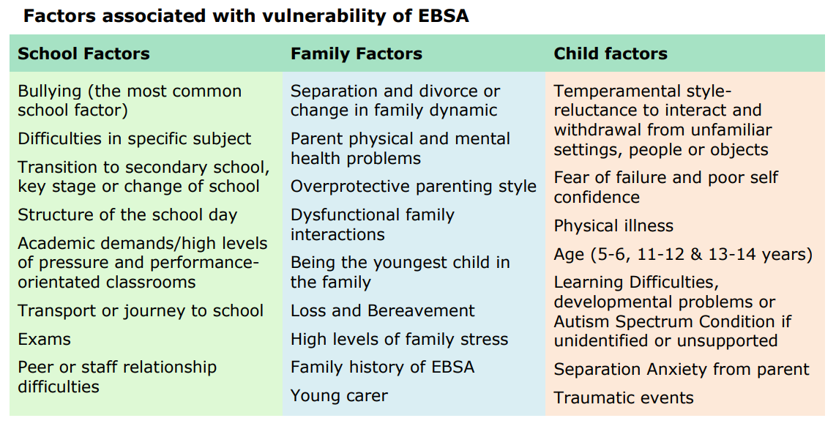
Vulnerabilities
Image: West Sussex Council

Slide 8
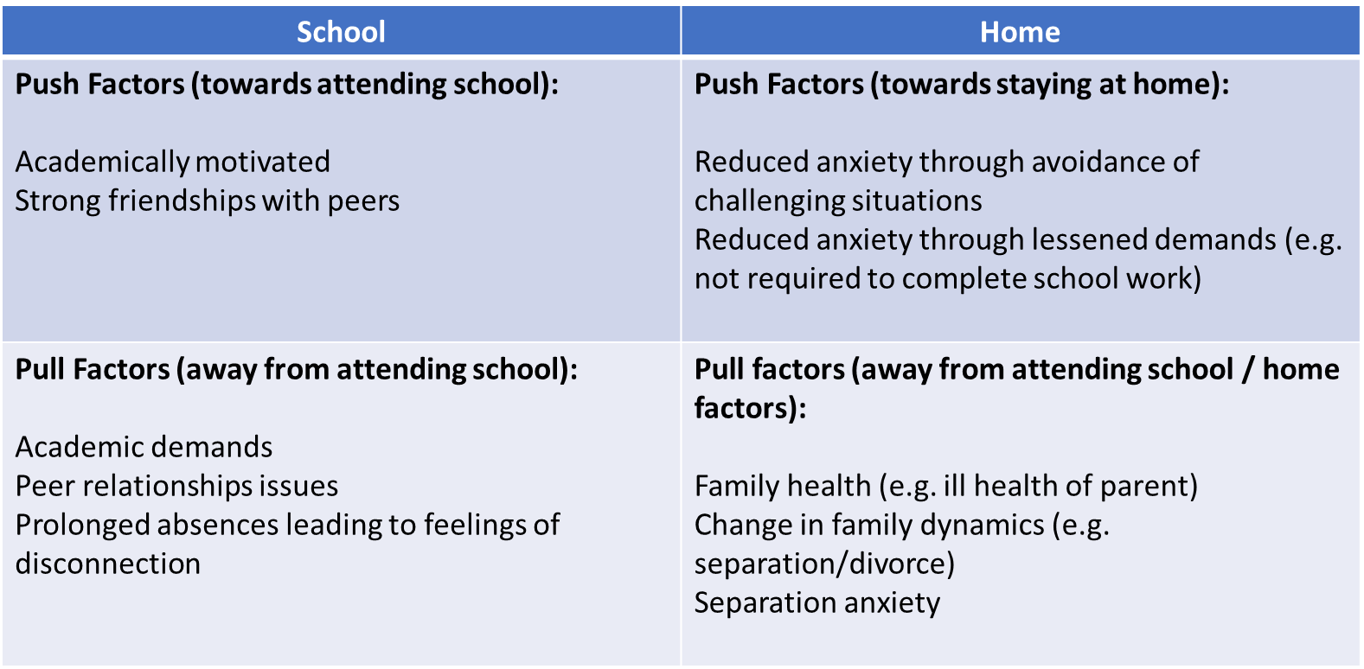
Push and Pull Factors

Slide 9
EBSA Workshop Question 1 :
Reflecting on your own context, what do you think are the main risk factors associated with vulnerability of EBSA? You could consider the risk factors at the level of the school, the family, and the child/young person.
You have 5 minutes to discuss with your shoulder partner.
We will then take 5 minutes to gather some feedback from the wider group in the room and on Teams.
Notes:
Caroline to facilitate

Slide 10
Cognitive Behavioural Approaches
Thoughts- "Something bad will happen"
Feelings- Anxiety, fear, threat, despair, frustration
Behaviour- Avoidance (refusal, fight/flight)
Notes:
Anxiety affects different parts of us, and cognitive behavioural approaches emphasise the link between all these different parts. In particular, it aims to ultimately change the "automatic negative thoughts" that can contribute to and worsen emotions, body sensations and eventually behaviour.
Thoughts: The inner voice in our head – what we tell ourself is happening around us (in the context of anxiety, this is quite often not aligned with reality and we get stuck in thinking traps).
Feelings: Important to emphasise with young people that these are uncomfortable, but not bad. Takes the blame element away from the cycle they can be in, in relation to school avoidance.
(Body sensations)- another element within this cycle but not captured in the diagram.
Behaviours: Our responses to a situation. An example of a behaviour response is avoidance, which we'll go into in the next slide.

Slide 11
Avoidance Cycle- School
Thoughts (negative) e.g. "It's too busy", "I can't cope".
Anxious feelings about school + Negative body sensations
Behaviour: Avoid school
Feelings after the Behaviour: Anxiety immediately reduces
Outcome: Increased school avoidance
Maintaining factors (effects of reduced attendance, school-based):
Falling behind in school- work
Loss of friends, isolation
Maintaining factors (home-based)
Access to pleasurable activities at home
Self-selected routines
Notes:
-This outlines the avoidance cycle in relation to attending school, which falls under "emotionally based school avoidance".
-This cycle outlines the link between negative thoughts about school and the child's ability to cope and how it can result in avoidance. Importantly, this cycle acknowledges how challenging this cycle can be to break, as the immediate effect of the avoidance is reduced feelings of anxiety. Over time though, this can make the young person lack belief in their ability to ever cope, re-inforcing the belief that school is unsafe.
-Some maintaining factors continue to make this cycle complex. The longer the young person avoids school, school-based maintaining factos like falling behind in work and isolation can make it even harder for them to have motivation to access help/support to return. Home-based maintaining factors, like greater access to pleasurable activities at home and self-selected routines (perhaps sleeping in), also make it challenging to break this cycle.

Slide 12
How Can We Help?
Do
Ensure agreed resources & supports is in place with good communication.
Review
Monitor progress & adjust plan as necessary
Assess
Gain a full understanding of the various factors (Child, school, home /family)
Plan
Based on available info plan for a realistic reintegration.
Notes:
Caroline to briefly outline

Slide 13
Assess: Information Gathering
Is it EBSA?
The extent of absence and anxiety
Child, family and school Factors
The Young Person’s Views
Notes:
•When attendance difficulties become apparent it’s important to investigate the reasons for these difficulties and not to make any assumptions. Having a clear understanding of the factors causing and maintaining EBSA is essential for our plan to be successful.
So we need to establish…
•Is it EBSA? Or are there more practical barriers at play such as travel difficulties. At this point we may have before dismissed ‘truancy’ as not being emotion based but we’ll explore how EBSA can present as this later
•The extent and severity of school absence and anxiety and also to investigate the types of anxiety present.
•To gather information about the child, family and school factors that may be contributing to the EBSA.
•Although due to how complex and individual EBSA can be, it’s difficult to have a standard approach to assessment, it is essential that the views of the young person are gathered and listened to along with parents/ carers and key school staff.

Slide 14
Assess: Information Gathering
Young People
What Worries Me/ Helps Me
School Avoidance Assessment Scale (Kearney, 1990)
Parents/ Carers
Parent School Avoidance Scale (Kearney, 1990)
Parents views- question prompts
School
Establish strengths, difficulties, supports in place etc.
Round Robin
EBSA Pupil Workbook (West Sussex EPS)
Background, current situation, views
School Anxiety Scale – Teacher (Kearney, 1990)
Notes:
•Gathering info from YP/ PandC/ School – resources in files section on teams
•For YP experiencing EBSA, they are likely to become anxious when asked to discuss returning. Currently their managing their feelings of anxiety by avoiding school, so any talk about going back to school is going to raise their anxiety as you are proposing to take away their way of coping with their fears. A good place to start any assessment with a young person is to acknowledge it may be difficult but you would like to know what they think and feel. Empathy is key, without endorsing the school avoidance.
•The approaches taken will depend on the YP’s age, level of understanding and language skills. Even if they are able, often YP can find it difficult to verbalise what they are thinking and feeling.
•--
Parents and carers – Parents may find it difficult to talk about the concerns they have and the difficulties they experience in trying to get their child into school. It is important that we (school) take time to build a collaborative partnership working together in the best interest of the child.
Sometimes parents may have had similar experiences to their child and may experience their own anxiety making it especially difficult for them.
During the information gathering stage it is important to gather background information, establish the current situation and the parent’s views. Questions should be sensitive and the person asking should employ active listening skills.
---
It is essential that we obtain information from relevant school staff who work most closely with the child or young person.
Staff may have valuable information to help identify triggers for anxiety and strategies the young person responds positively to. In particular it is important to seek out the views of any members of staff the young person speaks positively about and any member of staff where relationships may be more difficult.

Slide 15
Plan: Interpret Information and Planning
Collaborative
Optimistic approach
Individualised
Individual and flexible
Realistic
Gradual and graded return
Communication of plan to all school staff working with child
Stick to agreed plan and steps
Firm and consistent
Plan is informed from assessment
Notes:
An optimistic approach should be taken, if the child fails to attend school on one day, start again the next day.
At the start of the plan the child is likely to show more distress and all should be aware of this. School staff and parents need to work together to agree a firm and consistent approach.
•All school staff that will come into contact with the young person should be aware of the return to school plan and any adaptations to normal routines or expectations that are in place to support the child.
•Once actions on a support plan are agreed with a young person, e.g. returning to school in very finely graded steps, stick to what has been agreed for that week, even if things seem to be going really well, as pushing things further than agreed can heighten anxiety, reduce trust and backfire overall.

Slide 16
Do: Interventions and Strategies
Avoiding negative emotion
(e.g. fear of the toilets; the noise in the lunch hall; lots of people in the corridors between classes).
Situation Avoidance
(e.g. feeling left out at playtime; reading out loud in class or other public speaking task; working as part of a group).
Tangible reward
(e.g. when out of school can watch tv, play computer games, hang out with friends).
Relationship seeking
(e.g. change in family dynamic, concerned about the well-being of parent, a lack of school belongingness).
Building skills and experiences in targeted areas with gradual exposure
Social inclusion and friendship support (e.g. buddying, peer mentoring)
Social skills interventions (teaching and modelling)
Pre/ post teaching in subject areas of key work missed
Targeted interventions out with school
Anxiety management techniques
Gradual re-exposure to school
Identify safe spaces
Respond to pupil feedback on ‘hotspots’
Build in opportunities for calming activities
Increasing “rewards” for attendance and disincentives for nonattendance
Consider how need being met outwith school, could be met in school (e.g. sense of belonging)
Increase the appeal of school using child’s interests
Explore the child’s hopes and aspirations
Support parents/ carers to:
Support their travel to and from school
Teach them how to resist offers from peers
Key relationships in school e.g. meet and greet
Work with parents/ carers to help them to:
Support moments of distress or anxiety
Establish morning routines
Positive and individual time to spend with the child outside of school hours
Focus on positive behaviours
Limit the attention the child receives when they do not attend school
Notes:
Intervention should be informed by a functional analysis of school avoidance behaviour. Interventions should be bespoke to the individual and based upon the information which was gathered in the assessment and integration stage.
1. To avoid something or situations that elicits negative feelings or high levels of stress/ sensory overload (e.g. fear of the toilets; the noise in the lunch hall; lots of people moving all together in the corridors between classes, tests/ exams).
Interventions should include learning about anxiety and worrying, how it affects our thinking, feeling and behaviour. How avoidance of the feared situation makes things worse. The YP should be taught anxiety management techniques such as relaxation training and deep breathing.
There should be a gradual re-exposure to school setting using a graded exposure approach created with the young person from least feared school situations to most School should consider the provision of safe spaces that pupils can go to, such as wellbeing base, chill out zones, library, these may be less stigmatising for some pupils.
2. To escape difficult social situations (e.g. feeling left out at playtime; reading out loud in class or other public speaking/group task; working as part of a group).
As above … In addition the child should be taught social skills and given opportunities to practice coping skills in real-life social and evaluative situations, starting small and building up to most challenging. There could be pre teaching of key work missed, buddying, peer mentoring and role playing what they are going to say when peers ask about their absence from
School etc.
3. To get attention from or spend more time with significant others (e.g. change in family dynamic, concerned about the well-being of parent).
Intervention would usually include work with care-givers supporting them to develop skills and techniques to:
•Manage the school avoidance behaviours such as meltdowns or physical/ somatic complaints
•Establish morning routines, use problem solving techniques
•Establish positive and individual time to spend with the child outside school hours
•Focus on positive behaviours
•
4. To spend more time out of school as it is more fun or stimulating (watch tv, go shopping, play computer games, hang out with friends).
Intervention would usually include:
•Unmet needs – e.g. school belonging
•Increasing “rewards” for attendance and disincentives for nonattendance i.e. laptop time, access to internet, phone credit, time with friends in town etc.
•Limit the attention a child receives during non-attendance
•If possible take away the more stimulating activity
•Make school as stimulating as possible, find out the child or young person’s interests and if possible apply this to the work completed in school

Slide 17
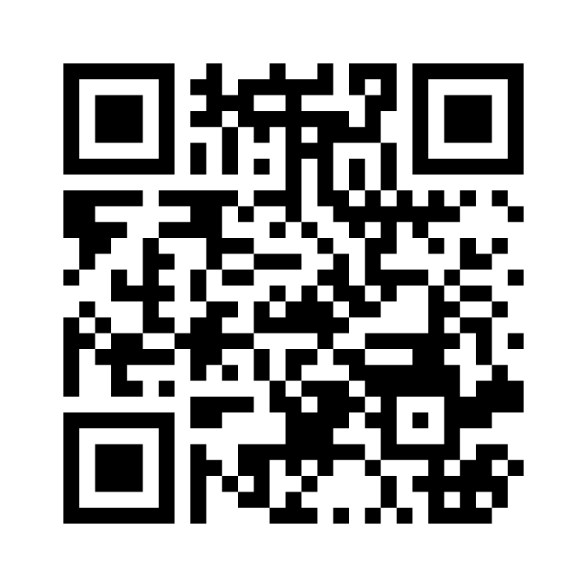
EBSA Workshop Question 2 :
Reflecting on your own context, can you discuss any strategies that you have tried or would like to try in supporting young people with EBSA?
www.menti.com
Voting code: 3752 1781

Slide 18
References
Blagg, N. (1987). School Phobia and its treatment. London. Croom Helm. Conduct.
Elliott, J G. (1999). Practitioner Review: School Refusal: Issues of Conceptualisation, Assessment, and Treatment. J. Child Psychology & Psychiatry. Vol. 40, No. 7, pp. 1001-1012.
Garry, E. (1996) Truancy: first steps to a lifetime of problems. Washington DC Office of Juvenile Justice and Delinquency Protection.
Gulliford, A. & Miller, A. (2015) Coping with life by coping with school? School refusal in young people. In Educational Psychology Ed. Cline, T., Gulliford, A. & Birch, S. Routledge. Hove, UK.
Kearney, C.A. and Silvermann, W.K. (1990) A preliminary analysis of afunctional model of assessment and treatment of school refusal behaviour. Behaviour Modification 14, 340-366.

Slide 19
References
Pellegrini, D. (2007). School non-attendance: definitions, meanings, responses, interventions. Educational Psychology in Practice, 23(1), 63-77.
Taylor, C. (2012) Improving attendance at school. London DFE.
Thambirajah M,S., Grandison K.J., and De-Hayes L. (2008) Understanding School refusal: a handbook for professionals in education, Health and Social Care. Jessica Kingsley, London, UK.
Walter, D. Hautmann,C. Rizk, S. Patermann, M. Sinzig, J. Lehnmuhl, G. & Doepfner, M. (2010) Short term effects of impaired cognitive behavioural treatments of adolescents with anxious-depressed school absenteeism: an observational study. European Child and Adolescent Psychiatry, 19, 835-844.

