Slide 1
Accessing and Analysing Attendance Data
FVWL RIC Data Coaches
Kimberly Robinson – Falkirk
Barry Speedie – West Lothian
Michaela MacDonald – Stirling
Seonaid Maclean – Clackmannanshire
Notes:
Barry

Slide 2
Attendance Data Matters
The FVWL RIC focus for session 22-23 has been attendance
As a team we looked at attendance data for the 4 LA’s for session 21-22 and nationally attendance has dropped since Covid
Attendance is the responsibility of all and a legal obligation
Attendance impacts on all aspects of the school – attainment, H&W, positive destinations and links with all the other stretch aims
We have looked at attendance data at RIC, LA and at school level – with focussed attention on key groups like SIMD, CEYP, ASN & FSM etc
We have analysed data over time and looked for patterns
We have looked at how the 4 LAs use attendance codes
The RIC has an Attendance Steering group where we share current attendance data to drive improvements
Notes:
Barry
Attendance gaining a higher profile. Included as a new measure in NIF

Slide 3
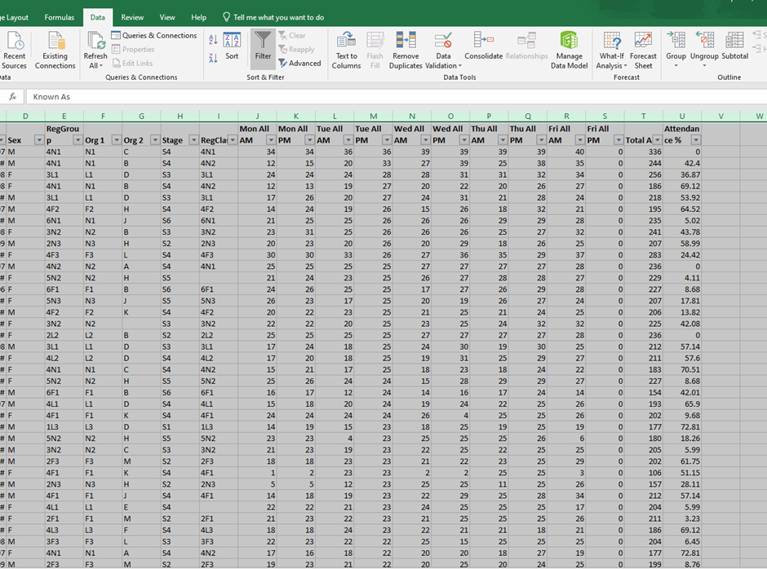
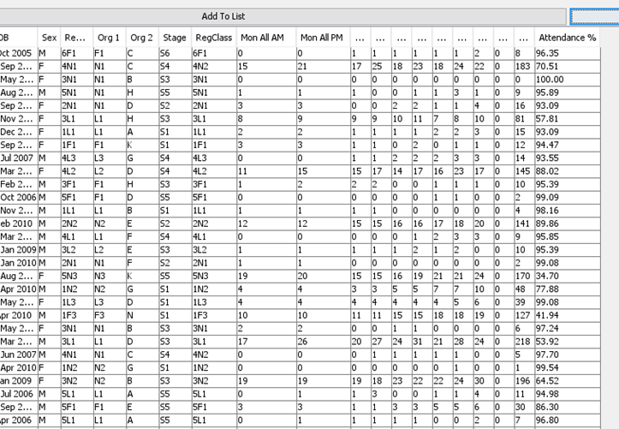
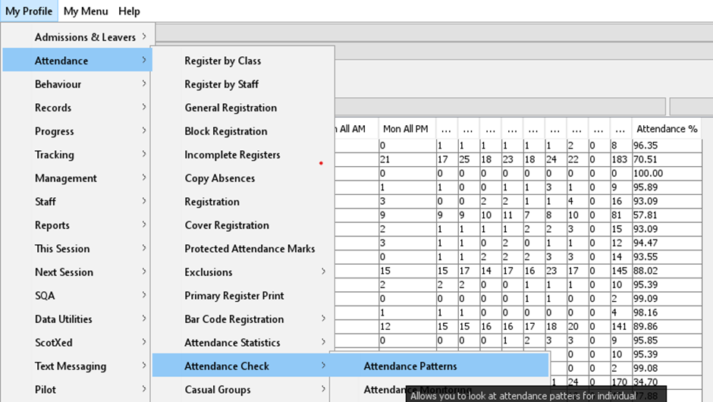
Seemis Reports Clackmannanshire
In Clackmannanshire they look at data via Seemis reports
Attendance Patterns report on Seemis
This allows you to investigate the overall attendance percentage and look for daily patterns
Notes:
Kimberly

Slide 4
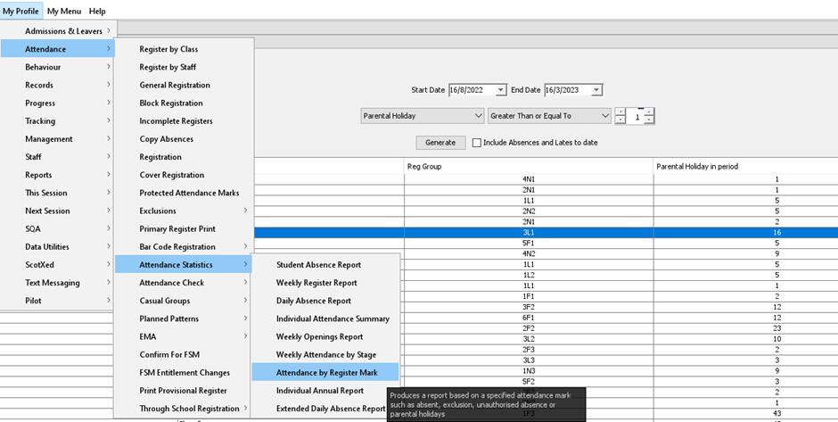
Seemis Reports Clackmannanshire
In Clacks they look at data via Seemis reports
Attendance by register mark report on Seemis
This allows you to look at parental holidays, OAT etc - to dig deeper into the reasons for absence
Notes:
Kimberly

Slide 5
Stirling Council Michaela MacDonald
Seemis BI available to all schools
Attendance by Free School Meals and SIMD custom report on SEEMiS
Monthly attendance reports created and sent to schools
Notes:
I am only going to talk through Attendance by FSM and SIM report

Slide 6
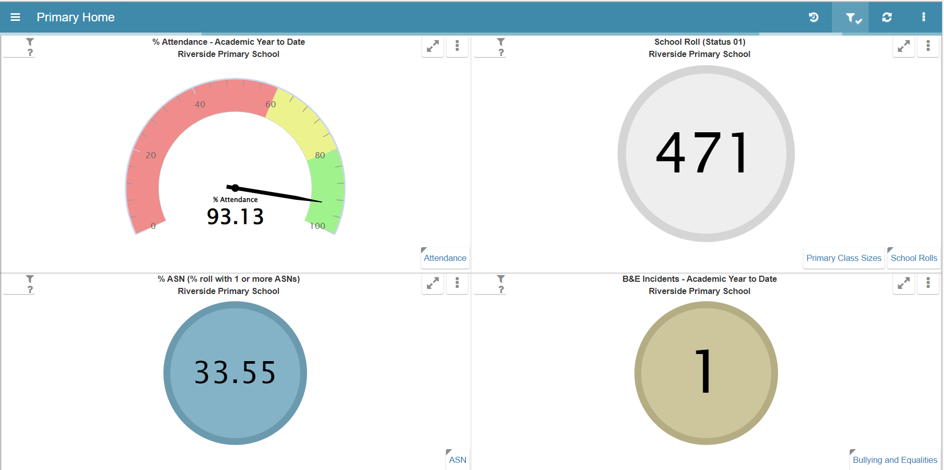
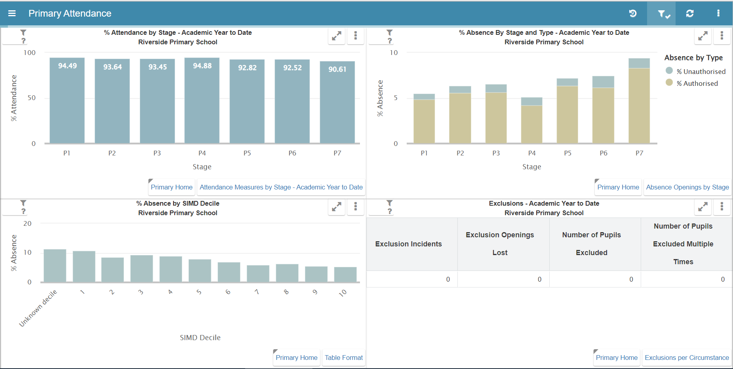
Seemis BI Attendance Reports
Available to all Local Authorities/schools
Seemis central coordinator needs to request to become available to schools in LA
Seemis BI dashboard to look at attendance – does not give pupil level data
Notes:
Michaela

Slide 7
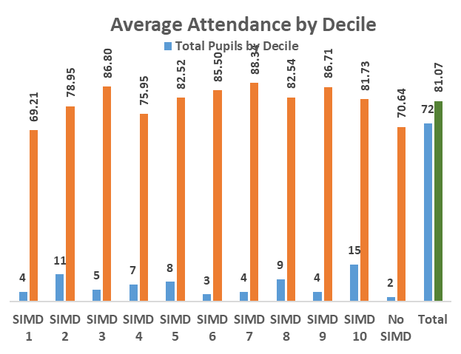
Attendance by FSM and SIMD report
How do we use this?
•Custom report set up on SEEMiS
•Monthly/Termly tracking of attendance by SIMD/FSM
•Live information on numbers of children registered for FSM
•Live SIMD overview information
Notes:
Michaela
SEEMiS analysist created a custom report on SEEMiS that all Primary Schools, High Schools and EY establishments have access to
We then have an excel template that schools copy their Custom Seemis report for the whole school into. This excel template then automatically generates charts for the school based on a number of different headings.
We encourage schools to create this report and save it each month or term
The reports are live starting from the beginning of the school year
Will share the charts now

Slide 8
Attendance by FSM and SIMD report
Average Attendance by Decile
Notes:
Looked at daily absences across LA’s. Looked at what was the impact of missing the first few days of terms – more likely to have higher absence across the term. Looked at what days – if missed T, W & Th then it became more likely to have an issue with absence. Look at list of kids missing in 1st week of term and those missing midweek – attendance officers focussed on 1-1 support. Looked at previous years data. Those in care less likely to have high absence. FSM lower attendance, ASN lower attendance.
Michaela
Blue is the number of children from each decile, orange is their average attendance

Slide 9
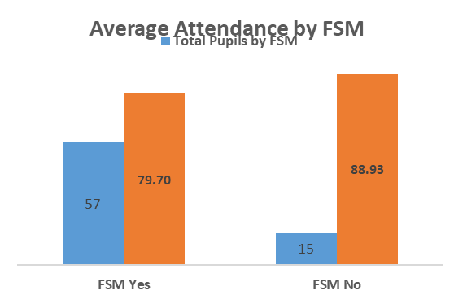
Attendance by FSM and SIMD report
Average Attendance by Free School Meal
Notes:
Michaela

Slide 10
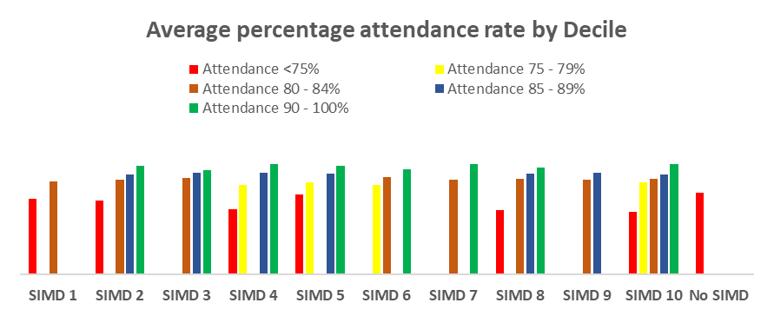
Attendance by FSM and SIMD report
Average Attendance rate by decile
Notes:
Highlights the average attendace rate per decile –describe SIMD 1 and 10
These charts help inform PEF Plans and SIP Plans

Slide 11
Attendance by FSM and SIMD report
Able to easily identify pupils
Notes:
After looking at the charts you can come back to the "Data" tab of the excel spreadsheet and add filters so you can identify children easily.
This will allow you to create data informed interventions to promote attendance

Slide 12
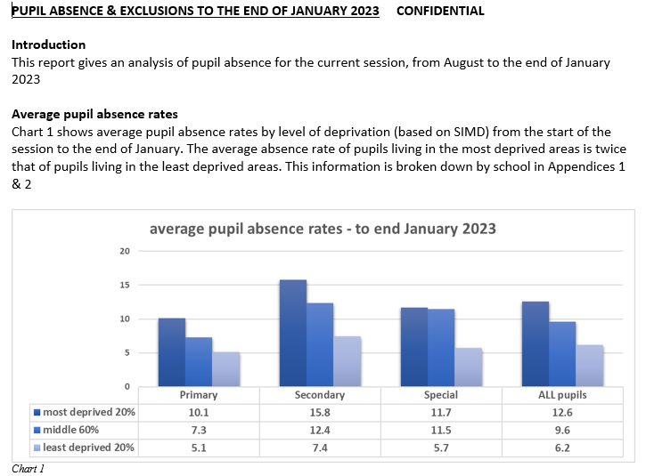
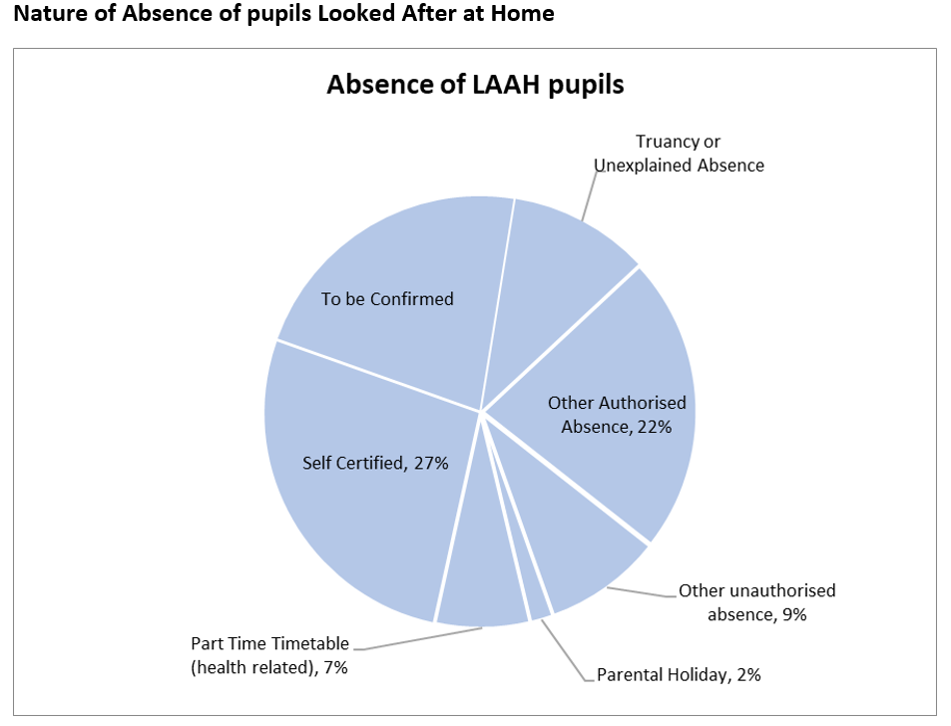
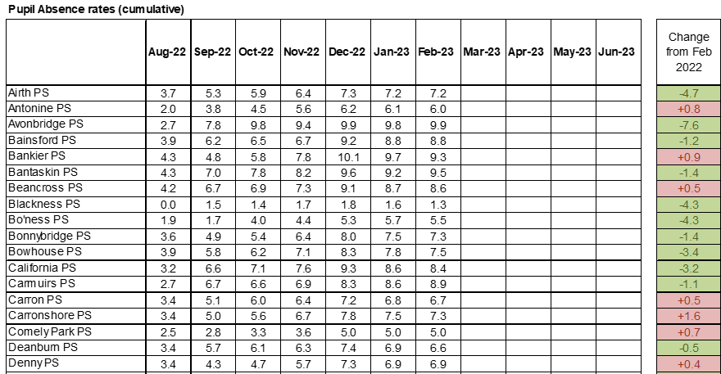
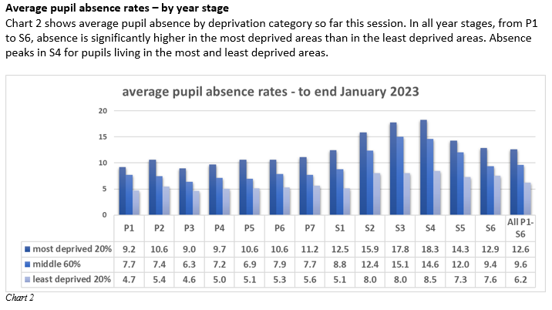
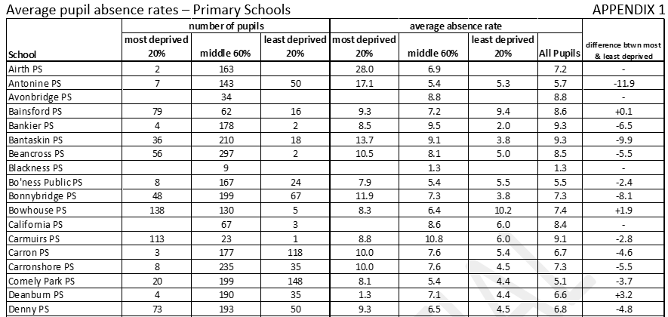
Falkirk Kimberly Robinson
EXAMPLE
What we have been doing in Falkirk
Issue a monthly attendance report to all HTs
Share schools data across Falkirk with particular focus on key groups such as Q1, ASN, CEYP etc
Notes:
Kimberly

Slide 13
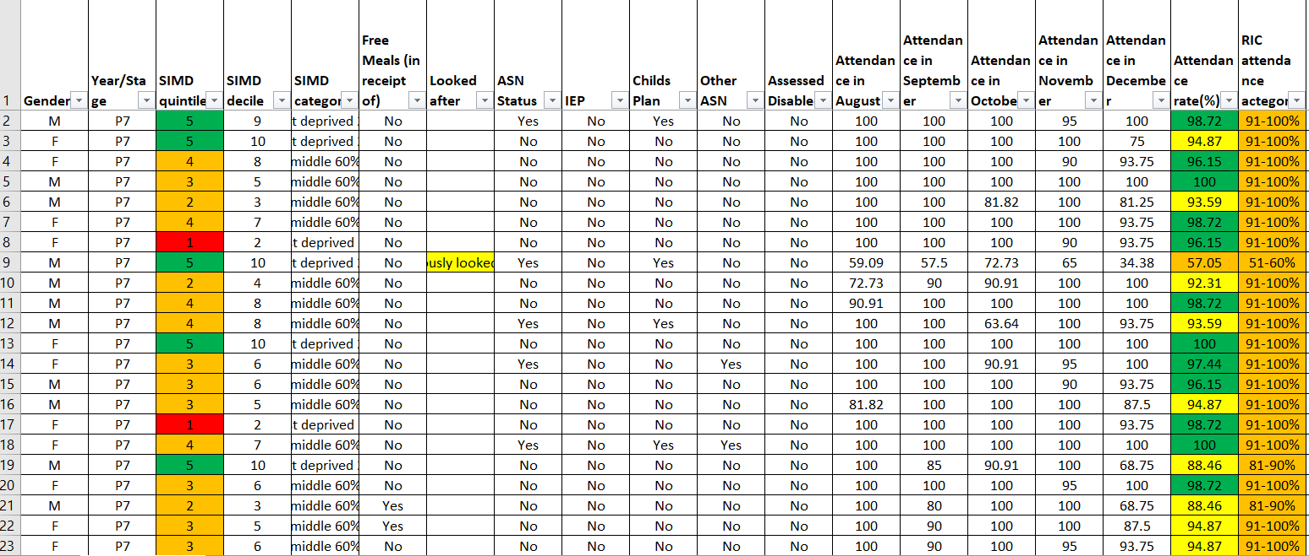
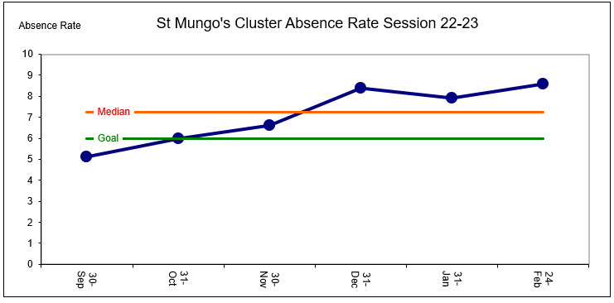
Falkirk Kimberly Robinson
What we are doing through the Attendance Focus this year
Working with a cluster in Falkirk (7 primaries and 1 secondary)
Seemis data for each school to dive deeper into data – identify groups for targeted interventions
Example
Notes:
Kimberly

Slide 14
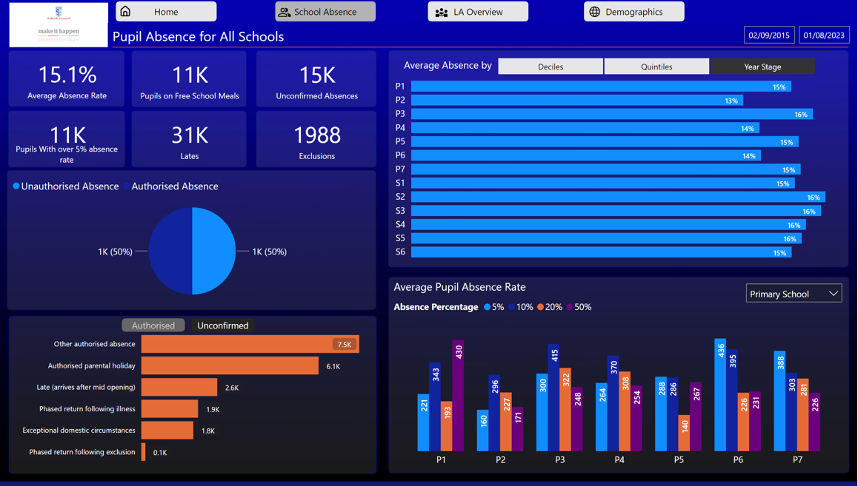
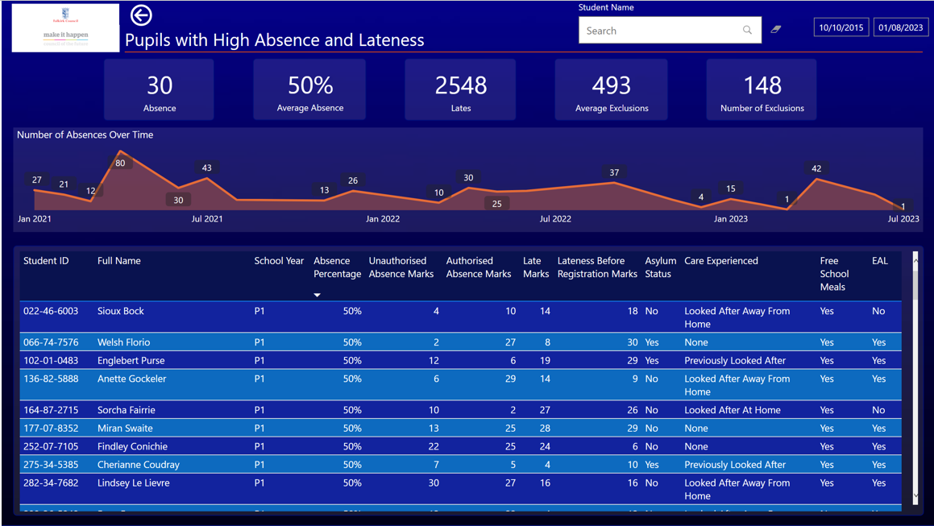
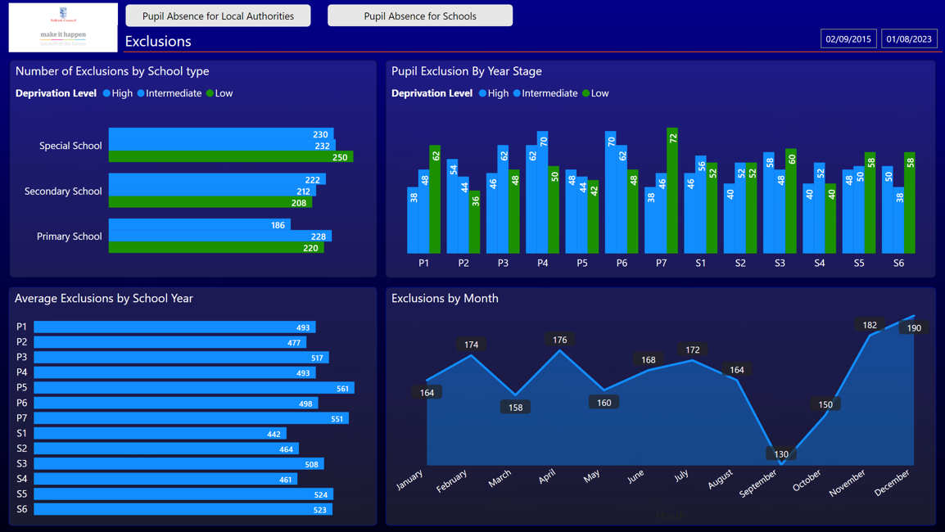
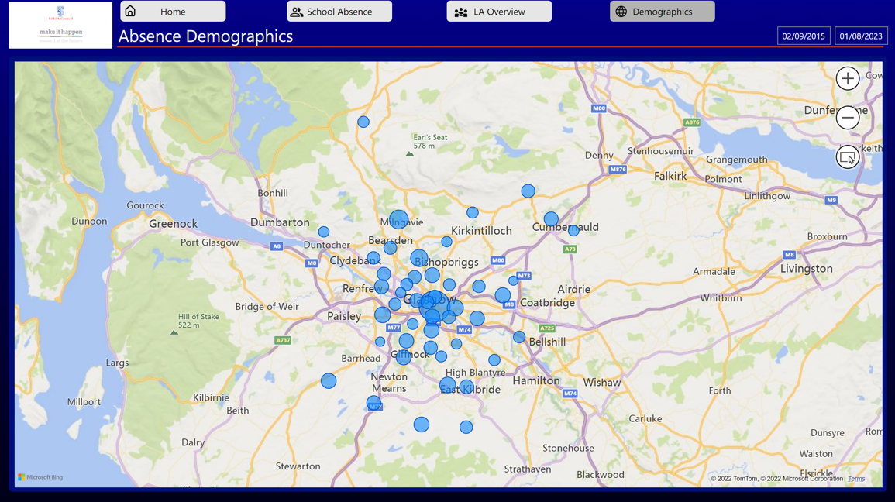
Falkirk Kimberly Robinson
What we are working towards next
Developing a Attendance BI Dashboard for schools/LA
Live feed from Seemis to provide up to date data for schools – analyse their data more regularly
Notes:
Kimberly

Slide 15
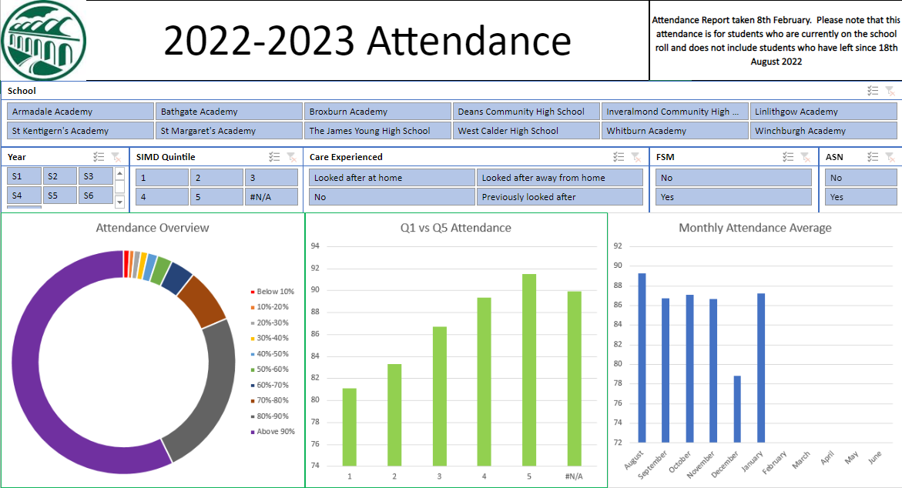
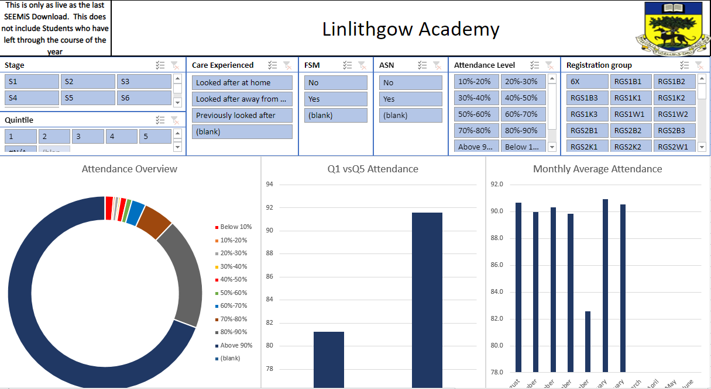
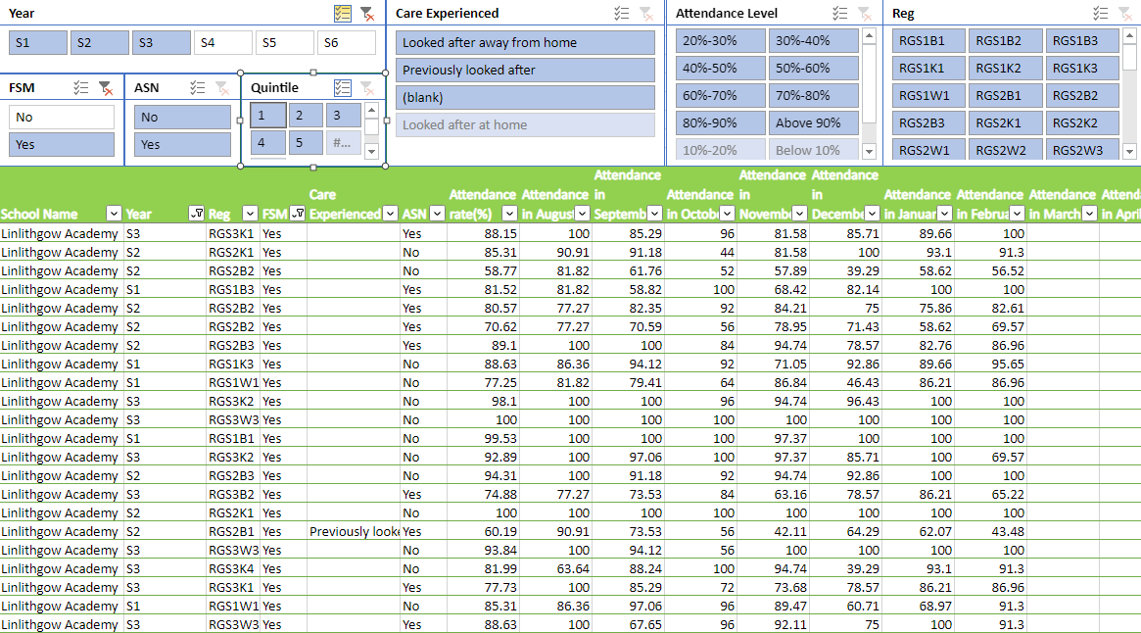
West Lothian Barry Speedie
What we have been doing in West Lothian.
Created a West Lothian Secondary Schools Dashboard.
Provided all Secondary schools with a tool which allows analysis of Q1, ASN, FSM and CEYP.
Notes:
West Lothian Secondary Schools Dashboard is provided to all schools
School attendance analysis tool which each school owns and updates.
Track targeted students, characteristics
Easily identify Year groups, classes and individual students whose attendance is causing concerns.

Slide 16
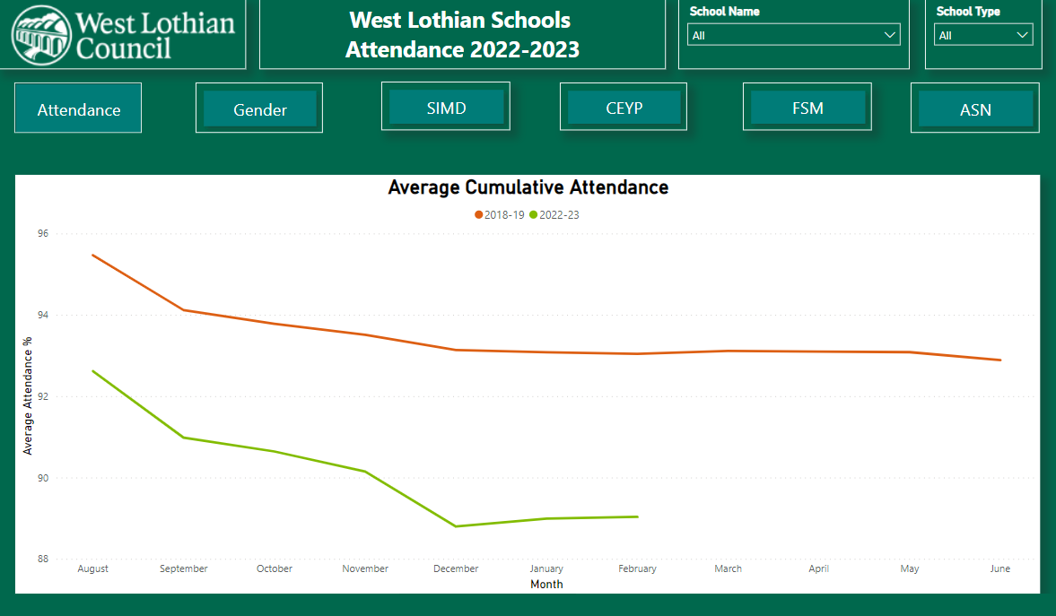
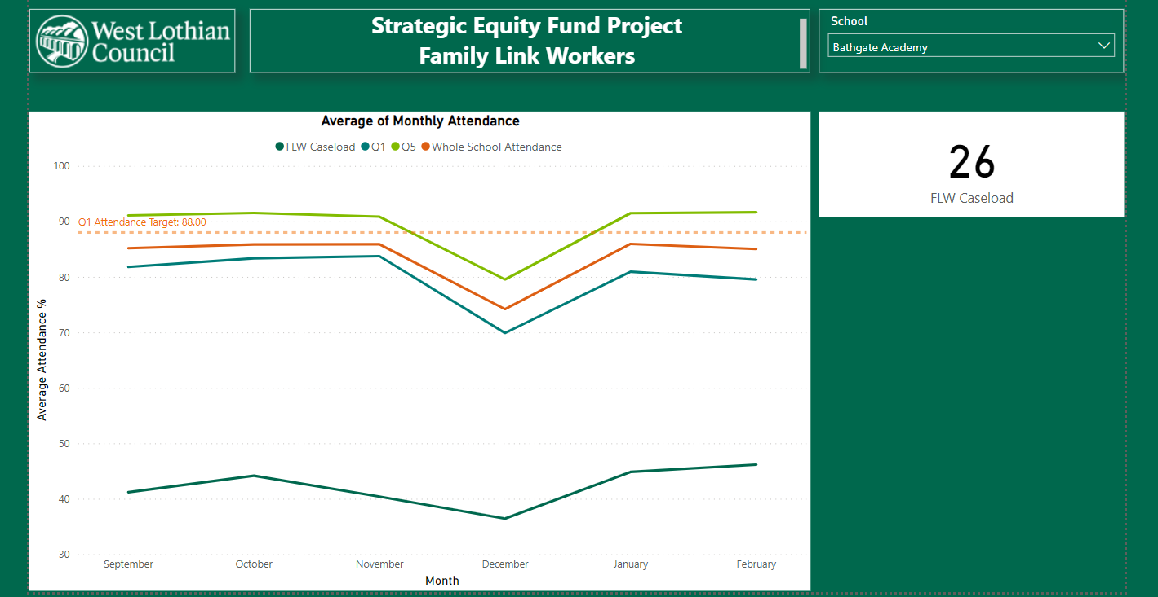
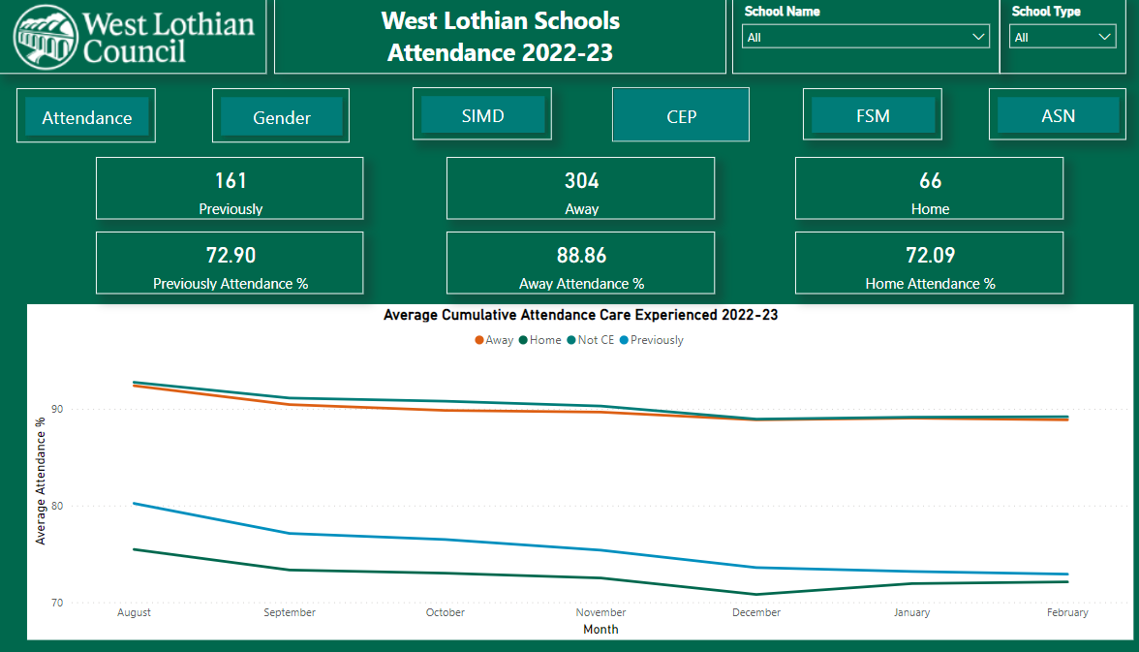
West Lothian Barry Speedie
What we have been doing as an attendance focus this Year.
Developing Power BI Dashboard to make attendance analysis quick and easy.
Further develop the SEF Attendance project to include Primary Schools
Notes:
SEEMiS BI currently being developed and will be launched In the summer term.
Reports available for the SEF Attendance project
Attendance dashboard will be available for all schools and will include a number of measures and allow schools to drill down to individual student level.

Slide 17
Discussion and Questions
Does anyone want share how they have been using Attendance data in their setting?
Is anyone using Seemis regularly to monitor attendance?
Any questions?
Get in touch:
kimberly.robinson@falkirk.gov.uk
barry.speedie@westlothian.gov.uk
Notes:
Michaela

