Slide 1

Self-Evaluation Resource
Notes:
This resource has been developed from an Education Scotland resource/ self-evaluation found on the National Improvement hub: Recognising and realising children’s rights: A professional learning resource to promote self-evaluation and improvement planning | Learning resources | National Improvement Hub (education.gov.scot)
As part of the FVWL RIC UNCRC working group, we have developed this further to make it user friendly and accessible for everyone across children's services. The purpose of the self-evaluation is to allow teams and establishments to consider their current practice and use evidence to inform their improvement journey to embedding UNCRC into practice. It is not intended to be completed in one go or necessarily in the order provided – it is up to individual establishments to decide which element to start with and how best to work through it, likely over a number of years.
The RIC group have come together to share practice and develop resources collaboratively. We are developing a UNCRC toolkit and this is part of it. You can access other tools via the FVWL Blog …...
UNCRC – Forth Valley & West Lothian Regional Improvement Collaborative (glowscotland.org.uk)

Slide 2
UNCRC Self-Evaluation
This resource allows establishments and teams to self-evaluate their practice considering the UNCRC and supports improvement planning to ensure this is part of daily practice.
How to use this self-evaluation approach to improve practice:
This self-evaluation approach could be used to provide professional learning to staff around the UNCRC and to help them reflect on how they are taking forward children’s rights within their context.
Some key improvement questions include:
How well do we understand the UNCRC and how the articles within it relate to the practice?
How well do we understand and demonstrate our role as duty bearers of children’s rights?
To what extent do we make links between the UNCRC and our culture, values and ethos; skills and activities; curricular programmes and targeted support?
Notes:
Think we need to make this more generic and not just aimed at schools. That way the presentation can be used for a mixed audience
Would you also want to add links into How Good is OUR school? EYs version HGIOELC? CLD version? - added these links to the next page.

Slide 3

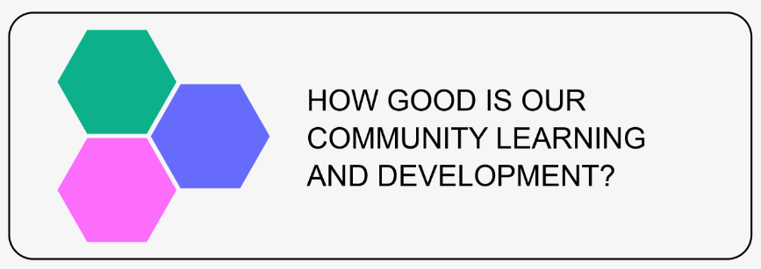

Depending on the setting, you will see clear links to the following frameworks:
How Good is our School? (fourth edition),
How good is our CLD | HGIOCLD
How good is our early learning and childcare?

Slide 4
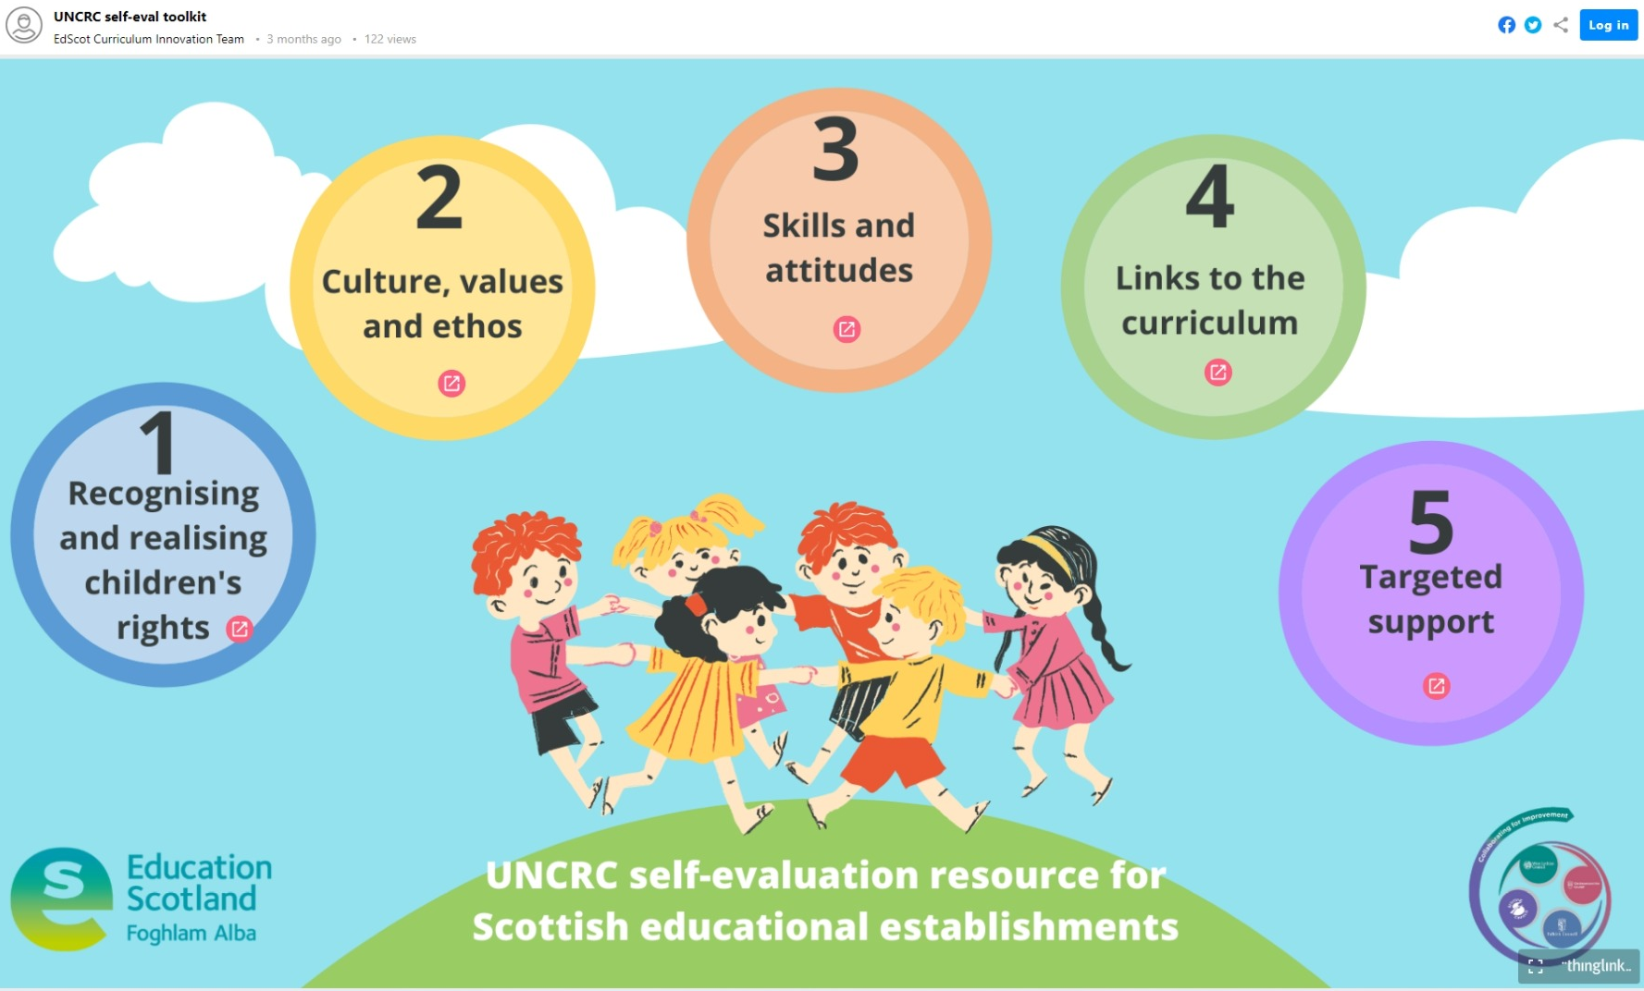
UNCRC Self Evaluation using Thinglink
UNCRC self-eval toolkit (thinglink.com)
Notes:
https://www.thinglink.com/scene/1543282141343776770
Could explain how there are 2 documents:
1. ThingLink – to provide information and prompts for discussions and signposts to development activities, resources, professional reading or further PL plus examples of practice (via the FVWL inspiration hub): UNCRC – Forth Valley & West Lothian Regional Improvement Collaborative (theinspirationhub.co.uk)
2. MIcrosoft Form – to allow teams/ establishments to self-evaluate and consider the evidence they have
Duplication link: https://forms.office.com/Pages/ShareFormPage.aspx?id=oyzTzM4Wj0KVQTctawUZKe4S6FWI-6dMgVggZP3q22ZUQzhUQ1dOQlFNVlA0MjA5VUo3M1c3UkhFNy4u&sharetoken=tayUUAtwAGOF4hjjdxZS
It is good to have both open and be able to tag between the two documents.

Slide 5


Using Thinglink
The UNCRC Self-Evaluation resource has 5 sections:
Recognising and realising children’s rights
Culture, values and ethos
Skills and attitudes
Links to the curriculum
Targeted support
Clicking on the red square will take you into a new link to explore each section.

Slide 6

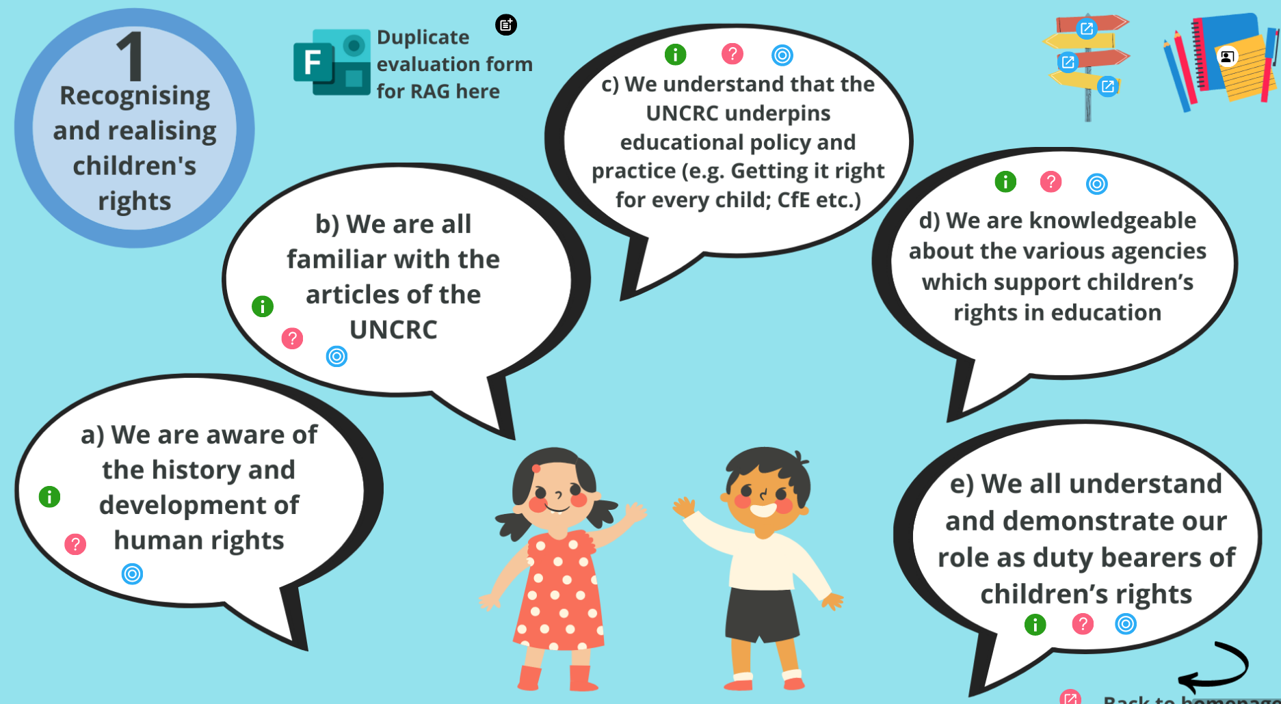


Using Thinglink
Within each section, you will see a selection of self-evaluation statements.
Use the links to access additional information.
Ideas to consider
Discussion prompts
What could red/amber/green look like

Slide 7

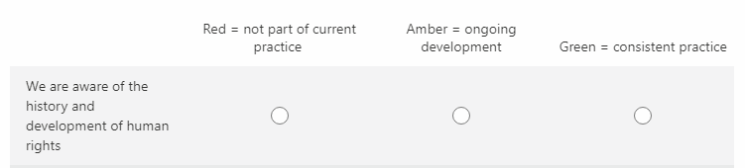
Evaluation Form RAG
Use this link to duplicate a form via Microsoft Forms.
This form will allow you to give RAG ratings for each statement
This can be used to collect responses from colleagues within your setting.
Practitioners are asked to RAG various statements where:
Red = not part of current practice
Amber = ongoing development
Green = consistent practice
Notes:
Duplication link:
https://forms.office.com/Pages/ShareFormPage.aspx?id=oyzTzM4Wj0KVQTctawUZKe4S6FWI-6dMgVggZP3q22ZUQzhUQ1dOQlFNVlA0MjA5VUo3M1c3UkhFNy4u&sharetoken=tayUUAtwAGOF4hjjdxZS
Once you click on this duplication link, you will see a tab at the top saying 'duplicate this form'.
Click on 'duplicate this form' and it makes a copy of the form into your own Microsoft forms. The form is now yours to use and adapt as you wis and it becomes the home for all your information. . If you don't make a duplicate, you will not have access to the results.
You can then click 'share' on the right hand side and click ' send and collect responses'. It will produced a link or a QR code that you can then share with your staff.
If you wish all staff to complete the form, it can be done this way, if you prefer it to be done and one entry per department, it can also be done this way.
Since you are the owner of the form, you will be the only one who can view responses. If you want others to view the responses e.g. other leaders or staff, click 'share' on the right hand side but this time scroll down and copy the link under 'share to collaborate'

Slide 8
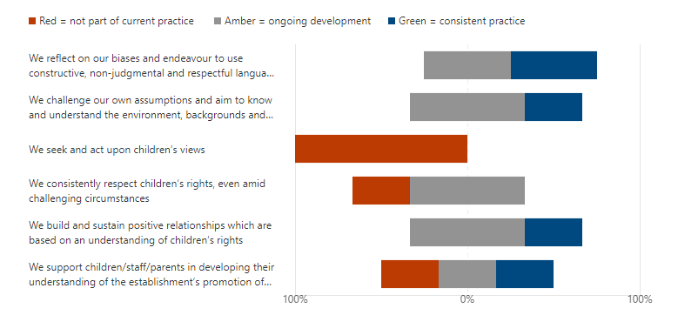
Example of results from Microsoft Form self-evaluation
Notes:
Once you have collated your results from the microsoft form it may look like this (on slide)
This can then be used to inform next steps for example, it is obvious that something needs to be done immediately to seek and act upon children's views followed by supporting children/staff and parents in developing their understanding of rights.
The form can also be revisited /repeated periodicially and if you download the results as an excel, it provides a date stamps so you can see which ones were at the start of the year and monitor progress.
Would we want to also write another slide about how you can then use the results from the Form to inform practice?
We could take a shot of the one we did - the excel spreadsheet - and put it up?

Slide 9
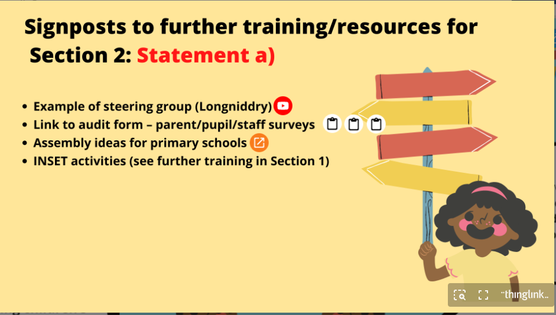





Next steps
e.g.
Click on the blue icons
to find signposts to further training or resources based on your identified needs
Click on the white and black person icon to view examples of practice on FVWL Inspiration website (still being added to)

Slide 10
FVWL RIC Blog and Inspiration hub
UNCRC – Forth Valley & West Lothian Regional ImprovementCollaborative (glowscotland.org.uk)
The Inspiration Hub – Inspiring good practice hub for FVWLRIC
Notes:
All other resources and some background information can be found on the FVWL blog page – it is continually being updated and added to.
You will also find examples of practice on the FVWL inspiration hub, again continually being added to. If you have examples of how you are recognising and realising children's rights, please add to the FVWL inspiration hub using the UNCRC tag. Anyone can add.

